Slide 1




Hardness of Range Avoidance and Proof Complexity Generators from Demi-Bits
+ Independent and concurrent work of (ECCC TR25-190 & TR25-191)
Hanlin Ren
Institute for Advanced Study
Yichuan Wang
University of California, Berkeley
Yan Zhong
Johns Hopkins University
Rahul Ilango
Institute for Advanced Study

Slide 2
Can we build “cryptography” against time-bounded adversaries?
What can such “cryptography” do?

Slide 3
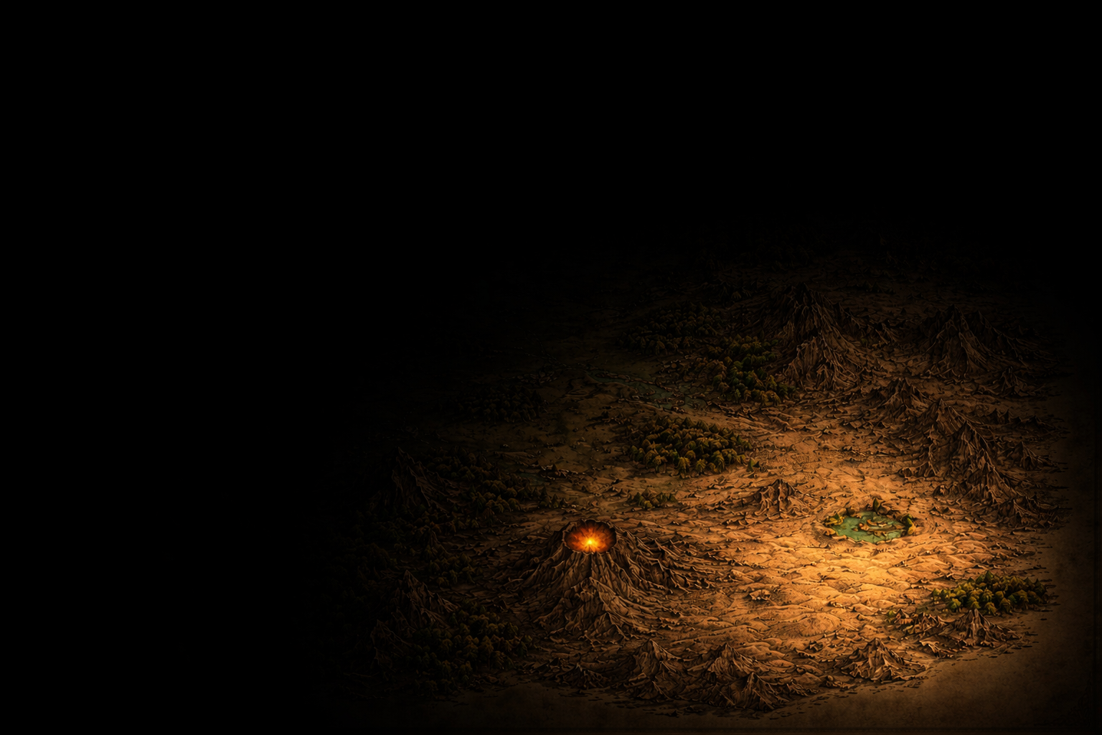

Yes, there is “cryptography” against time-bounded adversaries! (Plausibly?)
And they can do more than we think…
Key exchange
One-way Functions
Public-key encryption
Diffie-Hellman ‘76
Rivest-Shamir-Adleman ‘77
……

Slide 4

Multilinear maps
Indistinguishability obfuscation
…
Functional encryption
Witness encryption
Pairings
Correlation intractable hash functions
NIZK
SNARGs
Attribute-Based Encryption
Commitment Schemes
Collision-resistant hash functions
Oblivious Transfer
Zero knowledge
PRGs
Fully homomorphic encryption
Key exchange
One-way Functions
Private information retrieval
Public-key encryption

Slide 5
Can we build “cryptography” against nondeterministic adversaries?
What can such “cryptography” do?

Slide 6
Yes, there is “cryptography” against nondeterministic adversaries! (plausibly????????)
What can these “cryptography” do?
Super-bits
Our results
Demi-bits
Rudich’97

Slide 7
Spoiler
We proved some interesting phenomenon
that seems unique in the world of “cryptography against nondeterministic adversaries”
with a very simple proof! (featured in this talk)
…only to discover that Rahul Ilango independently found an even simpler proof (also featured in this talk)

Slide 8
1. What is “cryptography against nondeterministic adversaries”?
2. Is such “cryptography” interesting / useful?

Slide 9
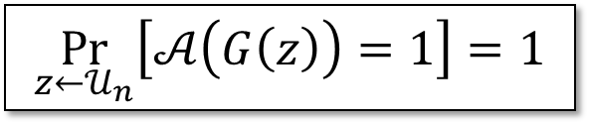
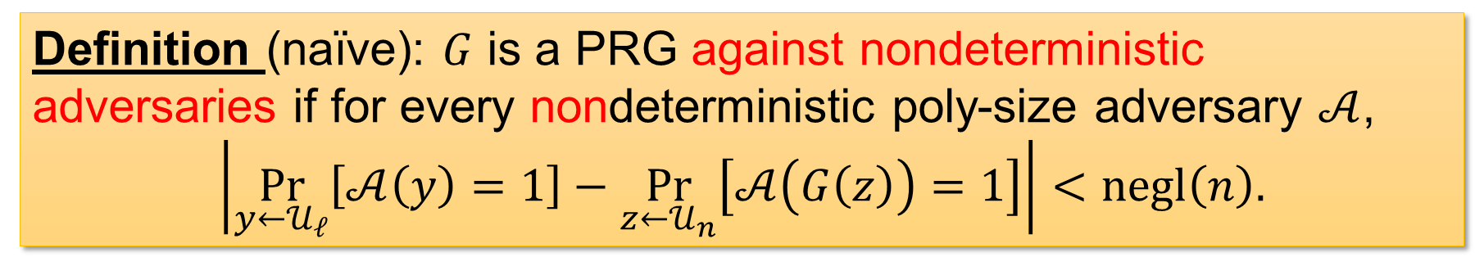

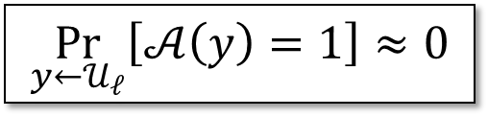

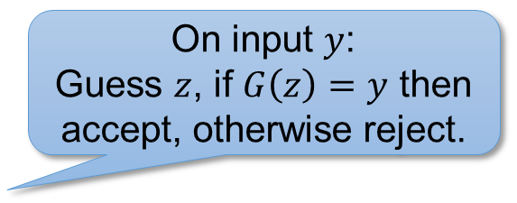
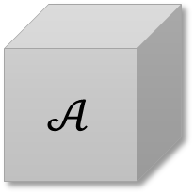
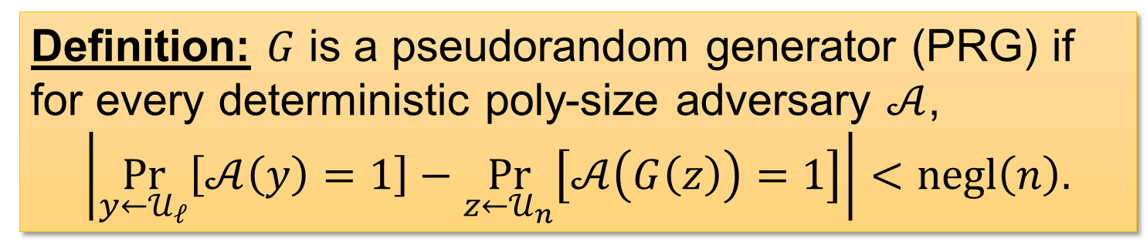

What is “cryptography against nondeterministic adversaries”?
On input $y$:
Guess $z$, if $G\left(z\right)=y$ then accept, otherwise reject.
$$y∈{\left\{0,1\right\}}^{ℓ}$$
$$\underset{y←𝒰_{ℓ}}{Pr}\left[𝒜\left(y\right)=1\right]≈0$$
$$G$$
$$𝒜$$
$$\underset{z←𝒰_{n}}{Pr}\left[𝒜\left(G\left(z\right)\right)=1\right]=1$$
Maybe no adversary can reverse this?
$$x∈{\left\{0,1\right\}}^{n}$$
Definition (naïve): $G$ is a PRG against nondeterministic adversaries if for every nondeterministic poly-size adversary $𝒜$,
$$\left|\underset{y←𝒰_{ℓ}}{Pr}\left[𝒜\left(y\right)=1\right]−\underset{z←𝒰_{n}}{Pr}\left[𝒜\left(G\left(z\right)\right)=1\right]\right|<negl\left(n\right).$$
Definition: $G$ is a pseudorandom generator (PRG) if for every deterministic poly-size adversary $𝒜$,
$$\left|\underset{y←𝒰_{ℓ}}{Pr}\left[𝒜\left(y\right)=1\right]−\underset{z←𝒰_{n}}{Pr}\left[𝒜\left(G\left(z\right)\right)=1\right]\right|<negl\left(n\right).$$
Notes:
TODO: need to say what is a nondeterministic adversary

Slide 10

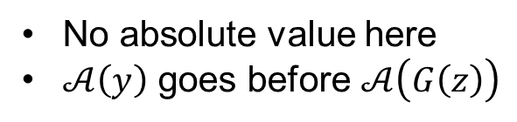
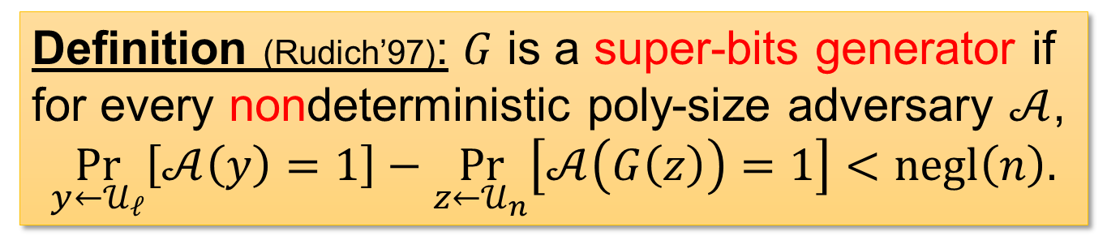
What is “cryptography against nondeterministic adversaries”?
On input $y$:
Guess $z$, if $G\left(z\right)=y$ then accept, otherwise reject.
$$y∈{\left\{0,1\right\}}^{ℓ}$$
$$\underset{y←𝒰_{ℓ}}{Pr}\left[𝒜\left(y\right)=1\right]≈0$$
$$G$$
$$𝒜$$
$$\underset{z←𝒰_{n}}{Pr}\left[𝒜\left(G\left(z\right)\right)=1\right]=1$$
Maybe no adversary can reverse this?
$$x∈{\left\{0,1\right\}}^{n}$$
Definition (Rudich’97): $G$ is a super-bits generator if for every nondeterministic poly-size adversary $𝒜$,
$$\underset{y←𝒰_{ℓ}}{Pr}\left[𝒜\left(y\right)=1\right]−\underset{z←𝒰_{n}}{Pr}\left[𝒜\left(G\left(z\right)\right)=1\right]<negl\left(n\right).$$
No absolute value here
$𝒜\left(y\right)$ goes before $𝒜\left(G\left(z\right)\right)$

Slide 11
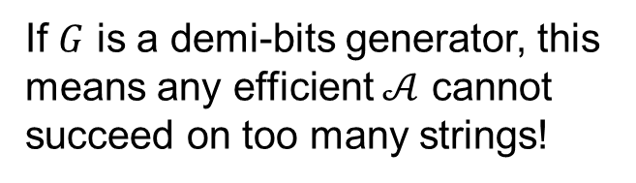
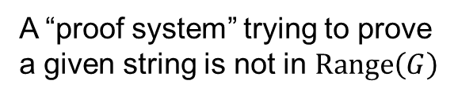

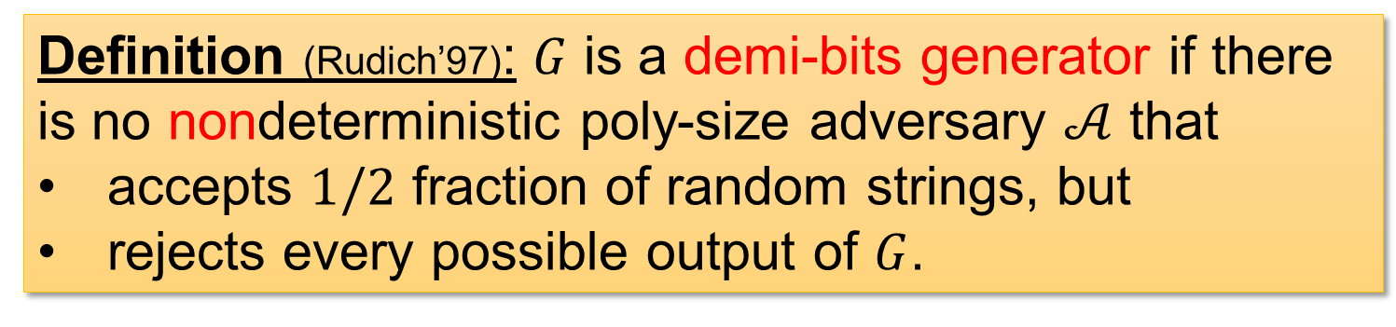
Demi-bits generators
$$y∈{\left\{0,1\right\}}^{ℓ}$$
If $G$ is a demi-bits generator, this means any efficient $𝒜$ cannot succeed on too many strings!
$$G$$
$$𝒜$$
$$x∈{\left\{0,1\right\}}^{n}$$
A “proof system” trying to prove a given string is not in $Range\left(G\right)$
Definition (Rudich’97): $G$ is a demi-bits generator if there is no nondeterministic poly-size adversary $𝒜$ that
accepts $1/2$ fraction of random strings, but
rejects every possible output of $G$.

Slide 12




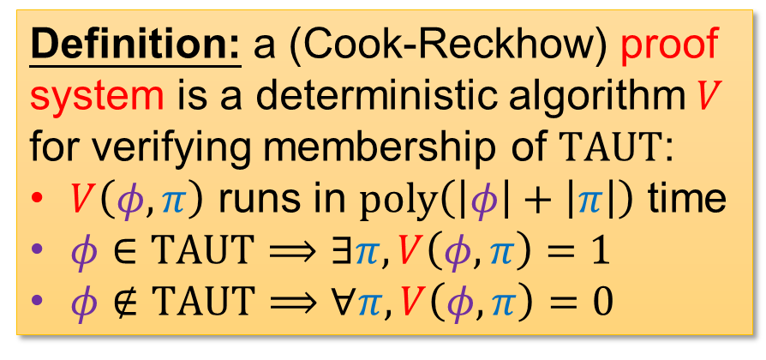
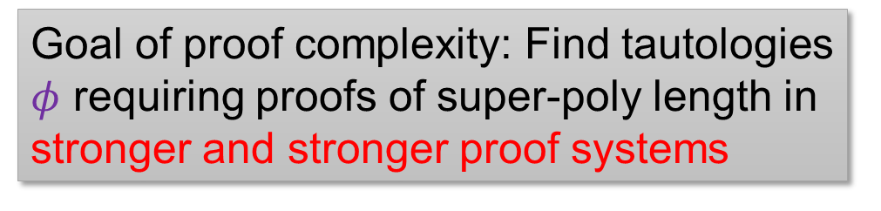
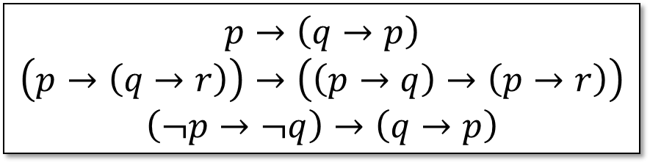
Proof systems
Proof systems $=$ nondeterministic algorithms for $TAUT$ ({tautologies}, $coNP$-complete)
If every $φ∈TAUT$ admits a proof of length $poly\left(\left|φ\right|\right)$, then we say $V$ is polynomially bounded.
Definition: a (Cook-Reckhow) proof system is a deterministic algorithm $V$ for verifying membership of $TAUT$:
$V\left(φ,π\right)$ runs in $poly\left(\left|φ\right|+\left|π\right|\right)$ time
$φ∈TAUT⟹∃π, V\left(φ,π\right)=1$
$φ∉TAUT⟹∀π, V\left(φ,π\right)=0$
And this would imply $NP=coNP$…
$$p→\left(q→p\right)$$
$$\left(p→\left(q→r\right)\right)→\left(\left(p→q\right)→\left(p→r\right)\right)$$
$$\left(¬p→¬q\right)→\left(q→p\right)$$
Goal of proof complexity: Find tautologies $φ$ requiring proofs of super-poly length in stronger and stronger proof systems
Łukasiewicz’s $P_{2}$

Slide 13

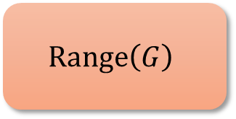

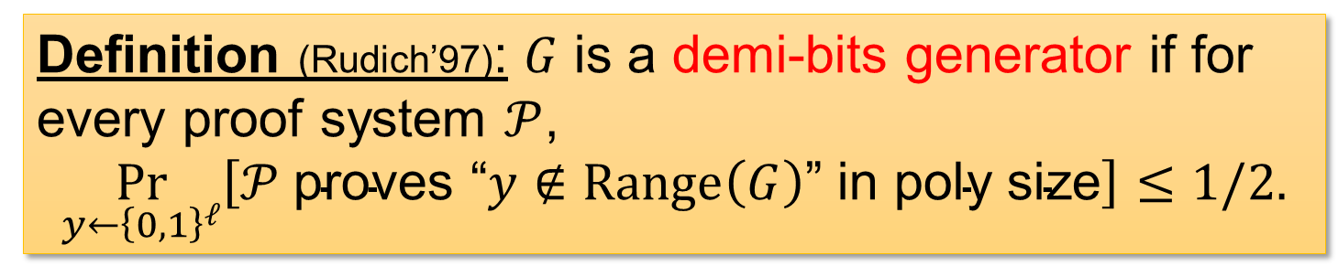
Demi-bits generators
$$y∈{\left\{0,1\right\}}^{ℓ}$$
$${\left\{0,1\right\}}^{ℓ}$$
What $𝒫$ can figure out to be outside $Range\left(G\right)$
$$G$$
$$Range\left(G\right)$$
$$x∈{\left\{0,1\right\}}^{n}$$
Definition (Rudich’97): $G$ is a demi-bits generator if for every proof system $𝒫$,
$$\underset{y←{\left\{0,1\right\}}^{ℓ}}{Pr}\left[𝒫 \text{proves} \text{“}y∉Range\left(G\right)\text{”} \text{in} \text{poly} \text{size}\right]≤1/2.$$

Slide 14
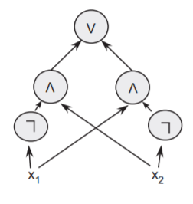


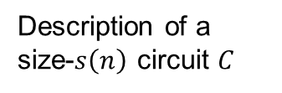
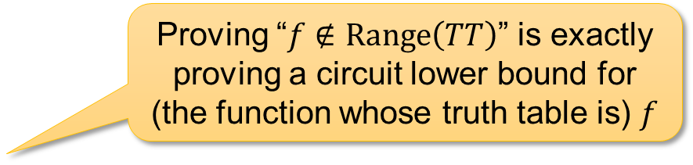

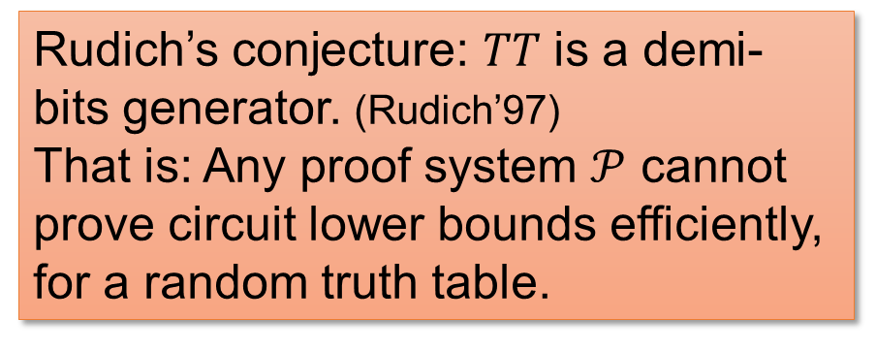


So, are there demi-bits generators?
Proving “$f∉Range\left(TT\right)$” is exactly proving a circuit lower bound for (the function whose truth table is) $f$
Candidate:
Truth Table Generator ($TT$)
Truth table of $C$
Rudich’s conjecture: $TT$ is a demi-bits generator. (Rudich’97)
That is: Any proof system $𝒫$ cannot prove circuit lower bounds efficiently, for a random truth table.
$$0110010011…………001010$$
$2^{n}$ bits
$$TT$$
Description of a size-$s\left(n\right)$ circuit $C$

Slide 15
1. What is “cryptography against nondeterministic adversaries”?
2. Is such “cryptography” interesting / useful?

Slide 16


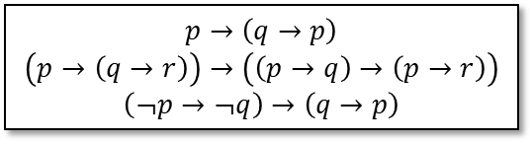

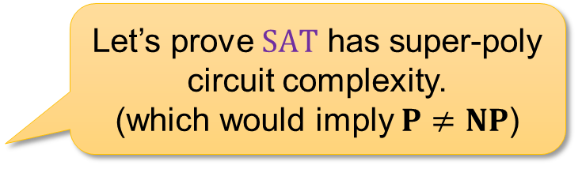
How hard is it to prove circuit lower bounds?
Let’s prove $SAT$ has super-poly circuit complexity. (which would imply $P≠NP$)
Ah this is SOOO hard?!
Can you give me ANY explicit function with circuit complexity $≥10n$?
Complexity theorists in the 70s
Complexity theorists nowadays…
Your favorite proof system
Why can’t we prove circuit lower bounds?
$$p→\left(q→p\right)$$
$$\left(p→\left(q→r\right)\right)→\left(\left(p→q\right)→\left(p→r\right)\right)$$
$$\left(¬p→¬q\right)→\left(q→p\right)$$
https://en.wikipedia.org/wiki/Wojak#/media/File:Wojak_cropped.jpg
https://imgflip.com/memegenerator/254022862/cry-wojak

Slide 17

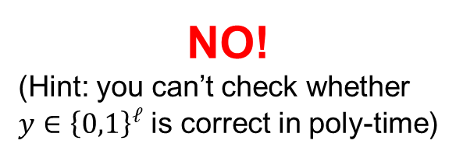

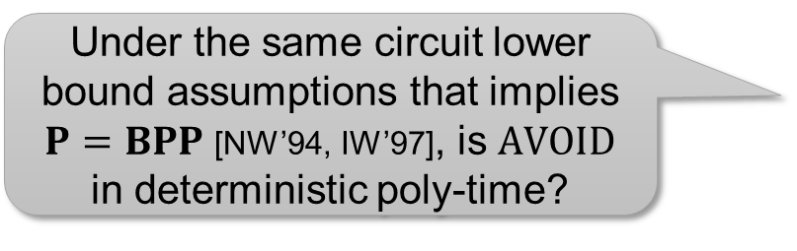
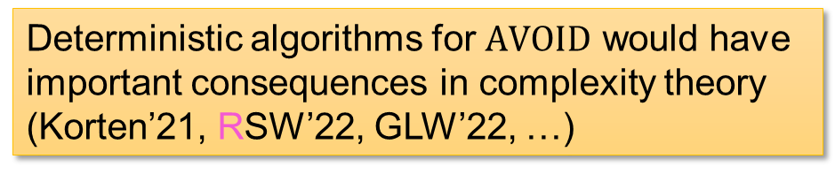
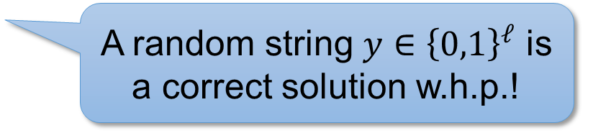

Hardness of Range Avoidance?
Input: a (multi-output) circuit $C:{\left\{0,1\right\}}^{n}→{\left\{0,1\right\}}^{ℓ}$ ($ℓ>n$)
Output: any string $y∉Range\left(C\right)$
I.e., for every $x∈{\left\{0,1\right\}}^{n}$, $C\left(x\right)≠y$
A random string $y∈{\left\{0,1\right\}}^{ℓ}$ is a correct solution w.h.p.!
$$y∈{\left\{0,1\right\}}^{ℓ}$$
Deterministic algorithms for $AVOID$ would have important consequences in complexity theory (Korten’21, RSW’22, GLW’22, …)
$$C$$
$$x∈{\left\{0,1\right\}}^{n}$$
NO!
(Hint: you can’t check whether $y∈{\left\{0,1\right\}}^{ℓ}$ is correct in poly-time)
Under the same circuit lower bound assumptions that implies $P=BPP$ [NW’94, IW’97], is $AVOID$ in deterministic poly-time?

Slide 18
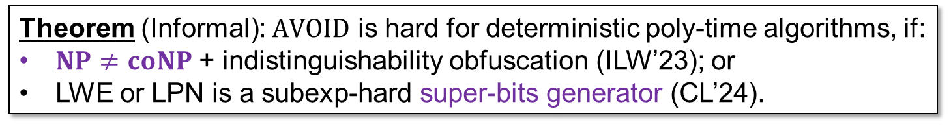
Hardness of Range Avoidance?
Input: a (multi-output) circuit $C:{\left\{0,1\right\}}^{n}→{\left\{0,1\right\}}^{ℓ}$ ($ℓ>n$)
Output: any string $y∉Range\left(C\right)$
I.e., for every $x∈{\left\{0,1\right\}}^{n}$, $C\left(x\right)≠y$
How to differentiate between randomized and deterministic (poly-time) algorithms?
$$y∈{\left\{0,1\right\}}^{ℓ}$$
$$C$$
A deterministic algorithm is guaranteed to be correct. Use it in proof systems!
$$x∈{\left\{0,1\right\}}^{n}$$
Theorem (Informal): $AVOID$ is hard for deterministic poly-time algorithms, if:
$NP≠coNP$ + indistinguishability obfuscation (ILW’23); or
LWE or LPN is a subexp-hard super-bits generator (CL’24).
Rahul Ilango

Slide 19
Our Results
Theorem: If there is a demi-bits generator, then:
(Ilango’26) every circuit lower bound is hard to prove, relative to a random oracle.
(Ilango’26, RWZ’26) the Range Avoidance problem doesn’t have deterministic poly-time algorithms.
Contrapositive view (from an anonymous reviewer):
If you can certify one string not in the range, then you can certify a lot!

Slide 20
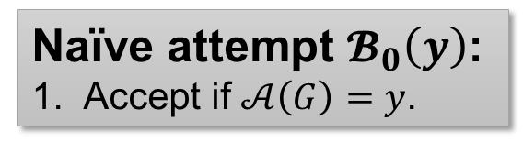

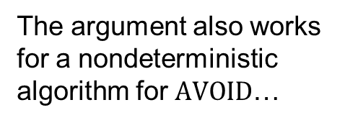


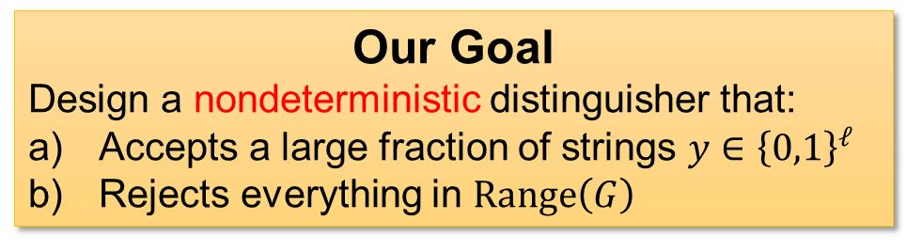
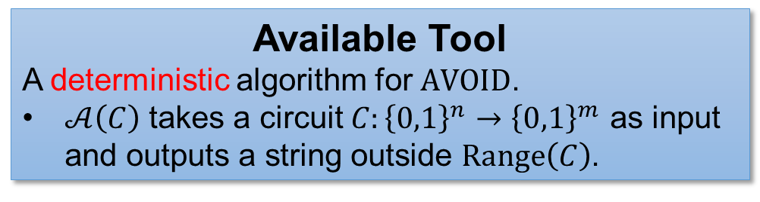


Proof 1
RWZ’ 26
Our Goal
Design a nondeterministic distinguisher that:
Accepts a large fraction of strings $y∈{\left\{0,1\right\}}^{ℓ}$
Rejects everything in $Range\left(G\right)$
The argument also works for a nondeterministic algorithm for $AVOID$…
Available Tool
A deterministic algorithm for $AVOID$.
$𝒜\left(C\right)$ takes a circuit $C:{\left\{0,1\right\}}^{n}→{\left\{0,1\right\}}^{m}$ as input and outputs a string outside $Range\left(C\right)$.
$$y∈{\left\{0,1\right\}}^{ℓ}$$
$$G$$
$$x∈{\left\{0,1\right\}}^{n}$$
Naïve attempt $𝓑_{0}\left(y\right)$:
Accept if $𝒜\left(G\right)=y$.
$ℬ_{0}$ might only accept a small fraction of strings ☹
A demi-bits generator $G$
Notes:
We will argue about (a) in the next slide, but maybe pause here for you guys to see why this doesn’t work for a randomized algorithm for AVOID

Slide 21

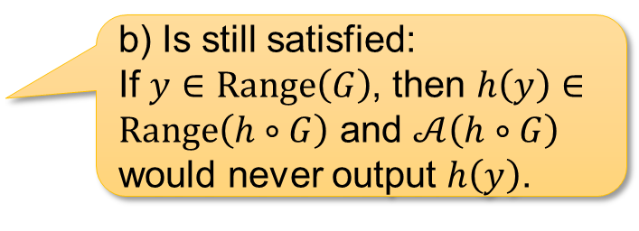
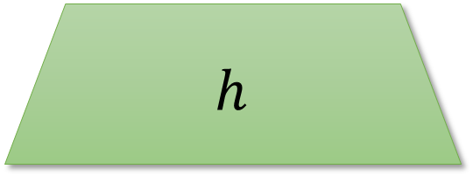
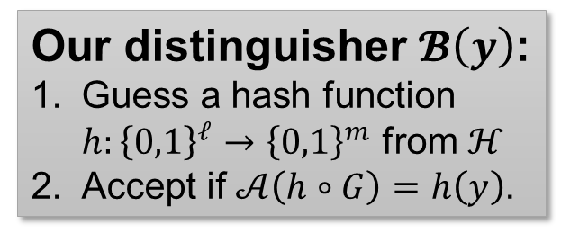
Idea: add a hash function!
Our Goal
Design a nondeterministic distinguisher that:
Accepts a large fraction of strings $y∈{\left\{0,1\right\}}^{ℓ}$
Rejects everything in $Range\left(G\right)$
$$h\left(y\right)∈{\left\{0,1\right\}}^{m}$$
$$h$$
Available Tool
A deterministic algorithm for $AVOID$.
$𝒜\left(C\right)$ takes a circuit $C:{\left\{0,1\right\}}^{n}→{\left\{0,1\right\}}^{m}$ as input and outputs a string outside $Range\left(C\right)$.
$$y∈{\left\{0,1\right\}}^{ℓ}$$
$$G$$
Our distinguisher $𝓑\left(y\right)$:
Guess a hash function $h:{\left\{0,1\right\}}^{ℓ}→{\left\{0,1\right\}}^{m}$ from $ℋ$
Accept if $𝒜\left(h∘G\right)=h\left(y\right)$.
b) Is still satisfied:
If $y∈Range\left(G\right)$, then $h\left(y\right)∈Range\left(h∘G\right)$ and $𝒜\left(h∘G\right)$ would never output $h\left(y\right)$.
$$x∈{\left\{0,1\right\}}^{n}$$
Naïve attempt $𝓑_{0}\left(y\right)$:
Accept if $𝒜\left(G\right)=y$.
A demi-bits generator $G$
Notes:
We will argue about (a) in the next slide, but maybe pause here for you guys to see why this doesn’t work for a randomized algorithm for AVOID

Slide 22





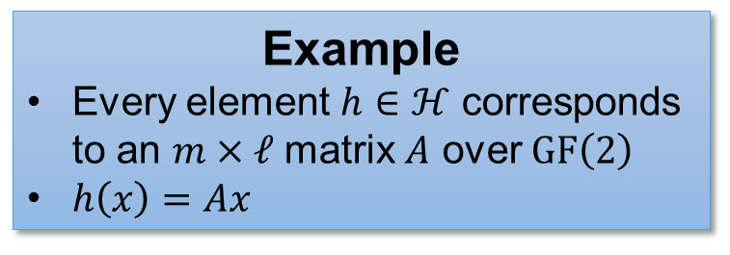
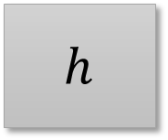






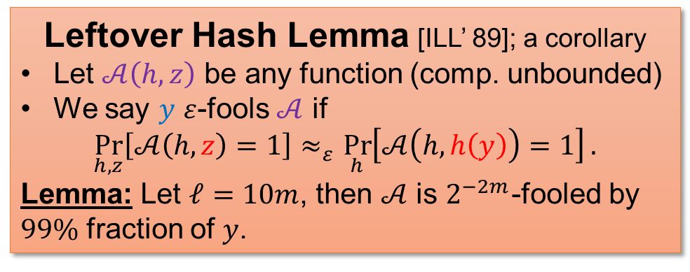


Universal hash functions
$$ℋ=\left\{h:{\left\{0,1\right\}}^{ℓ}→{\left\{0,1\right\}}^{m}\right\}$$
Leftover Hash Lemma [ILL’ 89]; a corollary
Let $𝒜\left(h,z\right)$ be any function (comp. unbounded)
We say $y$ $ε$-fools $𝒜$ if
$$\underset{h,z}{Pr}\left[𝒜\left(h,z\right)=1\right]≈_{ε}\underset{h}{Pr}\left[𝒜\left(h,h\left(y\right)\right)=1\right].$$
Lemma: Let $ℓ=10m$, then $𝒜$ is $2^{−2m}$-fooled by $99\%$ fraction of $y$.
Example
Every element $h∈ℋ$ corresponds to an $m×ℓ$ matrix $A$ over $GF\left(2\right)$
$h\left(x\right)=Ax$
$$y∈{\left\{0,1\right\}}^{ℓ}$$
$$𝒜$$
$$h$$
hash function
$$h$$
$$h$$
random
random
$$z$$
$m$-bit output
$$z$$
random
$$z$$
$$=h\left(y\right)$$

Slide 23

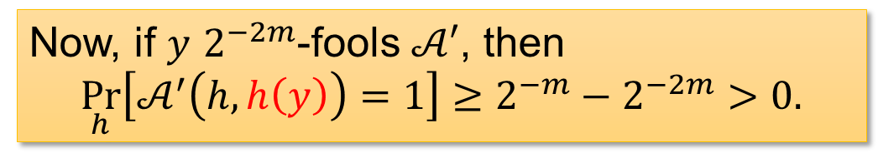

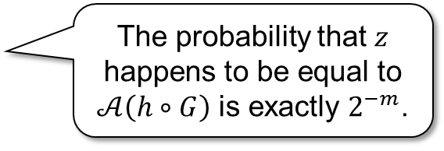

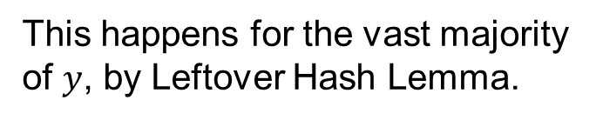
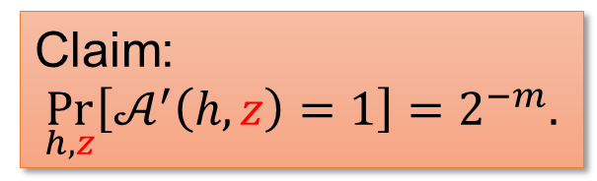
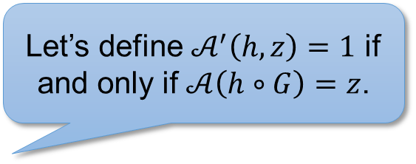



Analysis: Why do we accept many strings?
Our distinguisher $𝓑\left(y\right)$:
Guess a hash function $h:{\left\{0,1\right\}}^{ℓ}→{\left\{0,1\right\}}^{m}$ from $ℋ$
Accept if $𝒜\left(h∘G\right)=h\left(y\right)$.
Claim:
$$\underset{h,z}{Pr}\left[𝒜^{′}\left(h,z\right)=1\right]=2^{−m}.$$
The probability that $z$ happens to be equal to $𝒜\left(h∘G\right)$ is exactly $2^{−m}$.
Now, if $y$ $2^{−2m}$-fools $𝒜′$, then
$$\underset{h}{Pr}\left[𝒜^{′}\left(h,h\left(y\right)\right)=1\right]≥2^{−m}−2^{−2m}>0.$$
Let’s define $𝒜^{′}\left(h,z\right)=1$ if and only if $𝒜\left(h∘G\right)=z$.
… and $ℬ\left(y\right)$ accepts!
When we guess some $h$ such that $𝒜^{′}\left(h,h\left(y\right)\right)=1$, we have $𝒜\left(h∘G\right)=h\left(y\right)$.
$$𝒜′$$
$$h$$
hash function
$$z$$
$m$-bit output
This happens for the vast majority of $y$, by Leftover Hash Lemma.

Slide 24



Wrap up
Our distinguisher $𝓑\left(y\right)$:
Guess a hash function $h:{\left\{0,1\right\}}^{ℓ}→{\left\{0,1\right\}}^{m}$ from $ℋ$
Accept if $𝒜\left(h∘G\right)=h\left(y\right)$.
Given a (non)deterministic algorithm for $AVOID$, we can break any demi-bits generator!
Theorem
If $G:{\left\{0,1\right\}}^{n}→{\left\{0,1\right\}}^{ℓ}$ is a demi-bits generator, then there is no nondeterministic poly-time algorithms that solves $AVOID$, even over the instances of the form ${\left\{h∘G\right\}}_{h∈ℋ}$
Extensions
We can build proof complexity generators that are “pseudo-surjective” [Krajíček’ 04] in some parameter regime.

Slide 25








Proof 2 by $BPP⊆PH$
Ilango’ 26
Let $D⊆{\left\{0,1\right\}}^{n}$ be dense.
That is, $D$ contains a constant fraction of $n$-bit strings.
Shifts of $D$
Let $x∈{\left\{0,1\right\}}^{n}$, define
$$D⊕x=\left\{y⊕x | y∈D\right\}.$$
$$D$$
Theorem (Lautemann’83): there are $t≤O\left(n\right)$ shifts $x_{1},x_{2},…,x_{t}$ such that every string in ${\left\{0,1\right\}}^{n}$ is covered by one of $D⊕x_{i}$.
Core idea behind $BPP⊆PH$ (Lautemann’83) and also Rahul Ilango’s proof!
Proof: pick these shifts randomly and use Chernoff bound + union bound.
$${\left\{0,1\right\}}^{n}$$

Slide 26




If random circuit lower bounds are hard, then all circuit lower bounds are hard?
We couldn’t quite prove that! ☹
Let $D=\{$length-$2^{n}$ truth tables that $𝒫$ thinks are “easy”$\}$ (i.e., for which $𝒫$ couldn’t prove lower bounds)
$$D$$
If random circuit lower bounds are hard, then $D$ is dense!
Choose random $x_{1}…x_{t}$.
Lautemann ’83: Every length-$N$ truth table is covered by $D⊕x_{i}$ for some $x_{i}$!
$𝒫$ thinks that every truth table is easy relative to $\left(x_{1},…,x_{t}\right)$.
$${\left\{0,1\right\}}^{2^{n}}$$
Rahul Ilango

Slide 27








If random circuit lower bounds are hard, then all ___________ are hard
circuit lower bounds relative to a random oracle
Choose random $x_{1}…x_{t}$.
Lautemann ’83: Every length-$N$ truth table is covered by $D⊕x_{i}$ for some $x_{i}$!
$𝒫$ thinks that every truth table is easy relative to $\left(x_{1},…,x_{t}\right)$.
If $𝒫$ can’t prove is hard, then $𝒫$ can’t prove is hard relative to as well.
If is easy, then is easy relative to .
Rahul Ilango
$$=$$
$$⊕$$
Arbitrary truth table
Some $x_{i}$
Something in $D$
($𝒫$ thinks this is easy)
Conclusion
If random circuit lower bounds are hard, then all circuit lower bounds relative to a random $\left(x_{1}…x_{t}\right)$ are hard!
Notes:
donghua

Slide 28



Wrap up
Theorem
If random circuit lower bounds are hard to prove, then w.h.p. over an oracle $𝒪$, every $𝒪$-oracle circuit lower bounds are hard to prove!
To prove “$f$ is hard”, guess $𝒪=\left(x_{1},…,x_{t}\right)$ and prove “$f⊕x_{i}$ is hard relative to $𝒪$”.
Corollary
If $G$ is a demi-bits generator, then every $searchNP$ algorithm fails to solve $AVOID$ on some instance of the form
$$C_{\vec{x}}\left(s,i\right)≔G\left(s\right)⊕x_{i}$$
Where $\vec{x}=\left(x_{1},…,x_{t}\right)$.

Slide 29

Summary
Unprovability of circuit lower bounds?
Metamathematical difficulties of complexity theory?
Super-bits
Thank you!
Demi-bits
Hardness of $AVOID$
(special thank to GPT for images ☺)

