Slide 1
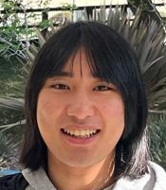
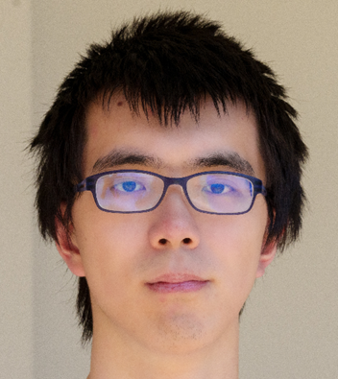


Hardness of Range Avoidance and Proof Complexity Generators from Demi-Bits
+ Independent and concurrent work of (ECCC TR25-190 & TR25-191)
Hanlin Ren
Institute for Advanced Study
Yichuan Wang
University of California, Berkeley
Yan Zhong
Johns Hopkins University
Rahul Ilango
Institute for Advanced Study
0 / 24

Slide 2
In this talk…
Proof complexity
New methods for constructing proof complexity generators!
Circuit complexity
Why are circuit lower bounds hard? (Speculative)
Average-case complexity
Average-case to best-case (??) reductions (in the nondeterministic setting)
Two complete proofs (!!!)
General audience?
A complete proof of the main result! (Very simple)
1 / 24

Slide 3
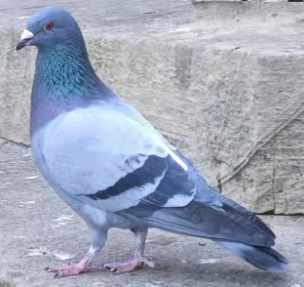
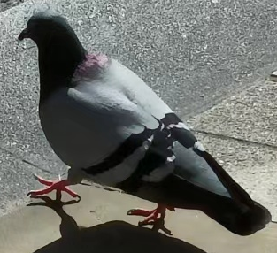
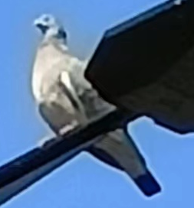
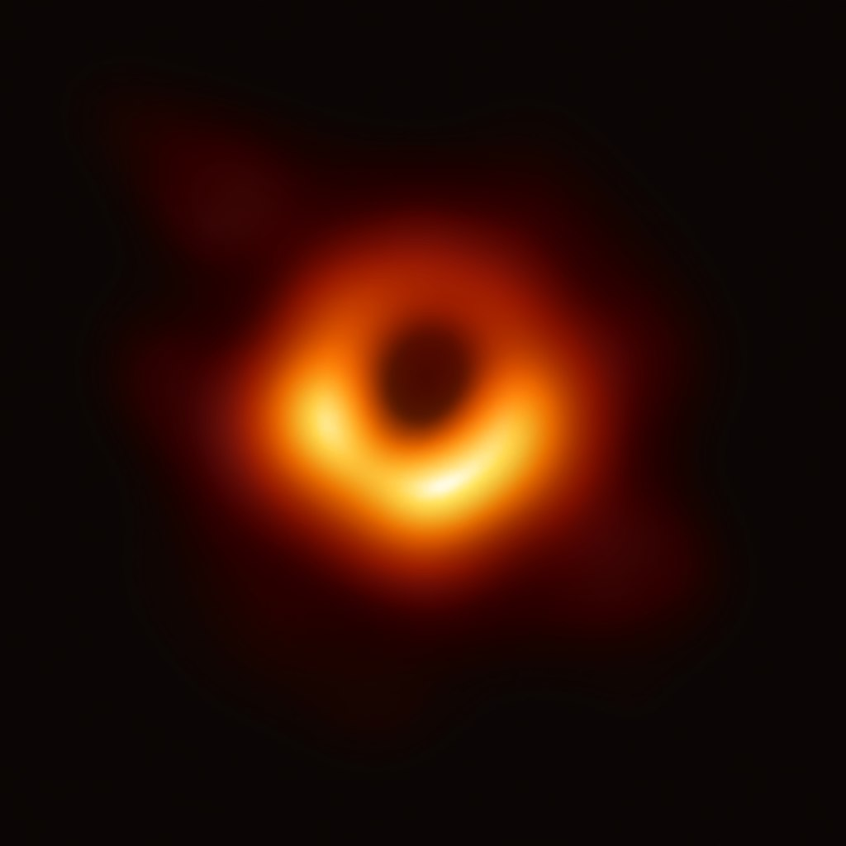



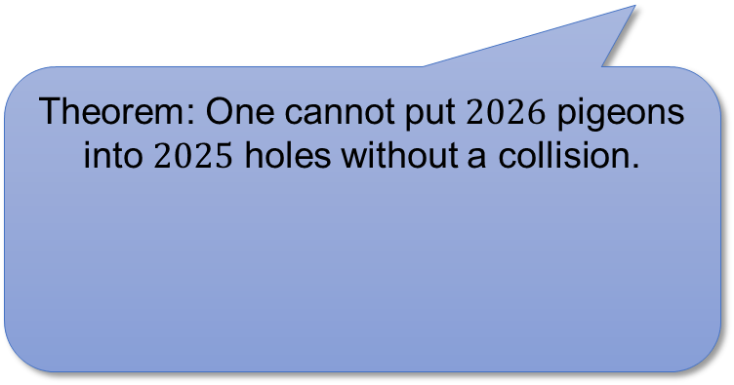





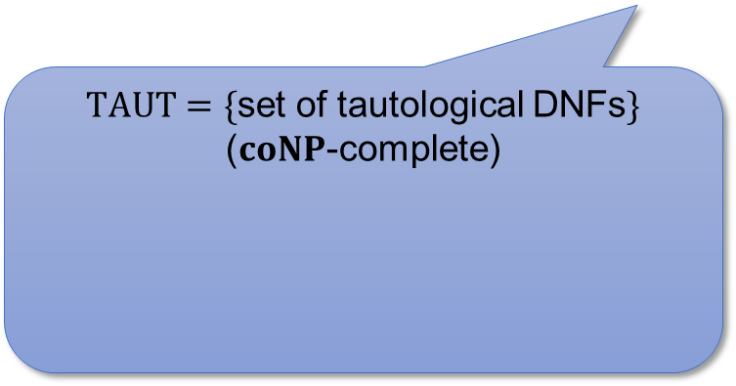

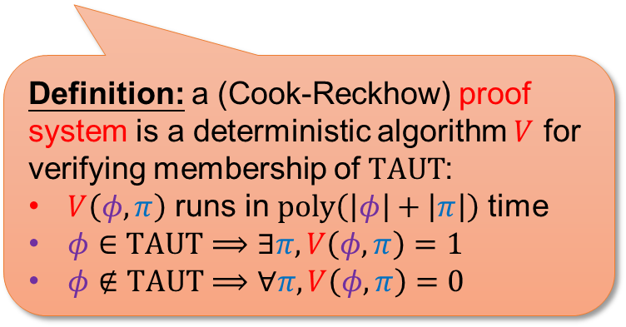



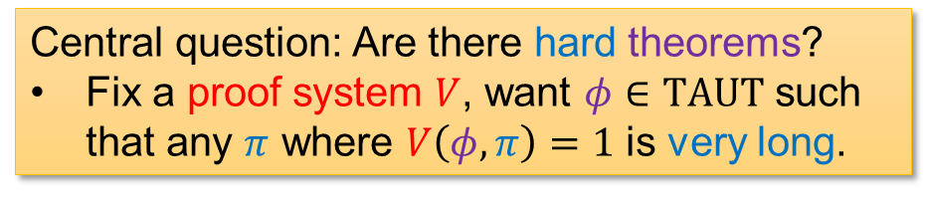
Proof Complexity 101
How hard is it to prove theorems in proof systems?
(in terms of proof length)
Theorem: One cannot put $2026$ pigeons into $2025$ holes without a collision.
$TAUT=\{$set of tautological DNFs$\}$
($coNP$-complete)
Definition: a (Cook-Reckhow) proof system is a deterministic algorithm $V$ for verifying membership of $TAUT$:
$V\left(φ,π\right)$ runs in $poly\left(\left|φ\right|+\left|π\right|\right)$ time
$φ∈TAUT⟹∃π, V\left(φ,π\right)=1$
$φ∉TAUT⟹∀π, V\left(φ,π\right)=0$
Resolution
OR
Resolution rule
Weakening rule
$$\frac{C∨ℓ D∨\overline{ℓ}}{C∨D}$$
$$\frac{C}{C∨D}$$
AND
AND
$$⋯$$
AND
$$x_{3}$$
$$x_{7}$$
$${\overline{x}}_{11}$$
$${\overline{x}}_{6}$$
$$x_{9}$$
$${\overline{x}}_{2}$$
$$x_{18}$$
$${\overline{x}}_{15}$$
$$x_{4}$$
Theorem (Haken ’85): Resolution requires exponential-size proof of the Pigeonhole Principle.
Central question: Are there hard theorems?
Fix a proof system $V$, want $φ∈TAUT$ such that any $π$ where $V\left(φ,π\right)=1$ is very long.
Informal Theorem (Buss ’87, Bonet-Buss-Pitassi ’95, Hrubeš-Tzameret ’15, …):
Frege can prove many natural theorems in (quasi)polynomial size.
2 / 24

Slide 4


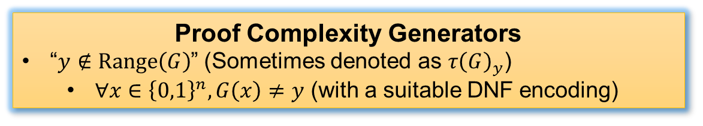





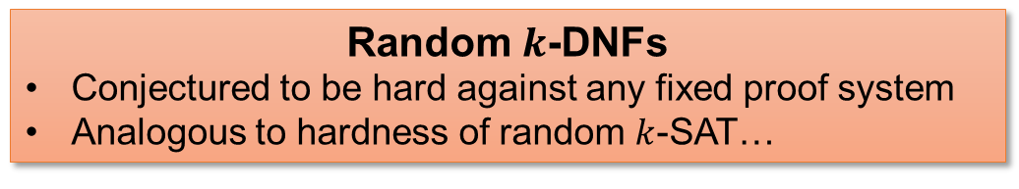

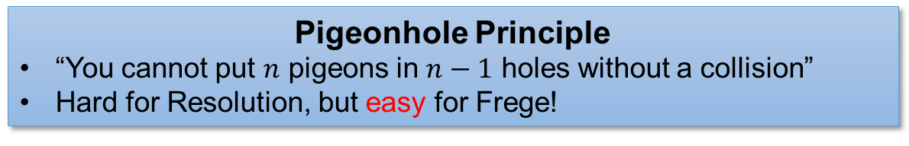



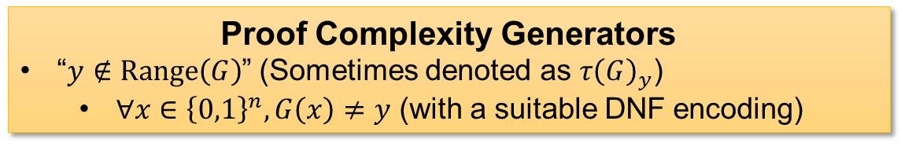


(Candidate) Hard Tautologies?
Pigeonhole Principle
“You cannot put $n$ pigeons in $n−1$ holes without a collision”
Hard for Resolution, but easy for Frege!
OR
Random $k$-DNFs
Conjectured to be hard against any fixed proof system
Analogous to hardness of random $k$-SAT…
AND
AND
$$⋯$$
AND
$$x_{3}$$
$$x_{7}$$
$${\overline{x}}_{11}$$
$${\overline{x}}_{6}$$
$$x_{9}$$
$${\overline{x}}_{2}$$
$$x_{18}$$
$${\overline{x}}_{15}$$
$$x_{4}$$
$$y∈{\left\{0,1\right\}}^{ℓ}$$
Proof Complexity Generators
“$y∉Range\left(G\right)$” (Sometimes denoted as $τ{\left(G\right)}_{y}$)
$∀x∈{\left\{0,1\right\}}^{n}, G\left(x\right)≠y$ (with a suitable DNF encoding)
Proof Complexity Generators
“$y∉Range\left(G\right)$” (Sometimes denoted as $τ{\left(G\right)}_{y}$)
$∀x∈{\left\{0,1\right\}}^{n}, G\left(x\right)≠y$ (with a suitable DNF encoding)
$$G$$
$$x∈{\left\{0,1\right\}}^{n}$$
3 / 24

Slide 5

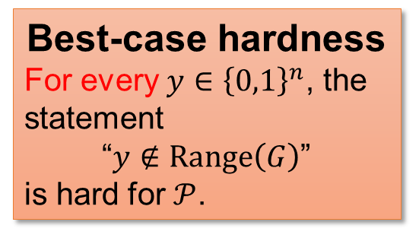
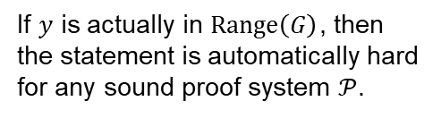
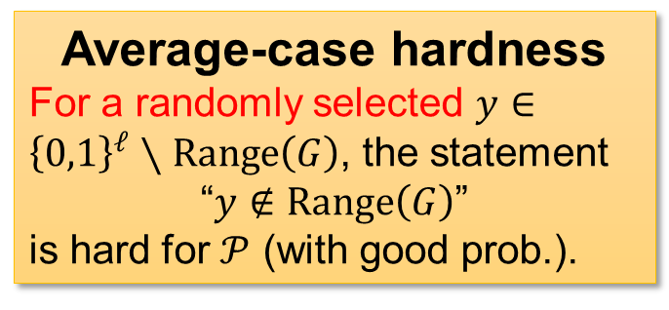

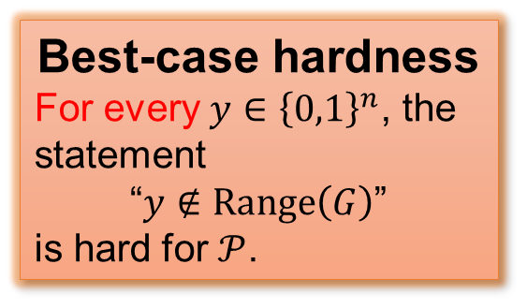
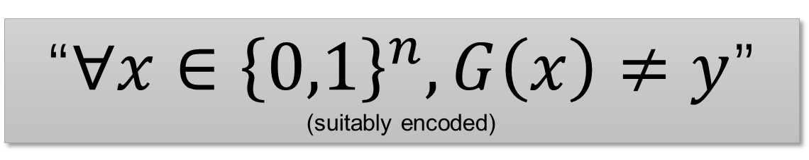
Proof Complexity Generators
$$y∈{\left\{0,1\right\}}^{ℓ}$$
“$∀x∈{\left\{0,1\right\}}^{n}, G\left(x\right)≠y$”
(suitably encoded)
$$G$$
$$x∈{\left\{0,1\right\}}^{n}$$
Average-case hardness
For a randomly selected $y∈{\left\{0,1\right\}}^{ℓ}∖Range\left(G\right)$, the statement
“$y∉Range\left(G\right)$”
is hard for $𝒫$ (with good prob.).
Best-case hardness
For every $y∈{\left\{0,1\right\}}^{n}$, the statement
“$y∉Range\left(G\right)$”
is hard for $𝒫$.
Worst-case hardness
There exists $y∉Range\left(G\right)$ such that the statement
“$y∉Range\left(G\right)$”
is hard for $𝒫$.
Best-case hardness
For every $y∈{\left\{0,1\right\}}^{n}$, the statement
“$y∉Range\left(G\right)$”
is hard for $𝒫$.
If $y$ is actually in $Range\left(G\right)$, then the statement is automatically hard for any sound proof system $𝒫$.
4 / 24
Notes:
In fact, when we say a proof complexity generator against some proof system in literature, we nearly always mean best-case hardness. But I’m gonna talk about average-case hardness as wel so let me always add “best-case hardness” for clarity.

Slide 6



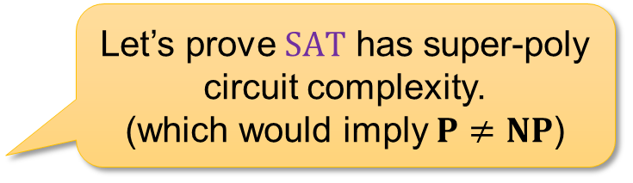
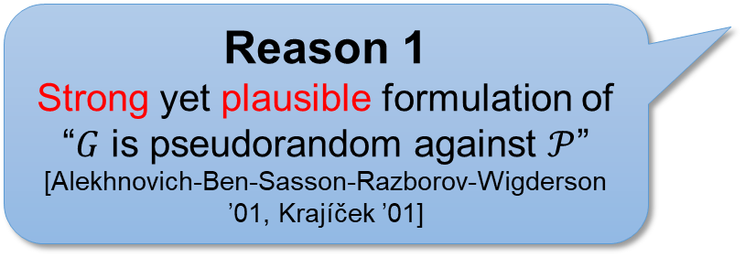
Why best-case hardness?
Reason 1
Strong yet plausible formulation of “$G$ is pseudorandom against $𝒫$” [Alekhnovich-Ben-Sasson-Razborov-Wigderson ’01, Krajíček ’01]
Best-case hardness
For every $y∈{\left\{0,1\right\}}^{n}$, the statement
“$y∉Range\left(G\right)$”
is hard for $𝒫$.
Reason 2
Why are circuit lower bounds hard?
Let’s prove $SAT$ has super-poly circuit complexity. (which would imply $P≠NP$)
Ah this is SOOO hard?!
Can you give me ANY explicit function with super-poly circuit complexity?
Complexity theorists in the 70s
Complexity theorists nowadays…
https://en.wikipedia.org/wiki/Wojak#/media/File:Wojak_cropped.jpg
https://imgflip.com/memegenerator/254022862/cry-wojak
5 / 24

Slide 7

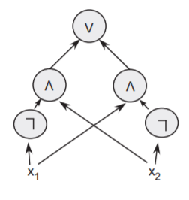

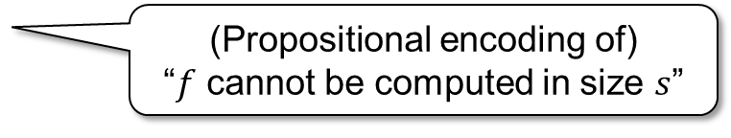


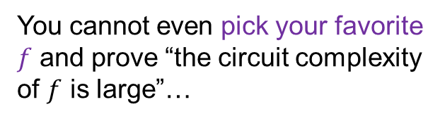
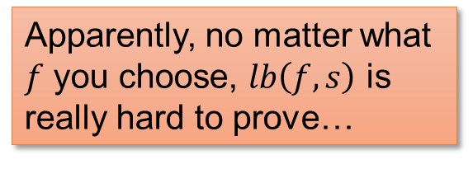
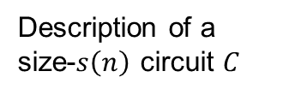

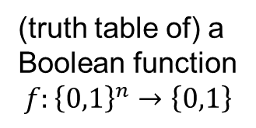




Why best-case hardness?
Circuit lower bound tautologies
$$lb\left(f, s\right)$$
Apparently, no matter what $f$ you choose, $lb\left(f,s\right)$ is really hard to prove…
(Propositional encoding of) “$f$ cannot be computed in size $s$”
(truth table of) a Boolean function
$$f:{\left\{0,1\right\}}^{n}→\left\{0,1\right\}$$
size parameter
(a DNF of size $poly\left(2^{n}\right)$)
Truth Table Generator ($TT$)
Okay, maybe the truth table generator is a proof complexity generator with best-case hardness…
Truth table of $C$
$$0110010011…………001010$$
$2^{n}$ bits
$$TT$$
You cannot even pick your favorite $f$ and prove “the circuit complexity of $f$ is large”…
$\tilde{O}\left(s\left(n\right)\right)$ bits
Description of a size-$s\left(n\right)$ circuit $C$
Complexity theorists
6 / 24
Notes:
Best-case really means that you can’t prove lower bounds even if you’re allowed to pick your favorite hard function…
Lb has description length 2^n

Slide 8

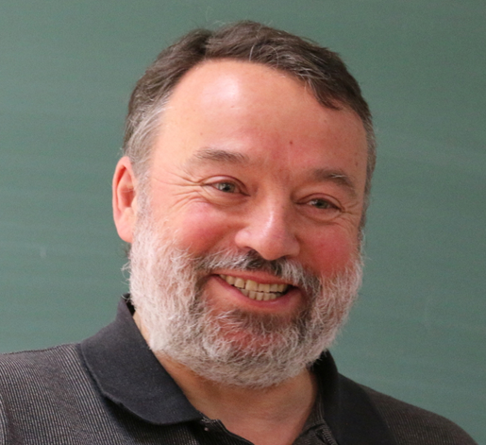
Krajíček’s conjecture
It seems unclear whether this conjecture can be based on more “standard” assumptions in complexity theory.
Conjecture (Krajíček ’04, ’23, ’24):
There is a proof complexity generator that is (best-case) hard against all proof systems.
…Partly because those assumptions are mostly about worst-case / average-case hardness, while Krajíček’s conjecture is about best-case hardness.
Jan Krajíček
7 / 24

Slide 9
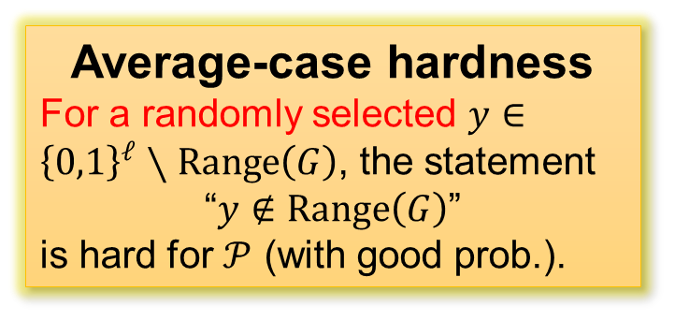
Proof Complexity Generators
$$y∈{\left\{0,1\right\}}^{ℓ}$$
“$∀x∈{\left\{0,1\right\}}^{n}, G\left(x\right)≠y$”
(suitably encoded)
$$G$$
$$x∈{\left\{0,1\right\}}^{n}$$
Worst-case hardness
There exists $y∉Range\left(G\right)$ such that the statement
“$y∉Range\left(G\right)$”
is hard for $𝒫$.
Average-case hardness
For a randomly selected $y∈{\left\{0,1\right\}}^{ℓ}∖Range\left(G\right)$, the statement
“$y∉Range\left(G\right)$”
is hard for $𝒫$ (with good prob.).
Best-case hardness
For every $y∈{\left\{0,1\right\}}^{n}$, the statement
“$y∉Range\left(G\right)$”
is hard for $𝒫$.
If $y$ is actually in $Range\left(G\right)$, then the statement is automatically hard for any sound proof system $𝒫$.
8 / 24

Slide 10
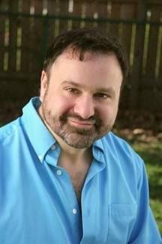
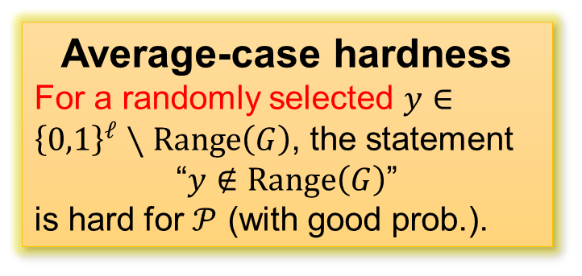
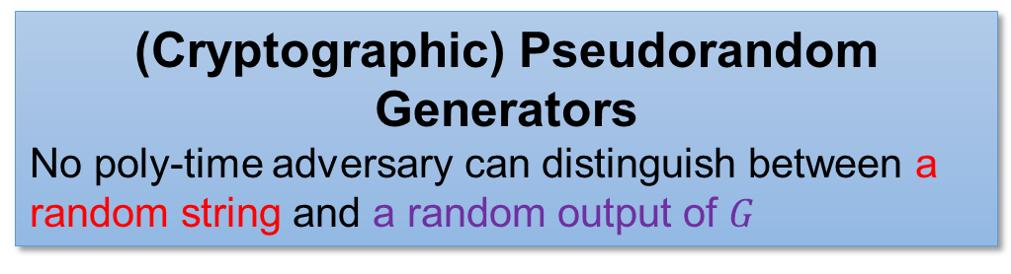
Average-case hardness…?
$$y∈{\left\{0,1\right\}}^{ℓ}$$
Average-case hardness
For a randomly selected $y∈{\left\{0,1\right\}}^{ℓ}∖Range\left(G\right)$, the statement
“$y∉Range\left(G\right)$”
is hard for $𝒫$ (with good prob.).
A theory of cryptography / pseudorandomness against nondeterministic adversaries? [Rudich ’97]
$$G$$
$$x∈{\left\{0,1\right\}}^{n}$$
(Cryptographic) Pseudorandom Generators
No poly-time adversary can distinguish between a random string and a random output of $G$
Steven Rudich
9 / 24

Slide 11

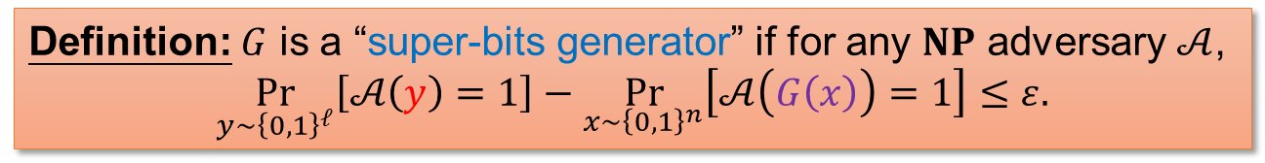
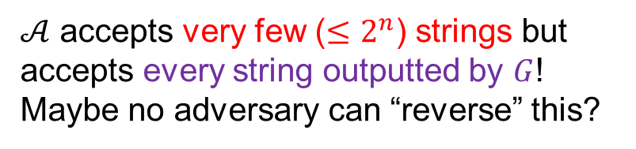
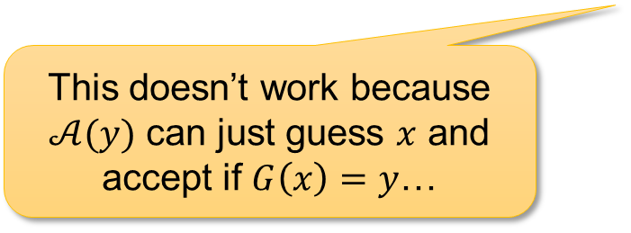
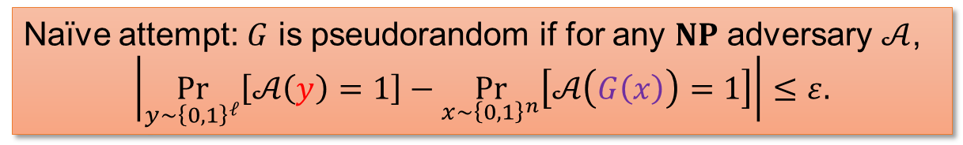
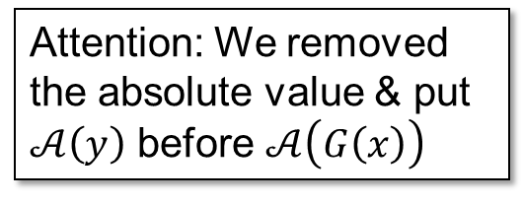
How to define pseudorandomness against nondet. adversaries?
$$y∈{\left\{0,1\right\}}^{ℓ}$$
Naïve attempt: $G$ is pseudorandom if for any $NP$ adversary $𝒜$,
$$\left|\underset{y∼{\left\{0,1\right\}}^{ℓ}}{Pr}\left[𝒜\left(y\right)=1\right]−\underset{x∼{\left\{0,1\right\}}^{n}}{Pr}\left[𝒜\left(G\left(x\right)\right)=1\right]\right|≤ε.$$
$$G$$
$$x∈{\left\{0,1\right\}}^{n}$$
$𝒜$ accepts very few ($≤2^{n}$) strings but accepts every string outputted by $G$!
Maybe no adversary can “reverse” this?
This doesn’t work because $𝒜(y)$ can just guess $x$ and accept if $G\left(x\right)=y$…
Attention: We removed the absolute value & put $𝒜\left(y\right)$ before $𝒜\left(G\left(x\right)\right)$
Definition: $G$ is a “super-bits generator” if for any $NP$ adversary $𝒜$,
$$\underset{y∼{\left\{0,1\right\}}^{ℓ}}{Pr}\left[𝒜\left(y\right)=1\right]−\underset{x∼{\left\{0,1\right\}}^{n}}{Pr}\left[𝒜\left(G\left(x\right)\right)=1\right]≤ε.$$
10 / 24

Slide 12
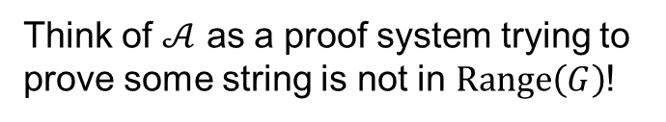

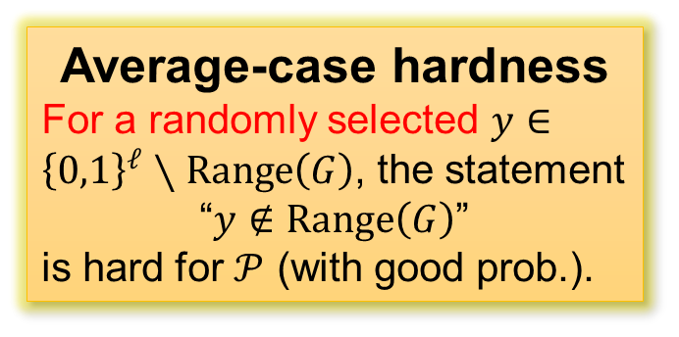
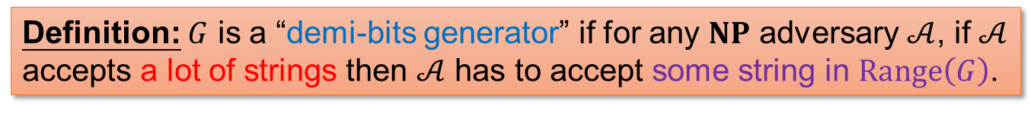
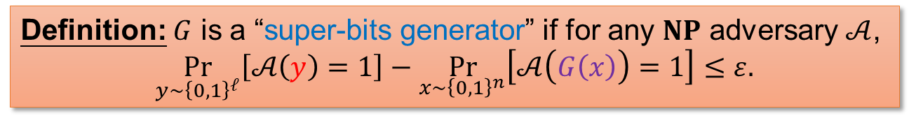
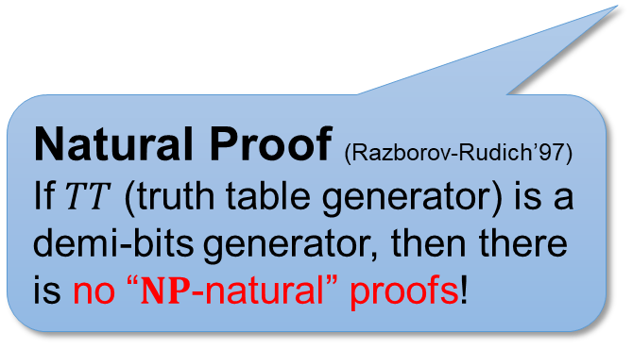
Demi-bits generators
$$y∈{\left\{0,1\right\}}^{ℓ}$$
Definition: $G$ is a “super-bits generator” if for any $NP$ adversary $𝒜$,
$$\underset{y∼{\left\{0,1\right\}}^{ℓ}}{Pr}\left[𝒜\left(y\right)=1\right]−\underset{x∼{\left\{0,1\right\}}^{n}}{Pr}\left[𝒜\left(G\left(x\right)\right)=1\right]≤ε.$$
Definition: $G$ is a “demi-bits generator” if for any $NP$ adversary $𝒜$, if $𝒜$ accepts a lot of strings then $𝒜$ has to accept some string in $Range\left(G\right)$.
$$G$$
$$≡$$
Think of $𝒜$ as a proof system trying to prove some string is not in $Range\left(G\right)$!
$$x∈{\left\{0,1\right\}}^{n}$$
Average-case hardness
For a randomly selected $y∈{\left\{0,1\right\}}^{ℓ}∖Range\left(G\right)$, the statement
“$y∉Range\left(G\right)$”
is hard for $𝒫$ (with good prob.).
Natural Proof (Razborov-Rudich’97)
If $TT$ (truth table generator) is a demi-bits generator, then there is no “$NP$-natural” proofs!
Demi-bits are arguably one of the most fundamental primitives in “cryptography against nondeterministic adversaries”
11 / 24
Notes:
The correctness of crypto assumptions is a subjective issue, but my feeling is that TT should be a pretty secure demi-bits generator ☺

Slide 13
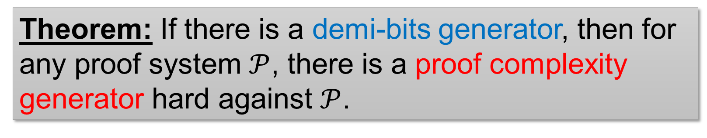
Our Results
Theorem: If there is a demi-bits generator, then for any proof system $𝒫$, there is a proof complexity generator hard against $𝒫$.
Transforming average-case hardness to best-case hardness!
Intuitive (but not quite correct) version:
If most circuit lower bounds are hard to prove, then any circuit lower bound is hard to prove.
Open question: prove this version?
Contrapositive view (from an anonymous reviewer):
If you can certify one string not in the range, then you can certify a lot!
12 / 24

Slide 14




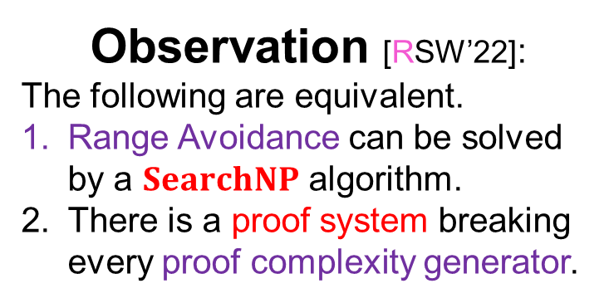

Range Avoidance ($AVOID$)
Input: a (multi-output) circuit $C:{\left\{0,1\right\}}^{n}→{\left\{0,1\right\}}^{ℓ}$ ($ℓ>n$)
Output: any string $y∉Range\left(C\right)$
I.e., for every $x∈{\left\{0,1\right\}}^{n}$, $C\left(x\right)≠y$
A “non-output” of $C$.
$$y∈{\left\{0,1\right\}}^{ℓ}$$
Observation [RSW’22]:
The following are equivalent.
Range Avoidance can be solved by a $SearchNP$ algorithm.
There is a proof system breaking every proof complexity generator.
$$C$$
Range Avoidance
$$x∈{\left\{0,1\right\}}^{n}$$
Proof complexity generators
13 / 24
https://www.vecteezy.com/png/20716945-3d-glossy-dollar-coin-golden-reflective-dollar-coin-3d-illustration

Slide 15






Hardness of $AVOID$
$Avoid$ is easy for randomized algorithms
Just output a random string $y∈{\left\{0,1\right\}}^{ℓ}$ and it will be outside $Range\left(C\right)$ with high probability ☺
Are there good deterministic algorithms?
[Chen-Li ’24] (building on ILW’ 23):
$AVOID$ is not even in $SearchNP$, if we assume LWE or LPN is hard against nondeterministic algorithms!
[Ilango-Li-Williams ’23]:
No, if we assume certain cryptographic assumptions and $NP≠coNP$!
$$y∈{\left\{0,1\right\}}^{ℓ}$$
$$C$$
Our results (building on CL ’24) & [Ilango ’25]:
If there exists a demi-bits generator (of suitable stretch), then $AVOID$ is not in $SearchNP$!
$$x∈{\left\{0,1\right\}}^{n}$$
14 / 24

Slide 16

Theorem: If there is a demi-bits generator, then:
For any proof system $𝒫$, there is a proof complexity generator hard against $𝒫$.
$AVOID$ cannot be solve by $SearchNP$ algorithms.
Rest of this talk: two (!) different proofs of this result (One by us & one by Rahul ☺)
15 / 24

Slide 17















Proof 1 by universal hash functions
RWZ’ 26
$$ℋ=\left\{h:{\left\{0,1\right\}}^{ℓ}→{\left\{0,1\right\}}^{m}\right\}$$
Leftover Hash Lemma [ILL’ 89]; a corollary
Let $𝒜\left(h,z\right)$ be any function (comp. unbounded)
We say $y$ $ε$-fools $𝒜$ if
$$\underset{h,z}{Pr}\left[𝒜\left(h,z\right)=1\right]≈_{ε}\underset{h}{Pr}\left[𝒜\left(h,h\left(y\right)\right)=1\right].$$
Lemma: Let $ℓ=10m$, then $𝒜$ is $2^{−2m}$-fooled by $99\%$ fraction of $y$.
Example
Every element $h∈ℋ$ corresponds to an $m×ℓ$ matrix $A$ over $GF\left(2\right)$
$h\left(x\right)=Ax$
$$y∈{\left\{0,1\right\}}^{ℓ}$$
$$𝒜$$
$$h$$
hash function
$$h$$
$$h$$
random
random
$$z$$
$m$-bit output
$$z$$
random
$$z$$
$$=h\left(y\right)$$
16 / 24

Slide 18













Breaking demi-bits by solving $AVOID$
Our Goal
Design a nondeterministic distinguisher that:
Accepts a large fraction of strings $y∈{\left\{0,1\right\}}^{ℓ}$
Rejects everything in $Range\left(G\right)$
$$h\left(y\right)∈{\left\{0,1\right\}}^{m}$$
$$h$$
The argument also works for a nondeterministic algorithm for $AVOID$…
Available Tool
A deterministic algorithm for $AVOID$.
$𝒜\left(C\right)$ takes a circuit $C:{\left\{0,1\right\}}^{n}→{\left\{0,1\right\}}^{m}$ as input and outputs a string outside $Range\left(C\right)$.
$$y∈{\left\{0,1\right\}}^{ℓ}$$
$$G$$
Our distinguisher $𝓑\left(y\right)$:
Guess a hash function $h:{\left\{0,1\right\}}^{ℓ}→{\left\{0,1\right\}}^{m}$ from $ℋ$
Accept if $𝒜\left(h∘G\right)=h\left(y\right)$.
If $y∈Range\left(G\right)$, then $h\left(y\right)∈Range\left(h∘G\right)$ and $𝒜\left(h∘G\right)$ would never output $h\left(y\right)$.
$$x∈{\left\{0,1\right\}}^{n}$$
Naïve attempt $𝓑_{0}\left(y\right)$:
Accept if $𝒜\left(G\right)=y$.
A demi-bits generator $G$
b) is satisfied ☺
17 / 24
Notes:
We will argue about (a) in the next slide, but maybe pause here for you guys to see why this doesn’t work for a randomized algorithm for AVOID

Slide 19











Analysis: Why do we accept many strings?
Our distinguisher $𝓑\left(y\right)$:
Guess a hash function $h:{\left\{0,1\right\}}^{ℓ}→{\left\{0,1\right\}}^{m}$ from $ℋ$
Accept if $𝒜\left(h∘G\right)=h\left(y\right)$.
Claim:
$$\underset{h,z}{Pr}\left[𝒜^{′}\left(h,z\right)=1\right]=2^{−m}.$$
The probability that $z$ happens to be equal to $𝒜\left(h∘G\right)$ is exactly $2^{−m}$.
Now, if $y$ $2^{−2m}$-fools $𝒜′$, then
$$\underset{h}{Pr}\left[𝒜^{′}\left(h,h\left(y\right)\right)=1\right]≥2^{−m}−2^{−2m}>0.$$
Let’s define $𝒜^{′}\left(h,z\right)=1$ if and only if $𝒜\left(h∘G\right)=z$.
… and $ℬ\left(y\right)$ accepts!
When we guess some $h$ such that $𝒜^{′}\left(h,h\left(y\right)\right)=1$, we have $𝒜\left(h∘G\right)=h\left(y\right)$.
$$𝒜′$$
$$h$$
hash function
$$z$$
$m$-bit output
This happens for the vast majority of $y$, by Leftover Hash Lemma.
18 / 24

Slide 20



Wrap up
Our distinguisher $𝓑\left(y\right)$:
Guess a hash function $h:{\left\{0,1\right\}}^{ℓ}→{\left\{0,1\right\}}^{m}$ from $ℋ$
Accept if $𝒜\left(h∘G\right)=h\left(y\right)$.
Given a (non)deterministic algorithm for $AVOID$, we can break any demi-bits generator!
Theorem
If $G:{\left\{0,1\right\}}^{n}→{\left\{0,1\right\}}^{ℓ}$ is a demi-bits generator, then:
No nondeterministic poly-time algorithms can solve $AVOID$, even over the instances of the form ${\left\{h∘G\right\}}_{h∈ℋ}$
For every proof system $𝒫$, there is $h∈ℋ$ such that $h∘G$ is a proof complexity generator against $𝒫$.
Extensions
Our proof complexity generators are also pseudo-surjective [Krajíček’ 04] in some parameter regime.
19 / 24

Slide 21








Proof 2 by $BPP⊆PH$
Ilango’ 26
Let $D⊆{\left\{0,1\right\}}^{n}$ be dense.
That is, $D$ contains a constant fraction of $n$-bit strings.
Shifts of $D$
Let $x∈{\left\{0,1\right\}}^{n}$, define
$$D⊕x=\left\{y⊕x | y∈D\right\}.$$
$$D$$
Theorem (Lautemann’83): there are $t≤O\left(n\right)$ shifts $x_{1},x_{2},…,x_{t}$ such that every string in ${\left\{0,1\right\}}^{n}$ is covered by one of $D⊕x_{i}$.
Core idea behind $BPP⊆PH$ (Lautemann’83) and also Rahul Ilango’s proof!
Proof: pick these shifts randomly and use Chernoff bound + union bound.
$${\left\{0,1\right\}}^{n}$$
20 / 24

Slide 22




If random circuit lower bounds are hard, then all circuit lower bounds are hard?
We couldn’t quite prove that! ☹
Let $D=\{$length-$2^{n}$ truth tables that $𝒫$ thinks are “easy”$\}$ (i.e., for which $𝒫$ couldn’t prove lower bounds)
$$D$$
If random circuit lower bounds are hard, then $D$ is dense!
Choose random $x_{1}…x_{t}$.
Lautemann ’83: Every length-$N$ truth table is covered by $D⊕x_{i}$ for some $x_{i}$!
$𝒫$ thinks that every truth table is easy relative to $\left(x_{1},…,x_{t}\right)$.
$${\left\{0,1\right\}}^{2^{n}}$$
Rahul Ilango
21 / 24

Slide 23








If random circuit lower bounds are hard, then all ___________ are hard
circuit lower bounds relative to a random oracle
Choose random $x_{1}…x_{t}$.
Lautemann ’83: Every length-$N$ truth table is covered by $D⊕x_{i}$ for some $x_{i}$!
$𝒫$ thinks that every truth table is easy relative to $\left(x_{1},…,x_{t}\right)$.
If $𝒫$ can’t prove is hard, then $𝒫$ can’t prove is hard relative to as well.
If is easy, then is easy relative to .
Rahul Ilango
$$=$$
$$⊕$$
Arbitrary truth table
Some $x_{i}$
Something in $D$
($𝒫$ thinks this is easy)
Conclusion
If random circuit lower bounds are hard, then all circuit lower bounds relative to a random $\left(x_{1}…x_{t}\right)$ are hard!
22 / 24
Notes:
donghua

Slide 24




Corollaries of Ilango’26
Proof Complexity Generators
Range Avoidance
Theorem
If $G$ is a demi-bits generator, then for every proof system $𝒫$, with high probability over $\vec{x}=\left(x_{1},…,x_{t}\right)$,
$$C_{\vec{x}}\left(s,i\right)≔G\left(s\right)⊕x_{i}$$
is a proof complexity generator against $𝒫$.
Theorem
If $G$ is a demi-bits generator, then every $searchNP$ algorithm fails to solve $AVOID$ on some instance of the form
$$C_{\vec{x}}\left(s,i\right)≔G\left(s\right)⊕x_{i}$$
Where $\vec{x}=\left(x_{1},…,x_{t}\right)$.
Implies (a non-uniform version of) Krajíček’s conjecture:
There is a $P/poly$-computable generator against all proof systems.
Implies (errorless) average-case hardness of $AVOID$ against $searchNP$!
23 / 24

Slide 25



Summary
If random circuit lower bounds are hard to prove, then every circuit lower bound (in most relativized worlds) is hard to prove!
Average-case to Best-case reduction for breaking proof complexity generators!
Proof I [RWZ ’26]: leftover hash lemma
$ℬ\left(y\right)$: Guess $h$ and accept if
$$AVOID\left(h∘G\right)=h\left(y\right)$$
Maybe demi-bits are the fundamental reason that we’re so stuck at proving circuit lower bounds?
Proof II [Ilango ’26]: Lautemann’s shifts
If $y∈D⊕x_{i}$ and $D$ is “easy”, then $y$ is “easy” given $x_{i}$ as well!
Thank you!
Questions are welcome!
24 / 24

