Slide 1
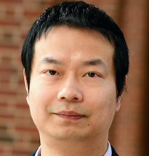




Many Proof Complexity Generators
Inside
One Demi-Bits Generator
Progress =
Xin Li
Johns Hopkins University
Hanlin Ren
IAS $→$ MPI
Yan Zhong
Johns Hopkins University
@ITCS, SUFE
Aug 26, 2026

Slide 2
Many Proof Complexity Generators
Inside
One Demi-Bits Generator
Progress =
What’s a “proof complexity generator”?
What’s a “demi-bits generator”?
Why are there many “proof complexity generators” inside one “demi-bits generator”?
Why study these generators?
My motivation: because circuit lower bounds are hard to prove, and we want to understand why!
Spoiler: the proof is just one line ☺

Slide 3

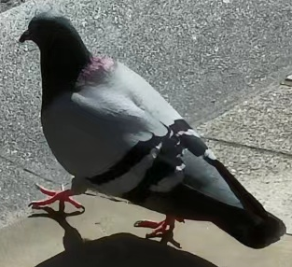



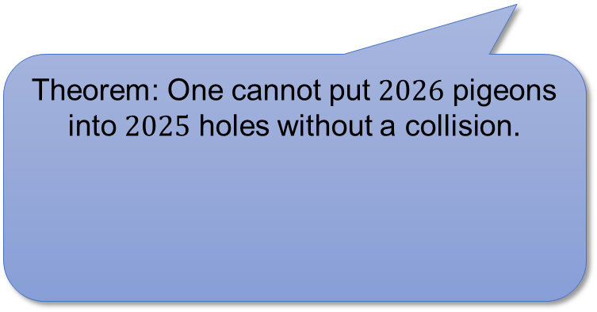
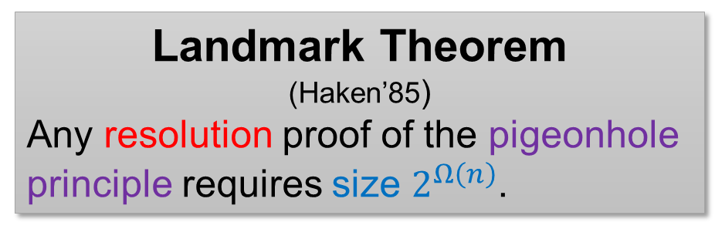

Proof Complexity
Progress =
How hard is it to prove theorems in proof systems?
  (in terms of proof length)
Theorem: One cannot put $2026$ pigeons into $2025$ holes without a collision.
Resolution
Resolution rule
Weakening rule
$$\frac{C∨ℓ D∨\overline{ℓ}}{C∨D}$$
$$\frac{C}{C∨D}$$
Landmark Theorem
(Haken’85)
Any resolution proof of the pigeonhole principle requires size $2^{Ω\left(n\right)}$.
Goal: Prove that certain theorems require long proofs in certain proof systems!

Slide 4


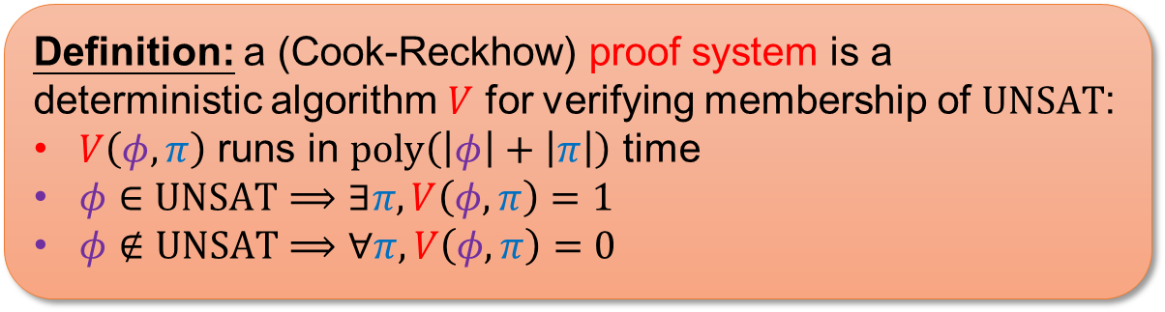



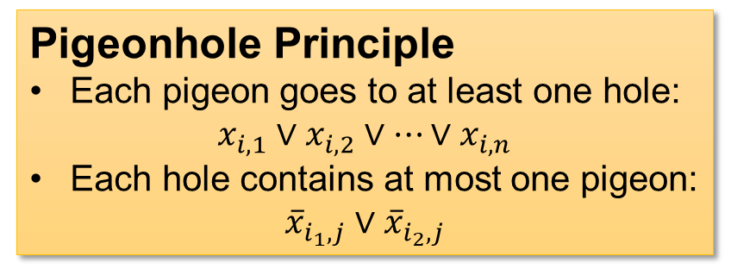





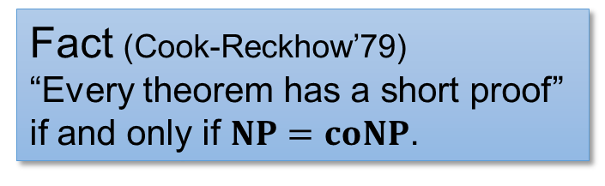
Proof Complexity
Progress =
(Propositional) theorems = unsatisfiable CNFs.
Proof systems = nondeterministic algorithms for certifying a CNF is unsatisfiable.
AND
Pigeonhole Principle
Each pigeon goes to at least one hole:
$x_{i,1}∨x_{i,2}∨…∨x_{i,n}$
Each hole contains at most one pigeon:
${\overline{x}}_{i_{1},j}∨{\overline{x}}_{i_{2},j}$
OR
OR
$$⋯$$
OR
$$x_{3}$$
$$x_{7}$$
$${\overline{x}}_{11}$$
$${\overline{x}}_{6}$$
$$x_{9}$$
$${\overline{x}}_{2}$$
$$x_{18}$$
$${\overline{x}}_{15}$$
$$x_{4}$$
Definition: a (Cook-Reckhow) proof system is a deterministic algorithm $V$ for verifying membership of $UNSAT$:
$V\left(φ,π\right)$ runs in $poly\left(\left|φ\right|+\left|π\right|\right)$ time
$φ∈UNSAT⟹∃π, V\left(φ,π\right)=1$
$φ∉UNSAT⟹∀π, V\left(φ,π\right)=0$
Fact (Cook-Reckhow’79)
“Every theorem has a short proof” if and only if $NP=coNP$.

Slide 5
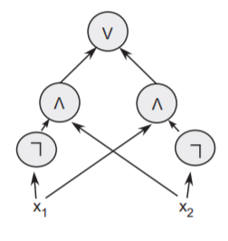
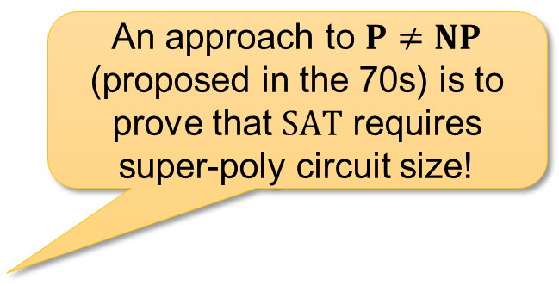

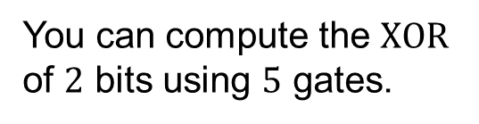
Circuit Complexity
Progress =
How hard is it to compute certain functions?
  “size” of a circuit
An approach to $P≠NP$ (proposed in the 70s) is to prove that $SAT$ requires super-poly circuit size!
?
You can compute the $XOR$ of $2$ bits using $5$ gates.
Can you compute $SAT$ (or your favourite $NP$-complete problem) using $poly\left(n\right)$ many gates?

Slide 6
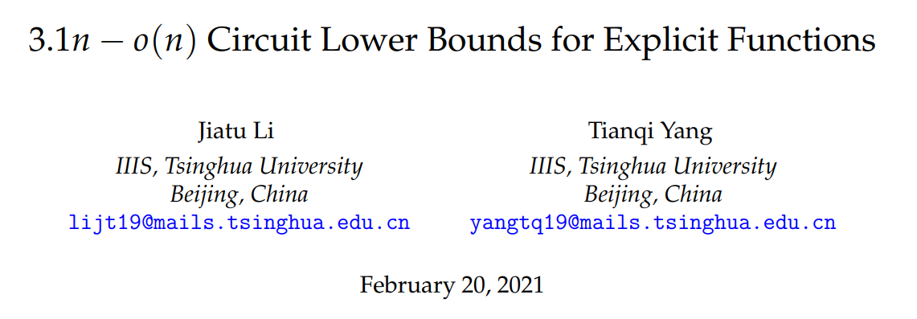
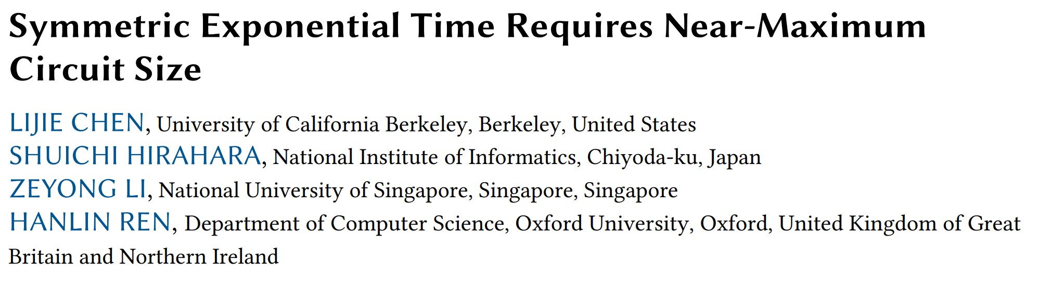




Circuit Lower Bounds Are Hard…
Progress =
We don’t know:
Can we prove a super-poly lower bound for $SAT$ ?
any $L∈NP$
$$10n$$
any $L∈NE$
Exponential-time version of $NP$
State-of-the-art:

Slide 7

Why are circuit lower bounds hard?
Progress =
… because of the proof complexity of circuit complexity!
… because the range avoidance problem is hard!
… because of the “natural proofs” barrier!
https://sucai.redocn.com/12780859.html

Slide 8
Why are circuit lower bounds hard?
Progress =
… because of the proof complexity of circuit complexity!
… because the range avoidance problem is hard!
… because of the “natural proofs” barrier!
https://sucai.redocn.com/12780859.html

Slide 9



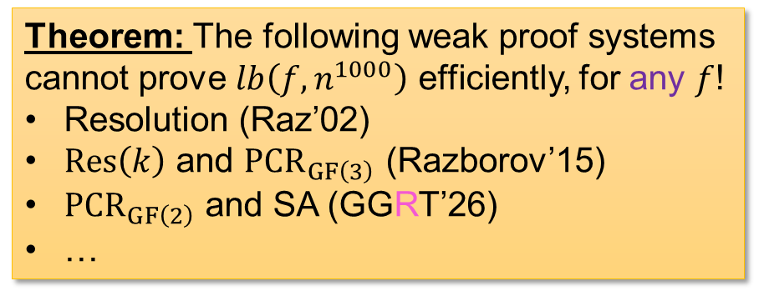

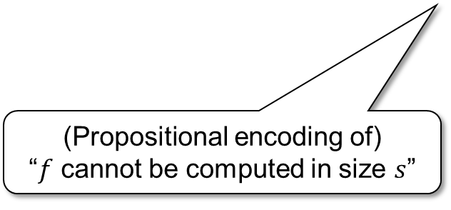
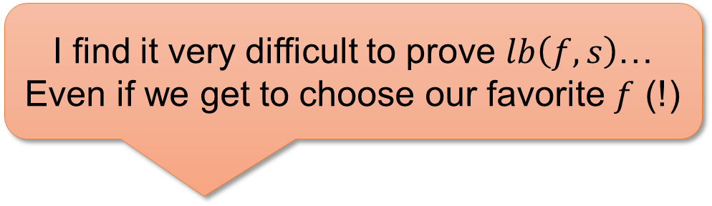
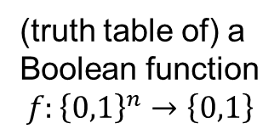

Proof Complexity of
Circuit Complexity
Progress =
Circuit lower bound tautologies
$$lb\left(f, s\right)$$
I find it very difficult to prove $lb\left(f,s\right)$…
Even if we get to choose our favorite $f$ (!)
(truth table of) a Boolean function
$$f:{\left\{0,1\right\}}^{n}→\left\{0,1\right\}$$
size parameter
(Propositional encoding of)
“$f$ cannot be computed in size $s$”
(a CNF of size $poly\left(2^{n}\right)$)
Complexity theorists
Proof systems
Theorem: The following weak proof systems cannot prove $lb\left(f,n^{1000}\right)$ efficiently, for any $f$!
Resolution (Raz’02)
$Res\left(k\right)$ and ${PCR}_{GF\left(3\right)}$ (Razborov’15)
${PCR}_{GF\left(2\right)}$ and SA (GGRT’26)
…
Picture by GPT

Slide 10


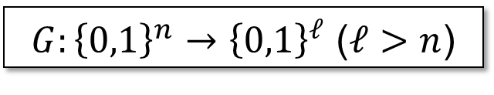


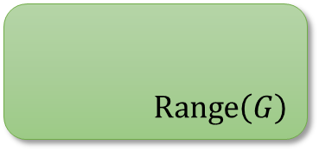
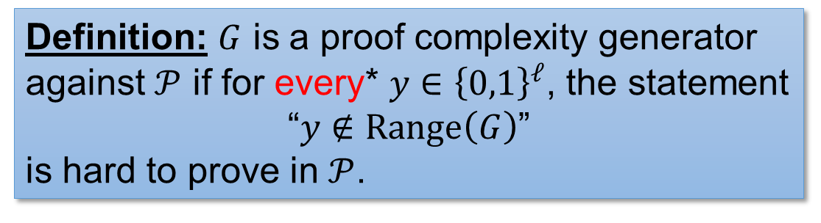
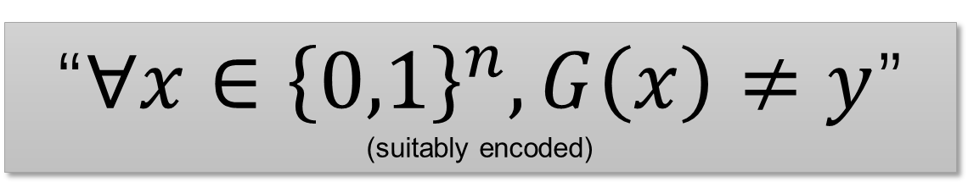
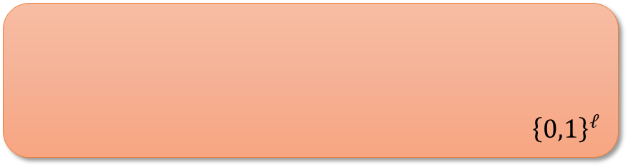
Proof Complexity Generators
Progress =
Definition: $G$ is a proof complexity generator against $𝒫$ if for every* $y∈{\left\{0,1\right\}}^{ℓ}$, the statement
“$y∉Range\left(G\right)$”
is hard to prove in $𝒫$.
$G:{\left\{0,1\right\}}^{n}→{\left\{0,1\right\}}^{ℓ}$ ($ℓ>n$)
$$y∈{\left\{0,1\right\}}^{ℓ}$$
$$G$$
“$∀x∈{\left\{0,1\right\}}^{n}, G\left(x\right)≠y$”
(suitably encoded)
$$x∈{\left\{0,1\right\}}^{n}$$
$${\left\{0,1\right\}}^{ℓ}$$
Although $Range\left(G\right)$ only contains a small fraction of ${\left\{0,1\right\}}^{ℓ}$, $𝒫$ finds it hard to figure out this fact.
$$Range\left(G\right)$$
*If $y$ is actually in $Range\left(G\right)$, then the statement is impossible to prove, hence also hard to prove.

Slide 11





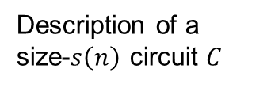



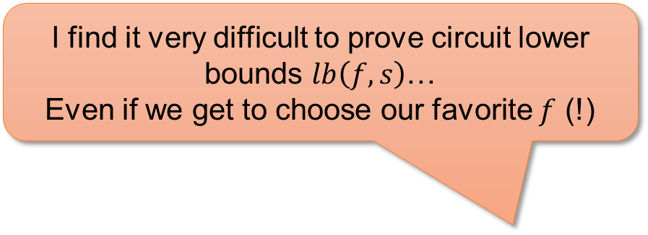
The Truth Table Generator
Progress =
I find it very difficult to prove circuit lower bounds $lb\left(f,s\right)$…
Even if we get to choose our favorite $f$ (!)
Truth Table Generator ($TT$)
Truth table of $C$
Okay, maybe that’s because the truth table generator is a very hard proof complexity generator… .
$$0110010011…………001010$$
$2^{n}$ bits
$$TT$$
$\tilde{O}\left(s\left(n\right)\right)$ bits
Description of a size-$s\left(n\right)$ circuit $C$
Complexity theorists

Slide 12
Why are circuit lower bounds hard?
Progress =
… because of the proof complexity of circuit complexity!
… because the range avoidance problem is hard!
… because of the “natural proofs” barrier!
https://sucai.redocn.com/12780859.html

Slide 13



Range Avoidance Problem
Progress =
Input: a (multi-output) circuit $C:{\left\{0,1\right\}}^{n}→{\left\{0,1\right\}}^{ℓ}$ ($ℓ>n$)
Output: any string $y∉Range\left(C\right)$
  I.e. for every $x∈{\left\{0,1\right\}}^{n}$, $C\left(x\right)≠y$
Trivial randomized algorithm: Output a random $y←{\left\{0,1\right\}}^{ℓ}$.
  Question: deterministic algorithms?
A “non-output” of $C$.
$$y∈{\left\{0,1\right\}}^{ℓ}$$
$$C$$
$$x∈{\left\{0,1\right\}}^{n}$$

Slide 14
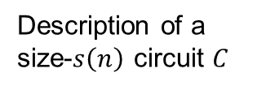
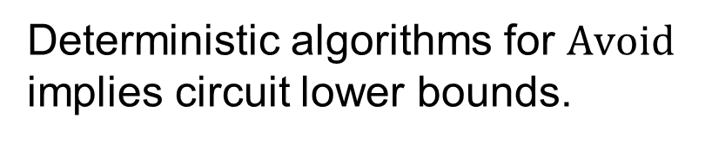
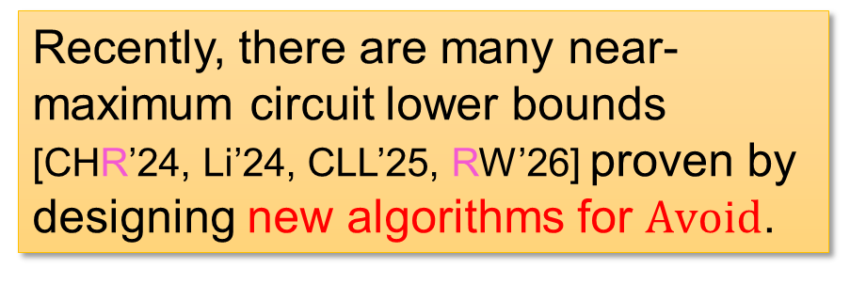




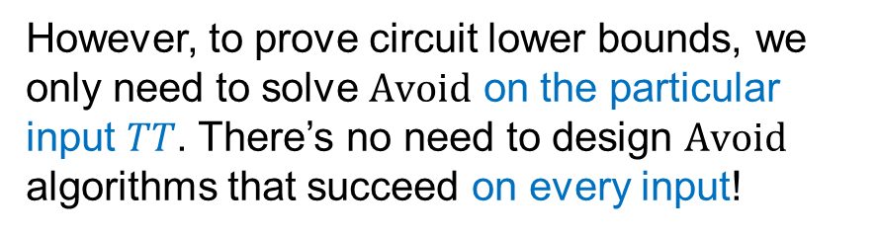



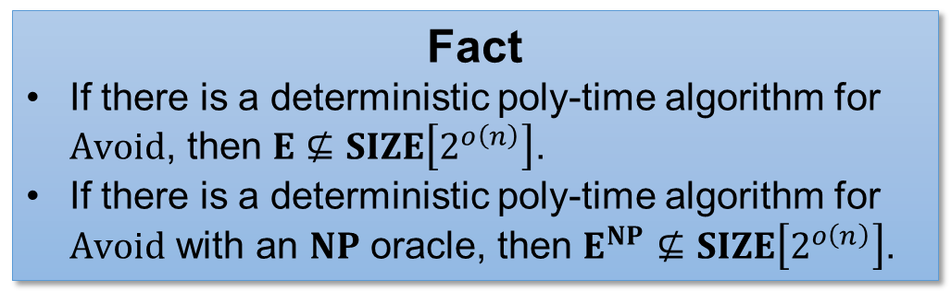
Circuit Lower Bounds via Solving $Avoid$
Progress =
Deterministic algorithms for $Avoid$ implies circuit lower bounds.
Truth Table Generator ($TT$)
Truth table of $C$
Fact
If there is a deterministic poly-time algorithm for $Avoid$, then $E⊈SIZE\left[2^{o\left(n\right)}\right]$.
If there is a deterministic poly-time algorithm for $Avoid$ with an $NP$ oracle, then $E^{NP}⊈SIZE\left[2^{o\left(n\right)}\right]$.
$$0110010011…………001010$$
$2^{n}$ bits
$$TT$$
$\tilde{O}\left(s\left(n\right)\right)$ bits
Description of a size-$s\left(n\right)$ circuit $C$
Recently, there are many near-maximum circuit lower bounds [CHR’24, Li’24, CLL’25, RW’26] proven by designing new algorithms for $Avoid$.
However, to prove circuit lower bounds, we only need to solve $Avoid$ on the particular input $TT$. There’s no need to design $Avoid$ algorithms that succeed on every input!

Slide 15
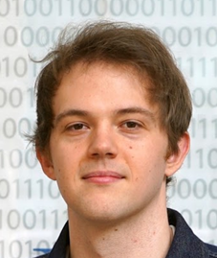

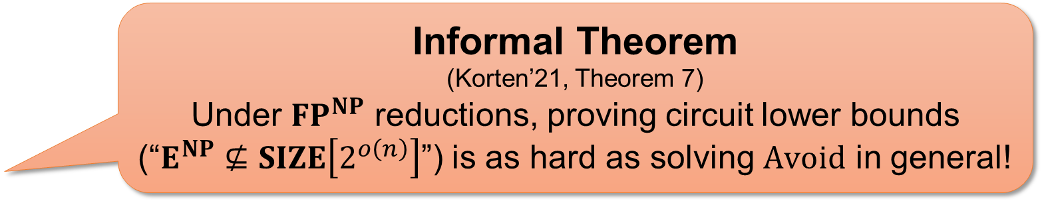

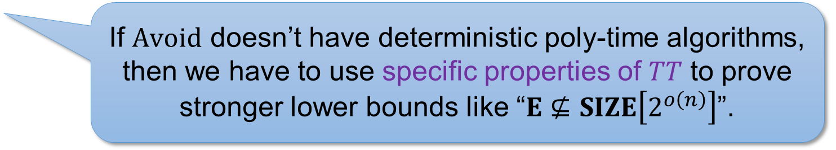
Are we losing a lot?
Progress =
…by focusing on $Avoid$, instead of circuit lower bounds
No...
Informal Theorem
(Korten’21, Theorem 7)
Under ${FP}^{NP}$ reductions, proving circuit lower bounds (“$E^{NP}⊈SIZE\left[2^{o\left(n\right)}\right]$”) is as hard as solving $Avoid$ in general!
If we have an $NP$ oracle
If $Avoid$ doesn’t have deterministic poly-time algorithms, then we have to use specific properties of $TT$ to prove stronger lower bounds like “$E⊈SIZE\left[2^{o\left(n\right)}\right]$”.
Oliver Korten
... and Yes?
Proven in [ILW’23, CL’24] under cryptographic assumptions!
(without the $NP$ oracle)

Slide 16

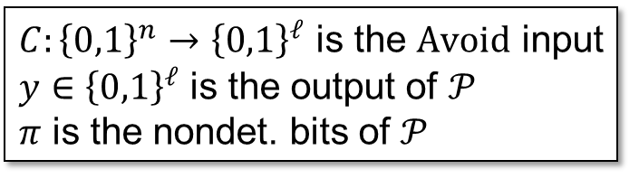
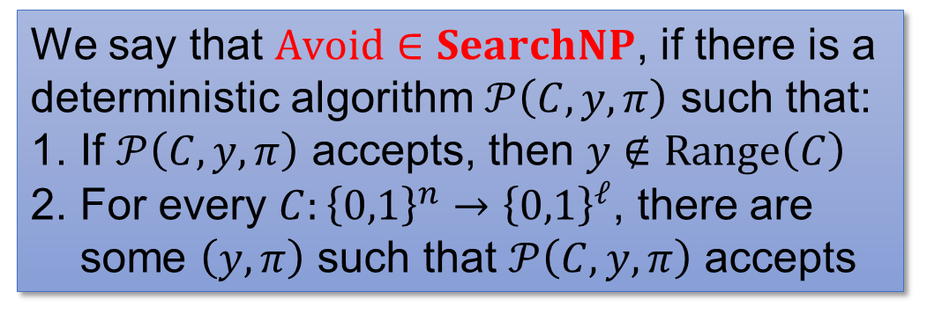
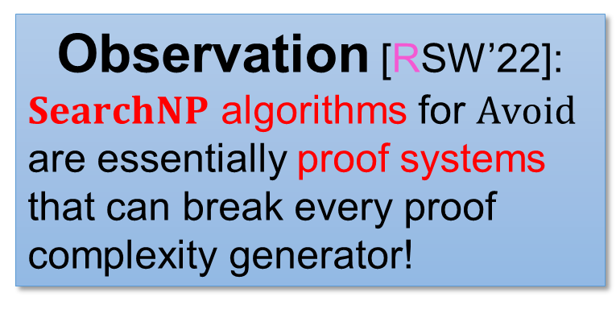
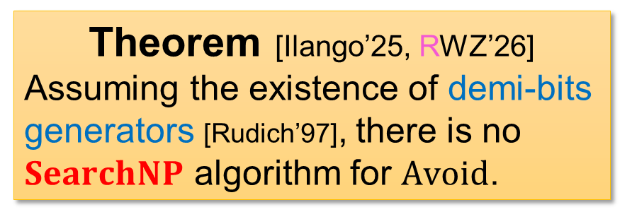

$Avoid$ is hard even for nondeterministic algorithms!
Progress =
Theorem [Ilango’25, RWZ’26]
Assuming the existence of demi-bits generators [Rudich’97], there is no $SearchNP$ algorithm for $Avoid$.
We say that $Avoid∈SearchNP$, if there is a deterministic algorithm $𝒫\left(C,y,π\right)$ such that:
If $𝒫\left(C,y,π\right)$ accepts, then $y∉Range\left(C\right)$
For every $C:{\left\{0,1\right\}}^{n}→{\left\{0,1\right\}}^{ℓ}$, there are some $\left(y,π\right)$ such that $𝒫\left(C,y,π\right)$ accepts
What’s a “demi-bits generator”?
See a few slides later ☺
$C:{\left\{0,1\right\}}^{n}→{\left\{0,1\right\}}^{ℓ}$ is the $Avoid$ input
$y∈{\left\{0,1\right\}}^{ℓ}$ is the output of $𝒫$
$π$ is the nondet. bits of $𝒫$
$$y∈{\left\{0,1\right\}}^{ℓ}$$
Observation [RSW’22]:
$SearchNP$ algorithms for $Avoid$ are essentially proof systems that can break every proof complexity generator!
$$C$$
$$x∈{\left\{0,1\right\}}^{n}$$
Hence, [Ilango’25, RWZ’26] are transformations from demi-bits generators to proof complexity generators!

Slide 17
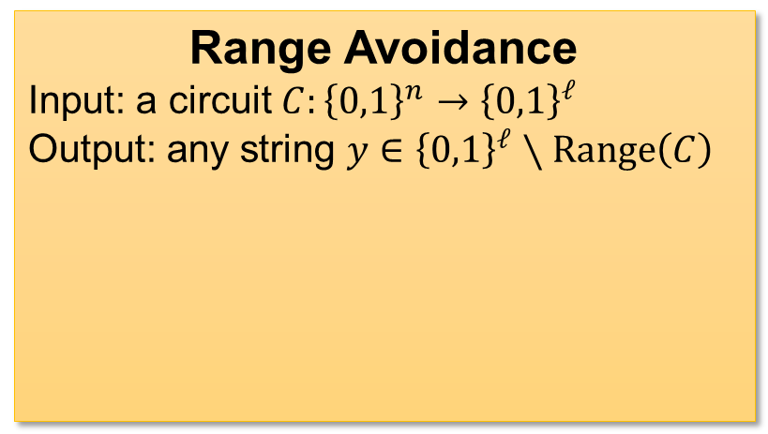
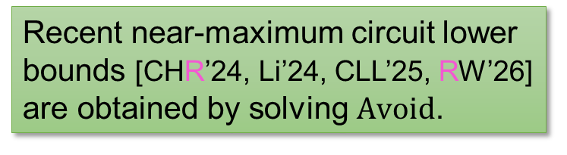


Recap
Progress =
Range Avoidance
Input: a circuit $C:{\left\{0,1\right\}}^{n}→{\left\{0,1\right\}}^{ℓ}$
Output: any string $y∈{\left\{0,1\right\}}^{ℓ}∖Range\left(C\right)$
Crypto assumptions
(existence of “demi-bits generators”)
Recent work
[Ilango’25, RWZ’26]
$$y∈{\left\{0,1\right\}}^{ℓ}$$
$$C$$
Hardness of $Avoid$
There is no $SearchNP$ algorithm for $Avoid$.
The trivial randomized algorithm for $Avoid$ cannot be derandomized.
$$x∈{\left\{0,1\right\}}^{n}$$
Recent near-maximum circuit lower bounds [CHR’24, Li’24, CLL’25, RW’26] are obtained by solving $Avoid$.
One has to exploit specific properties of $TT$ to improve these circuit lower bounds.

Slide 18
Why are circuit lower bounds hard?
Progress =
… because of the proof complexity of circuit complexity!
… because the range avoidance problem is hard!
… because of the “natural proofs” barrier!
https://sucai.redocn.com/12780859.html

Slide 19

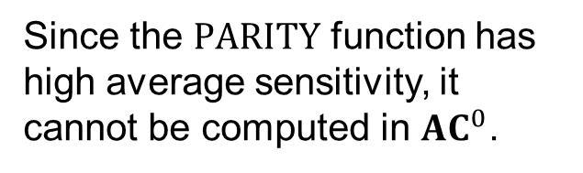
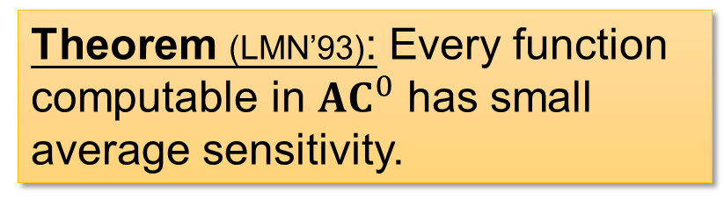
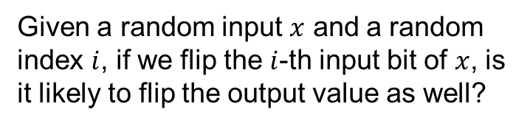
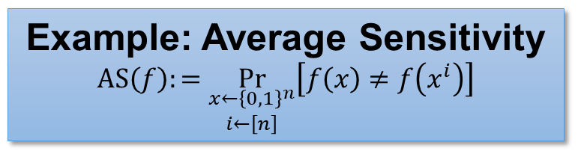
Natural Proofs Barrier
Progress =
When we prove “$f$ has high circuit complexity”, we identify a property $𝒬$ that $f$ has, but every function computed by small circuits doesn’t.
Theorem (LMN’93): Every function computable in ${AC}^{0}$ has small average sensitivity.
Example: Average Sensitivity
$$AS\left(f\right):=\underset{\begin{aligned}x←{\left\{0,1\right\}}^{n} \\ i←\left[n\right]\end{aligned}}{Pr}\left[f\left(x\right)≠f\left(x^{i}\right)\right]$$
Given a random input $x$ and a random index $i$, if we flip the $i$-th input bit of $x$, is it likely to flip the output value as well?
Since the $PARITY$ function has high average sensitivity, it cannot be computed in ${AC}^{0}$.

Slide 20


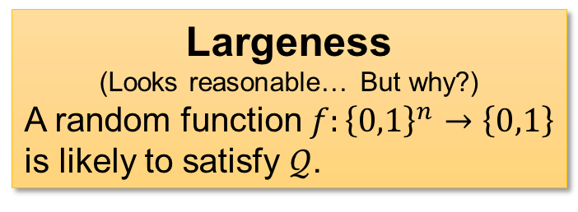
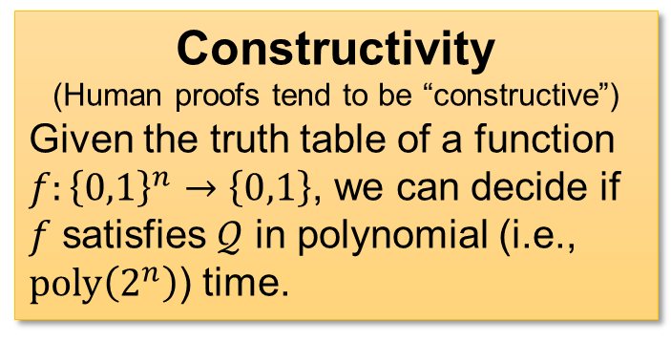
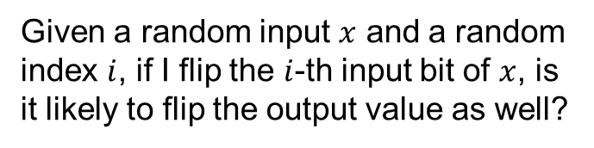

Natural Proofs Barrier
Progress =
A property $𝒬$ is natural (Razborov-Rudich’97) if:
Constructivity
(Human proofs tend to be “constructive”)
Given the truth table of a function $f:{\left\{0,1\right\}}^{n}→\left\{0,1\right\}$, we can decide if $f$ satisfies $𝒬$ in polynomial (i.e., $poly\left(2^{n}\right)$) time.
Largeness
(Looks reasonable… But why?)
A random function $f:{\left\{0,1\right\}}^{n}→\left\{0,1\right\}$ is likely to satisfy $𝒬$.
Of course, you can compute average sensitivity of $f$ in $poly\left(2^{n}\right)$ time.
A random function is likely to have high average sensitivity.
Example: Average Sensitivity
$$AS\left(f\right):=\underset{\begin{aligned}x←{\left\{0,1\right\}}^{n} \\ i←\left[n\right]\end{aligned}}{Pr}\left[f\left(x\right)≠f\left(x^{i}\right)\right]$$
Given a random input $x$ and a random index $i$, if I flip the $i$-th input bit of $x$, is it likely to flip the output value as well?

Slide 21




Natural Proofs Barrier
Progress =
Circuit lower bounds that we already have tend to be natural!
Against ${AC}^{0}$ (average sensitivity, random restriction, …)
Against ${AC}^{0}\left[p\right]$ (polynomial method…)
Against $n^{3}$-size formulas
……
Informal Theorem (RR’97):
You cannot prove ($P/_{poly}$) circuit lower bounds using a natural property, unless you can break all of cryptography (one-way functions)!
Alexander Razborov
Steven Rudich

Slide 22





Natural Proofs Barrier
Progress =
Constructivity
(Human proofs tend to be “constructive”)
Given the truth table of a function $f:{\left\{0,1\right\}}^{n}→\left\{0,1\right\}$, we can decide if $f$ satisfies $𝒬$ in polynomial (i.e., $poly\left(2^{n}\right)$) time.
$NP$-Constructivity
(Human proofs tend to be “constructive”)
Given the truth table of a function $f:{\left\{0,1\right\}}^{n}→\left\{0,1\right\}$, we can “prove” that $f$ satisfies $𝒬$ in nondeterministic $poly\left(2^{n}\right)$ time.
Largeness
(Looks reasonable… But why?)
A random function $f:{\left\{0,1\right\}}^{n}→\left\{0,1\right\}$ is likely to satisfy $𝒬$.
Why largeness?
Why constructivity?
(will discuss later)
Since proof systems are nondeterministic algorithms, let’s use $NP$-constructivity!
Rudich’s conjecture
Circuit lower bounds cannot be proved via an $NP$-natural property.
Steven Rudich
(RANDOM’97)

Slide 23



Demi-Bits Generator
Progress =
Definition: $G$ is a demi-bits generator against $𝒫$ if for a large fraction (say, $1/3$) of $y∈{\left\{0,1\right\}}^{ℓ}$, the statement
“$y∉Range\left(G\right)$”
is hard to prove in $𝒫$.
$G:{\left\{0,1\right\}}^{n}→{\left\{0,1\right\}}^{ℓ}$ ($ℓ>n$)
$$y∈{\left\{0,1\right\}}^{ℓ}$$
$$G$$
“$∀x∈{\left\{0,1\right\}}^{n}, G\left(x\right)≠y$”
(suitably encoded)
$$x∈{\left\{0,1\right\}}^{n}$$
$${\left\{0,1\right\}}^{ℓ}$$
$$Range\left(G\right)$$
What $𝒫$ can figure out to be outside $Range\left(G\right)$

Slide 24




Rudich’s Conjecture
Progress =
Rudich’s conjecture (Rudich’97)
Circuit lower bounds cannot be proved via an $NP$-natural property.
$NP$-Constructivity
(Human proofs tend to be “constructive”)
Given the truth table of a function $f:{\left\{0,1\right\}}^{n}→\left\{0,1\right\}$, we can “prove” that $f$ satisfies $𝒬$ in nondeterministic $poly\left(2^{n}\right)$ time.
Truth Table Generator ($TT$)
Truth table of $C$
Largeness
(Looks reasonable… But why?)
A random function $f:{\left\{0,1\right\}}^{n}→\left\{0,1\right\}$ is likely to satisfy $𝒬$.
$$0110010011…………001010$$
$2^{n}$ bits
$$TT$$
$\tilde{O}\left(s\left(n\right)\right)$ bits
Description of a size-$s\left(n\right)$ circuit $C$
Rudich’s conjecture = “$TT$ is a demi-bits generator against every proof system”!

Slide 25



Comparison
Progress =
Proof Complexity Generator
The statement “$y∉Range\left(G\right)$” is hard to prove for every $y∈{\left\{0,1\right\}}^{ℓ}$
$G:{\left\{0,1\right\}}^{n}→{\left\{0,1\right\}}^{ℓ}$ ($ℓ>n$)
$$y∈{\left\{0,1\right\}}^{ℓ}$$
Demi-Bits Generator
The statement “$y∉Range\left(G\right)$” is hard to prove for a $1/3$ fraction of $y∈{\left\{0,1\right\}}^{ℓ}$
$$G$$
$$x∈{\left\{0,1\right\}}^{n}$$
Clearly, proof complexity generators are qualitatively stronger objects than demi-bits generators!

Slide 26





Main Result
Progress =
There are many proof complexity generators hidden inside every demi-bits generator!
Let $G:{\left\{0,1\right\}}^{n}→{\left\{0,1\right\}}^{ℓ}$ with $ℓ>10n$, and $𝒫$ be a “well-behaved” proof system.
Theorem
If $G$ is a demi-bits generator against $𝒫$, then for a random subset $I⊆\left[ℓ\right]$,
$$G_{I}:{\left\{0,1\right\}}^{n}→{\left\{0,1\right\}}^{I}$$
is a proof complexity generator against $𝒫$ with noticeable probability.
$$G$$
Since $ℓ>10n$, $\left|I\right|>n$ with high probability.
This is the simplest transformation from demi-bits generators to proof complexity generators!
Due to its simplicity (compared to [Ilango’25, RWZ’26]), we also obtain hardness of ${NC}^{0}$-Avoid, Remote Point [APY’09], Hard Partial Truth Tables [AS’10], …

Slide 27




Shattering
Progress =
A set of strings $S⊆{\left\{0,1\right\}}^{n}$ shatters a subset of indices $I⊆\left[n\right]$, if every pattern $y∈{\left\{0,1\right\}}^{I}$ appears somewhere in $S$.
  For every $y∈{\left\{0,1\right\}}^{I}$, there exists $z∈S$ such that $z{\left.​\right|}_{I}=y$.
01001100
00100101
11010110
00111110
10011101
10000101
01010110
11000100
01011101
00110111
01000111
10001010
Pajor’s Lemma
(Strengthening of the Sauer-Shelah Lemma)
Any subset $S⊆{\left\{0,1\right\}}^{n}$ shatters at least $\left|S\right|$ many subsets of indices.
Shatters $38$ subsets including $∅,\left\{0\right\},\left\{1\right\},…,\left\{7\right\},\left\{0,1\right\},\left\{0,3\right\},\left\{0,4\right\},\left\{0,6\right\},…,\left\{1,3,7\right\}$
A set of $12$ strings that shatters $I=\left\{1,3,4\right\}$ ($0$-indexed)

Slide 28




Proof of the Main Result
Progress =
Let $H=\{y∈{\left\{0,1\right\}}^{ℓ}:𝒫$ cannot prove “$y∉Range\left(G\right)$” efficiently$\}$.
  Strings that $𝒫$ finds it “hard”
$G$ is a demi-bits generator $⟹\left|H\right|$ is large.
Claim: If $I⊆\left[ℓ\right]$ is shattered by $H$, and $\left|I\right|>n$, then $G_{I}$ is
a proof complexity generator for $𝒫$.
  Suppose $𝒫$ can prove $y∉Range\left(G_{I}\right)$ for some $y∈{\left\{0,1\right\}}^{I}$.
  Since $H$ shatters $I$, there exists $z∈H$ such that $z{\left.​\right|}_{I}=y$.
  Thus, $𝒫$ can prove “$z∉Range\left(G\right)$” as well, contradicting the
  definition of $H$!
01001100
00100101
11010110
00111110
10011101
10000101
01010110
11000100
01011101
00110111
01000111
10001010
There are at least $\left|H\right|$ such sets $I$, most of which has size $>n$.
If I can prove “110 $∉Range(G_{I})$”, then I can prove “01010110 $∉Range\left(G\right)$”.
$$H$$

Slide 29

Discussion: Largeness in Natural Proofs?
Progress =
Constructivity
(Human proofs tend to be “constructive”)
Given the truth table of a function $f:{\left\{0,1\right\}}^{n}→\left\{0,1\right\}$, we can decide if $f$ satisfies $𝒬$ in polynomial (i.e., $poly\left(2^{n}\right)$) time.
Largeness
(Looks reasonable… But why?)
A random function $f:{\left\{0,1\right\}}^{n}→\left\{0,1\right\}$ is likely to satisfy $𝒬$.
Why largeness?
[Williams’14, CWY’23]: Circuit lower bounds $≡$ constructive (but not necessarily large) properties!
Do lower bound properties have to be large? Can we design non-large properties?
Many proposals for overcoming the natural proof barrier are non-large ☺
(buzzwords: KRW conjecture; hardness magnification; …)

Slide 30






Discussion: Largeness in Natural Proofs?
Progress =
Suppose:
“$TT$ is a demi-bits generator” $⟺$ “$TT$ is a proof complexity generator”
(which is a false claim)
Then largeness is inherent!
A property that’s $NP$-constructive $=$
breaking $TT$ as a proof complexity generator
A property that’s $NP$-constructive and large $=$ breaking $TT$ as a demi-bits generator
To prove stronger lower bounds, we have to use specific properties of $TT$ that distinguishes it from other generators.
Our result means…
If $TT$ is a demi-bits generator, then something that looks similar to $TT$ (namely $TT_{S}$ for a random $S⊆{\left\{0,1\right\}}^{n}$) are proof complexity generators!
Actually, this “specific property” needs to distinguish $TT$ from most generators of the form ${TT}_{S}$ ($S⊆{\left\{0,1\right\}}^{n}$)!
Oliver Korten

Slide 31





Summary
Progress =
Demi-Bits Generator
The statement “$y∉Range\left(G\right)$” is hard to prove for a $1/3$ fraction of $y∈{\left\{0,1\right\}}^{ℓ}$
Theorem
If $G$ is a demi-bits generator against $𝒫$, then for a random subset $I⊆\left[ℓ\right]$,
$$G_{I}:{\left\{0,1\right\}}^{n}→{\left\{0,1\right\}}^{I}$$
is a proof complexity generator against $𝒫$ with noticeable probability.
Proof Complexity Generator
The statement “$y∉Range\left(G\right)$” is hard to prove for every $y∈{\left\{0,1\right\}}^{ℓ}$
In fact, this is true as long as $\left|I\right|>n$ and {hard strings of $G$} shatters $I$!
$$y∈{\left\{0,1\right\}}^{ℓ}$$
Conclusion
To prove a circuit lower bound, we have to use special properties of $TT$ that distinguishes it from not only arbitrary generators, but also $TT_{S}$ for most $S⊆{\left\{0,1\right\}}^{n}$!
$$G$$
$$x∈{\left\{0,1\right\}}^{n}$$

