Slide 1
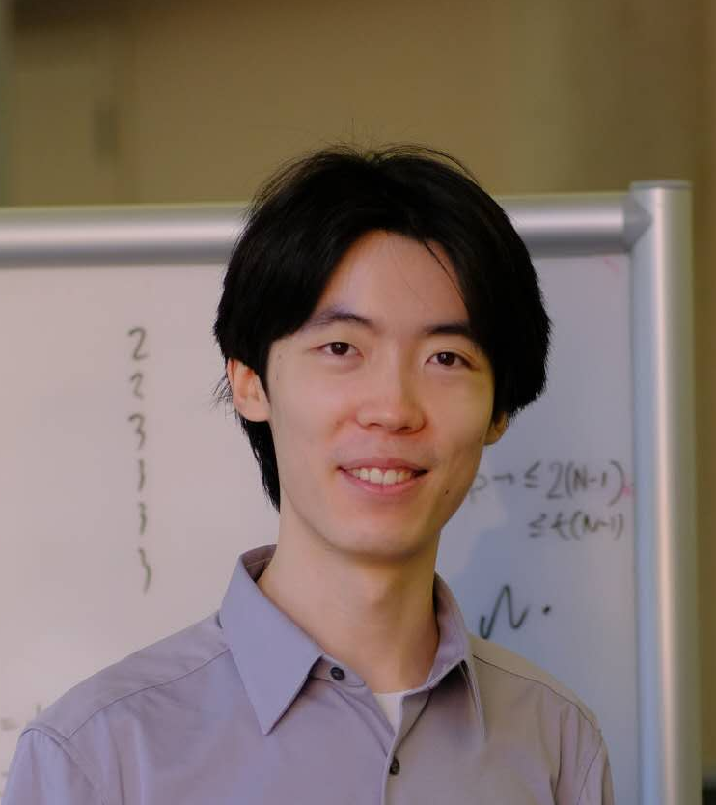


Finding Bugs in Short Proofs:
The Metamathematics of
Resolution Lower Bounds
Jiawei Li
(UT Austin)
Yuhao Li
(Columbia)
Hanlin Ren
(IAS)
June 25, 2026
@ STOC’26

Slide 2
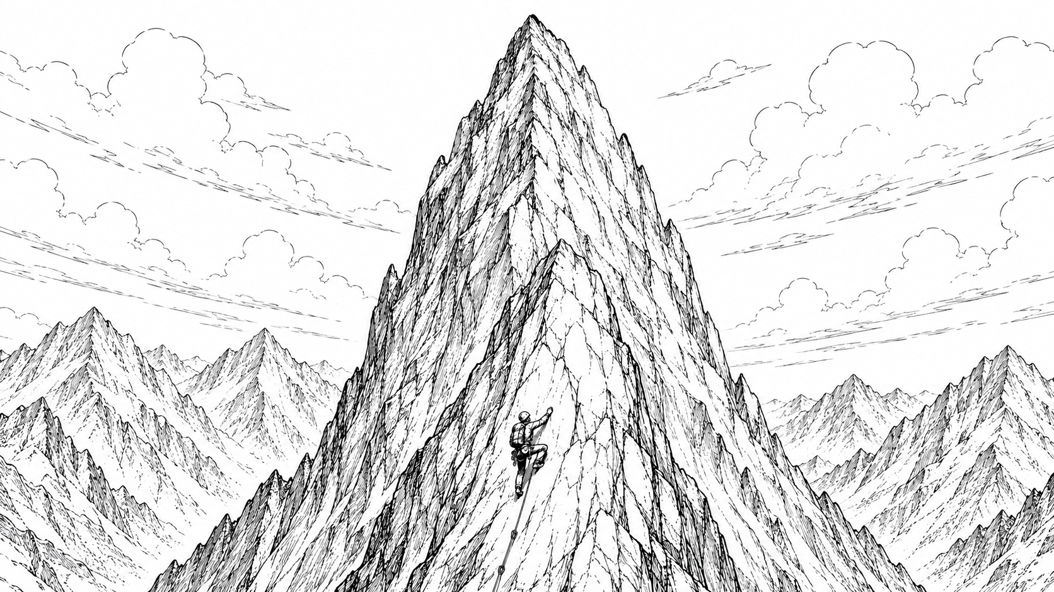


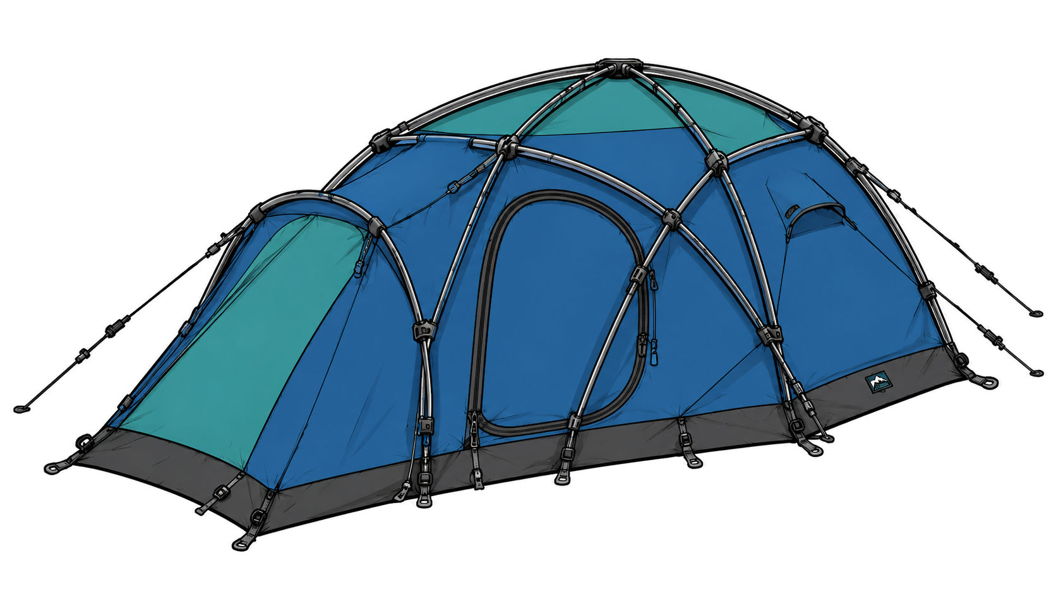










$$P/_{poly}$$
To climb Mount Everest, we need a strong body as well as a variety of climbing tools.
To prove lower bounds, we need a clever brain as well as a variety of mathematical tools.
EF
$${NC}^{1}$$
Frege
Proving lower bounds is like…
$${TC}^{0}$$
${AC}^{0}\left[p\right]$-Frege
${AC}^{0}$-Frege
$${AC}^{0}\left[2\right]$$
$${AC}^{0}$$
Resolution

Slide 3
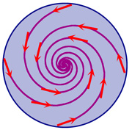
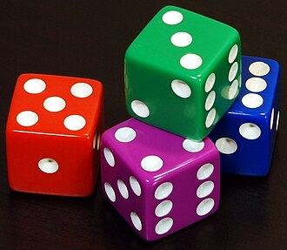

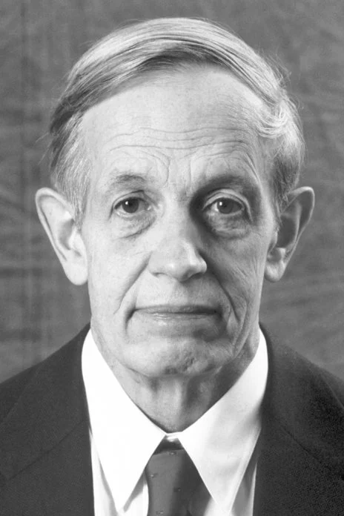



Detour: Nash Equilibrium
Theorem (Nash): Every “game” has an “equilibrium”.
Equilibrium
Game
Games $⟹$ continues maps!
Brouwer’s fixed point theorem
John Nash
https://www.nobelprize.org/prizes/economic-sciences/1994/nash/facts/
https://en.wikipedia.org/wiki/Dice#/media/File:6sided_dice_(cropped).jpg
https://en.wikipedia.org/wiki/Brouwer_fixed-point_theorem#/media/File:Th%C3%A9or%C3%A8me-de-Brouwer-(cond-2).jpg

Slide 4
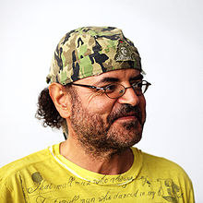




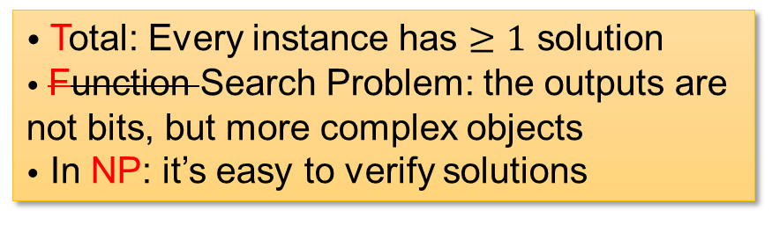


TFNP
Remark: you can study this in terms of bounded arithmetic and proof complexity as well ☺.
Theorem (Nash): Every “game” has an “equilibrium”.
What’s the complexity of finding an equilibrium?
$$PPA$$
$$PPP$$
$$PLS$$
Problem: NASH
Input: a game
Output: an equilibrium
$$PPADS$$
Christos Papadimitriou
$$PPAD$$
• Total: Every instance has $≥1$ solution
• Function Search Problem: the outputs are not bits, but more complex objects
• In NP: it’s easy to verify solutions
$$CLS$$
https://en.wikipedia.org/wiki/Christos_Papadimitriou

Slide 5
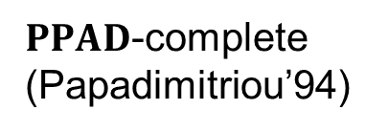
PPAD
(Implicitly by Nash)
Problem: NASH
Input: a game
Output: an equilibrium
Problem: BROUWER
(informal)
Input: a “continuous function”
Output: a fixed point
(DGP09, CDT09)
$PPAD$-complete (Papadimitriou’94)
To prove the existence of equilibriums, I need both:
A Big Tool:
Brouwer’s fixed point theorem
(the totality of BROUWER)
A Clever Brain:
View games as cont. fns!
(NASH reduces to BROUWER)
John Nash

Slide 6
$$P/_{poly}$$
EF
What are the “mathematical tools” needed to prove long-standing lower bounds?
$${NC}^{1}$$
What are the “mathematical tools” we have already used to prove lower bounds?
Frege
$${TC}^{0}$$
${AC}^{0}\left[p\right]$-Frege
${AC}^{0}$-Frege
$${AC}^{0}\left[2\right]$$
$${AC}^{0}$$
Resolution

Slide 7
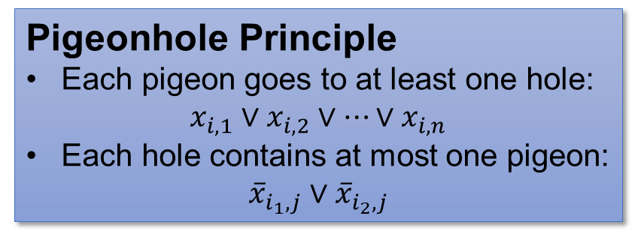
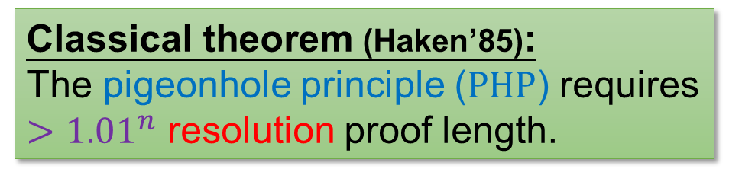



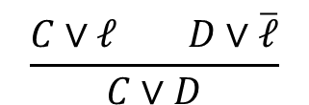
Proof complexity & Resolution
(1-min crash course)
Goal of proof complexity:
Show that certain theorems require a long proof in interesting proof systems.
Pigeonhole Principle
Each pigeon goes to at least one hole:
$x_{i,1}∨x_{i,2}∨…∨x_{i,n}$
Each hole contains at most one pigeon:
${\overline{x}}_{i_{1},j}∨{\overline{x}}_{i_{2},j}$
Classical theorem (Haken’85):
The pigeonhole principle ($PHP$) requires $>{1.01}^{n}$ resolution proof length.
Resolution
Resolution rule
$$\frac{C∨ℓ D∨\overline{ℓ}}{C∨D}$$
$$⊥$$
Weakening rule
$$\frac{C}{C∨D}$$
Axioms of $PHP$
Intermediate derivations
Final contradiction

Slide 8

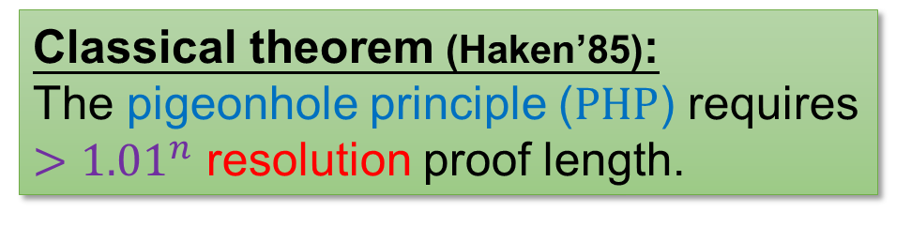




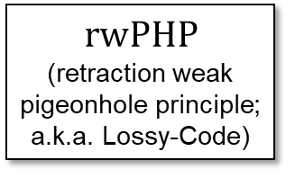


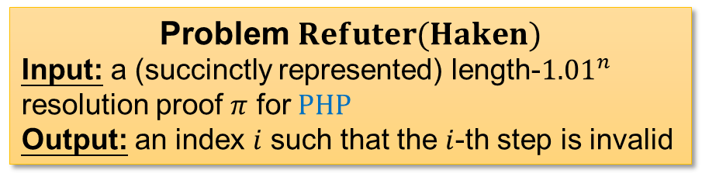

Refuter Problem
Classical theorem (Haken’85):
The pigeonhole principle ($PHP$) requires $>{1.01}^{n}$ resolution proof length.
Problem $Refuter(Haken)$
Input: a (succinctly represented) length-${1.01}^{n}$ resolution proof $π$ for $PHP$
Output: an index $i$ such that the $i$-th step is invalid
Our result: $Refuter(Haken)$ is $rwPHP\left(PLS\right)$-complete!
$$PPA$$
$$PPP$$
$$rwPHP\left(PLS\right)$$
This step violates resolution rules…
$$PPADS$$
$$PLS$$
$$⊥$$
$$rwPHP$$
(retraction weak pigeonhole principle; a.k.a. Lossy-Code)
$$CLS$$
Axioms of $PHP$
Intermediate derivations
Final contradiction
(# of steps $<{1.01}^{n}$)

Slide 9





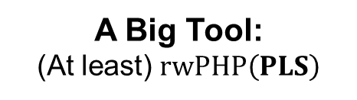
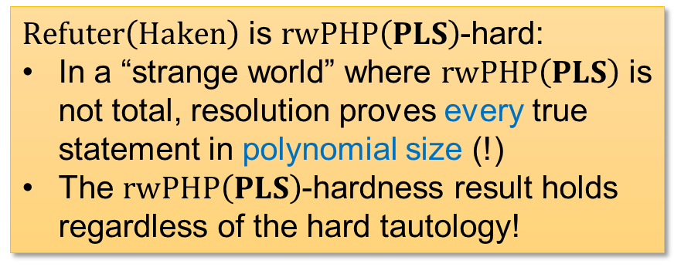
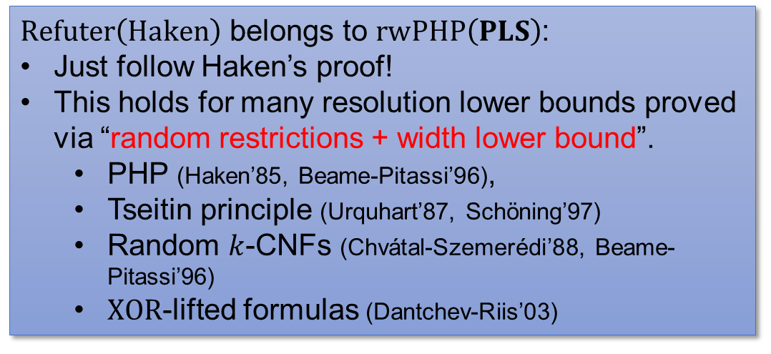
Proof Overview
Our result: $Refuter(Haken)$ is $rwPHP\left(PLS\right)$-complete!
$Refuter\left(Haken\right)$ belongs to $rwPHP\left(PLS\right)$:
Just follow Haken’s proof!
This holds for many resolution lower bounds proved via “random restrictions + width lower bound”.
  PHP (Haken’85, Beame-Pitassi’96),
  Tseitin principle (Urquhart’87, Schöning’97)
  Random $k$-CNFs (Chvátal-Szemerédi’88, Beame-Pitassi’96)
  $XOR$-lifted formulas (Dantchev-Riis’03)
$Refuter\left(Haken\right)$ is $rwPHP\left(PLS\right)$-hard:
In a “strange world” where $rwPHP\left(PLS\right)$ is not total, resolution proves every true statement in polynomial size (!)
The $rwPHP\left(PLS\right)$-hardness result holds regardless of the hard tautology!
Atserias—Muller’19, de Rezende et al’21
To prove a resolution lower bound, we need both:
“Pigs can fly”
A Clever Brain:
Design your random restrictions according to the tautology ☺
Pig airlines
A Big Tool:
(At least) $rwPHP\left(PLS\right)$

Slide 10

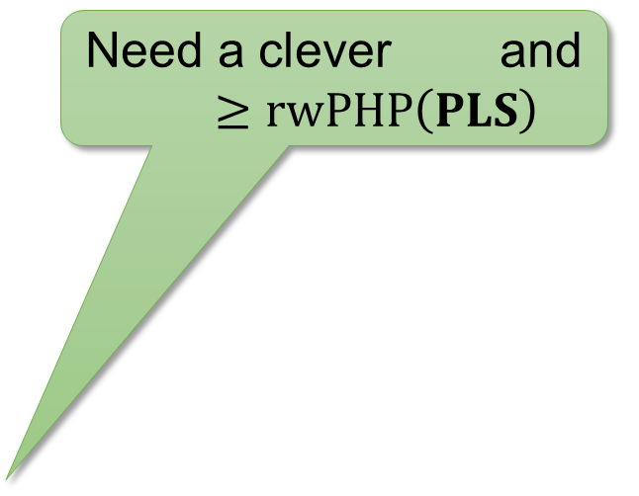

$$P/_{poly}$$
Need a clever and
$$≥ ??????$$
$rwPHP\left(PLS\right)$ is strictly stronger than $PLS$ ($=$resolution itself) in the decision tree setting.
Conjecture: “$??????$” is strictly stronger than EF?
EF
$${NC}^{1}$$
Frege
Need a clever and
$$≥rwPHP\left(PLS\right)$$
Thank you!
$${TC}^{0}$$
${AC}^{0}\left[p\right]$-Frege
${AC}^{0}$-Frege
$${AC}^{0}\left[2\right]$$
$${AC}^{0}$$
Resolution

Slide 11


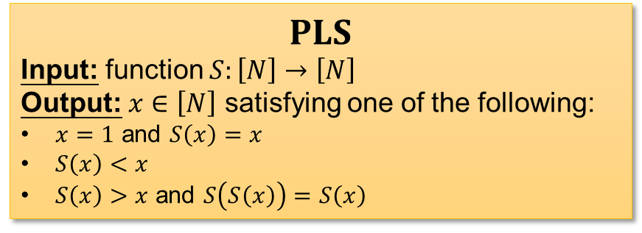


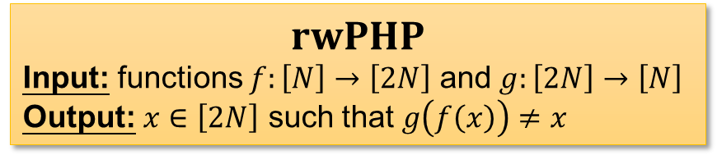

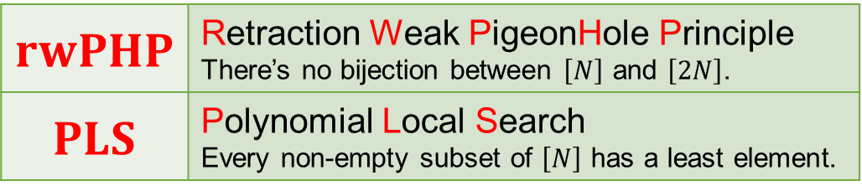
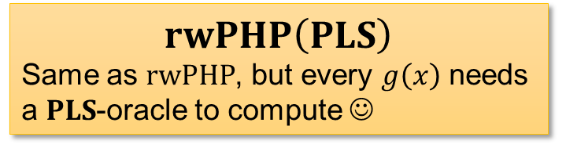
$$rwPHP\left(PLS\right)$$
Dictionary
$$rwPHP$$ | Retraction Weak PigeonHole Principle There’s no bijection between $\left[N\right]$ and $\left[2N\right]$.
$$PLS$$ | Polynomial Local Search Every non-empty subset of $\left[N\right]$ has a least element.
$$rwPHP\left(PLS\right)$$
Same as $rwPHP$, but every $g\left(x\right)$ needs a $PLS$-oracle to compute ☺
$$rwPHP$$
Input: functions $f:\left[N\right]→\left[2N\right]$ and $g:\left[2N\right]→\left[N\right]$
Output: $x∈\left[2N\right]$ such that $g\left(f\left(x\right)\right)≠x$
$$PLS$$
Input: function $S:\left[N\right]→\left[N\right]$
Output: $x∈\left[N\right]$ satisfying one of the following:
$x=1$ and $S\left(x\right)=x$
$S\left(x\right)<x$
$S\left(x\right)>x$ and $S\left(S\left(x\right)\right)=S\left(x\right)$
$$f$$
$$g$$
$$x$$
$$x$$
23 / 26

Slide 12



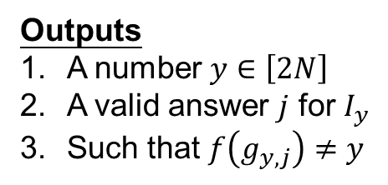





$$rwPHP\left(PLS\right)$$
$$rwPHP\left(PLS\right)$$
Inputs
a function $f:\left[N\right]→\left[2N\right]$
$2N$ $PLS$ instances $I_{1}…I_{2N}$
$g_{y,j}∈\left[N\right]$ for every $y∈\left[2N\right]$ and valid answer $j$ for $I_{y}$
Outputs
A number $y∈\left[2N\right]$
A valid answer $j$ for $I_{y}$
Such that $f\left(g_{y,j}\right)≠y$
$$f$$
$$I_{1}$$
$$I_{2}$$
$$I_{n}$$
$$g$$
$$…$$
24 / 26

Slide 13


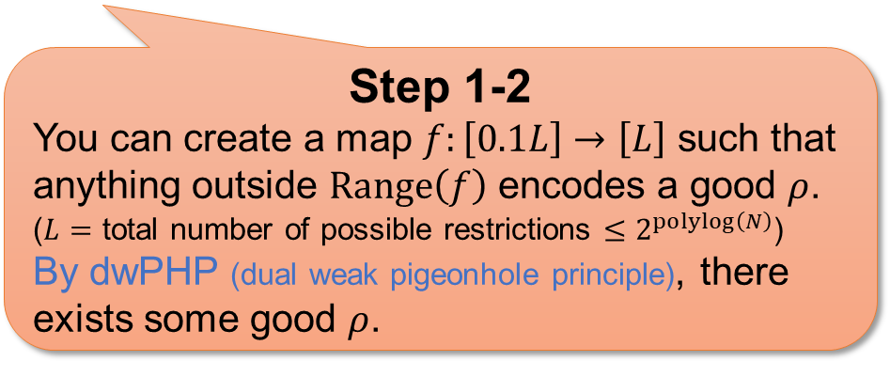
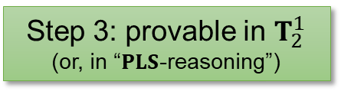
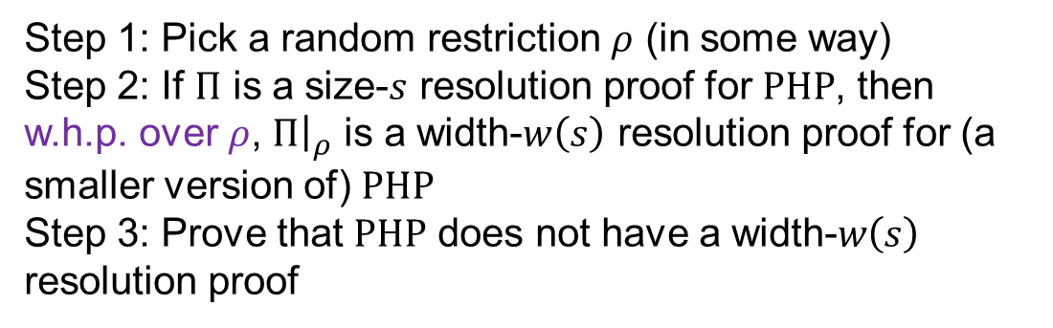
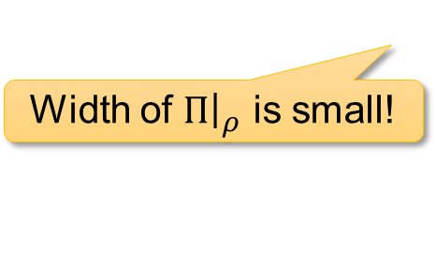



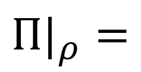
Random restriction…
… in $rwPHP\left(PLS\right)$?
Haken’s proof
(as simplified by Beame-Pitassi’96)
Step 1: Pick a random restriction $ρ$ (in some way)
Step 2: If $Π$ is a size-$s$ resolution proof for $PHP$, then w.h.p. over $ρ$, $Π{\left.​\right|}_{ρ}$ is a width-$w\left(s\right)$ resolution proof for (a smaller version of) $PHP$
Step 3: Prove that $PHP$ does not have a width-$w\left(s\right)$ resolution proof
$$Π=$$
$$⊥$$
$$⊥$$
Final contradiction
Intermediate derivations
Final contradiction
Axioms of $PHP$
Intermediate derivations
Axioms of $PHP$
With high probability over $ρ$
(Provable from dwPHP)
Step 1-2
You can create a map $f:\left[0.1L\right]→\left[L\right]$ such that anything outside $Range\left(f\right)$ encodes a good $ρ$.
($L=$ total number of possible restrictions $≤2^{polylog\left(N\right)}$)
By dwPHP (dual weak pigeonhole principle), there exists some good $ρ$.
$$Π|_{ρ}=$$
Step 3: provable in $T_{2}^{1}$
(or, in “$PLS$-reasoning”)
Width of $Π{\left.​\right|}_{ρ}$ is small!
25 / 26

Slide 14
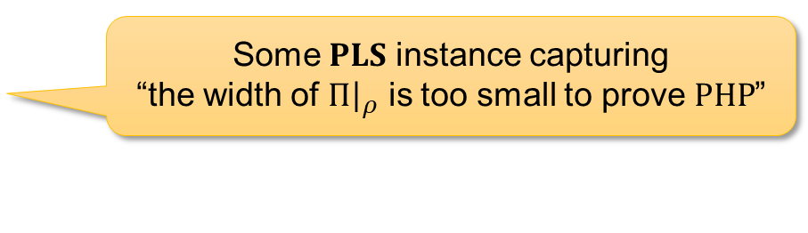




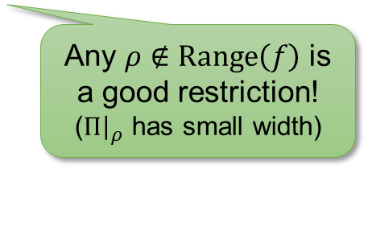
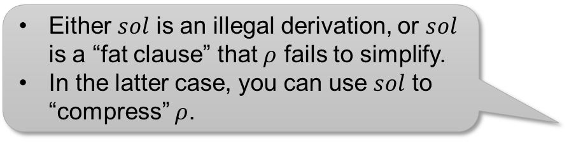


Random restriction…
… in $rwPHP\left(PLS\right)$!
Restrictions:
$$f$$
Any $ρ∉Range\left(f\right)$ is a good restriction!
($Π{\left.​\right|}_{ρ}$ has small width)
Either $sol$ is an illegal derivation, or $sol$ is a “fat clause” that $ρ$ fails to simplify.
In the latter case, you can use $sol$ to “compress” $ρ$.
$g\left(sol\right)=$compression of $ρ$
$$I_{ρ}$$
Some $PLS$ instance capturing
“the width of $Π{\left.​\right|}_{ρ}$ is too small to prove $PHP$”
Solution $sol$ of $I_{ρ}$
Restrictions:
$$ρ$$
$f\left(g\left(sol\right)\right)≠ρ⇒ρ$ is a good restriction $⇒sol$ is an illegal derivation.
26 / 26
Notes:
Good restriction = successfully shrinks the proof into low width

