Slide 1
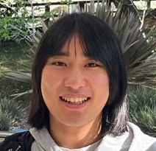
$NP$-Hardness of Approximating Meta-Complexity: A Cryptographic Approach
Yizhi Huang
(Tsinghua)
Rahul Ilango
(MIT)
Hanlin Ren
(Oxford)
STOC 2023

Slide 2
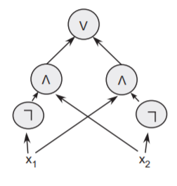
Minimum Circuit Size Problem
$MCSP$ (Minimum Circuit Size Problem)
Given a truth table, compute its circuit complexity
What’s the complexity of $MCSP$?
Input length $=N=2^{n}$
( ,$s$)
$$s$$
$$⟹$$
$$x$$ | $$0^{n}$$ | $$…$$ | $$1^{n}$$
$$f$$ | $$f\left(0^{n}\right)$$ | $$…$$ | $$f\left(1^{n}\right)$$
Is there a size-$s$ circuit computing $f$?
The (meta-)complexity of circuit complexity!
$MCSP$ is in $NP$.
$MCSP$ is intractable under standard crypto assumptions.
Is $MCSP$ $NP$-complete?
Big open question in meta-complexity…
[RR97, KC00]

Slide 3
Time-Bounded Kolmogorov Complexity and Its Meta-Complexity
$K\left(x\right)$: length of the shortest program computing $x$ (on empty input)
$K\left(01010101…01\right)=O\left(\log{n}\right)$
Counting argument: $K\left(random string\right)≈n$
Not computable ☹
$K^{t}\left(x\right)$: length of the shortest program computing $x$ in $t$ steps
$t=poly\left(\left|x\right|\right)⟹$ computing $K^{t}$ is in $NP$!
print("01" * (n/2))
Henceforth $K^{poly}$
$K^{poly}$ is also intractable under standard crypto assumptions.
Also big open question:
Is $K^{poly}$ $NP$-complete?

Slide 4
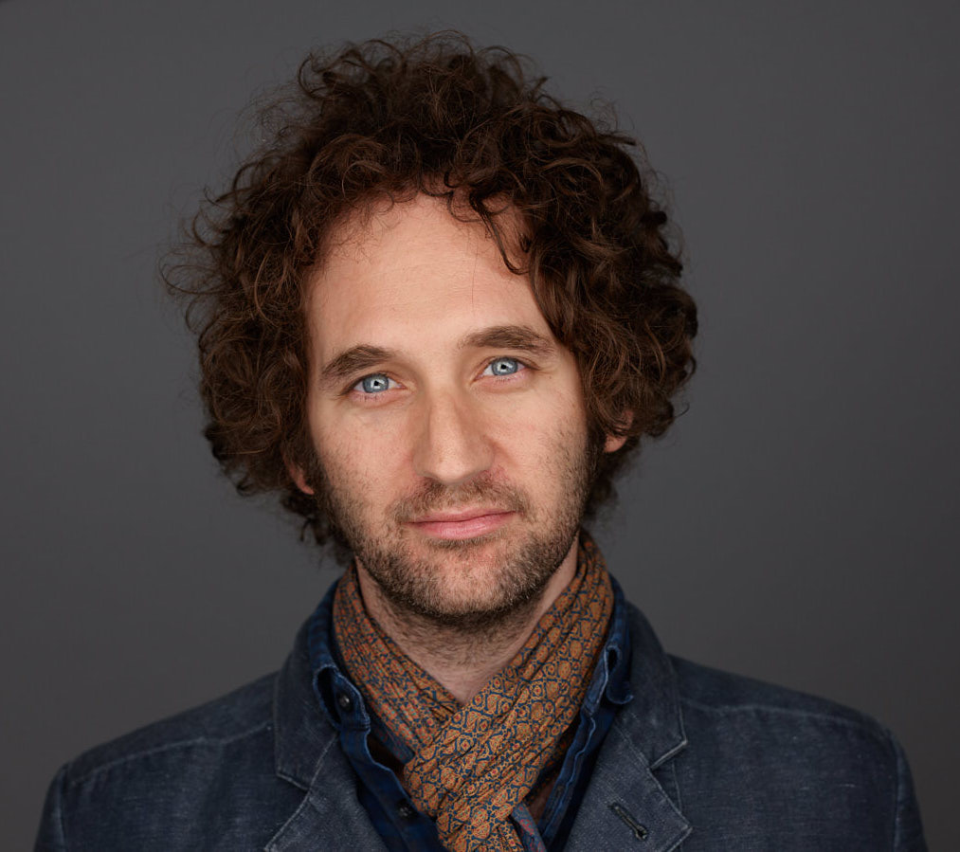
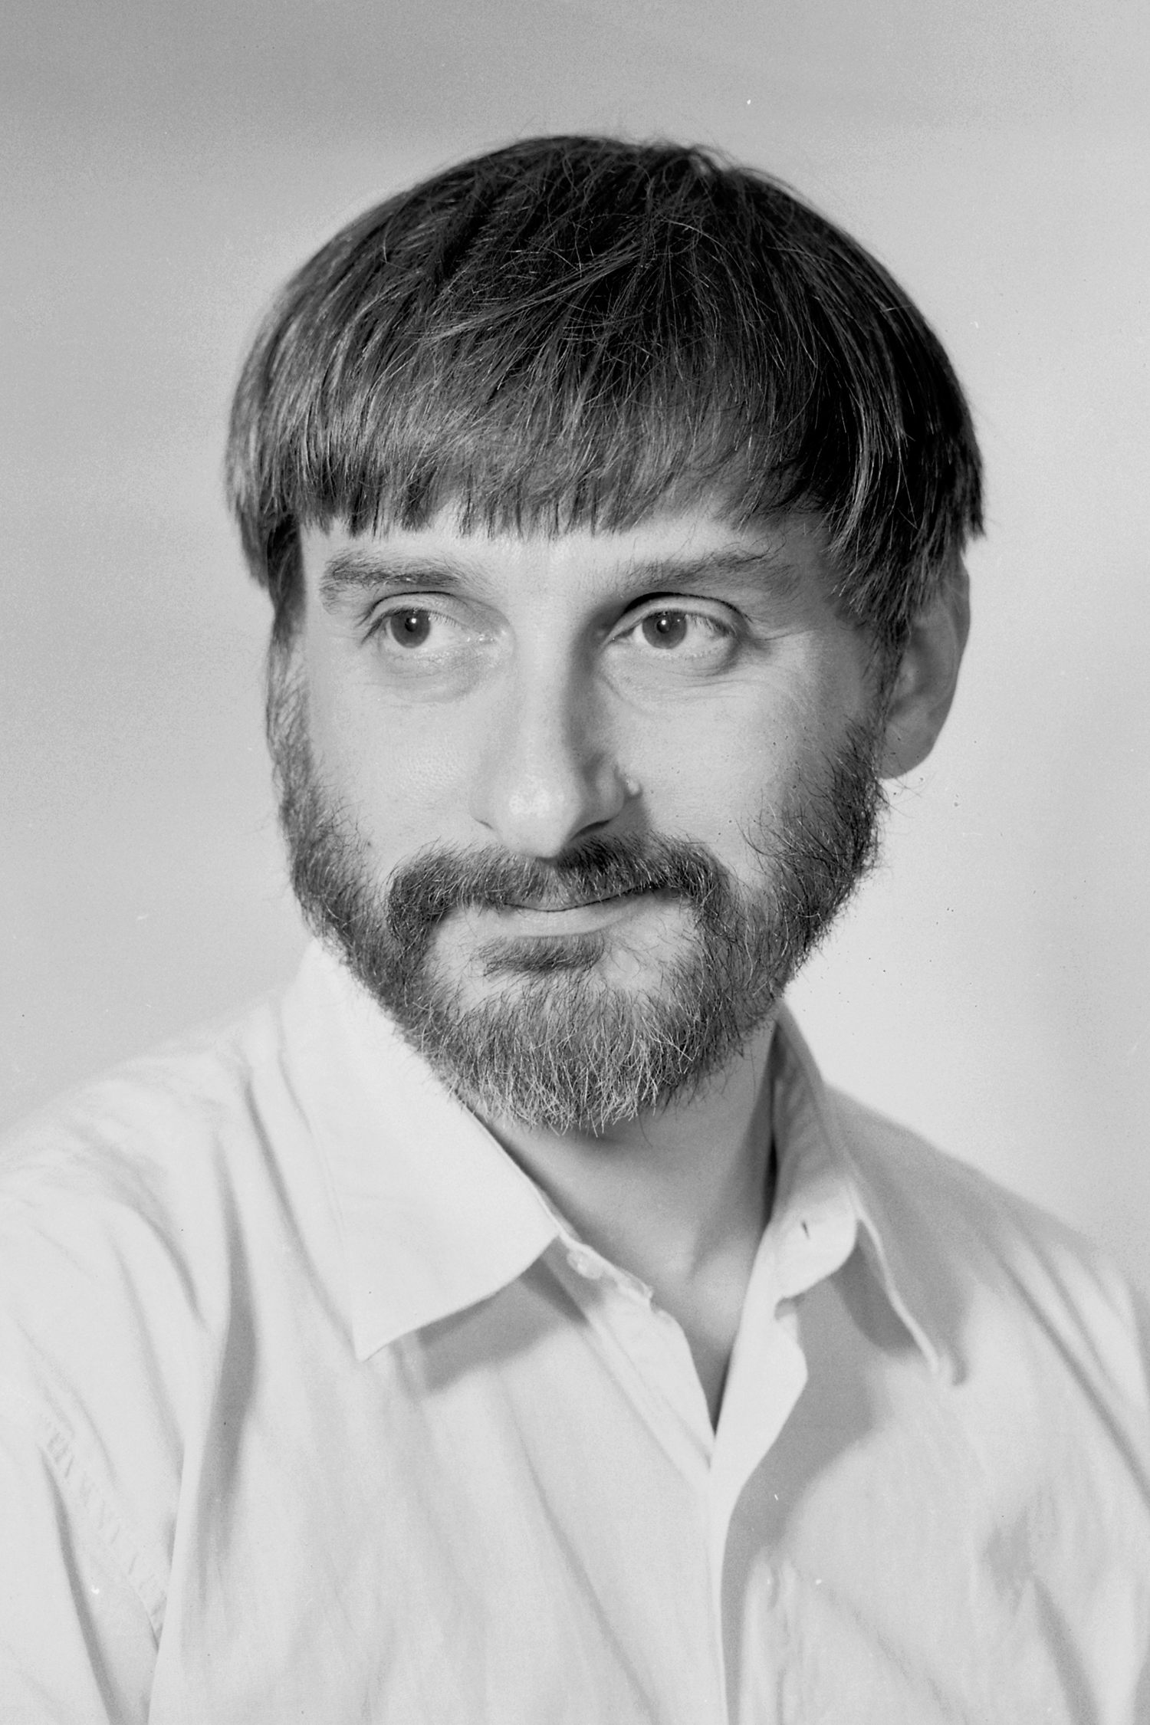
$NP$-completeness of meta-complexity: Why care about it?
[Murray-Williams 17]: If $MCSP$ is $NP$-hard under deterministic mapping reductions, then $EXP≠ZPP$.
Is it $NP$-hard? This problem will be “hard to solve”, but Yes or No?
Curiosity
[LP20, LP22]: Average-case complexity of $K^{poly}$ characterizes one-way functions!
Excluding Heuristica
$MCSP$ and $K^{poly}$ are natural problems whose complexity remain unidentified
… for 50 yrs!
OWF from $NP⊈BPP$?
[Hirahara18]: If $GapMCSP$ or $GapK^{poly}$ is $NP$-hard, then the worst- and average-case complexity of $NP$ are equivalent.

Slide 5
Minimum Oracle Circuit Size Problem
“Approaching $MCSP$ from above” [Ilango’20]
Given a function $f$ and an oracle $O$, compute the $O$-oracle circuit complexity of $f$
A “testing ground” for $MCSP$?
$NP$-hardness of $MOCSP$ under deterministic reductions $⟹EXP≠ZPP$ (still!)
[Ilango’20]: $NP$-hard under randomized reductions!
$$($$
$$,$$
$$)$$
$$x$$ | $$0^{n}$$ | $$…$$ | $$1^{n}$$
$$f$$ | $$f\left(0^{n}\right)$$ | $$…$$ | $$f\left(1^{n}\right)$$
$$x$$ | $$0^{m}$$ | $$…$$ | $$1^{m}$$
$$O$$ | $$O\left(0^{m}\right)$$ | $$…$$ | $$O\left(1^{m}\right)$$

Slide 6
Conditional $K^{poly}$ Complexity
$K^{t}\left(x | y\right)$: length of the shortest program computing $x$ in $t$ steps, given $y$
Using similar ideas as [Ilango’20], [Liu-Pass’22] showed that computing $K^{t}\left(x | y\right)$is $NP$-complete
$MOCSP$ is like “conditional circuit complexity”
Sublinear regime: $t≪\left|y\right|$
$NP$-complete [Liu-Pass’22, Hirahara’22]
The lower bound argument in the reduction: “In the NO case, the program has to miss some information in $y$ (because it cannot read all of $y$)”
Superlinear regime: $t≫\left|y\right|$
$NP$-completeness is unknown ☹
[Hirahara’22]: $NP$-completeness (in a certain param setting) still implies worst-case to average-case reduction for $NP$
Improving [Hirahara’18]…

Slide 7
Hardness of Approximation…?
Yes instances: complexity $≤s$
No instances: complexity $≥2^{\left(1−ε\right)n}s$
$$\left(s vs 2^{\left(1−ε\right)n}s\right)$$
Theorem (Hirahara’18): If ${Gap}_{ε}MCSP$ is $NP$-hard for every $ε>0$, then Heuristica doesn’t exist.
$$(s vs 0.1n⋅s)$$
Reduction from set cover, so $Θ\left(\log{N}\right)$-approx is optimal
Theorem (Ilango’20): $GapMOCSP$ is $NP$-hard!
$$\left(s vs N^{1/O\left(\log{\log{N}}\right)}⋅s\right)$$
Theorem (Hirahara’22): ${GapK}^{t}\left(x | y\right)$ is $NP$-hard!
Reduction from “Min Monotone Sat Assignment”, only $N^{1/O\left(\log{\log{N}}\right)}$ inapprox is known
When $N=2^{n}$, this is $\left(s vs 2^{n/O\left(\log{n}\right)}⋅s\right)$

Slide 8
Our Results
Strong (yet plausible) crypto
Result 1
Under plausible crypto assumptions, $GapK^{t}\left(x | y\right)$ is $NP$-hard to approximate in the super-linear regime
$NP$-hardness of “the problem in [Hirahara’22], whose $NP$-hardness excludes Heuristica”
$$\left(N^{0.0001} vs N−100\right)$$
[Hirahara’22]’s program of excluding Heuristica is viable!
Average-case hardness of $NP$
Yes case: computable in size $s$,
No case: average-case hard against size $2^{0.9999n}⋅s$
Result 2
Unconditionally, $GapMOCSP$ is $NP$-hard with near-optimal hardness-of-approximation
$$(s vs 2^{0.9999n}⋅s)$$
Previous results
$$\left(s vs 0.1n⋅s\right)$$
$$\left(s vs 2^{n/O\left(\log{n}\right)}⋅s\right)$$

Slide 9
Key Notion: Witness Encryption
Encryption using a (public) SAT instance!
$Encrypt\left(φ,msg;rand\right)→ct$
$Decrypt\left(φ,α,ct\right)→msg$
Intuition: encrypt a message, but anyone knowing the solution to a Sudoku puzzle / a proof of Riemann Hypothesis can decrypt!
Assumption: $Encrypt$ is randomized, but $Decrypt$ is not
Correctness: If $φ\left(α\right)=1$, then $Decrypt$ outputs the correct $msg$.
Security: If $φ$ is unsatisfiable, then
$$Encrypt\left(φ,0\right)≈_{c}Encrypt\left(φ,1\right).$$

Slide 10
$NP$-Hardness of $GapK^{t}\left(x | y\right)$ (super-linear regime)
Given: $φ$, want to reduce it to $\left(x,y\right)$
$x=$random message (of length $n^{100}$)
$y=\left(φ,Encrypt\left(φ,x;rand\right)\right)=\left(φ,ct\right)$
If $φ$ is satisfiable:
Let $α∈{\left\{0,1\right\}}^{n}$ be a witness, then $Decrypt\left(φ,α,ct\right)=x$.
$$K^{poly}\left(x | y\right)≤\left|α\right|+O\left(1\right).$$
If $φ$ is unsatisfiable:
Suppose $K^{poly}\left(x | y\right)<n−100$, then we can enumerate possible $x$ and break the security of witness encryption!

Slide 11
Oracle Witness Encryption
Everybody has access to a (specifically designed) oracle $𝒪$
${Encrypt}^{𝒪}\left(φ,msg;rand\right)→ct$
${Decrypt}^{𝒪}\left(φ,α,ct\right)→msg$
Caveat: the oracle fan-in is only $O\left(λ\right)$ where $λ \sim \log\left|φ\right|$ is the security parameter
Oracle length$=2^{O\left(λ\right)}=poly\left(\left|φ\right|\right)$
Need exponential security ($2^{Ω\left(λ\right)}$)!
Correctness: If $φ\left(α\right)=1$, then ${Decrypt}^{𝒪}$ outputs the correct $msg$.
Security: If $φ$ is unsatisfiable, then
$${Encrypt}^{𝒪}\left(φ,0\right)≈_{c}{Encrypt}^{𝒪}\left(φ,1\right).$$
Hope 1: if we design $𝒪$ carefully, then oracle witness encryption unconditionally exists…?
Hope 2: if oracle witness encryption exists, then $MOCSP$ is $NP$-hard (with large approx gap)?

Slide 12
Oracle WE $⟹NP$-hardness of $MOCSP$
Given an instance $φ$, want to produce an instance $\left(f,O\right)$
$φ$ is satisfiable if and only if $f$ has small $O$-oracle circuit complexity!
$$O$$
$$f$$
(random truth table)
$O_{1}$: the oracle under which witness encryption exists
If $φ$ is satisfiable, then by correctness of witness encryption, $f$ has a small $O$-oracle circuit:
$O_{2}\left(i,j\right)=j$-th bit of ${Encrypt}^{O_{1}}\left(φ,f_{i}\right)$
$f\left(i\right):$
Hardcode a witness $α$ of $φ$
Query $O_{2}$ to obtain $ct={Encrypt}^{O_{1}}\left(φ,f\left(i\right)\right)$
Run ${Decrypt}^{O_{1}}(φ,α,ct)$ and obtain $f\left(i\right)$
If $φ$ is unsatisfiable, then any small $O$-oracle circuit for $f$ violates the security of witness encryption! (Need a non-trivial proof)

Slide 13
How to construct oracle WE?
Look at the paper that introduced WE…
GGSW uses multilinear maps, so our oracle implements the generic multilinear map model.
Security proof highly non-trivial.
Yizhi Huang

Slide 14
Thank you!
Questions are welcome! ☺

