Slide 1
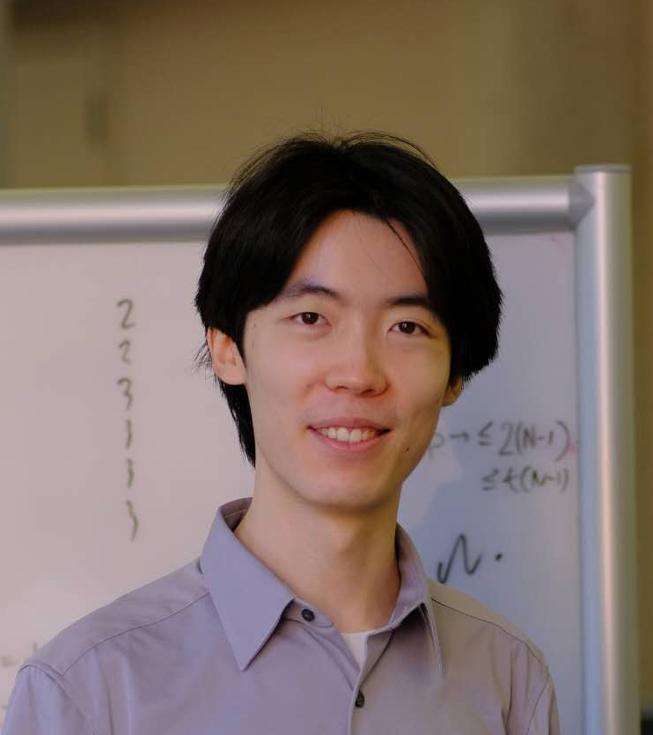
Metamathematics of Resolution Lower Bounds: A TFNP Perspective
Jiawei Li
(UT Austin)
Yuhao Li
(Columbia)
Hanlin Ren
(Oxford)
Aug 14, 2024
@SJTU

Slide 2
This Talk
Metamathematics of complexity lower bounds
Case study: Proof complexity $→$ resolution
No known lower bounds ☹
Frege
${AC}^{0}\left[2\right]$-Frege
Have lower bounds ☺
Res($⊕$)
Cutting Planes
${AC}^{0}$-Frege
How difficult is it to prove lower bounds?
Resolution
Hope this sheds lights on the lower bounds we want to prove ☺
We have already proved quite strong lower bounds!
What new techniques should we develop?
https://simons.berkeley.edu/programs/lower-bounds-computational-complexity
1 / 22

Slide 3
The $P$ vs $NP$ Problem
$SAT$ is $NP$-complete!
Poly-time languages
$$P=^{?}NP$$
Stephen A. Cook. The Complexity of Theorem-Proving Procedures.
2 / 22
https://www.cs.toronto.edu/~sacook/Steve_by_Yvonne.04.JPG

Slide 4
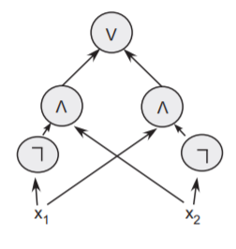
Circuit Complexity
Let’s try to prove circuit lower bounds!
State-of-the-art:
$NP$ requires $3.1n−o\left(n\right)$ size
(Li-Yang’22)
Open: $E^{NP}⊆SIZE\left[10n\right]$???
$NP$ vs $P/_{poly}$
Exponential time with an $NP$ oracle
Goal: Show that $SAT$ requires super-poly circuit size!
(This implies $P≠NP$)
A circuit computing $x_{1}⊕x_{2}$ from [Arora-Barak]
https://freepik.com/free-vector/hand-drawn-professor-cartoon-illustration_63345069.htm
3 / 22

Slide 5
Proof Complexity
$$p→\left(q→p\right)$$
$$\left(p→\left(q→r\right)\right)→\left(\left(p→q\right)→\left(p→r\right)\right)$$
$$\left(¬p→¬q\right)→\left(q→p\right)$$
Let’s try to find “hard theorems” for proof systems!
Łukasiewicz’s $P_{2}$
Goal: Show that every proof system has “hard theorems”!
(This implies $NP≠coNP$)
State-of-the-art:
Trivial $Ω\left(n^{2}\right)$ bound…
(Lemma 4.4.12, Krajíček’95)
Theorem: $¬¬¬¬¬¬¬¬True$.
Proof: $$¬¬¬¬¬¬¬¬True \\ ⟸¬¬¬¬¬¬True \\ ⟸¬¬¬¬True \\ ⟸¬¬True \\ ⟸True.$$
$NP$ vs $coNP$
4 / 22

Slide 6
How difficult is $P$ vs $NP$?
Being open for decades $≠$ difficult! Justification for this difficulty?
Algebrization
(Aaronson-Wigderson)
Natural Proofs
(Razborov-Rudich)
More…
Relativization
(Baker-Gill-Solovay)
$P$ vs $NP$
Locality
(Chen-Hirahara-Oliveira-Pich-Rajgopal-Santhanam)
Bounded Relativization
(Hirahara-Lu-Ren)
重音テト MMD by Chemikarma (https://www.deviantart.com/chippedlilac/art/chemikarma-sd-teto-download-teto-birthday-gift-444304333)
https://pixabay.com/vectors/barrier-construction-road-street-1292873/
5 / 22

Slide 7
Or, maybe like this?
$P$ vs $NP$
!!!!
Motivating question:
What’s sitting here??
Algebrization
(Aaronson-Wigderson)
Natural Proofs
(Razborov-Rudich)
Relativization
(Baker-Gill-Solovay)
https://babaiswiki.fandom.com/wiki/WHAT
6 / 22

Slide 8
A systematic approach?
Total functions in $NP$
Previous barriers can be circumvented by easy tricks! (see e.g., “hardness magnification”)
This talk: use $TFNP$ to shed lights on the difficulty of proving lower bounds!
Roughly speaking, the metamathematical “complexity” of proving lower bounds can be captured by the computational complexity of some $TFNP$ problems.
Unprovability in bounded arithmetic
Our “$TFNP$ approach” is heavily inspired, and in some sense “isomorphic”, to the bounded arithmetic approach.
Razborov (95a, 95b): Can weak fragments of Peano arithmetic (“bounded arithmetic”) prove $NP⊈P/_{poly}$?
Example theorem (Pich-Santhanam 21): $PV$ (“poly-time reasoning”) cannot prove [a strengthened version of “$NP≠coNP$”].
7 / 22

Slide 9
$$TFNP$$
Total functions in $NP$
Search Problems
Input: some string $x$
Output: some solution $y$
Such that: $V\left(x,y\right)=1$
$\left|y\right|=poly\left(\left|x\right|\right)$ and $V$ can be decided in poly-time
Any input has at least one solution!
$$∀x ∃y, s.t. V\left(x,y\right)=1.$$
Example 1: FACTORING
Input: a big integer $n$
Output: primes $p_{1},p_{2},…,p_{l}$
Such that: $p_{1}×p_{2}×…×p_{l}=n$.
Example 2: Pigeonhole Principle
Input: a circuit $C:{\left\{0,1\right\}}^{n}→{\left\{0,1\right\}}^{n−1}$
Output: $x,y∈{\left\{0,1\right\}}^{n}$
Such that: $x≠y$ but $C\left(x\right)=C\left(y\right)$
8 / 22

Slide 10
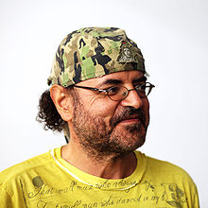
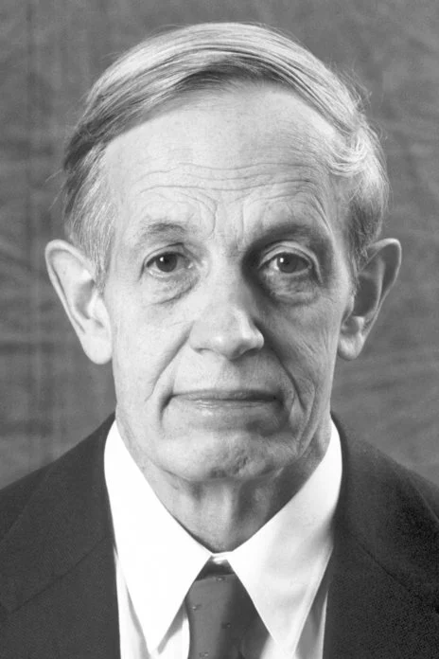
TFNP is Metamathematics!
NASH
Input: a “game” $G$
Output: a “Nash equilibrium” of $G$
BIG THEOREM (Daskalakis-Goldberg-Papadimitriou, Chen-Deng):
$NASH$ is $PPAD$-complete.
Turns out I had to use topological arguments, and there’s no easy way around!
Theorem: Every game has a Nash equilibrium.
Let’s define $PPAD=$(informally) the class of $TFNP$ problems provable using topological arguments!
To prove this theorem, I need to use some topological arguments…
Polynomial Parity Arguments on Directed graphs
Nash’s proof actually implies:
$$NASH∈PPAD.$$
Christos Papadimitriou
John Nash
https://www.nobelprize.org/prizes/economic-sciences/1994/nash/facts/
https://en.wikipedia.org/wiki/Christos_Papadimitriou
9 / 22

Slide 11
Metamathematics via TFNP…?
Metamathematics
$$TFNP$$
Nash’s theorem can be proved using topological arguments.
$$NASH∈PPAD.$$
Nash’s theorem cannot be proved without topological arguments* (!!!)
$NASH$ is $PPAD$-complete.
What’s the $TFNP$ problem attached with circuit lower bounds for $NP$??? (See next slide)
Circuit lower bounds for $NP$ is hard to prove.
$ℒ_{clb}$ is hard for some(??) $TFNP$ subclass.
One day, $NP⊈P/_{poly}$ will be proved** using this or that techniques.
Such a proof should also translate into a subclass of $TFNP$ containing $ℒ_{clb}$!
*: I’m being very imprecise about what’s “topological argument” here…
**: Let’s assume $NP$ is indeed hard, for now!
10 / 22

Slide 12
What is this $𝓛_{clb}$…?
It is, of course, the total search problem corresponding to
$∀$ poly-size circuit $C:{\left\{0,1\right\}}^{n}→{\left\{0,1\right\}}^{n}$, $∃ φ∈{\left\{0,1\right\}}^{n}$ and a satisfying assignment $a$ of $φ$, s.t. $C\left(φ\right)$ fails to find any satisfying assignment of $φ$.
Wait! This problem is in poly-time (under plausible assumptions [Pich-Santhanam’23])!
$∀$ poly-size circuit $C:{\left\{0,1\right\}}^{n}→\left\{0,1\right\}$, $∃ φ∈{\left\{0,1\right\}}^{n}$, s.t. $C\left(φ\right)$ fails to solve $SAT$ on $φ$.
$$SAT⊈P/_{poly}.$$
??
$$ℒ_{clb}$$
Input: poly-size circuit $C$ attempting to solve search-$SAT$
Output: $φ∈{\left\{0,1\right\}}^{n}$ and $a$
Valid solutions: $φ\left(a\right)=1$ and $φ\left(C\left(φ\right)\right)=0$
This problem is total iff $SAT⊈P/_{poly}$ is true*!
If it’s very hard, then $SAT⊈P/_{poly}$ would be difficult to prove.
*: Actually, this should be “$NP$ is hard for $P/_{poly}$ almost everywhere”. This talk ignores almost-everywhere vs infinitely-often issues.
11 / 22
Notes:
You are “refuting” that M solves search-SAT

Slide 13
How hard is $𝓛_{clb}$?
Input: a poly-size circuit $C$ attempting to solve $search$-$SAT$
Output: $φ$ and $a$
Valid solutions: $φ\left(a\right)=1$ but $C\left(φ\right)$ fails to output a satisfying assignment of $φ$
Takeaway:
Need a taxonomy of $TFZPP$ (total functions in $ZPP$) to talk about “hardness” of derandomisation!
Ongoing work. But much more needs to be done ☺
Observations [PS23]
OWF $⟹$ This refuter problem is in $TFZPP$.
OWF + derandomisation $⟹$ This refuter problem is in $FP$.
(Unconditional) anti-checkers $⟹$ This refuter problem is in $FP/_{poly}$.
12 / 22

Slide 14
Refuter Problems
Proof Lower Bound
For every length-$ℓ$ proof $π$ in system $𝒫$, claiming to prove $φ$, there exists an invalid derivation step in $π$.
Proof Lower Bound
There is no length-$ℓ$ proof in system $𝒫$ for some theorem $φ$.
Circuit Lower Bound
For every size-$s$ circuit $C$, there exists some input $x$ such that $C\left(x\right)≠L\left(x\right)$.
Circuit Lower Bound
Every size-$s$ circuit fails to compute $L$.
Refuter Problem
Input: size-$s$ circuit $C$
Output: string $x$ such that $C\left(x\right)≠L\left(x\right)$.
Refuter Problem
Input*: length-$ℓ$ proof $π$ for $φ$
Output: index $i$ such that the $i$-th step is invalid.
Many refuter problems are in $TFZPP$. Future direction: develop a theory of $TFZPP$ to talk about these problems!
Fits into the “traditional” $TFNP$ world ☺
*: Assume that $π$ is an exponentially-long proof presented succinctly. Alternatively, we need to work in the “decision tree” setting.
13 / 22

Slide 15
Our results: refuter problems for resolution lower bounds
(in proof complexity)
Why resolution?
It’s the most studied proof system.
Profound connections to SAT solving, query complexity etc…
It’s weak!
A vast literature of lower bounds: [H85, U87, CS88, CP90, BP96, S97, BW01, a lot more…]
Making it a nice “first step” for investigating metamathematics of proof complexity…?
What is resolution?
Resolution rule
Weakening rule
$$\frac{C∨ℓ D∨\overline{ℓ}}{C∨D}$$
$$\frac{C}{C∨D}$$
There are perhaps more papers published about proof complexity of resolution than about all remaining proof complexity topics combined.
——Jan Krajíček, Proof Complexity (2019)
$ℓ$: literal ($x_{i}$ or ${\overline{x}}_{i}$)
$C, D$: clauses (ORs of literals)
$$x_{1}$$
$${\overline{x}}_{1}∨{\overline{x}}_{2}$$
$${\overline{x}}_{2}$$
$$x_{2}$$
$$⊥$$
A resolution refutation of $x_{1},x_{2},{\overline{x}}_{1}∨{\overline{x}}_{2}$
14 / 22
Notes:
Most studied system, weak, lb known

Slide 16
Our results: refuter problems for resolution lower bounds
Classical theorem (Haken’85):
The pigeonhole principle ($PHP$) requires $>{1.01}^{n}$ resolution proof length.
Problem $Refuter(Haken)$
Input: a (succinctly represented) length-${1.01}^{n}$ resolution proof $π$ for $PHP$
Output: an index $i$ such that the $i$-th step is invalid
Our result: $Refuter(Haken)$ is $rwPHP\left(PLS\right)$-complete!
This step violates resolution rules…
A new $TFNP$ class in this paper!
$$⊥$$
Axioms of $PHP$
Intermediate derivations
Final contradiction
it corresponds to “$T_{2}^{1}+dwPHP\left(PV\right)$” in bounded arithmetic, so not really a new one ☺
(# of steps $<{1.01}^{n}$)
15 / 22

Slide 17
The metamathematics of resolution lower bounds
Resolution requires exp-size to prove:
Pigeonhole principle (Haken’85, Beame-Pitassi’96)
Tseitin principle (Urquhart’87, Schöning’97)
Random $k$-CNFs (Chvátal-Szemerédi’88, Beame-Pitassi’96)
$XOR$-lifted formulas (Dantchev-Riis’03)
$rwPHP\left(PLS\right)=TFNP$ problems provable from “random restriction”, just like $PPAD=TFNP$ problems provable from topological arguments!*
Result I: All these refuter problems are in $rwPHP\left(PLS\right)$, because these lower bounds can be proved by “random restriction”.
Interpretation:
if we want to prove ANY resolution lower bound at all, we have to at least do something that resembles random restriction…
Result II: The refuter problem for ANY** resolution lower bound is $rwPHP\left(PLS\right)$-hard.
*Both statements are highly informal.
**Technically, need the lower bound to be subexponential.
16 / 22

Slide 18
Glance of the hardness result
rwPHP = “retraction weak pigeonhole principle”
Theorem* (Informal)
The refuter problem corresponding to ANY (subexp) resolution lower bound is $rwPHP\left(PLS\right)$-hard.
$rwPHP$ (as a search problem)
Input: functions $f:\left[N\right]→\left[2N\right]$ and $g:\left[2N\right]→\left[N\right]$
Output: $x∈\left[2N\right]$ such that $g\left(f\left(x\right)\right)≠x$
Given: instance $\left(f,g\right)$ of $rwPHP$
Goal: reduce it to an instance $π$ of the refuter problem (which is a resolution proof)
Such that: given an invalid derivation in $π$, can find $x∈\left[2N\right]$ such that $g\left(f\left(x\right)\right)≠x$.
$$f$$
$$g$$
$$x$$
$rwPHP$ (as a mathematical fact)
For any two functions $f:\left[N\right]→\left[2N\right]$ and $g:\left[2N\right]→\left[N\right]$, there exists $x∈\left[2N\right]$ such that $g\left(f\left(x\right)\right)≠x$.
Idea: If $rwPHP$ were not true (for $\left(f,g\right)$), then every theorem would have short resolution proofs (constructed from $\left(f,g\right)$)!
*In fact, the proof of it is stolen(?) from Atserias--Müller’19 (Automating resolution is $NP$-hard) and its exposition in [dRGNPRS21].
17 / 22

Slide 19
The world if $rwPHP$ is false:
Assume: there is a bijection between $\left[N\right]$ and $\left[2N\right]$
There are $f:\left[N\right]→\left[2N\right]$ and $g:\left[2N\right]→\left[N\right]$ such that for every $x∈\left[2N\right]$, $f\left(g\left(x\right)\right)=x$.
“Pigs can fly”
Goal: prove every theorem that’s true, within resolution size $poly\left(N,n\right)$
Equivalent to solving every problem within decision DAG size $poly\left(N,n\right)$
Pig airlines
https://clipart-library.com/clipart/725472.htm
https://clipart-library.com/clipart/plane-cliparts-7.htm
18 / 22

Slide 20
The naïve decision tree…
…has size ${\sim 2}^{n}$
$$x_{1}$$
$$0$$
$$1$$
$$x_{2}$$
$$x_{2}$$
$$0$$
$$1$$
$$0$$
$$1$$
$$x_{3}$$
$$x_{3}$$
$$x_{3}$$
$$x_{3}$$
$$0$$
$$1$$
$$0$$
$$1$$
$$0$$
$$1$$
$$0$$
$$1$$
$$x_{4}$$
$$x_{4}$$
$$x_{4}$$
$$x_{4}$$
$$x_{4}$$
$$x_{4}$$
$$x_{4}$$
$$x_{4}$$
$$x_{n}$$
$$x_{n}$$
$$x_{n}$$
$$x_{n}$$
$$……$$
$$x_{n}$$
$$x_{n}$$
$$x_{n}$$
$$x_{n}$$
19 / 22

Slide 21
Compressing layers
RECALL
There are $f:\left[N\right]→\left[2N\right]$ and $g:\left[2N\right]→\left[N\right]$ such that for every $x∈\left[2N\right]$, $f\left(g\left(x\right)\right)=x$.
Layer $i$
($N$ nodes)
$$0$$
$$1$$
$$0$$
$$1$$
Layer $i+0.5$
($2N$ nodes)
$$¬rwPHP$$
Layer $i+1$
($N$ nodes)
Choose the nodes $f\left(1\right),f\left(2\right),…,f\left(N\right)$.
For each $i∈\left[2N\right]$, the $i$-th node appears in the $g\left(i\right)$-th position.
Task: select $N$ nodes from these $2N$ nodes in layer $i+0.5$ so that all the $2N$ nodes are selected (!!!)
20 / 22
https://pixabay.com/vectors/bulb-electricity-halo-idea-light-1293332/

Slide 22
The compressed decision DAG
Given $f:\left[N\right]→\left[2N\right]$ and $g:\left[2N\right]→\left[N\right]$ violating $rwPHP$ (meaning that for every $x∈\left[2N\right]$, $f\left(g\left(x\right)\right)=x$), we can create this decision DAG of size $poly\left(N,n\right)$ solving ALL and ANY problem.
$$…$$
$$width=N$$
$$width=2N$$
Hence a moderate-size resolution proof of ANY theorem!
$$width=N$$
$$width=2N$$
In reality, such $\left(f,g\right)$ cannot exist. But given any step that the resolution proof is wrong, we can spot out some $x$ such that $f\left(g\left(x\right)\right)≠x$.
$$…$$
$$width=N$$
$$width=2N$$
$$width=N$$
This is a reduction from $rwPHP$ to the refuter problem!
21 / 22

Slide 23
Summary
Refuter Problem (Circuit Complexity)
Input: size-$s$ circuit $C$
Output: string $x$ such that $C\left(x\right)≠L\left(x\right)$.
Takeaway message: The metamathematical difficulty of proving lower bounds can be captured by the computational complexity of these refuter problems!
Main Results
$rwPHP\left(PLS\right)$ captures the “minimum reasoning power” for proving resolution lower bounds!
Refuter Problem
(Proof Complexity)
Input*: length-$ℓ$ proof $π$ for $φ$
Output: index $i$ such that the $i$-th step is invalid.
Proof (Implicitly in AM19, dRGNPRS21):
If $rwPHP\left(PLS\right)$ were not total, then every theorem would admit a short resolution proof.
This step violates resolution rules!
Thank you!
$$⊥$$
Questions are welcome!
22 / 22

Slide 24
$$rwPHP\left(PLS\right)$$
Dictionary
$$rwPHP$$ | Retraction Weak PigeonHole Principle There’s no bijection between $\left[N\right]$ and $\left[2N\right]$.
$$PLS$$ | Polynomial Local Search Every non-empty subset of $\left[N\right]$ has a least element.
$$rwPHP\left(PLS\right)$$
Same as $rwPHP$, but every $g\left(x\right)$ needs a $PLS$-oracle to compute ☺
$$rwPHP$$
Input: functions $f:\left[N\right]→\left[2N\right]$ and $g:\left[2N\right]→\left[N\right]$
Output: $x∈\left[2N\right]$ such that $g\left(f\left(x\right)\right)≠x$
$$PLS$$
Input: function $S:\left[N\right]→\left[N\right]$
Output: $x∈\left[N\right]$ satisfying one of the following:
$x=1$ and $S\left(x\right)=x$
$S\left(x\right)<x$
$S\left(x\right)>x$ and $S\left(S\left(x\right)\right)=S\left(x\right)$
$$f$$
$$g$$
$$x$$
$$x$$
23 / 26

Slide 25
$$rwPHP\left(PLS\right)$$
$$rwPHP\left(PLS\right)$$
Inputs
a function $f:\left[N\right]→\left[2N\right]$
$2N$ $PLS$ instances $I_{1}…I_{2N}$
$g_{y,j}∈\left[N\right]$ for every $y∈\left[2N\right]$ and valid answer $j$ for $I_{y}$
Outputs
A number $y∈\left[2N\right]$
A valid answer $j$ for $I_{y}$
Such that $f\left(g_{y,j}\right)≠y$
$$f$$
$$I_{1}$$
$$I_{2}$$
$$I_{n}$$
$$g$$
$$…$$
24 / 26

Slide 26
Random restriction…
… in $T_{2}^{1}+dwPHP\left(PV\right)$?
Haken’s proof (as simplified by Beame-Pitassi’96)
Step 1: Pick a random restriction $ρ$ (in some way)
Step 2: If $Π$ is a size-$s$ resolution proof for $PHP$, then w.h.p. over $ρ$, $Π{\left.​\right|}_{ρ}$ is a width-$w\left(s\right)$ resolution proof for (a smaller version of) $PHP$
Step 3: Prove that $PHP$ does not have a width-$w\left(s\right)$ resolution proof
$$Π=$$
$$⊥$$
$$⊥$$
Final contradiction
Intermediate derivations
Final contradiction
Axioms of $PHP$
Intermediate derivations
Axioms of $PHP$
With high probability over $ρ$
(Provable from dwPHP)
Step 1-2
You can create a map $f:\left[0.1L\right]→\left[L\right]$ such that anything outside $Range\left(f\right)$ encodes a good $ρ$.
($L=$ total number of possible restrictions $≤2^{polylog\left(N\right)}$)
By dwPHP (dual weak pigeonhole principle), there exists some good $ρ$.
$$Π|_{ρ}=$$
Step 3: provable in $T_{2}^{1}$
(or, in “$PLS$-reasoning”)
Width of $Π{\left.​\right|}_{ρ}$ is small!
25 / 26

Slide 27
Random restriction…
… in $rwPHP\left(PLS\right)$?!
Restrictions:
$$f$$
Any $ρ∉Range\left(f\right)$ is a good restriction!
($Π{\left.​\right|}_{ρ}$ has small width)
Either $sol$ is an illegal derivation, or $sol$ is a “fat clause” that $ρ$ fails to simplify.
In the latter case, you can use $sol$ to “compress” $ρ$.
$g\left(sol\right)=$compression of $ρ$
$$I_{ρ}$$
Some $PLS$ instance capturing “the width of $Π{\left.​\right|}_{ρ}$ is too small to prove $PHP$”
Solution $sol$ of $I_{ρ}$
Restrictions:
$$ρ$$
$f\left(g\left(sol\right)\right)≠ρ⇒ρ$ is a good restriction $⇒sol$ is an illegal derivation.
26 / 26
Notes:
Good restriction = successfully shrinks the proof into low width

