Slide 1
Strong Average-Case Circuit Lower Bounds from Non-trivial Derandomization
Lijie Chen
MIT
Hanlin Ren
IIIS, Tsinghua
This presentation is based on Lijie’s slides ☺

Slide 2
(Oversimplified) History and Motivation
The Circuit Lower Bounds Program for $P≠NP$
Since 1980s, people wanted to prove $P≠NP$ via proving lower bounds for stronger and stronger circuit classes
Frontier: Stronger average-case circuit lower bounds for $ACC^{0}$
The Pseudorandom Generator (PRG) Program for $P=BPP$
Since 1980s, people wanted to prove $P=BPP$ via constructing PRGs for stronger and stronger circuit classes
Frontier: Strong Average-case lower bounds for $AC^{0}[2]$

Slide 3
(Oversimplified) History and Motivation
The Circuit Lower Bounds Program for $P≠NP$
Since 1980s, people wanted to prove $P≠NP$ via proving lower bounds for stronger and stronger circuit classes
Frontier: Stronger average-case circuit lower bounds for $ACC^{0}$
The Pseudorandom Generator (PRG) Program for $P=BPP$
Since 1980s, people wanted to prove $P=BPP$ via constructing PRGs for stronger and stronger circuit classes
Frontier: Strong Average-case lower bounds for $AC^{0}[2]$

Slide 4
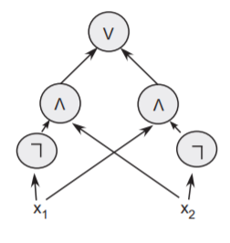
The circuit lower bounds program for $P≠NP$
The Circuit Lower Bounds Program for $P≠NP$
A plausible (at least in 1980s) way: prove circuit lower bounds!
Okay, today we know circuit lower bounds are hard…
People wanted to prove $P≠NP$…
The ultimate goal:
prove $NP$ does not have polynomial-size (general) circuits!
(hence proving $P≠NP$)
A circuit computing $x_{1}⊕x_{2}$ from [Arora-Barak]

Slide 5
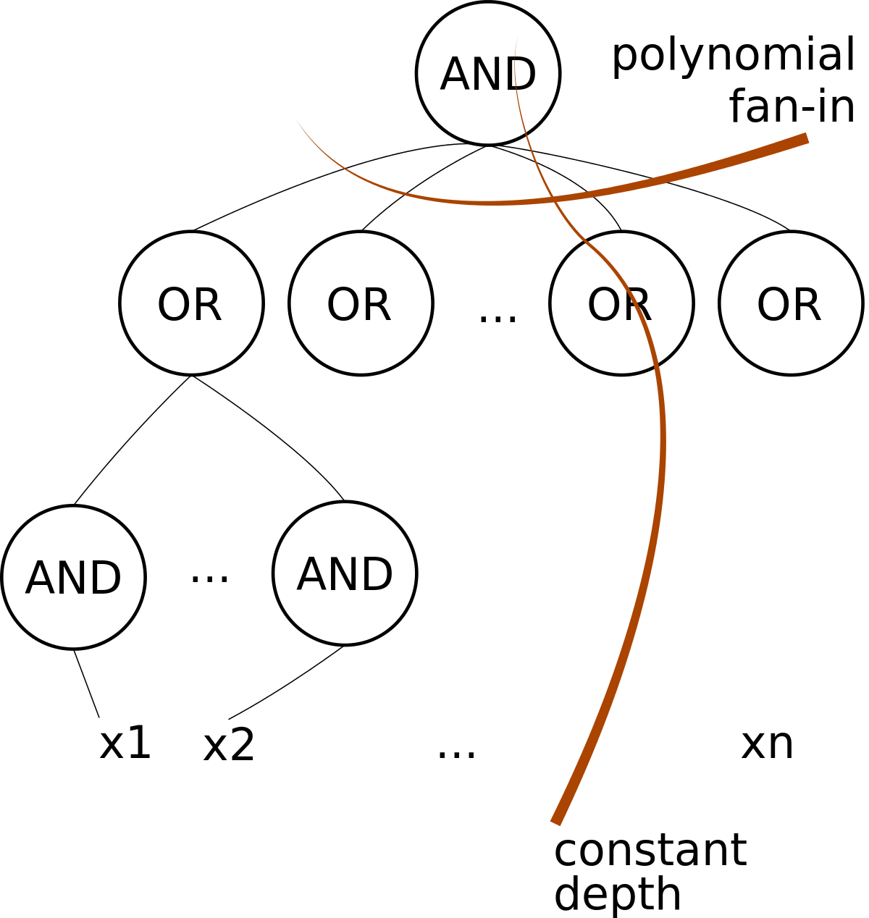
$AC^{0}$ circuits
The Circuit Lower Bounds Program for $P≠NP$
1980s: Understand restricted circuits first!
By studying less and less restricted circuits, hopefully we can reach general circuits ($P/poly$) some day…
$AC^{0}$: constant depth, AND/OR/NOT circuits
(unbounded fan-in)
[Ajt83,FSS84,Yao85,Has89]
Strong lower bounds for $AC^{0}$
The hard function: Parity!
Parity: outputs 1 $⇔$ number of 1 in the input is odd
Picture from https://en.wikipedia.org/wiki/AC0

Slide 6
$AC^{0}\left[p\right]$ circuits
The Circuit Lower Bounds Program for $P≠NP$
Okay, now we know $PARITY$ is hard for $AC^{0}$. What about $AC^{0}$ with $PARITY$?
$AC^{0}\left[p\right]$: $AC^{0}$ extended with $MOD\left[p\right]$ gates
$MOD[p]$: outputs 1 $⇔$ $p$ does not divide the
number of ones in the input
[Raz87,Smo87]
Strong lower bounds for $AC^{0}\left[p\right]$
for a prime $p$.
The hard function for $AC^{0}\left[2\right]$ is
$$MOD\left[3\right]!$$

Slide 7
$AC^{0}\left[6\right]$ circuits
The Circuit Lower Bounds Program for $P≠NP$
What about $AC^{0}\left[6\right]$, i.e. $AC^{0}\left[2\right]$ with $MOD\left[3\right]$?
$NEXP$: nondeterministic exponential time ($NTIME\left[2^{poly\left(n\right)}\right]$)
Shouldn’t be much harder than $AC^{0}\left[2\right]$…???
Actually, it’s been open for 20+ years whether
$NEXP$ (a gigantic class) contains a function
that cannot be computed by
poly-size $AC^{0}\left[6\right]$ circuits of depth $3$!
Progress basically stops here, until…

Slide 8
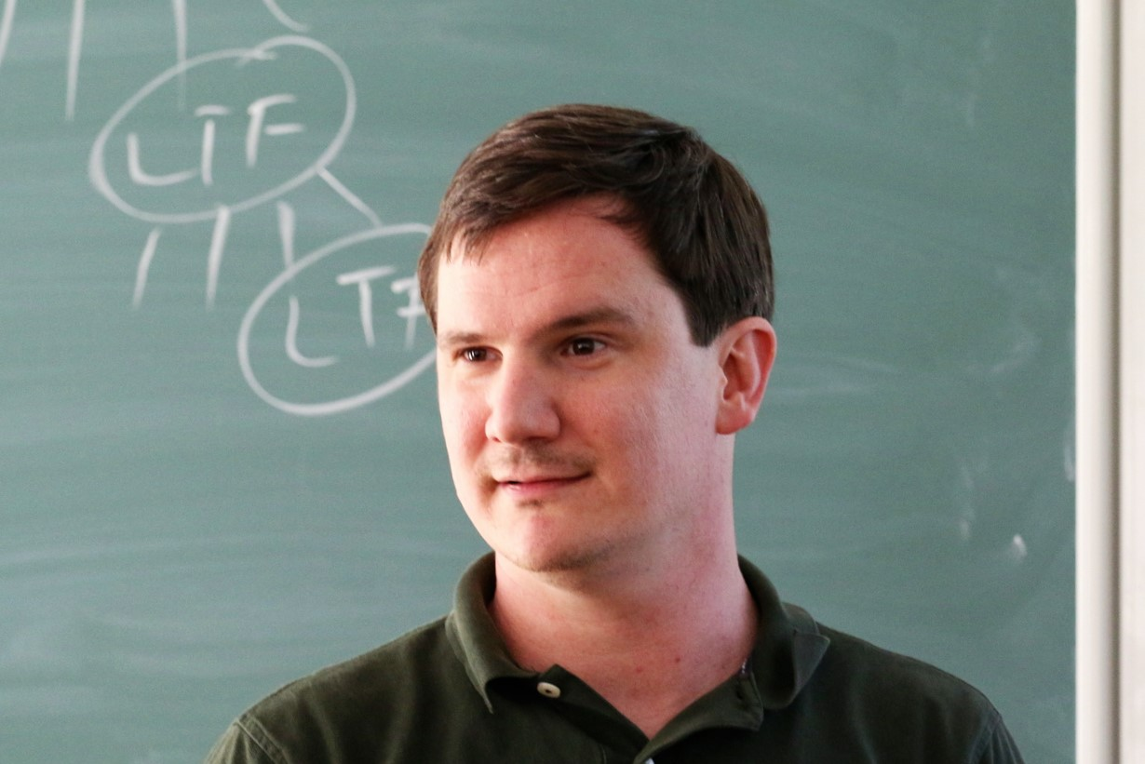
The Circuit Lower Bounds Program for $P≠NP$
$$NEXP⊈ACC^{0}$$
In 2011, R. Williams proved that $NEXP$
does not have polynomial-size $ACC^{0}$ circuits.
$$ACC^{0}$$
$AC^{0}\left[m\right]$: (constant-depth, AND/OR/NOT/$MOD\left[m\right]$).
$ACC^{0}$: the union of $AC^{0}\left[m\right]$ for all constants $m$.
Proven by the so-called
Algorithmic Method!

Slide 9
The Circuit Lower Bounds Program for $P≠NP$
Algorithmic Method
Proving Lower Bounds is a notoriously hard task
Why? You must argue that EVERY ALGORITHM (including those we never thought of) does not work
Meanwhile, it seems we are much better at finding algorithms: Max Matching, Max-Flow, Linear Programming, FFT, Fast matrix multiplication, Dynamic Programming…
R. Williams’ algorithmic approach to lower bounds:
Lower Bounds for $C$ from Non-trivial Algorithms for $C$!

Slide 10
Algorithmic Questions
The Circuit Lower Bounds Program for $P≠NP$
$C$-SAT
$C$-CAPP
$$C$$
$$C$$
Estimate quantity
$\underset{x∼U_{n}}{Pr}{[C\left(x\right)=1]}$,
with additive error $ε$
$2^{n}$ time is trivial for both case!
(simply try every possible assignments)
$∃x$ s.t. $C\left(x\right)=1?$
$∃x$ ?
$$x∼U_{n}$$

Slide 11
Algorithmic Questions
The Circuit Lower Bounds Program for $P≠NP$
$C$-SAT
$C$-CAPP
Define non-trivial algorithms:
1. Non-trivial SAT: $2^{n}/n^{ω\left(1\right)}$ time algorithm for SAT.
2. Non-trivial CAPP: $2^{n}/n^{ω\left(1\right)}$ time for CAPP with error $ε=1/poly(n)$.
$$C$$
$$C$$
Estimate quantity
$\underset{x∼U_{n}}{Pr}{[C\left(x\right)=1]}$,
with additive error $ε$
$∃$ x s.t. $C\left(x\right)=1?$
$∃x$ ?
$$x∼U_{n}$$

Slide 12
$$NEXP⊈ACC^{0}$$
The Circuit Lower Bounds Program for $P≠NP$
For “typical” $C$!
$2^{n}/n^{ω\left(1\right)}$ time SAT or CAPP for poly-size $C$ circuits
$⟹NEXP⊈$ poly-size $C$.
There is an algorithm solving $ACC^{0}$-SAT in $2^{n−n^{δ}}$ time where the size of the input circuit is $2^{n^{δ}}$.

Slide 13
The Circuit Lower Bounds Program for $P≠NP$
Subsequent Developments
In 2012, R. Williams: $NEXP∩coNEXP$ with 1 bit of advice
does not have polynomial-size $ACC^{0}$ circuits.
(make $NEXP$ a bit smaller)
In 2017, R. Chen, Oliveira and Santhanam: $NEXP$ cannot be
$\frac{1}{2}+1/polylog(n)$ approximated by polynomial-size $ACC^{0}$ circuits.
(extend to average-case)
Can this be improved to
$\frac{1}{2}+1/poly\left(n\right)$?
In 2018, Murray and R. Williams: $NQP$ (non-deterministic $2^{polylog(n)}$ time) does not have polynomial-size $ACC^{0}$ circuits.
(make $NEXP$ much smaller)
In 2019, L. Chen: $NQP$ (non-deterministic $2^{polylog(n)}$ time) cannot be
$\frac{1}{2}+1/polylog(n)$ approximated by polynomial-size $ACC^{0}$ circuits. The same for $NQP∩coNQP$ with 1 bit of advice
(improving all the above)

Slide 14
(Oversimplified) History and Motivation
The Circuit Lower Bounds Program for $NP≠P$
Since 1980s, people wanted to prove $NP≠P$ via proving lower bounds for stronger and stronger circuit classes
Frontier: Stronger average-case circuit lower bounds for $ACC^{0}$
The Pseudorandom Generator (PRG) Program for $P=BPP$
Since 1980s, people wanted to prove $P=BPP$ via constructing PRGs for stronger and stronger circuit classes
Frontier: Strong Average-case lower bounds for $AC^{0}[2]$

Slide 15
(Oversimplified) History
The Pseudorandom Generator Program for $P=BPP$
Idea: feed pseudorandom bits to the random tape of a $BPP$ algorithm
PRG
$s$ bits
$n$ bits
typically $s≪n$
$$BPTIME\left[t\right]⊆DTIME\left[\left(t+t_{PRG}\right)⋅2^{s}\right]$$
“Derandomization”
For this, we need to have a PRG for $P/poly$
(poly-size, unrestricted circuits)
with $O(log n)$-seed length
People wanted to show $P=BPP$ by building PRGs for
stronger and stronger circuits classes
But currently we don’t even have PRGs for $AC^{0}\left[2\right]$ with $n^{o(1)}$ seed length!

Slide 16
The Pseudorandom Generator Program for $P=BPP$
Pseudorandom Generators fooling $AC^{0}\left[2\right]$?
But currently we don’t even have PRGs for $AC^{0}\left[2\right]$ with $n^{o(1)}$ seed length!
Reason: don’t have strong enough average-case lower bounds against $AC^{0}\left[2\right]$!
Use Nisan-Wigderson’94?
Need a hard function that cannot be $\left(\frac{1}{2}+ε\right)$-approximated by $AC^{0}\left[2\right]$, at least for $ε<\frac{1}{n}$!

Slide 17
Pseudorandom Generators fooling $AC^{0}\left[2\right]$?
The Pseudorandom Generator Program for $P=BPP$
State-of-the-art average-case lower bound:
MAJORITY cannot be $\left(\frac{1}{2}+\frac{1}{n^{0.49}}\right)$-approximated by $AC^{0}\left[2\right]$ circuits.
This lower bound does not yield PRGs!
In fact, (before this work) it’s consistent that
$E^{NP}$ (a gigantic class that includes $NE$)
can be $\left(\frac{1}{2}+\frac{1}{\sqrt{n}}\right)$-approximated by (poly-size) $AC^{0}\left[2\right]$ circuits!
Need a hard function that cannot be $\left(\frac{1}{2}+ε\right)$-approximated by $AC^{0}\left[2\right]$, at least for $ε<\frac{1}{n}$!

Slide 18
This Work: Strong Average-Case Lower Bounds for $ACC^{0}$
Improved the $\frac{1}{2}+1/polylog(n)$ result in [Chen’19]
$NQP$ (non-deterministic $2^{polylog(n)}$ time) cannot be $\left(\frac{1}{2}+1/poly(n)\right)$-approximated by polynomial-size $ACC^{0}$ circuits.
The same holds for $(NQP∩coNQP)/1$
Surpassed the
$\frac{1}{2}+1/\sqrt{n}$-barrier for $AC^{0}[2]$

Slide 19
Strong Average-Case Lower Bounds From Non-trivial Derandomization
With $ε=1/poly\left(n\right)$
Theorem
$2^{n}/n^{ω(1)}$-time CAPP for $poly(n)$-size $𝒞$ circuits $⇒$ $NEXP$ cannot be $\left(\frac{1}{2}+1/poly(n)\right)$-approximated by $𝒞$.
(Similar results for $NQP$ and $NP$ (fixed-polynomial))

Slide 20
Today’s Plan
0. (Oversimplified) History and Motivation
1. Briefly review [Chen’19]’s approach and
why it only proved $\left(\frac{1}{2}+\frac{1}{polylog\left(n\right)}\right)$-inapproximability.
2. Approximate-Sum corrector, with a simple application:
$NQP⊈MAJ∘ACC^{0}$
I’ll focus on this interesting ingredient, rather than other parts of the proof!

Slide 21
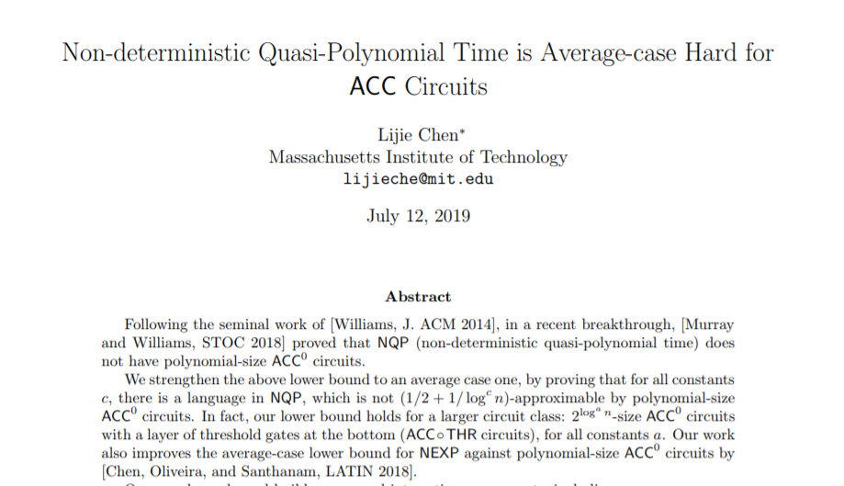
Today’s Plan
0. (Oversimplified) History and Motivation
1. Briefly review [Chen’19]’s approach and
why it only proved $\left(\frac{1}{2}+\frac{1}{polylog\left(n\right)}\right)$-inapproximability.
2. Approximate-Sum corrector, with a simple application:
$NQP⊈MAJ∘ACC^{0}$

Slide 22
$$MA$$
$NP$ with a randomized verifier!
Given an input $x$, guess some witness $y$, toss some coins $r$.
$x∈L⇒∃y\underset{r}{Pr}\left[A\left(x,y,r\right)=1\right]≥2/3$;
$x∉L⇒∀y\underset{r}{Pr}\left[A\left(x,y,r\right)=1\right]≤1/3$.

Slide 23
Circuit Lower Bounds for $MA$
[Santhanam’09] $∀k$, $MA/1$ doesn’t have $n^{k}$-size (general) circuits
Open: does $NP$ have $10n$-size circuit?
[MW’18] “almost almost-everywhere” circuit lower bounds for $MA$
[Chen’19] average-case a.a.e. lower bounds for $MA$
Takeaway of this slide:
You can indeed prove circuit lower bounds for $MA$!

Slide 24
NPRG and Derandomization of $MA$
$MA$ algorithm
$x∈L⇒∃y\underset{r}{Pr}\left[A\left(x,y,r\right)=1\right]≥2/3$;
$x∉L⇒∀y\underset{r}{Pr}\left[A\left(x,y,r\right)=1\right]≤1/3$.
$s$ bits
PRG
$n$ bits
NPRG
+ $MA$ lower bounds
= $NP$ lower bounds!
$$w$$
Accept?
Use NPRG to derandomize $MA$!
Nondeterministic PRG
Given input $1^{n}$, guess a witness $w$ first.
either rejects $w$ and STOP,
or takes a seed and computes a PRG
On input $x$:
Guess the proof $y$ and witness $w$
Use NPRG to estimate
$$\underset{r}{Pr}\left[A\left(x,y,r\right)=1\right]$$

Slide 25
NPRG and Derandomization of $MA$
$MA$ algorithm
$x∈L⇒∃y\underset{r}{Pr}\left[A\left(x,y,r\right)=1\right]≥2/3$;
$x∉L⇒∀y\underset{r}{Pr}\left[A\left(x,y,r\right)=1\right]≤1/3$.
$s$ bits
PRG
$n$ bits
Conditional NPRG
+ $MA$ lower bounds
= $NP$ lower bounds!
$$w$$
Accept?
Use NPRG to derandomize $MA$!
Nondeterministic PRG
Given input $1^{n}$, guess a witness $w$ first.
either rejects $w$ and STOP,
or takes a seed and computes a PRG
On input $x$:
Guess the proof $y$ and witness $w$
Use NPRG to estimate
$$\underset{r}{Pr}\left[A\left(x,y,r\right)=1\right]$$

Slide 26
Conditional construction of NPRG:
A very brief outline
NPRG assuming $NQP⊆ACC^{0}$?
Take $L∈NTIME\left[2^{n}\right]∖NTIME\left[2^{n}/n^{10}\right]$
Nondeterministic time hierarchy theorem
Build an NPRG $G_{L}$
Then: $P/poly$ collapses to $ACC^{0}$
Faster CAPP for $ACC^{0}$
$⟹$ Faster (nondet.) CAPP for $P/poly$!
($G_{L}$ doesn’t fool $P/poly$) $+$
(faster CAPP for $P/poly$) $⇒$
$L∈NTIME\left[2^{n}/n^{10}\right]$!
Contradiction!
It’s actually far from trivial, and involves PCP of proximity!
[Chen-Williams ’19]

Slide 27
Conditional construction of NPRG:
A very brief outline
Now we only assume $NQP$ can be $0.99$-approximated by $ACC^{0}$?
Again,
Time hierarchy + faster CAPP $⟹$ NPRG!
[Chen’19] still managed to show:
$NC^{1}$ collapses to $ACC^{0}$!
$NC^{1}$: poly-size formula
Technical bit: the NPRG only fools $NC^{1}$, need to adapt the whole proof, see [Chen’19]
Faster CAPP for $ACC^{0}$
$⟹$ faster (nondet.) CAPP for $NC^{1}$!

Slide 28
$NQP$ is average-case hard for $ACC^{0}$:
[Chen’19]’s approach in three steps
Step I: (Conditional Simulation)
Assuming $NQP$ can be $0.99$-approximated by $ACC^{0}$, $NC^{1}$ can be simulated by $ACC^{0}$.
Step II: (An NPRG for $NC^{1}$)
Step I together with a non-trivial derandomization algorithm for $ACC^{0}$ implies a $polylog(n)$-seed length NPRG for $NC^{1}$.
Step III: (The Lower Bound)
Prove that there is a language $L$ in $MAQP$ such that $L$ cannot be $0.99$-approximated by $NC^{1}$. Apply NPRG of Step II to derandomize $L$ in $NQP$. Contradiction!

Slide 29
The bottleneck of [Chen’19]
Step I: (Conditional Simulation)
Assuming $NQP$ can be $\left(\frac{1}{2}+\frac{1}{n^{k}}\right)$-approx. by $ACC^{0}$, $NC^{1}$ can be simulated by ???.
Step I: (Conditional Simulation)
Assuming $NQP$ can be $0.99$-approximated by $ACC^{0}$, $NC^{1}$ can be simulated by $ACC^{0}$.
Assuming we want to prove $NQP$ cannot be $\left(\frac{1}{2}+\frac{1}{n^{k}}\right)$-approximated by $ACC^{0}$…
Which parts of the proof fail?
Step II: (An NPRG for $NC^{1}$)
Step I together with a non-trivial derandomization algorithm for $ACC^{0}$ implies a $polylog(n)$-seed length NPRG for $NC^{1}$.
Step III: (The Lower Bound)
Prove that there is a language $L$ in $MAQP$ such that $L$ cannot be $\left(\frac{1}{2}+\frac{1}{n^{k}}\right)$-approximated by $NC^{1}$. Apply NPRG of Step II to derandomize $L$ in $NQP$. Contradiction!
Step III: (The Lower Bound)
Prove that there is a language $L$ in $MAQP$ such that $L$ cannot be $0.99$-approximated by $NC^{1}$. Apply NPRG of Step II to derandomize $L$ in $NQP$. Contradiction!
If Step I is correct, this step is not affected!

Slide 30
Circuit complexity of error correction:
Intuition
Suppose we have an $A{CC}^{0}$ subroutine that’s correct w.p. $0.99$.
We can run it $O\left(\log{n}\right)$ times and take majority.
$$MAJORITY$$
$ACC^{0}$ ckt
$ACC^{0}$ ckt
$ACC^{0}$ ckt
$ACC^{0}$ ckt
The resulting circuit is still $A{CC}^{0}$.

Slide 31
Circuit complexity of error correction:
Intuition
Suppose we have an $A{CC}^{0}$ subroutine that’s correct w.p. $\frac{1}{2}+\frac{1}{polylog\left(n\right)}$.
We can run it $polylog\left(n\right)$ times and take majority.
$$MAJORITY$$
$ACC^{0}$ ckt
$ACC^{0}$ ckt
$ACC^{0}$ ckt
$ACC^{0}$ ckt
$ACC^{0}$ ckt
$ACC^{0}$ ckt
MAJORITY of $polylog\left(n\right)$ bits is in $AC^{0}$! [Viola’09]
The resulting circuit is still $A{CC}^{0}$.

Slide 32
Circuit complexity of error correction:
Intuition
Suppose we have an $A{CC}^{0}$ subroutine that’s correct w.p. $\frac{1}{2}+\frac{1}{n^{k}}$.
We can run it $poly\left(n\right)$ times and take majority…???
$$MAJORITY$$
$ACC^{0}$ ckt
$ACC^{0}$ ckt
$ACC^{0}$ ckt
$ACC^{0}$ ckt
$ACC^{0}$ ckt
$ACC^{0}$ ckt
$ACC^{0}$ ckt
$ACC^{0}$ ckt
$ACC^{0}$ ckt
$ACC^{0}$ ckt
$ACC^{0}$ ckt
$ACC^{0}$ ckt
$ACC^{0}$ ckt
It’s conjectured (but not proved) that $MAJ∉{ACC}^{0}$!
The resulting circuit is in $ACC^{0}$ $MAJ∘A{CC}^{0}$…

Slide 33
The Key Issue on Improving [Chen’19]
Assuming $NQP$ can be $\left(\frac{1}{2}+n^{−k}\right)$-approximated by $ACC^{0}$,
$NC^{1}$ can be simulated by $MAJ∘ACC^{0}$…
We don’t know how to do circuit-analysis on $MAJ∘ACC^{0}$ ☹

Slide 34
Today’s Plan
0. (Oversimplified) History and Motivation
1. Briefly review [Chen’19]’s approach and
why it only proved $\left(\frac{1}{2}+\frac{1}{polylog\left(n\right)}\right)$-inapproximability.
2. Approximate-Sum corrector, with a simple application:
$NQP⊈MAJ∘ACC^{0}$

Slide 35
Approximate Sum
Let $𝒞$ be a circuit class. A Linear Sum of $𝒞$ is
$$L=α_{1}⋅C_{1}+α_{2}⋅C_{2}+…+α_{m}⋅C_{m}$$
where $α_{i}∈ℝ$, and $C_{i}∈𝒞$.
$$\left[−ε,ε\right]$$
if $F\left(x\right)=0$
$$\left[1−ε,1+ε\right]$$
if$F\left(x\right)=1$
$$SUM$$
We say $F:{\left\{0,1\right\}}^{n}→\{0,1\}$ is an approximate (linear) sum of $𝒞$, if there is an $L$ as above such that
$\left|L\left(x\right)−F\left(x\right)\right|≤ε$ for all $x$.
$$α_{1}$$
$$α_{2}$$
$$⋯$$
$$α_{m}$$
$$C_{1}$$
$$C_{2}$$
$$⋯$$
$$C_{m}$$

Slide 36
Why is Approx-Sum better than MAJ?
With this observation
[Chen-Williams]: nontrivial derand. algorithm for $ACC^{0}$ $⇒$ nontrivial derand. of approximate sum of $ACC^{0}$ $⇒$ $NQP$ cannot be computed by an approximate sum of $ACC^{0}$
Approx-Sum preserves algorithms!
e.g. CAPP algorithm for each $C_{i}$
$⟹$ CAPP algorithm for Approx-Sum of $C_{i}$
$$SUM$$
$$α_{1}$$
$$α_{2}$$
$$⋯$$
$$α_{m}$$
The obvious algorithm:
$$𝔼\left[F\left(x\right)\right]≈\sum_{i}{α_{i}𝔼\left[C_{i}\left(x\right)\right]}$$
$$C_{1}$$
$$C_{2}$$
$$C_{m}$$
$$⋯$$
A technical detail: Need to verify a given circuit is indeed an Approx-Sum

Slide 37
Error correction via Approximate Sum
For some $NC^{1}$-hard languages $A,B$,
If $A$ cannot be worst-case computed by approx-sum of $ACC^{0}$,
then $B$ cannot be $\left(\frac{1}{2}+\frac{1}{n^{100}}\right)$-approximated by $ACC^{0}$
Easier than $MAJ∘ACC^{0}$!
Collapse Theorem
If $B$ can be $\left(\frac{1}{2}+\frac{1}{n^{100}}\right)$-approximated by $ACC^{0}$,
then $NC^{1}$ collapses to approx-sum of $ACC^{0}$!
Let’s see an application first…

Slide 38
A quick proof of $NQP⊈MAJ∘ACC^{0}$
1. If $NQP$ can be $\left(\frac{1}{2}+n^{−k}\right)$-approximated by $ACC^{0}$, then $NC^{1}$ collapses to approximate sum of $ACC^{0}$.
$$MAJ$$
$$ACC^{0}$$
$$ACC^{0}$$
$$ACC^{0}$$
2. [Chen-Williams, 2019]: $NQP$ is not in approximate sum of $ACC^{0}$. Hence, $NQP$ is not in $NC^{1}$ (also not in $MAJ∘ACC^{0}$).
Discriminator Lemma
[Hajnal et al.’93], a variant
Let $s=$ fanin of , then
there is some subcircuit that can $\left(\frac{1}{2}+\frac{1}{O\left(s\right)}\right)$-approximate the whole function.
$$MAJ$$
3. If $NQP$ cannot be $\left(\frac{1}{2}+n^{−k}\right)$-approximated by $ACC^{0}$, then $NQP$ cannot be computed by $MAJ∘ACC^{0}$.
(The Discriminator Lemma)
$$ACC^{0}$$

Slide 39
Error Correction via Approximate Sum
For some $NC^{1}$-hard languages $A,B$,
If $A$ cannot be worst-case computed by approx-sum of $ACC^{0}$,
then $B$ cannot be $\left(\frac{1}{2}+\frac{1}{n^{100}}\right)$-approximated by $ACC^{0}$
Idea: Single-Query Randomized Reduction
“randomized encodings” for cryptographers!
Question $Q$
Randomized question $Q$
$$dlog_{g}\left(a×g^{r}\right)$$
$$dlog_{g}\left(a\right)$$

Slide 40
Single-Query Randomized Reduction: Setting
Ishai-Kushilevitz. Perfect constant-round secure computation via perfect randomizing polynomials.
Applebaum-Ishai-Kushilevitz. Cryptography in $NC^{0}$.
$ACC^{0}$(actually a projection [Goldwasser et al. STOC’07])
$$⊕L$$
Only need to know $⊕L$ is a class between $NC^{1}$ and $P$
Both $A,B$ are $⊕L$-complete
Want to compute $A$
Can compute $B$

Slide 41
Single-Query Randomized Reduction: Protocol
Input $x$ of $A$
Send $y$
Compute:
Uniformly random input $y$ of $B$
Random bit $b$
Reply $B\left(y\right)$
$$A\left(x\right)=B\left(y\right)⊕b$$

Slide 42
What if the server has bugs…
I only return correct answers for $\frac{1}{2}+ε$ fraction of inputs!
Input $x$ of $A$
Send $y$
Compute:
Uniformly random input $y$ of $B$
Random bit $b$
Reply $B\left(y\right)$
$$A\left(x\right)=B\left(y\right)⊕b$$
Anyway, my answer is correct w.p. at least $\frac{1}{2}+ε$!
Anyway, my answer is correct w.p. exactly $\frac{1}{2}+ε$!
Regardless of $x$!

Slide 43
Error correction with multiple buggy servers…
$$AVG$$
$$Pr\left[each server is correct\right]=\frac{1}{2}+ε$$
$$⊕$$
$$⊕$$
$$⊕$$
$$b_{1}$$
$$b_{2}$$
$$b_{3}$$
If $A\left(x\right)=0$ then $𝔼\left[AVG\right]=\frac{1}{2}−ε$
If $A\left(x\right)=1$ then $𝔼\left[AVG\right]=\frac{1}{2}+ε$
$$y_{2}$$
$$y_{3}$$
$$y_{1}$$
Take $poly\left(n,1/ε\right)$ servers
& use Chernoff bound:
If $A\left(x\right)=0$ then $AVG∈\left(\frac{1}{2}−1.01ε,\frac{1}{2}−0.99ε\right)$
If $A\left(x\right)=1$ then $AVG∈\left(\frac{1}{2}+0.99ε,\frac{1}{2}+1.01ε\right)$
Input $x$

Slide 44
Error correction with Approx-Sum!
Take $poly\left(n,1/ε\right)$ samples
& use Chernoff bound:
If $A\left(x\right)=0$ then $AVG∈\left(\frac{1}{2}−1.01ε,\frac{1}{2}−0.99ε\right)$
If $A\left(x\right)=1$ then $AVG∈\left(\frac{1}{2}+0.99ε,\frac{1}{2}+1.01ε\right)$
Approx-Sum of Buggy Servers!
$$AVG$$
$$⊕$$
$$⊕$$
$$⊕$$
$$\frac{1}{2}$$
$$b_{1}$$
$$b_{2}$$
$$b_{3}$$
$$\frac{1}{2}−ε$$
$$\frac{1}{2}+ε$$
$$0$$
$$1$$
$$\frac{1}{2}−1.01ε$$
$$\frac{1}{2}−0.99ε$$
$$\frac{1}{2}+0.99ε$$
$$\frac{1}{2}+1.01ε$$
$$y_{1}$$
$$y_{2}$$
$$y_{3}$$
Scaling!
$$0$$
$$1$$
$$−δ$$
$$δ$$
$$1−δ$$
$$1+δ$$
Input $x$

Slide 45
What if each buggy server is an $ACC^{0}$ circuit?
For some $NC^{1}$-hard languages $A,B$,
If $A$ cannot be worst-case computed by approx-sum of $ACC^{0}$,
then $B$ cannot be $\left(\frac{1}{2}+\frac{1}{n^{100}}\right)$-approximated by $ACC^{0}$
For some $NC^{1}$-hard languages $A,B$,
If $B$ can be $\left(\frac{1}{2}+\frac{1}{n^{100}}\right)$-approximated by $ACC^{0}$,
then $A$ can be worst-case computed by approx-sum of $ACC^{0}$!
$$AVG$$
$$AVG$$
For people who wants to read the paper, $A$ is called $CMD$ and $B$ is called $DCMD$.
$$⊕$$
$$⊕$$
$$⊕$$
$$⊕$$
$$⊕$$
$$⊕$$
$$b_{1}$$
$$b_{2}$$
$$b_{3}$$
$ACC^{0}$ circuit
$$b_{1}$$
$ACC^{0}$ circuit
$$b_{2}$$
$ACC^{0}$ circuit
$$b_{3}$$
$$y_{1}$$
$$y_{2}$$
$$y_{3}$$
$$y_{1}$$
$$y_{2}$$
$$y_{3}$$
Input $x$
Input $x$

Slide 46
Updated Three Steps
Step I’: (Conditional Simulation)
Assuming $NQP$ can be $\left(\frac{1}{2}+n^{−k}\right)$-approximated by $ACC^{0}$, $NC^{1}$ can be simulated by an approximate sum of $ACC^{0}$.
Involves use of PCP of Proximity!
See the paper!
Step II’: (An NPRG for $NC^{1}$)
Step I’ together with a non-trivial derandomization algorithm for $ACC^{0}$ implies a $polylog(n)$-seed length NPRG for $NC^{1}$.
Step III’: (The Lower Bound)
Prove that there is a language $L$ in $MAQP$ such that $L$ cannot be $\left(\frac{1}{2}+n^{−k}\right)$-approximated by $NC^{1}$. Apply NPRG of Step II’ to derandomize $L$ in $NQP$. Contradiction!

Slide 47
Conclusion
(Technical Take-home Message) Approximate Linear Sum is Both Weak and Strong Weak: Non-trivial Derand of $𝒞$ $⇒$ Non-trivial Derand of Approx. Sum of $𝒞$ (Preserve Algorithms)
Strong: Can do non-trivial error corrections!
(Conceptual Take-home Message)
Algorithms for $𝒞$ (a weaker class) can indeed imply lower bounds for $MAJ∘𝒞$ (a stronger class)!

Slide 48
Open Questions
Non-trivial
Lower Bounds for
We showed
CAPP for $𝒞$
$$MAJ∘𝒞$$
Conjectured by [Vyas and Williams]
Weak
Strong
?
#SAT for $𝒞$
$$SYM∘𝒞$$
?
Next Step?
SAT for $𝒞$
$$OR∘𝒞$$
?
#SAT for $𝒞$
$$THR∘𝒞$$

Slide 49
Open Questions
[Chen-R.’20]:
$E^{NP}$ cannot be $\left(\frac{1}{2}+\frac{1}{f\left(n\right)}\right)$-approximated by $ACC^{0}$ circuits of $f\left(n\right)$ size, for
sub-half-exponential $f\left(n\right).$
Can $E^{NP}$ be $\left(\frac{1}{2}+\frac{1}{2^{n^{o\left(1\right)}}}\right)$-approximated by $ACC^{0}$ circuits of $2^{n^{o\left(1\right)}}$ size?
[Williams’11]: $E^{NP}$ cannot be computed by $ACC^{0}$ circuits of $2^{n^{o\left(1\right)}}$ size (in the worst case)!
Related to the seed length of our unconditional NPRG…

Slide 50
Open Questions
Are there $P$-complete problem with “one-query” randomized reduction?
Our examples are $⊕L$-complete...

Slide 51
Thanks! Any Questions?

