Slide 1
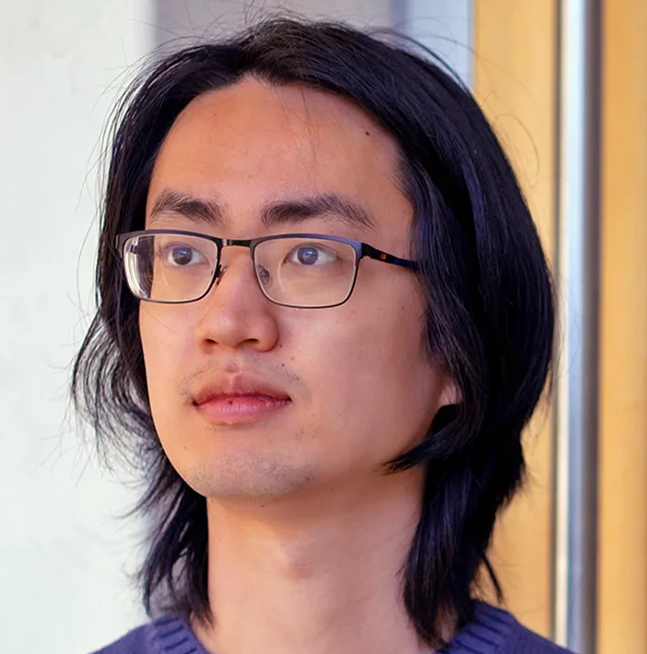
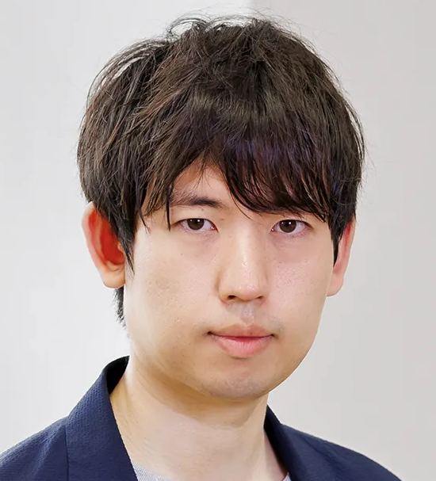
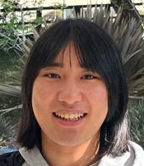
Symmetric Exponential Time Requires Near-Maximum Circuit Size
AND
Lijie Chen
Berkeley
Shuichi Hirahara
NII
Hanlin Ren
Oxford
Zeyong Li
NUS
https://arxiv.org/abs/2309.12912
https://arxiv.org/abs/2310.17762
0 / 29

Slide 2
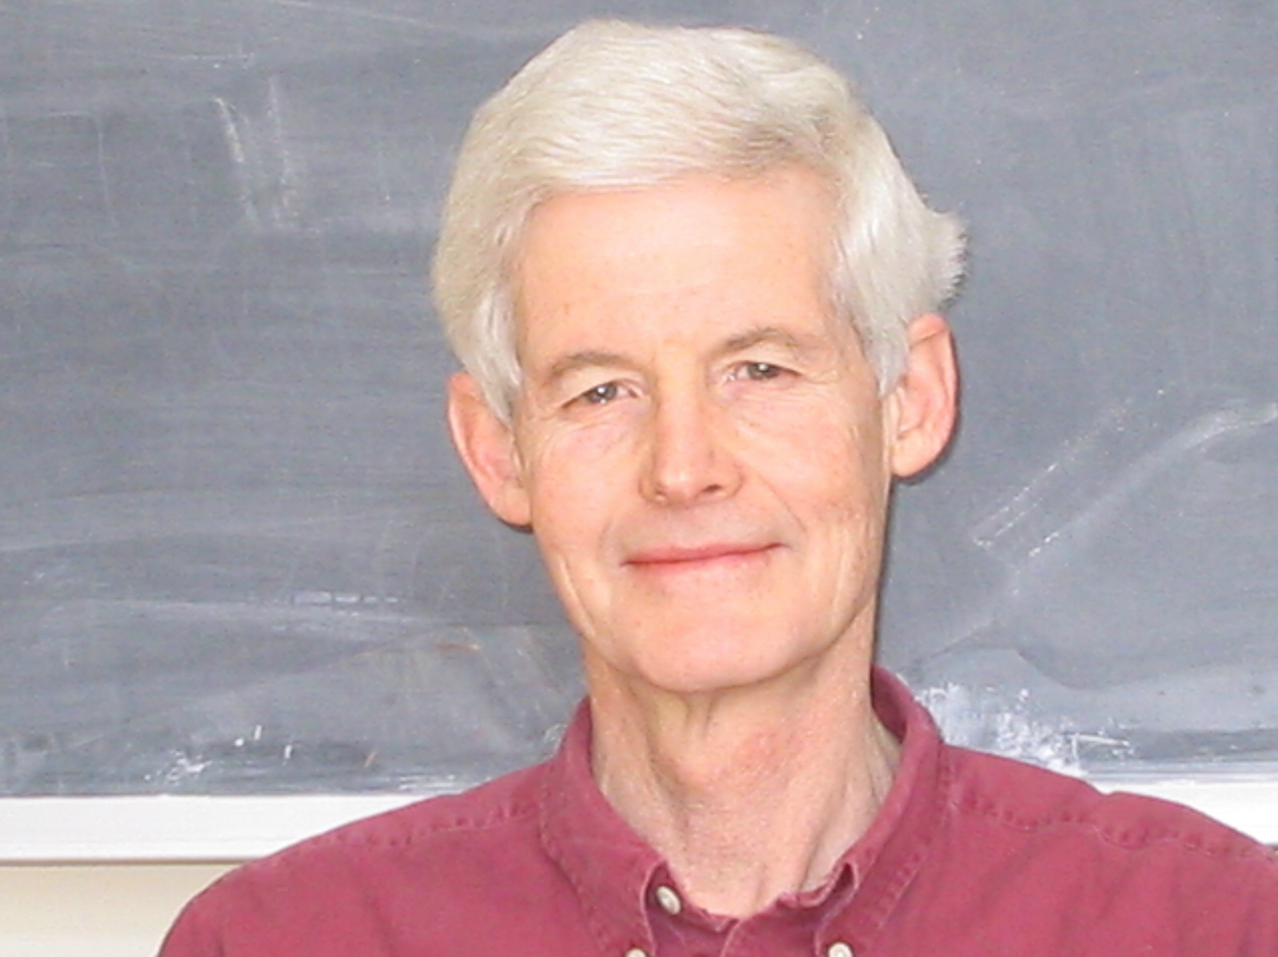
The $P$ vs $NP$ Problem
Poly-time languages
$$SAT$$
Stephen A. Cook. The Complexity of Theorem-Proving Procedures.
1 / 29
https://www.cs.toronto.edu/~sacook/Steve_by_Yvonne.04.JPG

Slide 3
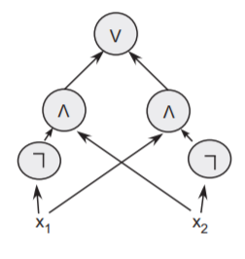
Circuit Complexity
(Some of the considerable efforts!)
Let’s try to prove $SAT$ requires super-polynomial circuit size.
Circuits are combinatorial objects. So maybe combinatorialists would figure out a way to manipulate them.
Yet, circuits are strong enough:
Poly-time languages $⊆$ poly-size circuits.
A circuit computing $x_{1}⊕x_{2}$ from [Arora-Barak]
2 / 29
https://freepik.com/free-vector/hand-drawn-professor-cartoon-illustration_63345069.htm

Slide 4
Progress (not up to scale)
Restricted circuit classes
$${AC}^{0}$$
$${AC}^{0}\left[p\right]$$
$${AC}^{0}\left[m\right]$$
$${TC}^{0}$$
$${NC}^{1}$$
$$…$$
$$P/_{poly}$$
Ajtai, FSS, Yao, Razborov, Smolensky, …
Williams
WHERE WE ARE
BFT
Kannan
$$NP$$
$$PSPACE$$
$$EXP$$
$$NEXP$$
$$MAEXP$$
$$Σ_{2}EXP$$
$$Σ_{3}EXP$$
$$EXPSPACE$$
Powerful languages
3 / 29

Slide 5
Progress (more accurate scaling)
Restricted circuit classes
$${AC}^{0}$$
$${AC}^{0}\left[p\right]$$
$${AC}^{0}\left[m\right]$$
$${TC}^{0}$$
$${NC}^{1}$$
$$L/_{poly}$$
$${NC}^{2}$$
$$…$$
$$P/_{poly}$$
Ajtai, FSS, Yao, Razborov, Smolensky, …
Williams
WHERE WE ARE
BFT
Kannan
$$NP$$
$$…$$
$$Σ_{2}P={NP}^{NP}$$
$$Σ_{3}P={NP}^{{NP}^{NP}}$$
Powerful languages
$$P^{PP}$$
$$PSPACE$$
$$EXP$$
$$NEXP$$
$$MAEXP$$
$$Σ_{2}EXP$$
$$Σ_{3}EXP$$
$$EXPSPACE$$
3 / 29

Slide 6
The battleground
… where something non-trivial has happened
$$NP$$
$$…$$
$$Σ_{2}P={NP}^{NP}$$
$$Σ_{3}P={NP}^{{NP}^{NP}}$$
Powerful languages
$$P^{PP}$$
$$PSPACE$$
$$EXP$$
$$NEXP$$
$$MAEXP$$
$$Σ_{2}EXP$$
$$Σ_{3}EXP$$
$$EXPSPACE$$
Requires super-poly size circuits (Kannan, KW, BCGKT, CCHO, Cai, BFT)
Requires exponential-size circuits (Kannan, MVW)
$$MAEXP$$
$${NEXP}^{NP}$$
$$\left(=Σ_{2}EXP\right)$$
$$NEXP$$
$$S_{2}EXP$$
$${ZPEXP}^{NP}$$
$$EXP$$
$${EXP}^{NP}$$
$${EXP}^{{NP}^{NP}}$$
$$coNEXP$$
$${coNEXP}^{NP}$$
$$\left(=Π_{2}EXP\right)$$
Proof: “the first exp-hard function” is in ${EXP}^{{NP}^{NP}}$
No non-trivial size lower bounds ☹
Proof: win-win arguments (that stops at “half-exponential” bounds and can’t prove exponential lower bounds)
4 / 29

Slide 7
Our results
$$NP$$
$$…$$
$$Σ_{2}P={NP}^{NP}$$
$$Σ_{3}P={NP}^{{NP}^{NP}}$$
Powerful languages
$$P^{PP}$$
$$PSPACE$$
$$EXP$$
$$NEXP$$
$$MAEXP$$
$$Σ_{2}EXP$$
$$Σ_{3}EXP$$
$$EXPSPACE$$
Theorem (Chen-Hirahara-R): These classes* require exponential size circuits!
Requires super-poly size circuits (Kannan, KW, BCGKT, CCHO, Cai, BFT)
Requires exponential-size circuits (Kannan, MVW)
$$MAEXP$$
$${NEXP}^{NP}$$
$$\left(=Σ_{2}EXP\right)$$
$$NEXP$$
$$S_{2}EXP$$
$${ZPEXP}^{NP}$$
$$EXP$$
$${EXP}^{NP}$$
$${EXP}^{{NP}^{NP}}$$
$$coNEXP$$
$${coNEXP}^{NP}$$
$$\left(=Π_{2}EXP\right)$$
Proof: “the first exp-hard function” is in ${EXP}^{{NP}^{NP}}$
No non-trivial size lower bounds ☹
New proof technique: an iterative win-win argument! (CLORS)
*: Ignoring one bit of advice
5 / 29

Slide 8
Zeyong Li’s Improvement
$$NP$$
$$…$$
$$Σ_{2}P={NP}^{NP}$$
$$Σ_{3}P={NP}^{{NP}^{NP}}$$
Powerful languages
$$P^{PP}$$
$$PSPACE$$
$$EXP$$
$$NEXP$$
$$MAEXP$$
$$Σ_{2}EXP$$
$$Σ_{3}EXP$$
$$EXPSPACE$$
Theorem (Li): These classes** require exponential size, on almost every input length!
Requires super-poly size circuits (Kannan, KW, BCGKT, CCHO, Cai, BFT)
Requires exponential-size circuits (Kannan, MVW)
$$MAEXP$$
$${NEXP}^{NP}$$
$$\left(=Σ_{2}EXP\right)$$
$$NEXP$$
$$S_{2}EXP$$
$${ZPEXP}^{NP}$$
$$EXP$$
$${EXP}^{NP}$$
$${EXP}^{{NP}^{NP}}$$
$$coNEXP$$
$${coNEXP}^{NP}$$
$$\left(=Π_{2}EXP\right)$$
Proof: “the first exp-hard function” is in ${EXP}^{{NP}^{NP}}$
No non-trivial size lower bounds ☹
New ingredient: a clever trick for getting rid of the win-win argument!
**: No “one-bit advice” caveat anymore!
5 / 29

Slide 9
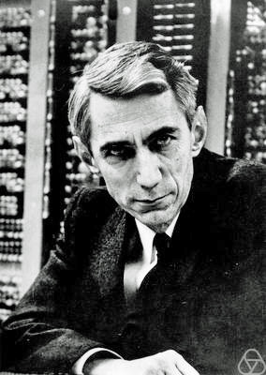
So, where are the hard functions?
since it’s so hard to find one…
Actually, hard functions are everywhere!
Theorem (Shannon): If $3s\log{s}<2^{n}$, then most $n$-bit functions have circuit complexity $>s$.
Proof:
# of $n$-bit Boolean functions $=2^{2^{n}}$
# of size-$s$ circuits $≤2^{3s\log{s}}$
If $3s\log{s}≤2^{n}−1$, then most $n$-bit functions has circuit complexity $>s$.
$2^{3s\log{s}}$ circuits
$$001…10$$
$$011…00$$
$$110…11$$
$$101…01$$
$$110…00$$
$$110…11$$
$$111..11$$
$$110…00$$
Claude Shannon
$2^{2^{n}}$ functions
6 / 29
Photo of Claude Shannon: Jacobs, Konrad, CC BY-SA 2.0 DE, via Wikimedia Commons

Slide 10
The Dual Weak Pigeonhole Principle
If you throw $N$ pigeons into $M$ holes, and $N≪M$, then there is an empty pigeonhole.
Dual: less pigeons than holes
Weak: much less pigeons than holes
empty
empty
empty
empty
7 / 29

Slide 11
Range Avoidance Problem
Input: a (multi-output) circuit $C:{\left\{0,1\right\}}^{n}→{\left\{0,1\right\}}^{ℓ}$ ($ℓ>n$)
Output: any string $y∉Range\left(C\right)$
I.e., for every $x∈{\left\{0,1\right\}}^{n}$, $C\left(x\right)≠y$
Trivial randomized algorithm: Output a random $y←{\left\{0,1\right\}}^{ℓ}$.
Question: deterministic algorithms? Even $P^{NP}$ algorithms?
A “non-output” of $C$.
$$y∈{\left\{0,1\right\}}^{ℓ}$$
$C\left(index of pigeon\right)=index of hole$, find an empty hole!
$$C$$
A problem that captures the complexity of dual weak pigeonhole principle!
$$x∈{\left\{0,1\right\}}^{n}$$
8 / 29

Slide 12
Results on Range Avoidance
Theorem (CHR): There is an infinitely-often single-valued $FS_{2}P$ algorithm for range avoidance!
Theorem (Li): There is a single-valued $FS_{2}P$ algorithm for range avoidance (on every input length)!
What is a “single-valued $FS_{2}P$ algorithm”???
Will see “single-valued $FΣ_{2}P$ algorithms” later ☺
9 / 29

Slide 13
Circuit lower bounds are just corollaries…
Theorem (Li): There is a single-valued $FS_{2}P$ algorithm for range avoidance (on every input length)!
$$⟹S_{2}E⊈SIZE\left[2^{0.01n}\right]‼!$$
Parameters
Want $f:{\left\{0,1\right\}}^{n}→\left\{0,1\right\}$ with circuit complexity $≥2^{0.01n}$
Let $N≔2^{n}$, then the truth table of $f$ has length $N$.
Solving range avoidance for $TT$ = proving circuit lower bounds!
E.g. solving range avoidance for $TT$ in deterministic $poly\left(N\right)$ time = proving $E⊈SIZE\left[2^{0.01n}\right]$
E.g. solving range avoidance for $TT$ in deterministic $poly\left(N\right)$ time with $NP$ oracle = proving $E^{NP}⊈SIZE\left[2^{0.01n}\right]$
$y∈{\left\{0,1\right\}}^{N}$: truth table of the circuit $C$
$$TT$$
$TT$ stands for “the Truth Table generator”
$x∈{\left\{0,1\right\}}^{N^{0.02}}$: description of a size-$N^{0.01}$ circuit $C$
10 / 29

Slide 14
The Beginning of Our Journey
How hard is it to prove the dual weak pigeonhole principle?
Henceforth “dwPHP”
in “bounded arithmetic”?
Theorem (Jeřábek): Over $S_{2}^{1}$, dwPHP is equivalent to Shannon’s theorem.
Shannon’s theorem: There is a Boolean function with circuit complexity $>2^{0.01n}$.
Emil Jeřábek
11 / 29
Photo of Emil Jeřábek: https://users.math.cas.cz/~jerabek/

Slide 15
dwPHP $⟺$ Shannon
$$y$$
dwPHP: Given a circuit $C$ from $N$ bits to $N+1$ bits, there is a string $y$ not in the range of $C$
$$C$$
$$∃y∈{\left\{0,1\right\}}^{N+1}∀x∈{\left\{0,1\right\}}^{N} C\left(x\right)≠y.$$
$$x$$
easy
interesting
$S_{2}^{1}$: some weak theory
$$N=2^{n}$$
$y∈{\left\{0,1\right\}}^{N}$: truth table of the circuit $C$
Shannon: There is a Boolean function $f:{\left\{0,1\right\}}^{n}→\left\{0,1\right\}$ without $2^{0.01n}$-size circuits.
$$TT$$
Special case of dwPHP for $C=TT$.
$x∈{\left\{0,1\right\}}^{N^{0.02}}$: description of a size-$N^{0.01}$ circuit $C$
12 / 29

Slide 16
$¬$dwPHP $⟺$ $¬$Shannon
Assume for simplicity that the output length is $2N$ instead of $N+1$.
$$y$$
$¬$dwPHP: There is a circuit $C:{\left\{0,1\right\}}^{N}→{\left\{0,1\right\}}^{2N}$ that can output every length-$2N$ string.
$$C$$
$$∀y∈{\left\{0,1\right\}}^{2N}∃x∈{\left\{0,1\right\}}^{N} C\left(x\right)=y.$$
Need to prove:
$$x$$
If I can compress every $2N$ bits into $N$ bits,
interesting
Then I can find a size-$N^{0.01}$ circuit for every length-$N$ truth table.
$S_{2}^{1}$: some weak theory
$$N=2^{n}$$
$y∈{\left\{0,1\right\}}^{N}$: truth table of the circuit $C$
$¬$Shannon: Every (!) Boolean function has circuits of size $2^{0.01n}$.
$$TT$$
Special case of $¬$dwPHP for $C=TT$.
$x∈{\left\{0,1\right\}}^{N^{0.02}}$: description of a size-$N^{0.01}$ circuit $C$
12 / 29

Slide 17
The GGM Construction
GGM = Goldreich-Goldwasser-Micali
$f∈{\left\{0,1\right\}}^{T}$: a length-$T$ truth table
$$i$$
$x_{4}←C\left(x_{3}\right).left$ and read $y_{i}$ from $x_{4}$
$$T=2^{4}N$$
$$x_{3}←C\left(x_{2}\right).right$$
$$2^{3}N$$
$$x_{2}←C\left(x_{1}\right).left$$
$$2^{2}N$$
$$2^{1}N$$
$$y$$
$$x_{1}←C\left( \right).right$$
$$C$$
$$N$$
$C$: some circuit falsifying dwPHP
$$∀y∈{\left\{0,1\right\}}^{2N}∃x∈{\left\{0,1\right\}}^{N} C\left(x\right)=y.$$
$$x$$
13 / 29

Slide 18
The Ultimate Compression
$$T$$
$$y$$
If dwPHP is false for circuit $C$, then every length-$T$ truth table has a circuit of size $poly\left(\left|C\right|,\log{T}\right)$!
$S_{2}^{1}$: some weak theory
To compute the $i$-th bit of $y$:
Hardcode
Walk along the GGM tree
Remark about parameters: set $T=poly\left(\left|C\right|\right)$ large enough so that $poly\left(\left|C\right|,\log{T}\right)≪T^{ε}$.
Theorem (Jeřábek): For every constant $ε>0$, if $S_{2}^{1}$ cannot prove dwPHP, then $S_{2}^{1}$ cannot prove the existence of $2^{εn}$-hard truth tables.
14 / 29

Slide 19
From Bounded Arithmetic to Total Search Problem
If the sentence $∀x ∃y φ\left(x,y\right)$ is true, then it defines a total search problem:
Moreover, if you prove $∀x ∃y φ\left(x,y\right)$ in a “weak” theory, then you get a complexity upper bound for FIND-$φ$!
FIND-$φ$
Input: $x$
Output: any $y$ such that $φ\left(x,y\right)$
For example:
If you prove $∀x ∃y φ\left(x,y\right)$ in $S_{2}^{1}$, then FIND-$φ$ has a deterministic poly-time algorithm.
If you prove $∀x ∃y φ\left(x,y\right)$ in $T_{2}^{1}$, then FIND-$φ$ reduces to $PLS$ (polynomial local search).
Main takeaway
Results in bounded arithmetic $⇒$ results in total search problems!
Caveat: dwPHP is a $∀∃∀$-sentence, so the problem we obtain is not necessarily in $TFNP$, but only in $TFΣ_{2}={TFNP}^{NP}$.
Range Avoidance!
$$∀C ∃y∈{\left\{0,1\right\}}^{N+1} ∀x∈{\left\{0,1\right\}}^{N} C\left(x\right)≠y.$$
15 / 29

Slide 20
Shannon is as hard as Range Avoidance…
Easy: Shannon is just Range Avoidance for $TT$!
Range Avoidance
Input: circuit $C:{\left\{0,1\right\}}^{N}→{\left\{0,1\right\}}^{N+1}$
Output: some string $y∈{\left\{0,1\right\}}^{N+1} \backslash Range\left(C\right)$
Shannon
Input: $1^{N}$ where $N=2^{n}$
Output: a truth table of length $N$ without $2^{εn}$-size circuits
Jeřábek04, Korten21
If we translate Jeřábek’s results into the language of total search problems…
Theorem (Korten 21):
There is a $P^{NP}$ reduction from Range Avoidance to Shannon!
Theorem (Jeřábek):
Over $S_{2}^{1}$, dwPHP is equivalent to Shannon’s theorem.
Oliver Korten
16 / 29
Photo of Oliver Korten: https://www.oliverkorten.com/
Notes:
Will not talk about details on how “explicit construction” is related to dwPHP, but mention that the existence of many objects are proved by dwPHP.

Slide 21
Korten’s Reduction
Reduction from Range Avoidance to Shannon:
Given: a circuit $C:{\left\{0,1\right\}}^{N}→{\left\{0,1\right\}}^{2N}$, and a hard truth table of length $T$
Output: some $y∈{\left\{0,1\right\}}^{2N}$ that’s not in the range of $C$
Time complexity: $poly\left(T,\left|C\right|\right)$ time with an $NP$ oracle
$$v_{10}$$
Note: if the truth table is indeed hard, then the algorithm has to fail somewhere.
$←$ lexicographically first preimage of , found by an $NP$ oracle
$$v_{11}$$
$←$ lexicographically first preimage of , found by an $NP$ oracle
$$v_{00}$$
$$v_{01}$$
$$v_{02}$$
$$v_{03}$$
$$v_{12}$$
$$v_{13}$$
$$v_{00}$$
$$v_{01}$$
$$v_{02}$$
$$v_{03}$$
$$v_{04}$$
$$v_{05}$$
$$v_{06}$$
is not in the range of $C$, we solved the range avoidance problem!
$$v_{07}$$
$$v_{10}$$
$$v_{11}$$
$$v_{12}$$
$$v_{13}$$
Everything afterwards is filled by x.
$$v_{20}$$
x
The place where we fail $⟹$ a solution to range avoidance
x
17 / 29

Slide 22
Results on Range Avoidance
Theorem (CHR): There is an infinitely-often single-valued $FΣ_{2}P$ algorithm for range avoidance!
What’s this?
Theorem (Li): There is a single-valued $FΣ_{2}P$ algorithm for range avoidance (on every input length)!
18 / 29

Slide 23
$FNP$ Algorithms
Poly-time algorithm with assistance of an untrusted prover.
Requirements:
For every $x$, there is a valid proof $π$ such that $Verifier\left(x,π\right)$ outputs a valid solution for $x$
If $Verifier\left(x,π\right)$ outputs anything at all, then it outputs a valid solution for $x$
$Verifier\left(x,π\right)$ runs in poly time
$$x$$
$$π$$
Powerful, but untrusted prover
Poly-time verifier
19 / 29

Slide 24
$FΣ_{2}P$ Algorithms
Poly-time algorithm with assistance of two untrusted provers.
Prover 1 wants the verifier to output some solution.
Prover 2 wants prover 1 to fail.
Requirements:
For every $x$, there is a valid proof $π_{1}$ such that for every $π_{2}$, $Verifier\left(x,π_{1},π_{2}\right)$ outputs a valid solution for $x$
For every $x$ and $π_{1}$, there is a $π_{2}$ such that $Verifier\left(x, π_{1},π_{2}\right)$ either rejects or outputs a valid solution for $x$
$Verifier\left(x,π_{1},π_{2}\right)$ runs in poly time
Poly-time verifier
$$π_{1}$$
$$π_{2}$$
$$x$$
Prover 1
Prover 2
20 / 29

Slide 25
Wait, isn’t that trivial?
There is a trivial $FΣ_{2}P$ algorithm for Range Avoidance!
Problem: the verifier doesn’t define a “canonical” non-output of $C$.
If Prover 1 is cheating, Prover 2 can catch it by sending $x$ such that $C\left(x\right)=y$.
A claimed non-output $y∈{\left\{0,1\right\}}^{ℓ}$
Poly-time verifier
Any non-output of $C$ could be outputted by the verifier!
Verifier: If $C\left(x\right)≠y$, then output $y$.
$$C:{\left\{0,1\right\}}^{n}→{\left\{0,1\right\}}^{ℓ}$$
Verifier’s goal: find $y∈{\left\{0,1\right\}}^{ℓ} \backslash Range\left(C\right)$.
Prover 1
Prover 2
21 / 29

Slide 26
Single-Valued $FΣ_{2}P$ Algorithm ($FΣ_{2}Psv$)
Poly-time algorithm with assistance of two untrusted provers.
Prover 1 wants the verifier to output a canonical solution $y$. (WLOG assume $π_{1}$ contains $y$ itself; prover 1 claims that $y$ is both valid and canonical.)
Prover 2 wants prover 1 to fail.
Requirements:
For every $x$, there is a valid proof $π_{1}$ such that for every $π_{2}$, $Verifier\left(x,π_{1},π_{2}\right)$ outputs the canonical solution $y=y\left(x\right)$
If $π_{1}$ claims some solution $y^{′}≠y$, then there is some $π_{2}$ such that $Verifier\left(x, π_{1},π_{2}\right)$ rejects
$Verifier\left(x,π_{1},π_{2}\right)$ runs in poly time
$$π_{1}$$
$$π_{2}$$
Poly-time verifier
$$x$$
Prover 1
Prover 2
22 / 29

Slide 27
Idea: Computational History
$$y$$
$$C$$
$𝒜$: some(?) brute force algorithm for solving Range Avoidance for $C$
If prover 2 didn’t find a wrong step of $HIST$, then I’ll output whatever $HIST$ says.
$$x$$
If prover 1 is cheating, then some computational step of $HIST$ must be incorrect!
This is single-valued because $𝒜$ is deterministic!
A claimed computational history $HIST$ of $𝒜$
A wrong step of $HIST$
Poly-time verifier
$$C:{\left\{0,1\right\}}^{n}→{\left\{0,1\right\}}^{ℓ}$$
Verifier’s goal: find canonical $y∈{\left\{0,1\right\}}^{ℓ} \backslash Range\left(C\right)$.
Prover 1
Prover 2
23 / 29

Slide 28
$𝓐=$Korten’s Reduction!
$Korten\left(C,f\right)=$a non-output of $C$ found using $f$ as a hard function
$History\left(C,f\right)=$“history” of $Korten\left(C,f\right)$
Concatenation of values at each node + index of the node that fails
Depth $0$
$$v_{00}$$
$$0$$
$$v_{01}$$
$$1$$
$$v_{02}$$
$$2$$
$$v_{03}$$
$$3$$
$$v_{04}$$
$$4$$
$$v_{05}$$
$$5$$
$$v_{06}$$
$$6$$
$$v_{07}$$
$$7$$
Depth $1$
$$v_{10}$$
$$0$$
$$v_{11}$$
$$1$$
$$v_{12}$$
$$2$$
$$v_{13}$$
$$3$$
Depth $2$
$$v_{20}$$
$$0$$
x
$$1$$
Depth $3$
Index$=\left(depth,node number\right)=\left(2,1\right)$
x
$$0$$
$$History\left(C,f\right)=$$
$$v_{00}$$
$$v_{01}$$
$$v_{02}$$
$$v_{03}$$
$$v_{04}$$
$$v_{05}$$
$$v_{06}$$
$$v_{07}$$
$$v_{10}$$
$$v_{11}$$
$$v_{12}$$
$$v_{13}$$
$$v_{20}$$
x
x
$$\left(2,1\right)$$
$$Korten\left(C,f\right)=$$
$$v_{12}$$
$$v_{13}$$
24 / 29

Slide 29
How can prover 2 verify the history?
Claim: $History\left(C,f\right)$ is the only string that passes all the following local checks:
For every $i<index$, $C\left(v_{i}\right)=v_{j}v_{k}$; [$v_{i}$ is valid]
For every $i<index$ and $v′<v_{i}$, $C\left(v^{′}\right)≠v_{j}v_{k}$; [$v_{i}$ is lexico first]
If $i=index$ then for every $v^{′}$, $C\left(v^{′}\right)≠v_{j}v_{k}$; [$Korten\left(⋅,⋅\right)$ fails at $index$]
For every $i>index$, $v_{i}=$“x” [everything after $index$ is “x”]
$$v_{j}$$
$$v_{k}$$
$$v_{i}$$
There are $poly\left(2^{N},T\right)$ checks, so prover 2 can encode a failed check in $poly\left(N,\log{T}\right)$ bits
x
$$index$$
x
x
x
25 / 29

Slide 30
But prover 1 needs to send too many bits!
Indeed, the length of $History\left(C,f\right)$ is $poly\left(T,N\right)$.
If $𝒜$ is really a brute-force algorithm, then $\left|T\right|$ might be exponential in $N$!
CHR’s Idea
Win-win analysis: if the circuit complexity of $f$ is small, then Prover 1 can send a small circuit for $f$; otherwise use $f$ to solve a larger input length!
Only infinitely often lower bounds
Li’s Idea
If you run $Korten\left(C,f\right)$ in post-order, then $Korten\left(C,f\right)$ can be compressed, unconditionally!
Works for almost every input length, simpler proofs
Li’s Idea
If you run $Korten\left(C,f\right)$ in post-order, then $Korten\left(C,f\right)$ can be compressed, unconditionally!
Works for almost every input length, simpler proofs
26 / 29

Slide 31
Li’s Insight: History in post-order
$f=$the naïve “hard string” of length $2N⋅2^{2N}$
index
Given these $O\left(N\right)$ nodes:
You can recover the whole history.
You can even access any position of the history in $poly\left(N\right)$ time!
Observation:
You can represent the whole history using $O\left(N\right)$ nodes!
Zeyong Li
27 / 29
Photo of Zeyong Li: https://sites.google.com/view/zeyong

Slide 32
A $FΣ_{2}Psv$ Algorithm for Range Avoidance
Verify that the history passes the local check.
When you query the $i$-th bit of the history, use the $poly\left(N\right)$-time algorithm mentioned before.
Prover 1
Prover 2
Local check
To communicate the whole history, it suffices to send these $O\left(N\right)$ key nodes!
If Prover 1 is wrong, his claimed history would be falsified by some local check. Send it.
Poly-time verifier
28 / 29

Slide 33
Conclusions
We have described a single-valued $FΣ_{2}P$ algorithm for the range avoidance problem. This implies
$$Σ_{2}E⊈SIZE\left[2^{0.01n}\right].$$
With some more work, we can obtain single-valued $FS_{2}P$ algorithms and prove lower bounds for $S_{2}E$!
“symmetric alternation” [Canetti 96, RS98]
Thank you!
$P^{NP}⊆S_{2}P⊆{ZPP}^{NP}$, so this is just “randomized” $P^{NP}$ [Cai 01]
Questions are welcome!
29 / 29

