Slide 1


Weak Rank Principle II
Lower Bounds and Applications
Hanlin Ren
Joint work with Michal Garlik, Svyatoslav Gryaznov, Iddo Tzameret
$$⋅$$
$$=$$
Aug 12, 2025
Proof Complexity workshop @Oxford

Slide 2

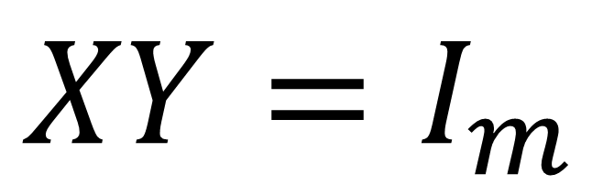

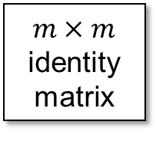
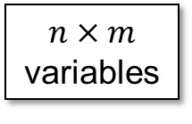
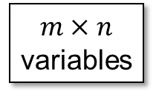
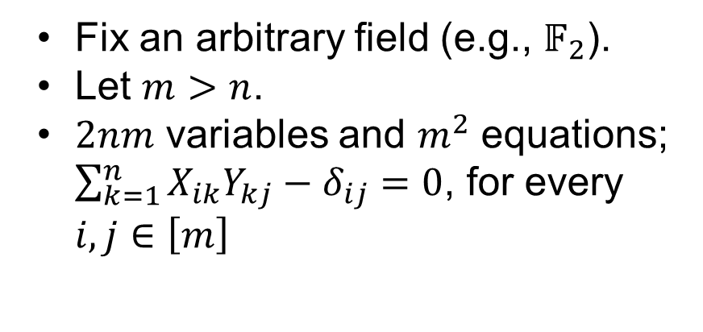
Recap: Rank Principle
Fix an arbitrary field (e.g., $𝔽_{2}$).
Let $m>n$.
$2nm$ variables and $m^{2}$ equations; $\sum_{k=1}^{n}{X_{ik}Y_{kj}}−δ_{ij}=0$, for every $i,j∈\left[m\right]$
$$XY=I_{m}$$
$m×n$ variables
$n×m$ variables
$m×m$ identity matrix
This talk: Why should you be interested in the proof complexity of the Rank Principle?
$$⋅$$
$$=$$
1 / 10

Slide 3

The Pigeonhole Principle
${PHP}_{n}^{m}$ (where $m>n$): If $m$ pigeons fly into $n$ holes, then there is a collision.
Hard tautologies in proof complexity:
Haken’85, PBI’93, KPW’95, Razborov’98, Raz’02, Razborov’02, …
Proof complexity generators:
Krajíček’04, Krajíček’09, Razborov’15, …
Approximate counting:
PWW88, Jeřábek’04, Jeřábek’07, …
Provability of circuit lower bounds:
Razborov’98, Raz’02, Razborov’04, …
2 / 10

Slide 4
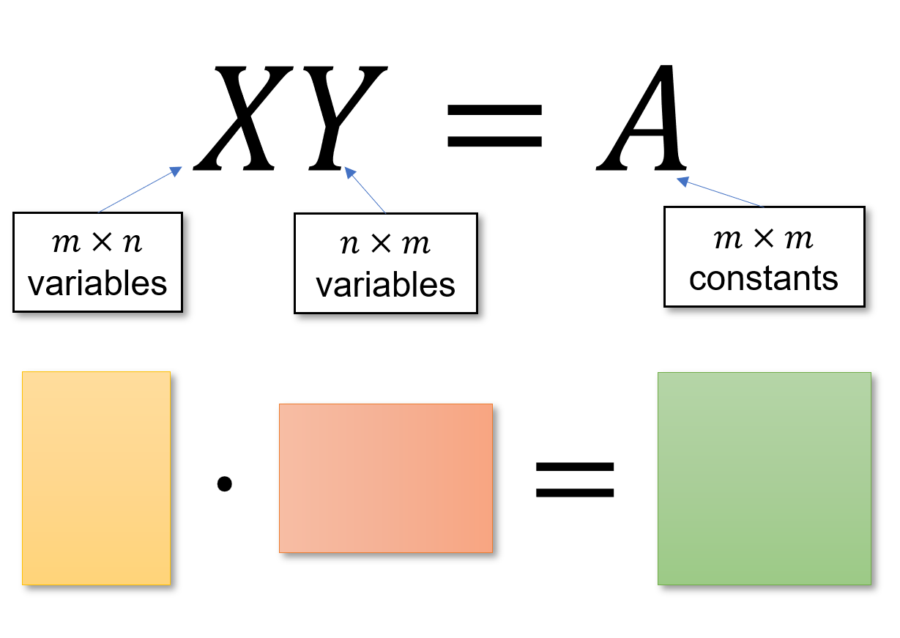
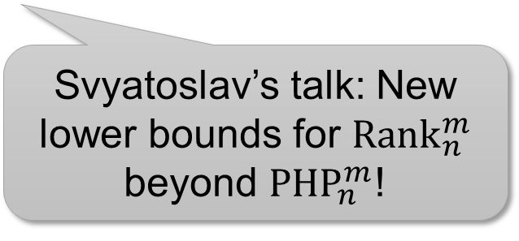
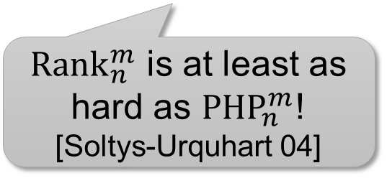
The Rank Principle
${Rank}_{n}^{m}$ (where $m>n$): The $m×m$ identity matrix cannot be decomposed into an $m×n×m$ matrix product
Hard tautologies in proof complexity?
Proof complexity generators?
Proof complexity generators?
Svyatoslav’s talk: New lower bounds for ${Rank}_{n}^{m}$ beyond ${PHP}_{n}^{m}$!
${Rank}_{n}^{m}$ is at least as hard as ${PHP}_{n}^{m}$!
[Soltys-Urquhart 04]
Approximate counting?
Provability of circuit lower bounds?
Provability of circuit lower bounds?
3 / 10

Slide 5
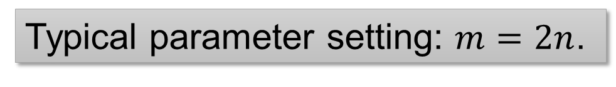
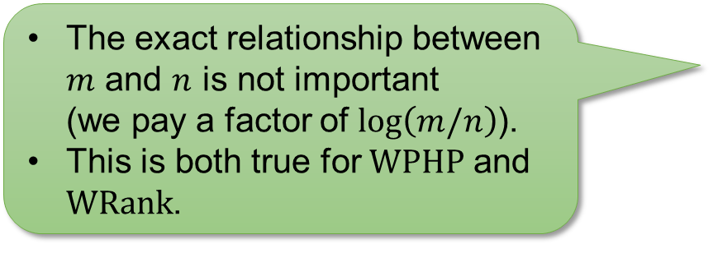
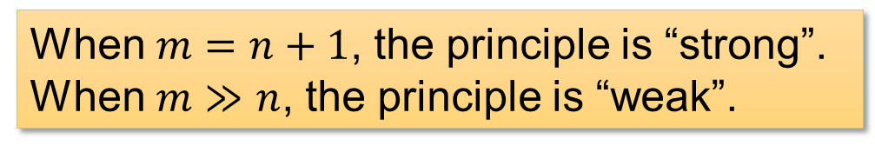
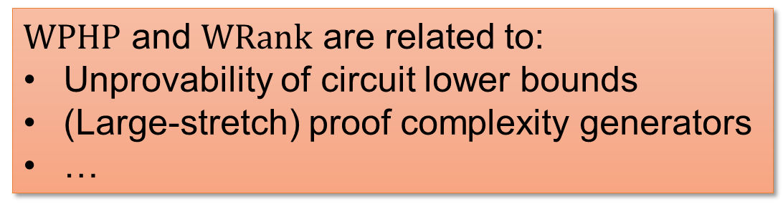
Strong vs Weak Principle
Pigeonhole
Rank
${PHP}_{n}^{m}$ (where $m>n$): If $m$ pigeons fly into $n$ holes, then there is a collision.
${Rank}_{n}^{m}$ (where $m>n$): The $m×m$ identity matrix cannot be decomposed into an $m×n×m$ matrix product
When $m=n+1$, the principle is “strong”.
When $m≫n$, the principle is “weak”.
The exact relationship between $m$ and $n$ is not important
(we pay a factor of $\log\left(m/n\right)$).
This is both true for $WPHP$ and $WRank$.
Typical parameter setting: $m=2n$.
$WPHP$ and $WRank$ are related to:
Unprovability of circuit lower bounds
(Large-stretch) proof complexity generators
…
4 / 10

Slide 6


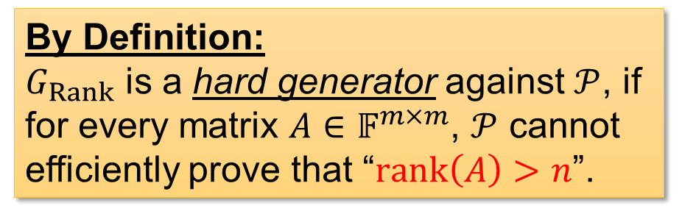
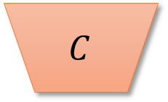
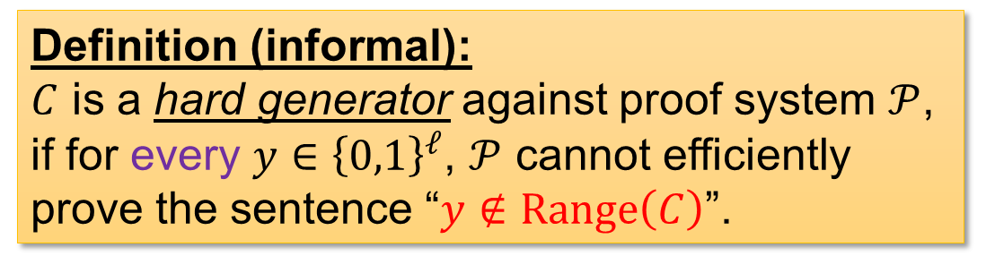

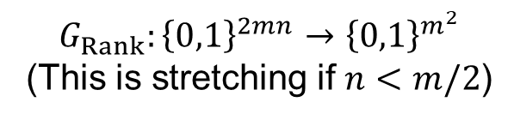






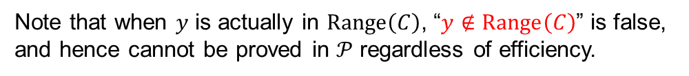



Proof Complexity Generators
Definition (informal):
$C$ is a hard generator against proof system $𝒫$, if for every $y∈{\left\{0,1\right\}}^{ℓ}$, $𝒫$ cannot efficiently prove the sentence “$y∉Range\left(C\right)$”.
$$y$$
$$C$$
$$x$$
$C:{\left\{0,1\right\}}^{s}→{\left\{0,1\right\}}^{ℓ}$ ($ℓ>s$)
Note that when $y$ is actually in $Range\left(C\right)$, “$y∉Range\left(C\right)$” is false, and hence cannot be proved in $𝒫$ regardless of efficiency.
$$X⋅Y$$
By Definition:
$G_{Rank}$ is a hard generator against $𝒫$, if for every matrix $A∈𝔽^{m×m}$, $𝒫$ cannot efficiently prove that “$rank\left(A\right)>n$”.
$$G_{Rank}$$
$$XY=I_{m}$$
$$X,Y$$
$$m×n$$
$$n×m$$
$$m×m$$
$$G_{Rank}:{\left\{0,1\right\}}^{2mn}→{\left\{0,1\right\}}^{m^{2}}$$
(This is stretching if $n<m/2$)
$$⋅$$
$$=$$
5 / 10

Slide 7

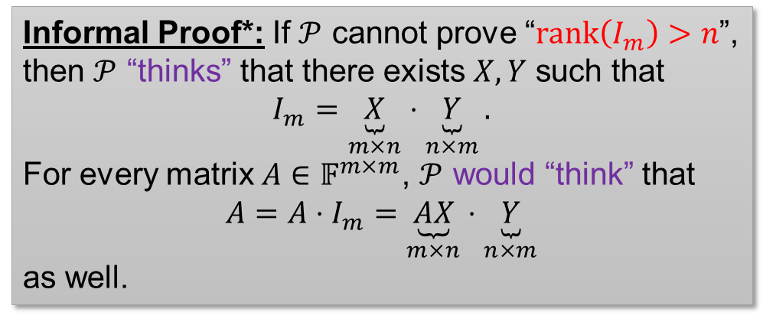
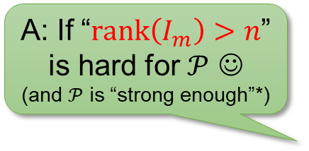
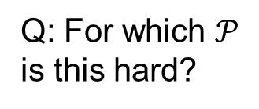
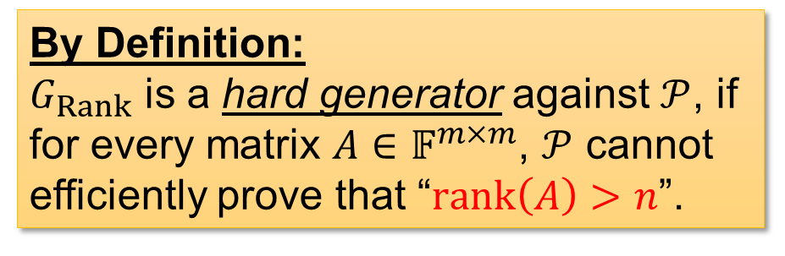
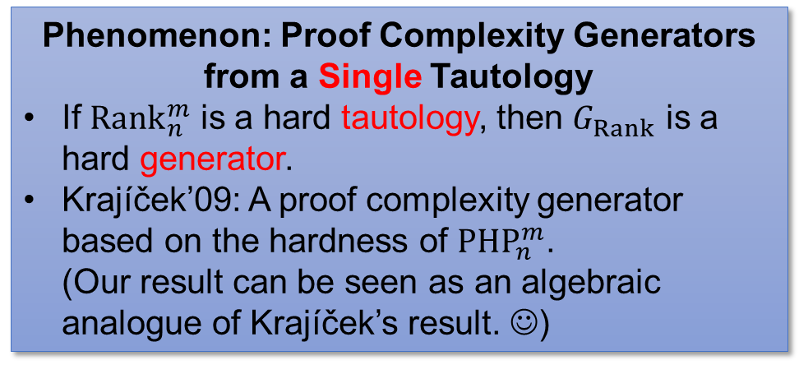
Hard Generators from $WRank$
By Definition:
$G_{Rank}$ is a hard generator against $𝒫$, if for every matrix $A∈𝔽^{m×m}$, $𝒫$ cannot efficiently prove that “$rank\left(A\right)>n$”.
A: If “$rank\left(I_{m}\right)>n$” is hard for $𝒫$ ☺
(and $𝒫$ is “strong enough”*)
Q: For which $𝒫$ is this hard?
Phenomenon: Proof Complexity Generators from a Single Tautology
If ${Rank}_{n}^{m}$ is a hard tautology, then $G_{Rank}$ is a hard generator.
Krajíček’09: A proof complexity generator based on the hardness of ${PHP}_{n}^{m}$.
(Our result can be seen as an algebraic analogue of Krajíček’s result. ☺)
Informal Proof*: If $𝒫$ cannot prove “$rank\left(I_{m}\right)>n$”, then $𝒫$ “thinks” that there exists $X,Y$ such that
$$I_{m}=\underset{m×n}{\underbrace{X}}⋅\underset{n×m}{\underbrace{Y}}.$$
For every matrix $A∈𝔽^{m×m}$, $𝒫$ would “think” that
$$A=A⋅I_{m}=\underset{m×n}{\underbrace{AX}}⋅\underset{n×m}{\underbrace{Y}}$$
as well.
*: Unfortunately, PCR (measured by size) cannot perform this reasoning efficiently. Need to work harder to show that $G_{Rank}$ is hard for PCR size!
6 / 10

Slide 8
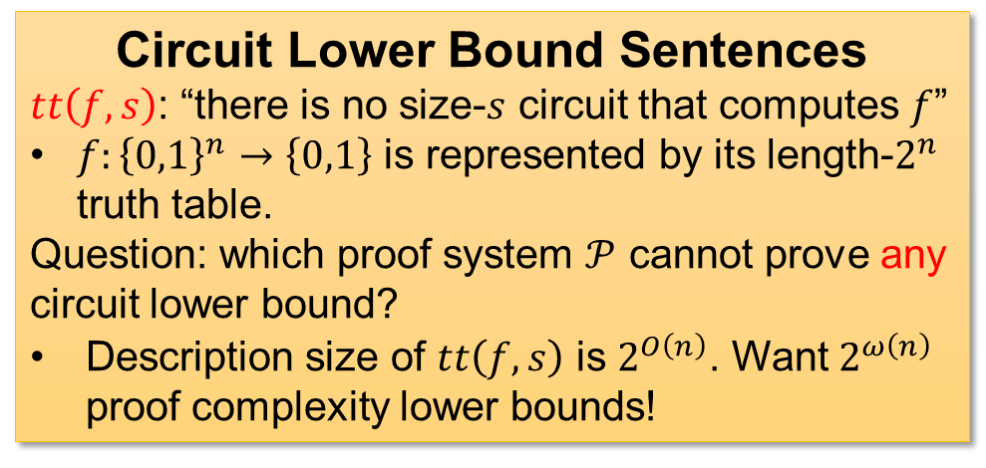
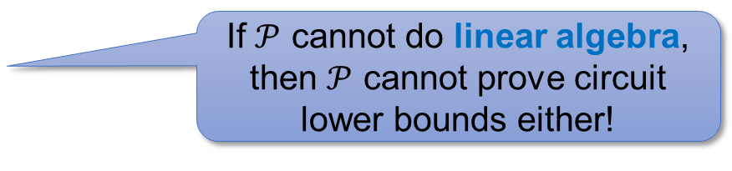
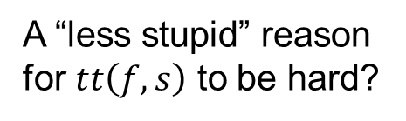
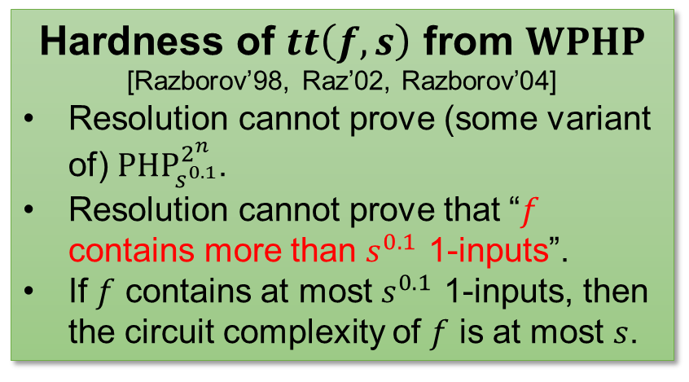
Provability of Circuit Lower Bounds
Circuit Lower Bound Sentences
$tt\left(f,s\right)$: “there is no size-$s$ circuit that computes $f$”
$f:{\left\{0,1\right\}}^{n}→\left\{0,1\right\}$ is represented by its length-$2^{n}$ truth table.
Question: which proof system $𝒫$ cannot prove any circuit lower bound?
Description size of $tt\left(f,s\right)$ is $2^{O\left(n\right)}$. Want $2^{ω\left(n\right)}$ proof complexity lower bounds!
Hardness of $tt\left(f,s\right)$ from $WPHP$
[Razborov’98, Raz’02, Razborov’04]
Resolution cannot prove (some variant of) ${PHP}_{s^{0.1}}^{2^{n}}$.
Resolution cannot prove that “$f$ contains more than $s^{0.1}$ 1-inputs”.
If $f$ contains at most $s^{0.1}$ 1-inputs, then the circuit complexity of $f$ is at most $s$.
A “less stupid” reason for $tt\left(f,s\right)$ to be hard?
Resolution cannot prove circuit lower bounds because resolution cannot count.
If $𝒫$ cannot do linear algebra, then $𝒫$ cannot prove circuit lower bounds either!
7 / 10

Slide 9


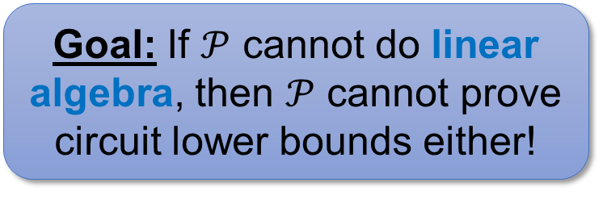
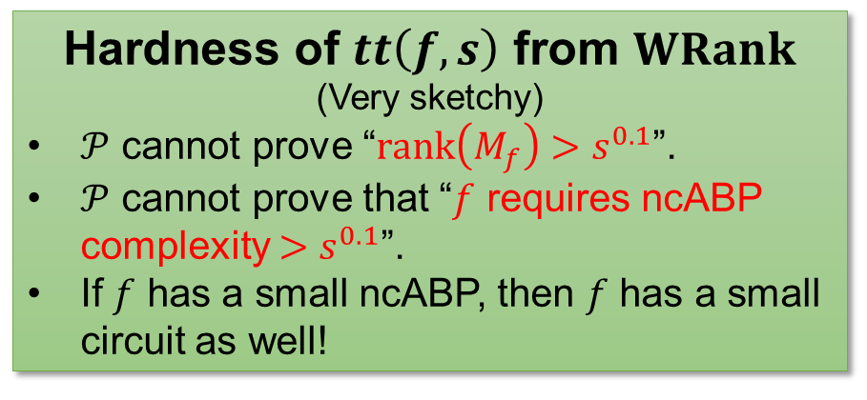
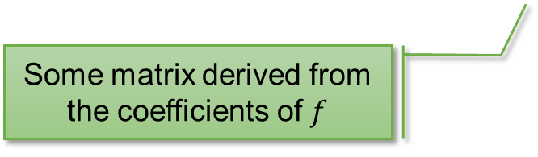
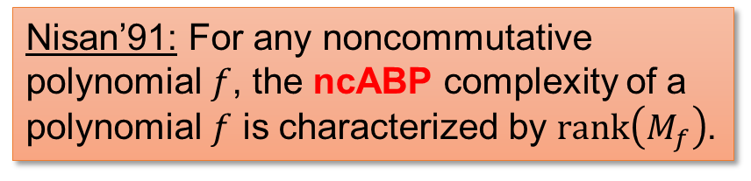
Provability of Circuit Lower Bounds
Goal: If $𝒫$ cannot do linear algebra, then $𝒫$ cannot prove circuit lower bounds either!
Hardness of $tt\left(f,s\right)$ from $WRank$
(Very sketchy)
$𝒫$ cannot prove “$rank\left(M_{f}\right)>s^{0.1}$”.
$𝒫$ cannot prove that “$f$ requires ncABP complexity $>s^{0.1}$”.
If $f$ has a small ncABP, then $f$ has a small circuit as well!
Noncommutative algebraic branching programs
Nisan’91: For any noncommutative polynomial $f$, the ncABP complexity of a polynomial $f$ is characterized by $rank\left(M_{f}\right)$.
What’s next?
Linear algebra
Counting
Some matrix derived from the coefficients of $f$
Circuit lower bounds
8 / 10

Slide 10
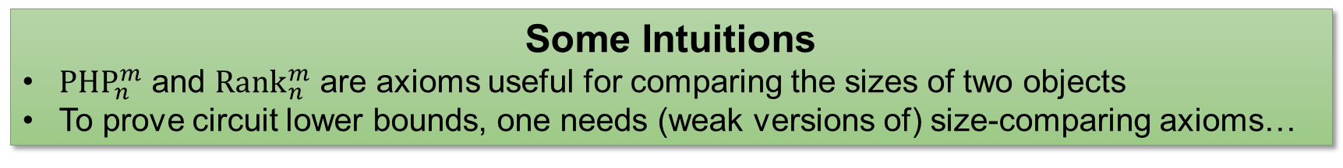

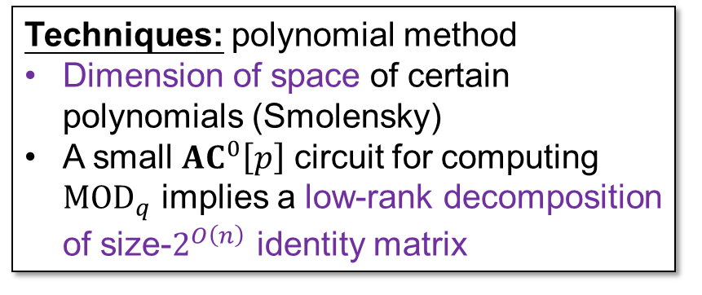
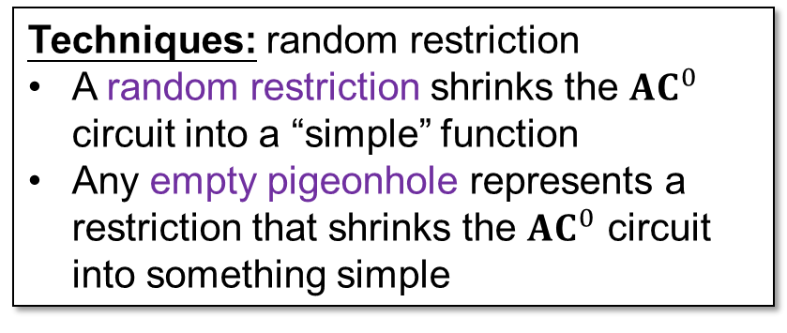
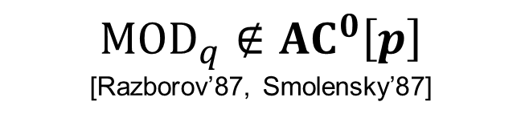
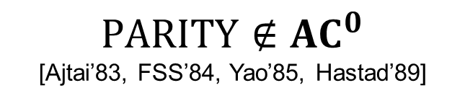
Circuit Lower Bounds follow from $WPHP$ / $WRank$!
$$PARITY∉{AC}^{0}$$
[Ajtai’83, FSS’84, Yao’85, Hastad’89]
$${MOD}_{q}∉{AC}^{0}\left[p\right]$$
[Razborov’87, Smolensky’87]
Techniques: random restriction
A random restriction shrinks the ${AC}^{0}$ circuit into a “simple” function
Any empty pigeonhole represents a restriction that shrinks the ${AC}^{0}$ circuit into something simple
Techniques: polynomial method
Dimension of space of certain polynomials (Smolensky)
A small ${AC}^{0}\left[p\right]$ circuit for computing ${MOD}_{q}$ implies a low-rank decomposition of size-$2^{O\left(n\right)}$ identity matrix
Some Intuitions
${PHP}_{n}^{m}$ and ${Rank}_{n}^{m}$ are axioms useful for comparing the sizes of two objects
To prove circuit lower bounds, one needs (weak versions of) size-comparing axioms…
9 / 10

Slide 11

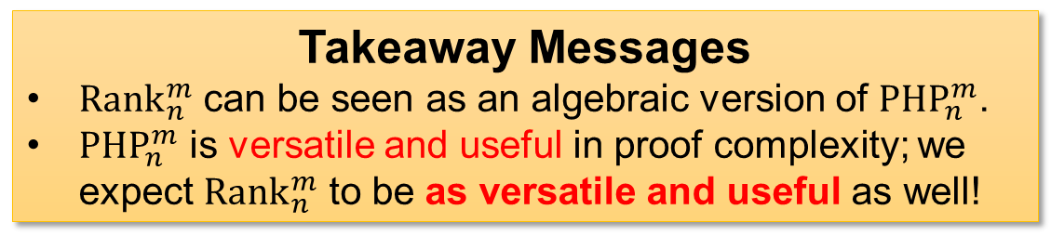
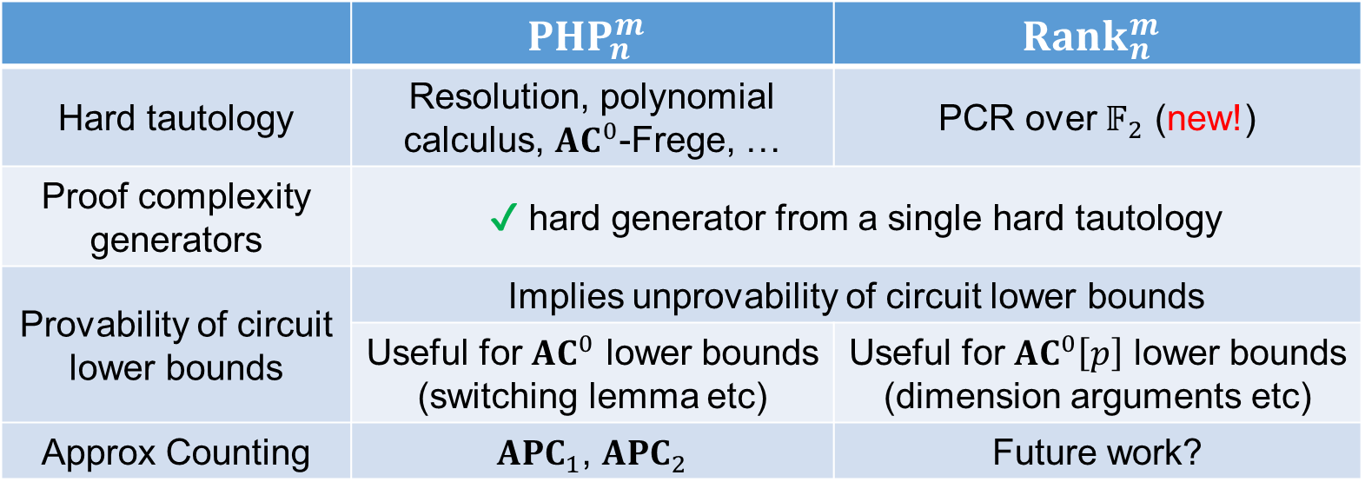
Summary: $PHP$ vs $Rank$
 | $${PHP}_{n}^{m}$$ | $${Rank}_{n}^{m}$$
Hard tautology | Resolution, polynomial calculus, ${AC}^{0}$-Frege, … | PCR over $𝔽_{2}$ (new!)
Proof complexity generators | ✔ hard generator from a single hard tautology
Provability of circuit lower bounds | Implies unprovability of circuit lower bounds
 | Useful for ${AC}^{0}$ lower bounds (switching lemma etc) | Useful for ${AC}^{0}\left[p\right]$ lower bounds (dimension arguments etc)
Approx Counting | ${APC}_{1}$, ${APC}_{2}$ | Future work?
Takeaway Messages
${Rank}_{n}^{m}$ can be seen as an algebraic version of ${PHP}_{n}^{m}$.
${PHP}_{n}^{m}$ is versatile and useful in proof complexity; we expect ${Rank}_{n}^{m}$ to be as versatile and useful as well!
Thank you!
10 / 10

