Slide 1
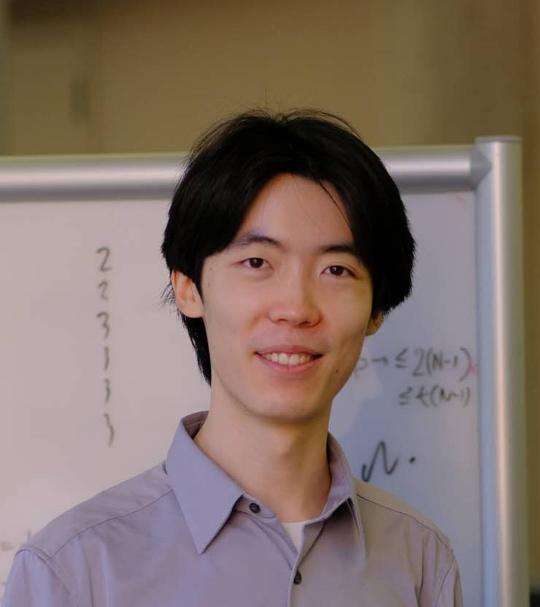
Metamathematics of Resolution Lower Bounds: A TFNP Perspective
Jiawei Li
(UT Austin)
Yuhao Li
(Columbia)
Hanlin Ren
(Oxford)
Sept 3, 2024
Proof Complexity workshop @Oxford

Slide 2
This Talk
Metamathematics of complexity lower bounds
Case study: Proof complexity $→$ resolution
How difficult is it to prove lower bounds?
No known lower bounds ☹
Frege
${AC}^{0}\left[2\right]$-Frege
Have lower bounds ☺
What new techniques should we develop?
Res($⊕$)
Cutting Planes
${AC}^{0}$-Frege
Resolution
We have already proved quite strong lower bounds!
Our understanding is very primitive and there are tons of open questions.
My hope 1: some of these questions will be interesting to you ☺
Our results: metamathematics of proving resolution lower bounds.
My hope 2: this will shed lights on the stronger lower bounds we want to prove ☺
https://simons.berkeley.edu/programs/lower-bounds-computational-complexity
1 / 17

Slide 3
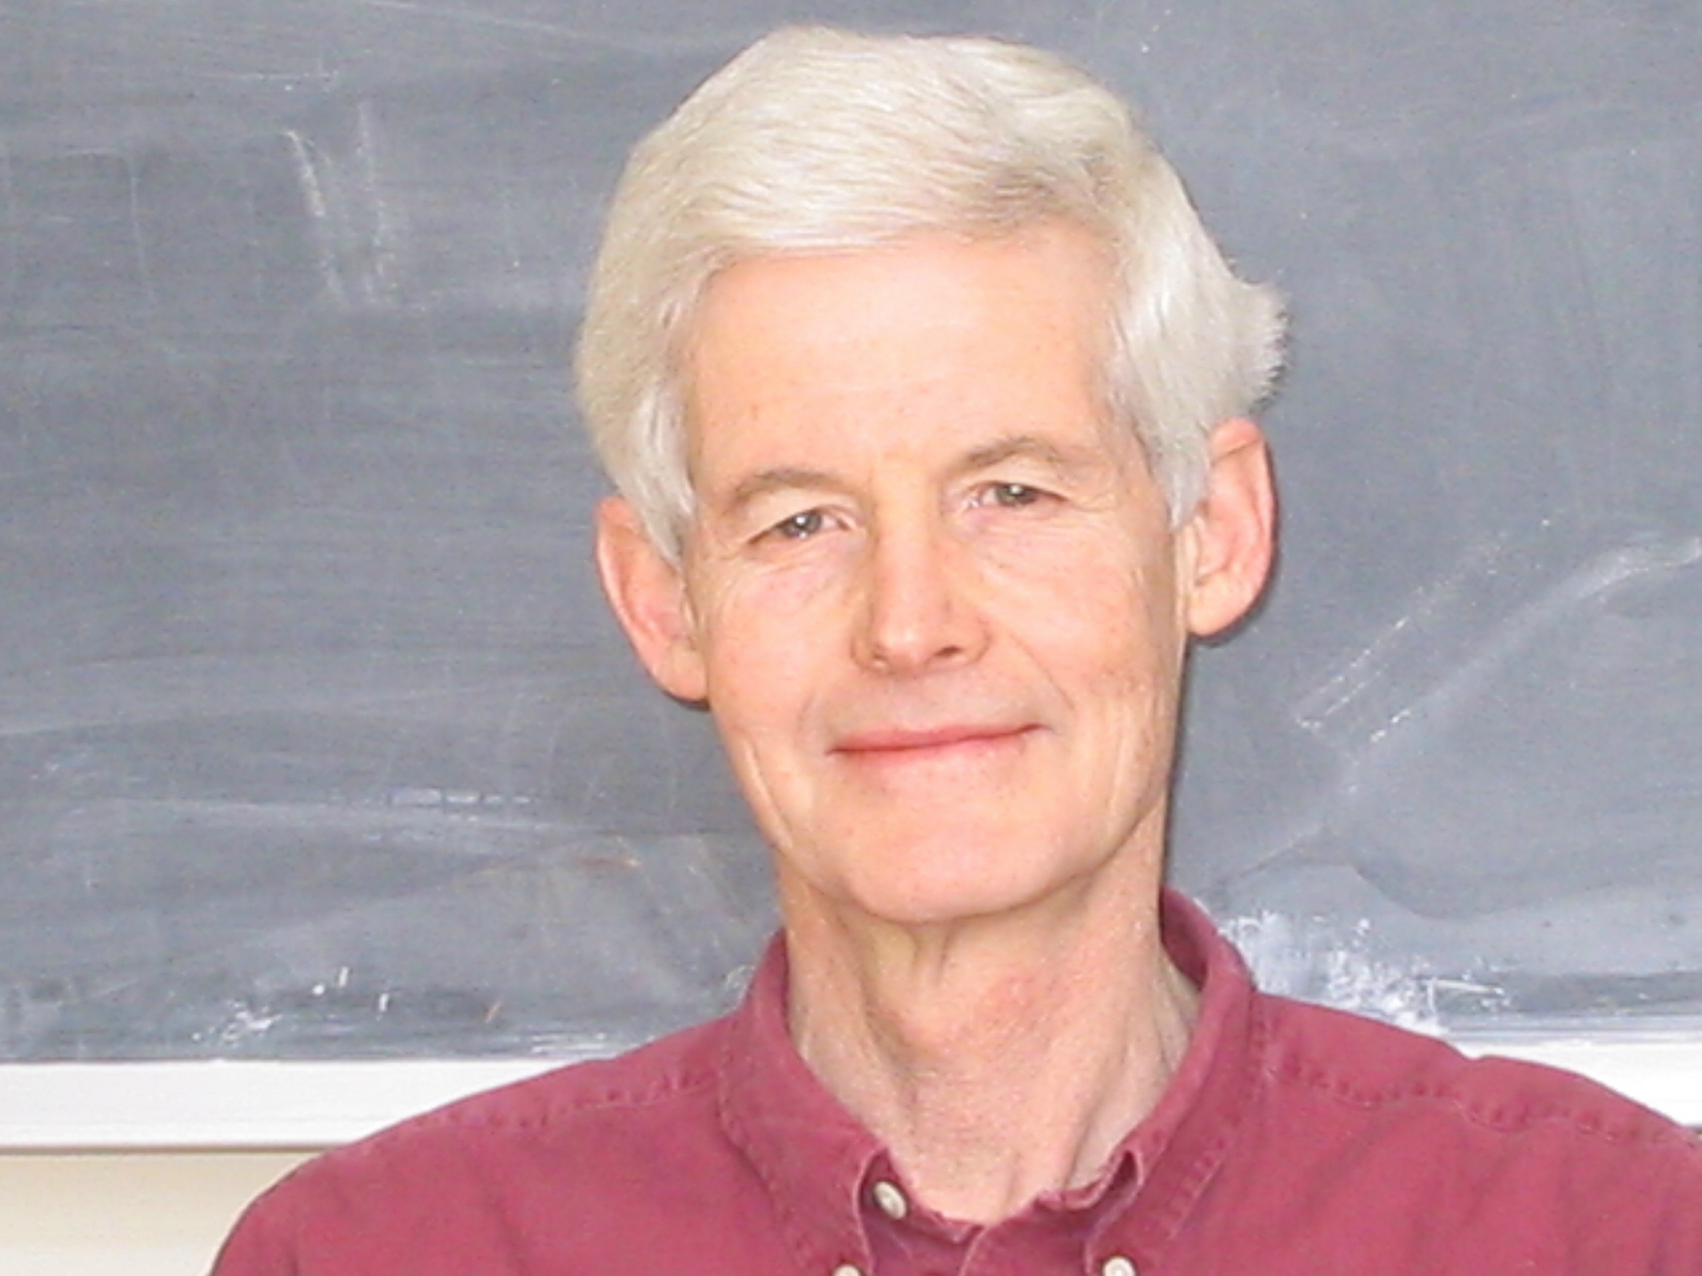
The $P$ vs $NP$ Problem
$SAT$ is $NP$-complete!
Poly-time languages
$$P=^{?}NP$$
Stephen A. Cook. The Complexity of Theorem-Proving Procedures.
2 / 17
https://www.cs.toronto.edu/~sacook/Steve_by_Yvonne.04.JPG

Slide 4
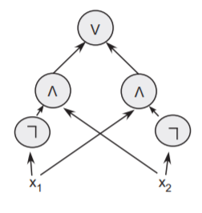
Some of the considerable efforts...
Circuit Lower Bounds
（towards $NP⊈P/_{poly}$)
Proof Lower Bounds
(towards $NP≠coNP$)
Theorem: $x_{1}∧x_{2}∧\left({\overline{x}}_{1}∨{\overline{x}}_{2}\right)$ is unsatisfiable.
Proof:
Goal: show that $SAT$ requires super-poly circuit size
Goal: Super-poly lower bound on the length of proofs in strong proof systems (e.g. Frege)
$$x_{1}$$
$${\overline{x}}_{1}∨{\overline{x}}_{2}$$
$${\overline{x}}_{2}$$
$$x_{2}$$
$$⊥$$
State-of-the-art:
$NP$ requires $3.1n−o\left(n\right)$ circuit size… (Li-Yang’22)
Theorem: $¬¬¬¬¬¬¬¬True$.
Proof: $$¬¬¬¬¬¬¬¬True \\ ⟸¬¬¬¬¬¬True \\ ⟸¬¬¬¬True \\ ⟸¬¬True \\ ⟸True.$$
State-of-the-art:
Trivial $Ω\left(n^{2}\right)$ bound…
(Lemma 4.4.12, Krajíček’95)
Open: Does $E^{NP}$ require $10n$ size?
3 / 17

Slide 5
How difficult is $P$ vs $NP$?
Do we just need to hit it harder?
Or maybe mathematics is not ready yet for $P$ vs $NP$?????
The more I think about $P$ versus $NP$, the less I understand about it.
——R. Ryan Williams
Some Estimated Likelihoods For Computational Complexity, 2019
????????????????????????????????????????????????????????????????????????????
Algebrization
(Aaronson-Wigderson)
Natural Proofs
(Razborov-Rudich)
More…
Relativization
(Baker-Gill-Solovay)
$P$ vs $NP$
Locality
(Chen-Hirahara-Oliveira-Pich-Rajgopal-Santhanam)
Bounded Relativization
(Hirahara-Lu-Ren)
重音テト MMD by Chemikarma (https://www.deviantart.com/chippedlilac/art/chemikarma-sd-teto-download-teto-birthday-gift-444304333)
https://pixabay.com/vectors/barrier-construction-road-street-1292873/
https://pixabay.com/vectors/trophy-gold-cup-yellow-pattern-309685/
4 / 17

Slide 6
Or, maybe like this?
$P$ vs $NP$
!!!!
Algebrization
(Aaronson-Wigderson)
Natural Proofs
(Razborov-Rudich)
Relativization
(Baker-Gill-Solovay)
https://babaiswiki.fandom.com/wiki/WHAT
5 / 17

Slide 7
Capturing via bounded arithmetic?
strong
Let’s try to establish the unprovability / independence of complexity lower bounds from weak theories!
(Razborov’95a, 95b)
Some strengthening of $NP≠coNP$
Unprovable in $PV$
(Pich-Santhanam 21)
Unprovable in very weak theories (Razborov 95)
Alexander Razborov
$$SAT∉P/_{poly}$$
Big open problem…
Theories of bounded arithmetic
Monotone circuit lower bounds
Provable in weak theories!
(Müller-Pich 20)
$$PV$$
“poly-time reasoning”
$$T_{2}^{1}$$
“$P^{NP}$-reasoning”
$$V_{2}^{1}$$
“exp-time reasoning”
$$PARITY∉{AC}^{0}$$
weak
https://cs.uchicago.edu/people/alexander-a-razborov/
https://pixabay.com/illustrations/dog-cartoon-dog-illustration-kid-dog-4841703/
https://pixabay.com/vectors/fox-animal-wild-nature-forest-3385002/
https://pixabay.com/vectors/elephant-animal-cartoon-wildlife-6087079/
6 / 17

Slide 8
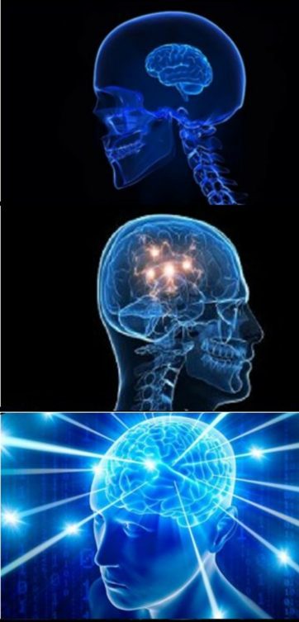
Reverse Math. of Lower Bounds
Reversals
Normally, we use axioms to derive theorems.
To show that the axioms are necessary, we assume the theorem and derive the axioms back!
Can you prove my lower bound?
Can $PV$ (“poly-time reasoning”) prove my lower bound?
Example (Chen-Li-Oliveira’24)
Some interesting lower bound can be proved from WPHP (weak pigeonhole principle).
Turns out that WPHP follows from this lower bound as well!
WPHP is sufficient and necessary for proving this lower bound!
What is the exact reasoning power needed to prove my lower bound?
7 / 17
https://pixabay.com/photos/cat-red-tomcat-cat-face-5496162/

Slide 9
Refuter problems (in circuit complexity)
If the lower bound is true, then this problem is a total search problem!
Proposal
Use the computational complexity of “refuter problems” to capture the provability of lower bounds.
Hence, it makes sense to study these refuter problems as $TFNP$* problems…
Circuit Lower Bound
Every size-$s$ circuit fails to compute $L$.
*: If $L∈P$ then the refuter problem is in $TFNP$.
What’s the complexity of these problems in $TFNP$?
Refuter Problem
(Chen-Jin-Santhanam-Williams’21, Chen-Tell-Williams’23)
Input: size-$s$ circuit $C$
Output: string $x$ such that $C\left(x\right)≠L\left(x\right)$.
Example: $PARITY∉{AC}^{0}$ (Hastad’86)
Input: a depth-$d$ size-$2^{n^{0.9/d}}$ ${AC}^{0}$ circuit $C$ attempting to compute $PARITY$
Output: string $x$ such that $C\left(x\right)≠PARITY\left(x\right)$.
8 / 17

Slide 10
Witnessing Theorems
Bounded reverse mathematics:
$$∀x∃y, V\left(x,y\right)=1$$
$TFNP$:
On input $x$, find $y$ such that $V\left(x,y\right)=1$
How hard is it to prove $∀x∃y,V\left(x,y\right)=1$?
How hard is it to find such a $y$ given an input $x$?
How hard is it to prove:
For every size-$s$ circuit $C$, there exists an input $x$ such that $C\left(x\right)≠L\left(x\right)$.
Witnessing Theorems
How hard is it to “refute”:
Given a size-$s$ circuit $C$, find an input $x$ such that $C\left(x\right)≠L\left(x\right)$.
“$𝒯$ proves the totality of $L$” $⟹$ “$L$ is in the class $C_{𝒯}$”
“$L$ is provably total in $PV$” $⟹L∈FP$
“$L$ is provably total in $T_{2}^{1}$” $⟹L∈PLS$ (Buss-Krajíček)
“$L$ is provably total in $V_{2}^{1}$” $⟹$ $L$ reduces to $WrongProof\left(Extended Frege\right)$ (Beckmann-Buss)
Reversal: “$T_{2}^{1}$-reasoning” is necessary & sufficient for proving my theorem!
Completeness: my total search problem is $PLS$-complete!
Image by pikisuperstar on Freepik
If you consider “universal” variants of these theories, these results become equivalences! (see e.g. Müller’21)
9 / 17
https://www.freepik.com/free-vector/realistic-chalk-blackboard_19380853.htm

Slide 11
Example: How hard is $NP$ vs $P/_{poly}$?
For every poly-size circuit $C$ attempting to solve $SAT$, there exists an input $φ$ such that $C\left(φ\right)≠SAT\left(φ\right)$.
Conjecture: $SAT⊈P/_{poly}$
Input: a poly-size circuit $C$ attempting to solve $search$-$SAT$
Output: $φ$ and $a$
Valid solutions: $φ\left(a\right)=1$ but $C\left(φ\right)$ fails to output a satisfying assignment of $φ$
For every poly-size circuit $C$ attempting to solve $search$-$SAT$, there exists an input $φ$ and a satisfying assignment $a$ such that $φ\left(a\right)=1$ but $C(φ)$ fails to output a satisfying assignment of $φ$.
??
Wait! This problem is in poly-time (under plausible assumptions)! [Pich-Santhanam’23]
$$PPA$$
$$PPP$$
$$PLS$$
This problem is total iff $SAT⊈P/_{poly}$.
$$PPAD$$
$$CLS$$
How hard is it compared with our $TFNP$ hierarchy?
$$FP$$
10 / 17

Slide 12
Example: How hard is $NP$ vs $P/_{poly}$?
Input: a poly-size circuit $C$ attempting to solve $search$-$SAT$
Output: $φ$ and $a$
Valid solutions: $φ\left(a\right)=1$ but $C\left(φ\right)$ fails to output a satisfying assignment of $φ$
Open Problem
How hard is this (total???) search problem, and how shall we quantify its hardness?
Observations [PS23]
OWF $⟹$ This refuter problem is in $TFZPP$.
OWF + derandomisation $⟹$ This refuter problem is in $FP$.
(Unconditional) anti-checkers $⟹$ This refuter problem is in $FP/_{poly}$.
Next: refuters for proof complexity in the traditional $TFNP$ regime!
11 / 17

Slide 13
Refuter problems (in proof complexity)
This step is illegal!
$$⊥$$
Axioms
Intermediate derivations
Final contradiction
(# of steps $≤ℓ$)
Proof Lower Bound
For every length-$ℓ$ $𝒫$-proof $π$ claiming to prove $φ$, there exists an invalid derivation step in $π$.
Proof Lower Bound
There is no length-$ℓ$ $𝒫$-proof of $φ$.
Decision Tree $TFNP$ (${TFNP}^{dt}$)
Input length: $N$
Each solution can be verified in decision-tree depth $polylog\left(N\right)$
(Think of each node has size $poly\left(n\right)$, but $N, ℓ \sim \exp\left(n\right)$.)
Refuter Problem
Input: purported length-$ℓ$ $𝒫$-proof $π$ for $φ$
Output: index $i$ such that the $i$-th step is illegal.
12 / 17

Slide 14
Our results: refuter problems for resolution lower bounds
Why resolution?
It’s the most studied proof system.
Profound connections to SAT solving, query complexity etc…
It’s weak!
A vast literature of lower bounds: [H85, U87, CS88, CP90, BP96, S97, BW01, a lot more…]
Making it a nice “first step” for investigating metamathematics of proof complexity…?
What is resolution?
Resolution rule
Weakening rule
$$\frac{C∨ℓ D∨\overline{ℓ}}{C∨D}$$
$$\frac{C}{C∨D}$$
There are perhaps more papers published about proof complexity of resolution than about all remaining proof complexity topics combined.
——Jan Krajíček, Proof Complexity (2019)
$ℓ$: literal ($x_{i}$ or ${\overline{x}}_{i}$)
$C, D$: clauses (ORs of literals)
$$x_{1}$$
$${\overline{x}}_{1}∨{\overline{x}}_{2}$$
$${\overline{x}}_{2}$$
$$x_{2}$$
$$⊥$$
A resolution refutation of $x_{1},x_{2},{\overline{x}}_{1}∨{\overline{x}}_{2}$
13 / 17

Slide 15
Our results: refuter problems for resolution lower bounds
Classical theorem (Haken’85):
The pigeonhole principle ($PHP$) requires $>{1.01}^{n}$ resolution proof length.
Problem $Refuter(Haken)$
Input: a (succinctly represented) length-${1.01}^{n}$ resolution proof $π$ for $PHP$
Output: an index $i$ such that the $i$-th step is invalid
Our result: $Refuter(Haken)$ is $rwPHP\left(PLS\right)$-complete!
This step violates resolution rules…
A new $TFNP$ class in this paper!
$$⊥$$
Axioms of $PHP$
Intermediate derivations
Final contradiction
It comes from the witnessing theorem of $T_{2}^{1}+dwPHP\left(PV\right)$, so not really a new one ☺
(# of steps $<{1.01}^{n}$)
14 / 17

Slide 16
The metamathematics of resolution lower bounds
Resolution requires exp-size to prove:
Pigeonhole principle (Haken’85, Beame-Pitassi’96)
Tseitin principle (Urquhart’87, Schöning’97)
Random $k$-CNFs (Chvátal-Szemerédi’88, Beame-Pitassi’96)
$XOR$-lifted formulas (Dantchev-Riis’03)
Result II: The refuter problem for ANY* resolution lower bound is $rwPHP\left(PLS\right)$-hard.
Proof sketch: if $rwPHP\left(PLS\right)$ were not total, then construct a short resolution proof for any theorem!
(Spoiler: the proof is stolen(?) from Atserias--Müller’19 and its exposition in [dRGNPRS21].)
Result I: All these refuter problems are in $rwPHP\left(PLS\right)$, because these lower bounds can be proved by “random restriction + width lower bounds”.
Interpretation:
“$rwPHP\left(PLS\right)$-reasoning” is sufficient for implementing a popular lower bound technique for resolution;
“$rwPHP\left(PLS\right)$-reasoning” is necessary if we want to prove ANY resolution lower bound at all!
In other words, we formalised these lower bounds in $T_{2}^{1}\left(α\right)+dwPHP\left(PV\left(α\right)\right)$.
Notable exception: general size-width tradeoffs (Ben-Sasson & Wigderson 01)
*Technically, need the lower bound to be subexponential.
15 / 17
https://pixabay.com/photos/kitten-cat-pet-feline-animal-fur-4557097/

Slide 17
Metamathematics of lower bounds
Circuit Complexity
Proof Complexity
General circuits
Frege
Can’t prove lower bounds
$${TC}^{0}$$
Rigid matrices
${AC}^{0}\left[2\right]$-Frege
${AC}^{0}\left[2\right]$-Frege
$${AC}^{0}\left[6\right]$$
One-tape Turing machine (with advice)
Res($⊕$)
Cutting Planes
Can prove lower bounds
Meta-complexity: $rwPHP$
(Korten’22, Chen-Li-Oliveira’24)
${AC}^{0}$-Frege
$${AC}^{0}\left[2\right]$$
Resolution
That is: $rwPHP\left(PLS\right)$ is necessary for proving any resolution lower bound!
Streaming Algorithms (with advice)
Speculation: [some axiom] is necessary for proving any ${AC}^{0}\left[2\right]$-Frege lower bound?
$${AC}^{0}$$
Meta-complexity: $rwPHP\left(PLS\right)$ (this work)
Connection to $P$ vs $BPP$
(Chen-Jin-Santhanam-Williams’21, Chen-Tell-Williams’23)
16 / 17

Slide 18
Summary
Refuter Problem (Circuit lower bounds)
Input: size-$s$ circuit $C$
Output: string $x$ such that $C\left(x\right)≠L\left(x\right)$.
Open problem I: Is the following $TFNP$ problem “difficult” in some sense?
Input: poly-size circuit $C$ attempting to solve $searchSAT$
Output: $φ,a$ such that $φ\left(a\right)=1$ but $C\left(φ\right)$ is not a satisfying assignment of $φ$
Main Results
$rwPHP\left(PLS\right)$ captures the “minimum reasoning power” for proving resolution lower bounds!
Proposal
The metamathematical difficulty of proving lower bounds can be captured by the computational complexity of these refuter problems!
Open problem II: Find a “large” subclass $𝒞⊆TFNP$ such that “$𝒞$-reasoning” is necessary for proving lower bounds against ${AC}^{0}\left[2\right]$-Frege.
Refuter Problem
(Proof lower bounds)
Input: length-$ℓ$ proof $π$ for $φ$
Output: index $i$ such that the $i$-th step is invalid.
Thank you!
Questions are welcome!
17 / 17

Slide 19
Glance of the hardness result
rwPHP = “retraction weak pigeonhole principle”
Theorem* (Informal)
The refuter problem corresponding to ANY (subexp) resolution lower bound is $rwPHP\left(PLS\right)$-hard.
$rwPHP$ (as a search problem)
Input: functions $f:\left[N\right]→\left[2N\right]$ and $g:\left[2N\right]→\left[N\right]$
Output: $x∈\left[2N\right]$ such that $g\left(f\left(x\right)\right)≠x$
Given: instance $\left(f,g\right)$ of $rwPHP$
Goal: reduce it to an instance $π$ of the refuter problem (which is a resolution proof)
Such that: given an invalid derivation in $π$, can find $x∈\left[2N\right]$ such that $g\left(f\left(x\right)\right)≠x$.
$$f$$
$$g$$
$$x$$
$rwPHP$ (as a mathematical fact)
For any two functions $f:\left[N\right]→\left[2N\right]$ and $g:\left[2N\right]→\left[N\right]$, there exists $x∈\left[2N\right]$ such that $g\left(f\left(x\right)\right)≠x$.
Idea: If $rwPHP$ were not true (for $\left(f,g\right)$), then every theorem would have short resolution proofs (constructed from $\left(f,g\right)$)!
*Remark: The proof of it is stolen(?) from Atserias--Müller’19 (Automating resolution is $NP$-hard) and its exposition in [dRGNPRS21].
18 / 22

Slide 20
The world if $rwPHP$ is false:
Assume: there is a bijection between $\left[N\right]$ and $\left[2N\right]$
There are $f:\left[N\right]→\left[2N\right]$ and $g:\left[2N\right]→\left[N\right]$ such that for every $x∈\left[2N\right]$, $f\left(g\left(x\right)\right)=x$.
“Pigs can fly”
Goal: prove every theorem that’s true, within resolution size $poly\left(N,n\right)$
Equivalent to solving every problem within decision DAG size $poly\left(N,n\right)$
Pig airlines
https://clipart-library.com/clipart/725472.htm
https://clipart-library.com/clipart/plane-cliparts-7.htm
19 / 22

Slide 21
The naïve decision tree…
…has size ${\sim 2}^{n}$
$$x_{1}$$
$$0$$
$$1$$
$$x_{2}$$
$$x_{2}$$
$$0$$
$$1$$
$$0$$
$$1$$
$$x_{3}$$
$$x_{3}$$
$$x_{3}$$
$$x_{3}$$
$$0$$
$$1$$
$$0$$
$$1$$
$$0$$
$$1$$
$$0$$
$$1$$
$$x_{4}$$
$$x_{4}$$
$$x_{4}$$
$$x_{4}$$
$$x_{4}$$
$$x_{4}$$
$$x_{4}$$
$$x_{4}$$
$$x_{n}$$
$$x_{n}$$
$$x_{n}$$
$$x_{n}$$
$$……$$
$$x_{n}$$
$$x_{n}$$
$$x_{n}$$
$$x_{n}$$
20 / 22

Slide 22
Compressing layers
RECALL
There are $f:\left[N\right]→\left[2N\right]$ and $g:\left[2N\right]→\left[N\right]$ such that for every $x∈\left[2N\right]$, $f\left(g\left(x\right)\right)=x$.
Layer $i$
($N$ nodes)
$$0$$
$$1$$
$$0$$
$$1$$
Layer $i+0.5$
($2N$ nodes)
$$¬rwPHP$$
Layer $i+1$
($N$ nodes)
Choose the nodes $f\left(1\right),f\left(2\right),…,f\left(N\right)$.
For each $i∈\left[2N\right]$, the $i$-th node appears in the $g\left(i\right)$-th position.
Task: select $N$ nodes from these $2N$ nodes in layer $i+0.5$ so that all the $2N$ nodes are selected (!!!)
21 / 22
https://pixabay.com/vectors/bulb-electricity-halo-idea-light-1293332/

Slide 23
The compressed decision DAG
Given $f:\left[N\right]→\left[2N\right]$ and $g:\left[2N\right]→\left[N\right]$ violating $rwPHP$ (meaning that for every $x∈\left[2N\right]$, $f\left(g\left(x\right)\right)=x$), we can create this decision DAG of size $poly\left(N,n\right)$ solving ALL and ANY problem.
$$…$$
$$width=N$$
$$width=2N$$
Hence a moderate-size resolution proof of ANY theorem!
$$width=N$$
$$width=2N$$
In reality, such $\left(f,g\right)$ cannot exist. But given any step that the resolution proof is wrong, we can spot out some $x$ such that $f\left(g\left(x\right)\right)≠x$.
$$…$$
$$width=N$$
$$width=2N$$
$$width=N$$
This is a reduction from $rwPHP$ to the refuter problem!
22 / 22

Slide 24
$$rwPHP\left(PLS\right)$$
Dictionary
$$rwPHP$$ | Retraction Weak PigeonHole Principle There’s no bijection between $\left[N\right]$ and $\left[2N\right]$.
$$PLS$$ | Polynomial Local Search Every non-empty subset of $\left[N\right]$ has a least element.
$$rwPHP\left(PLS\right)$$
Same as $rwPHP$, but every $g\left(x\right)$ needs a $PLS$-oracle to compute ☺
$$rwPHP$$
Input: functions $f:\left[N\right]→\left[2N\right]$ and $g:\left[2N\right]→\left[N\right]$
Output: $x∈\left[2N\right]$ such that $g\left(f\left(x\right)\right)≠x$
$$PLS$$
Input: function $S:\left[N\right]→\left[N\right]$
Output: $x∈\left[N\right]$ satisfying one of the following:
$x=1$ and $S\left(x\right)=x$
$S\left(x\right)<x$
$S\left(x\right)>x$ and $S\left(S\left(x\right)\right)=S\left(x\right)$
$$f$$
$$g$$
$$x$$
$$x$$
23 / 26

Slide 25
$$rwPHP\left(PLS\right)$$
$$rwPHP\left(PLS\right)$$
Inputs
a function $f:\left[N\right]→\left[2N\right]$
$2N$ $PLS$ instances $I_{1}…I_{2N}$
$g_{y,j}∈\left[N\right]$ for every $y∈\left[2N\right]$ and valid answer $j$ for $I_{y}$
Outputs
A number $y∈\left[2N\right]$
A valid answer $j$ for $I_{y}$
Such that $f\left(g_{y,j}\right)≠y$
$$f$$
$$I_{1}$$
$$I_{2}$$
$$I_{n}$$
$$g$$
$$…$$
24 / 26

Slide 26
Random restriction…
… in $T_{2}^{1}+dwPHP\left(PV\right)$?
Haken’s proof (as simplified by Beame-Pitassi’96)
Step 1: Pick a random restriction $ρ$ (in some way)
Step 2: If $Π$ is a size-$s$ resolution proof for $PHP$, then w.h.p. over $ρ$, $Π{\left.​\right|}_{ρ}$ is a width-$w\left(s\right)$ resolution proof for (a smaller version of) $PHP$
Step 3: Prove that $PHP$ does not have a width-$w\left(s\right)$ resolution proof
$$Π=$$
$$⊥$$
$$⊥$$
Final contradiction
Intermediate derivations
Final contradiction
Axioms of $PHP$
Intermediate derivations
Axioms of $PHP$
With high probability over $ρ$
(Provable from dwPHP)
Step 1-2
You can create a map $f:\left[0.1L\right]→\left[L\right]$ such that anything outside $Range\left(f\right)$ encodes a good $ρ$.
($L=$ total number of possible restrictions $≤2^{polylog\left(N\right)}$)
By dwPHP (dual weak pigeonhole principle), there exists some good $ρ$.
$$Π|_{ρ}=$$
Step 3: provable in $T_{2}^{1}$
(or, in “$PLS$-reasoning”)
Width of $Π{\left.​\right|}_{ρ}$ is small!
25 / 26

Slide 27
Random restriction…
… in $rwPHP\left(PLS\right)$?!
Restrictions:
$$f$$
Any $ρ∉Range\left(f\right)$ is a good restriction!
($Π{\left.​\right|}_{ρ}$ has small width)
Either $sol$ is an illegal derivation, or $sol$ is a “fat clause” that $ρ$ fails to simplify.
In the latter case, you can use $sol$ to “compress” $ρ$.
$g\left(sol\right)=$compression of $ρ$
$$I_{ρ}$$
Some $PLS$ instance capturing “the width of $Π{\left.​\right|}_{ρ}$ is too small to prove $PHP$”
Solution $sol$ of $I_{ρ}$
Restrictions:
$$ρ$$
$f\left(g\left(sol\right)\right)≠ρ⇒ρ$ is a good restriction $⇒sol$ is an illegal derivation.
26 / 26
Notes:
Good restriction = successfully shrinks the proof into low width

