Slide 1
Reverse Mathematics of Complexity Lower Bounds
Part I
Hanlin Ren
March 10, 2026 @ IAS CSDM Seminar

Slide 2

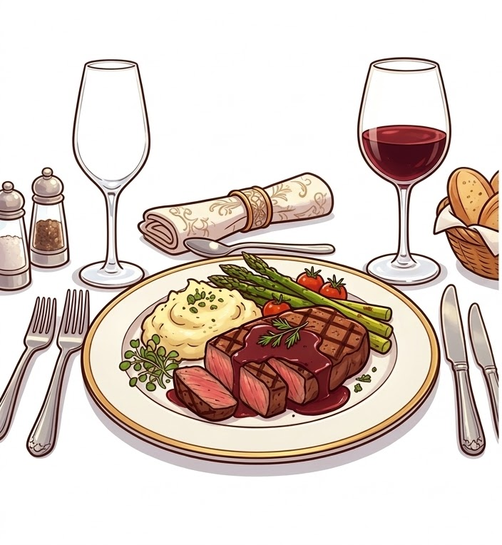

In Today’s Episode
Motivation (Why study “Reverse Mathematics of Complexity Lower Bounds”?)
How to talk about “this lower bound is stronger than that one”?
4.
https://pixabay.com/illustrations/tv-vintage-television-old-675805/
Picture generated by Gemini

Slide 3
Motivation
Why study “reverse mathematics of complexity lower bounds”?

Slide 4

https://simons.berkeley.edu/programs/lower-bounds-computational-complexity

Slide 5
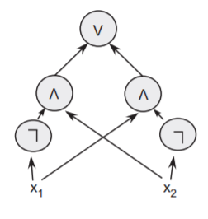

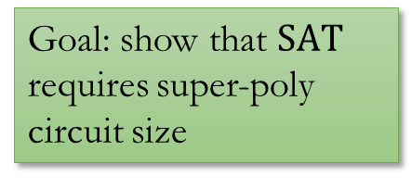
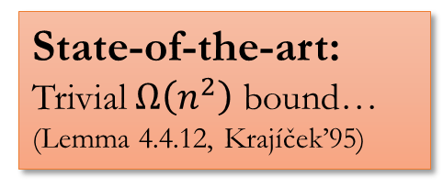
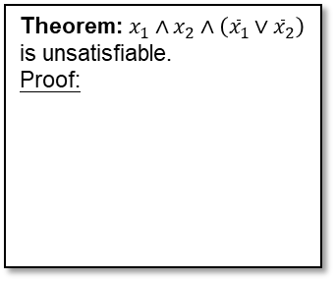




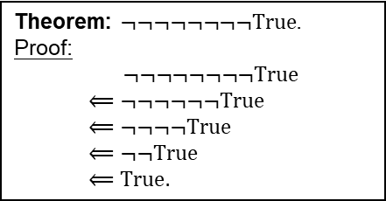
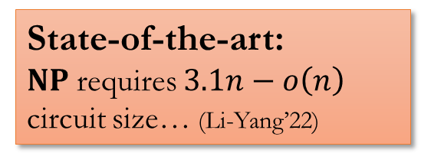

Lower Bounds Are Hard To Prove.
Circuit Lower Bounds
Proof Lower Bounds
Theorem: $x_{1}∧x_{2}∧\left({\overline{x}}_{1}∨{\overline{x}}_{2}\right)$ is unsatisfiable.
Proof:
Goal: show that $SAT$ requires super-poly circuit size
Goal: Super-poly lower bound on the length of proofs in strong proof systems (e.g. Frege)
$$x_{1}$$
$${\overline{x}}_{1}∨{\overline{x}}_{2}$$
$${\overline{x}}_{2}$$
$$x_{2}$$
$$⊥$$
State-of-the-art:
$NP$ requires $3.1n−o\left(n\right)$ circuit size… (Li-Yang’22)
Theorem: $¬¬¬¬¬¬¬¬True$.
Proof: $$¬¬¬¬¬¬¬¬True \\ ⟸¬¬¬¬¬¬True \\ ⟸¬¬¬¬True \\ ⟸¬¬True \\ ⟸True.$$
State-of-the-art:
Trivial $Ω\left(n^{2}\right)$ bound…
(Lemma 4.4.12, Krajíček’95)
Open: Does $E^{NP}$ require $10n$ size?

Slide 6



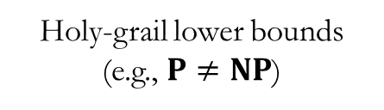
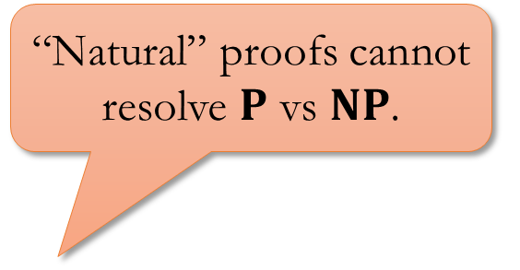
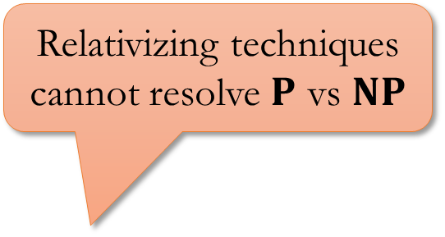
Circuit Complexity
Diagonalization
Hardness Magnification
KRW Conjecture
$$IP=PSPACE$$
“Natural” proofs cannot resolve $P$ vs $NP$.
Relativizing techniques cannot resolve $P$ vs $NP$
Holy-grail lower bounds (e.g., $P≠NP$)
Algebrization
(Aaronson-Wigderson)
Natural Proofs
(Razborov-Rudich)
More…
Relativization
(Baker-Gill-Solovay)
Locality
(Chen-Hirahara-Oliveira-Pich-Rajgopal-Santhanam)
Bounded Relativization
(Hirahara-Lu-Ren)
https://pixabay.com/vectors/barrier-construction-road-street-1292873/

Slide 7
$P$ vs $NP$
Algebrization
(Aaronson-Wigderson)
Natural Proofs
(Razborov-Rudich)
Relativization
(Baker-Gill-Solovay)
https://babaiswiki.fandom.com/wiki/WHAT

Slide 8
Personal Opinion:
We don’t understand why complexity lower bounds are hard to prove…
Personal Opinion (a more controversial one?):
Nowadays, we are still drastically underestimating the difficulty of proving (strong) lower bounds!

Slide 9

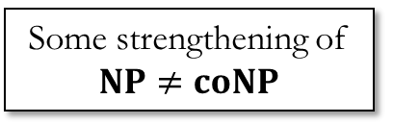


How hard is it to prove lower bounds?
strong
Unprovable in “poly-time reasoning”
(Pich-Santhanam 21)
Some strengthening of $NP≠coNP$
Unprovable in very weak theories (Razborov 95)
Alexander Razborov
$$SAT∉P/_{poly}$$
Let’s try to establish the unprovability / independence of complexity lower bounds from weak theories!
(Razborov’95a, 95b)
Big open problem…
Monotone circuit lower bounds
Provable in weak theories!
(Müller-Pich 20)
$$PARITY∉{AC}^{0}$$
weak
https://cs.uchicago.edu/people/alexander-a-razborov/

Slide 10
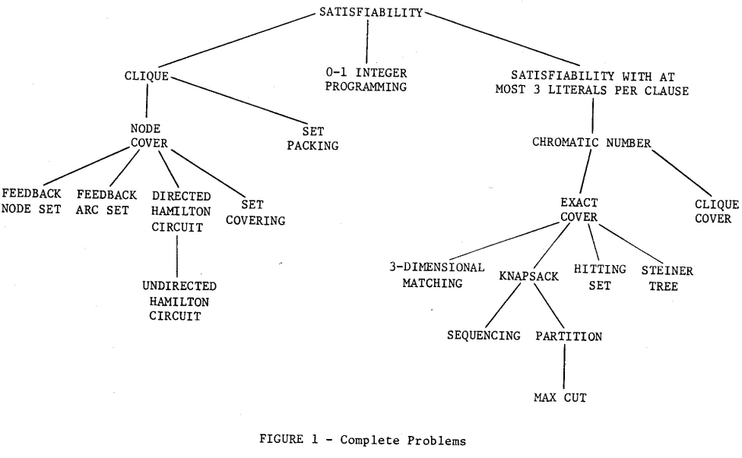
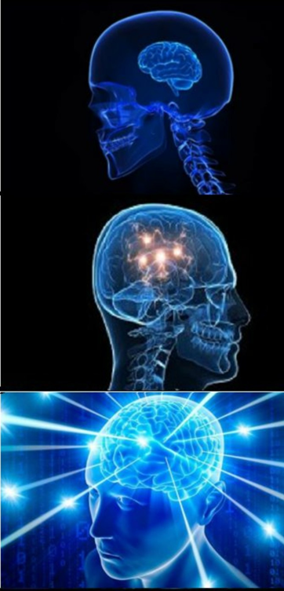
Reverse Mathematics
Reversals
Normally, we use axioms to derive theorems.
To show that the axioms are necessary, we assume the theorem and derive the axioms back!
Can you prove my lower bound?
Can “poly-time reasoning” prove my lower bound?
Why is reverse math of known lower bounds (still) interesting?
What is the exact reasoning power needed to prove my lower bound?
2. Speculate on stronger/unproved lower bounds?
1. Some intriguing phenomena happens!
Richard Karp.
Reducibility among combinatorial problems.

Slide 11
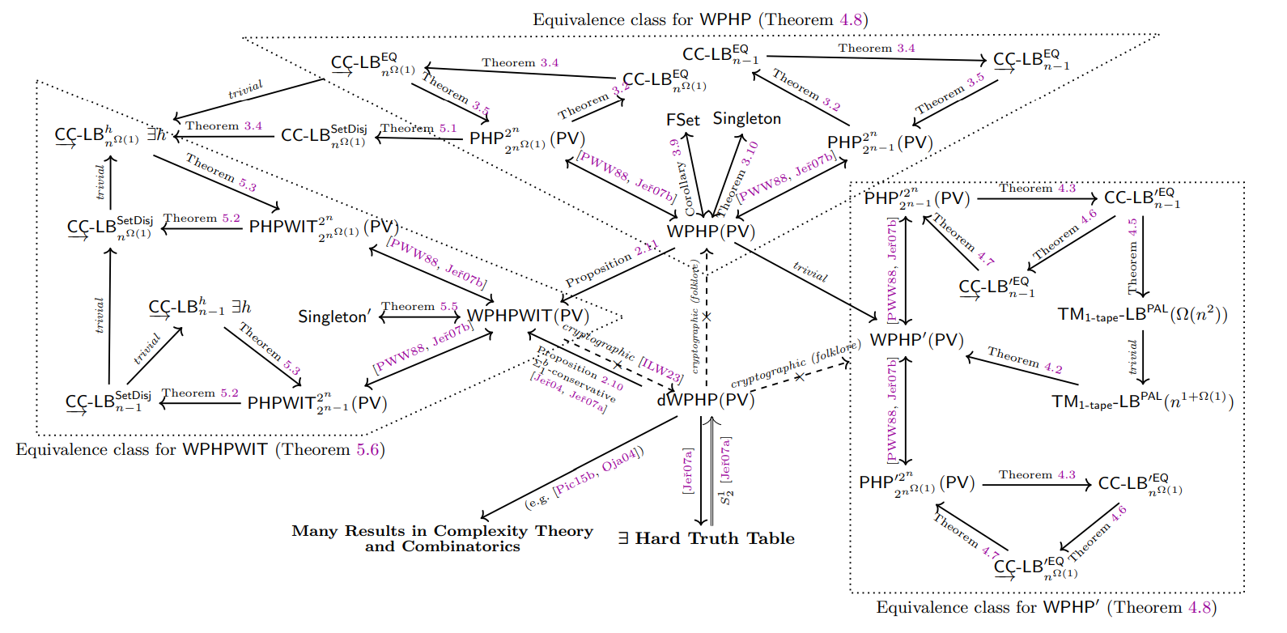
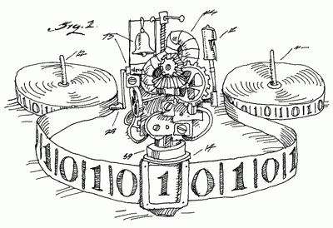
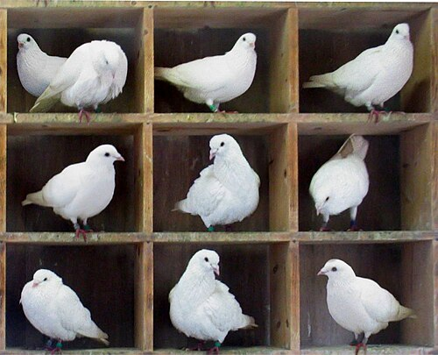

Phenomenon I: Lower bounds are classical combinatorial principles in disguise!
(today)
A classic & well-known lower bound against one-tape Turing machines (Maass’84)
(Weak) pigeonhole principle
$$≡$$
Would “SAT requires super-poly size circuits” turn out equivalent to some “combinatorial principle”?
Lijie Chen, Jiatu Li, and Igor C. Oliveira. Reverse Mathematics of Complexity Lower Bounds.
https://en.wikipedia.org/wiki/Pigeonhole_principle#/media/File:TooManyPigeons.jpg

Slide 12


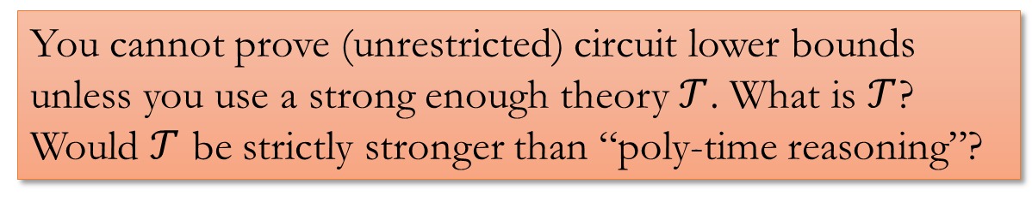


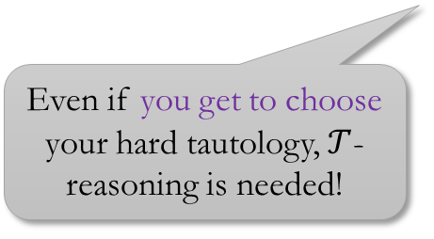

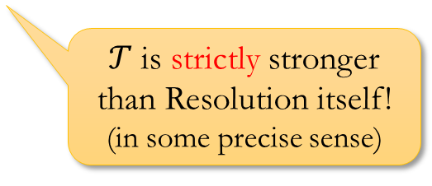
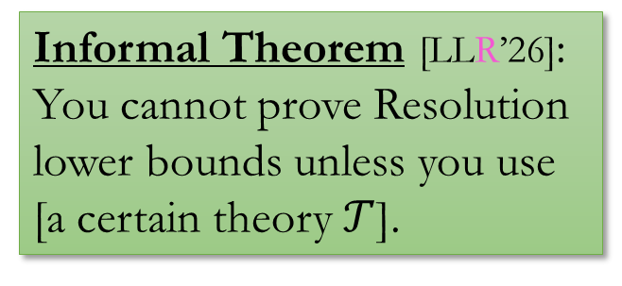
Phenomenon II: Minimum reasoning for analyzing your computational model!
(next week)
Informal Theorem [LLR’26]:
You cannot prove Resolution lower bounds unless you use [a certain theory $𝒯$].
$$x_{1}$$
$${\overline{x}}_{1}∨{\overline{x}}_{2}$$
$${\overline{x}}_{2}$$
$$x_{2}$$
$$⊥$$
Even if you get to choose your hard tautology, $𝒯$-reasoning is needed!
$𝒯$ is strictly stronger than Resolution itself! (in some precise sense)
Resolution proof system
(Many lower bounds known)
You cannot prove (unrestricted) circuit lower bounds unless you use a strong enough theory $𝒯$. What is $𝒯$? Would $𝒯$ be strictly stronger than “poly-time reasoning”?

Slide 13
How to talk about provability & reverse math?
A short answer & a long answer…

Slide 14
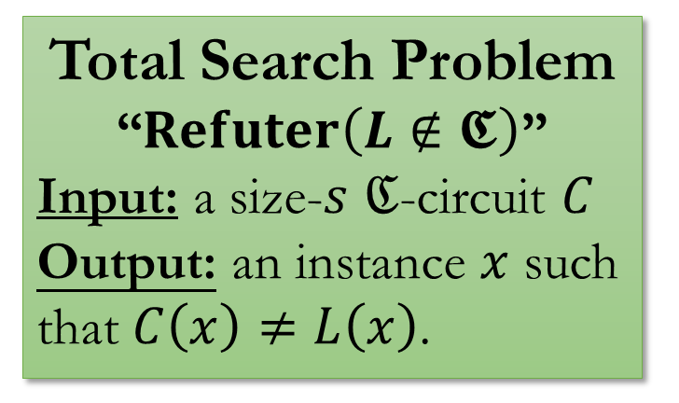
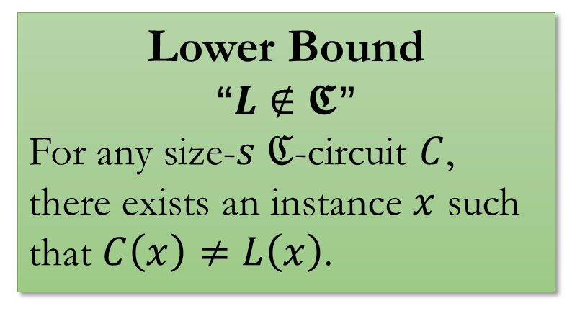
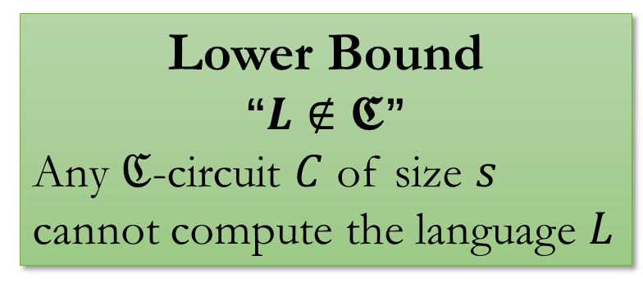
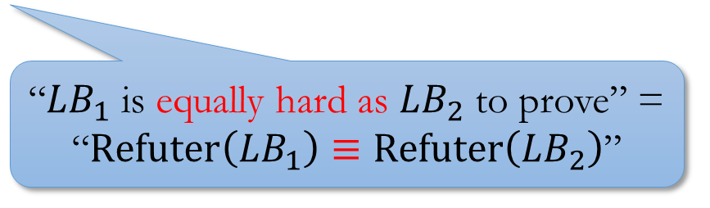
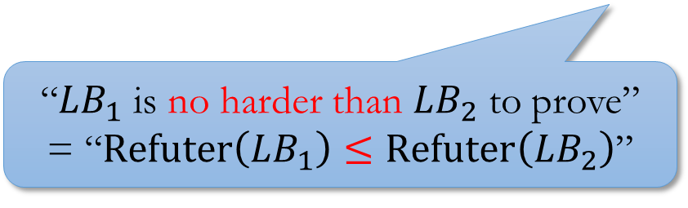
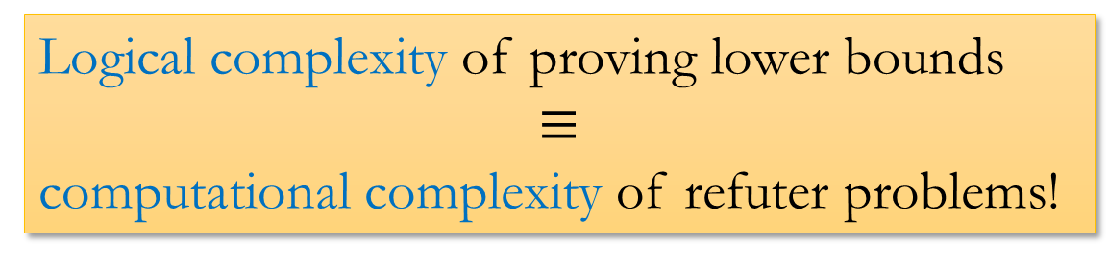
Short Answer: Refuter Problems
Lower Bound
“$L∉𝕮$”
For any size-$s$ $ℭ$-circuit $C$, there exists an instance $x$ such that $C\left(x\right)≠L\left(x\right)$.
Total Search Problem
“$Refuter\left(L∉𝕮\right)$”
Input: a size-$s$ $ℭ$-circuit $C$
Output: an instance $x$ such that $C\left(x\right)≠L\left(x\right)$.
Lower Bound
“$L∉𝕮$”
Any $ℭ$-circuit $C$ of size $s$ cannot compute the language $L$
Logical complexity of proving lower bounds
$$≡$$
computational complexity of refuter problems!
(to be justified)
“${LB}_{1}$ is no harder than ${LB}_{2}$ to prove” = “$Refuter\left({LB}_{1}\right)≤Refuter\left({LB}_{2}\right)$”
“${LB}_{1}$ is equally hard as ${LB}_{2}$ to prove” = “$Refuter\left({LB}_{1}\right)≡Refuter\left({LB}_{2}\right)$”

Slide 15
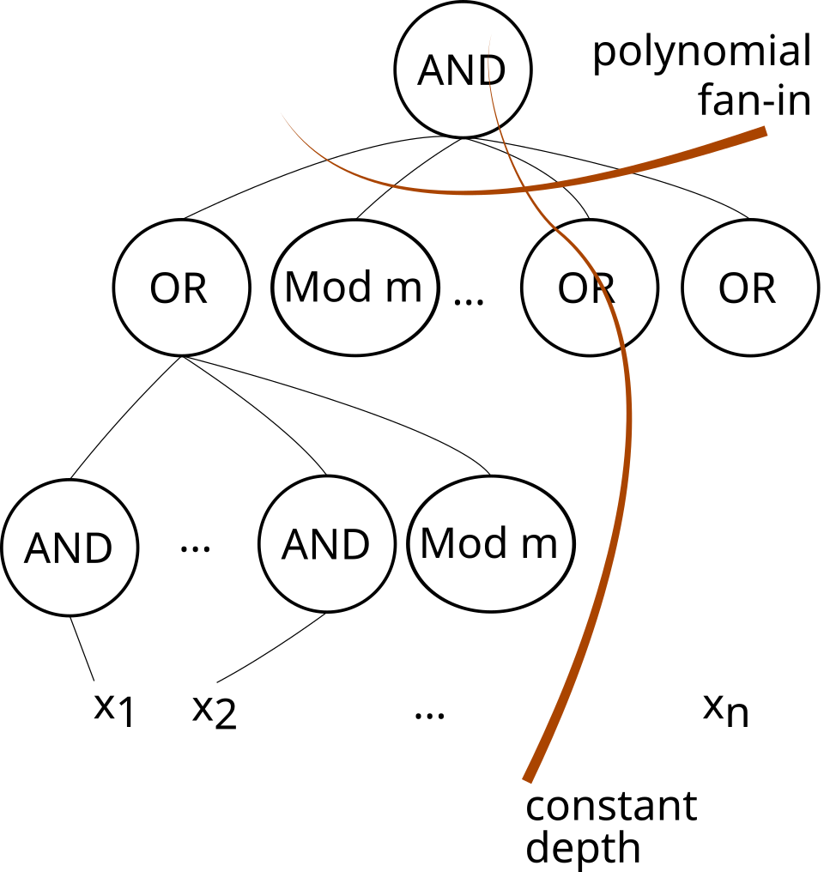
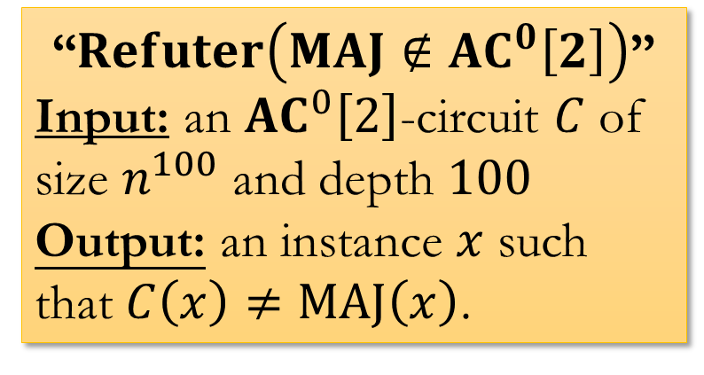
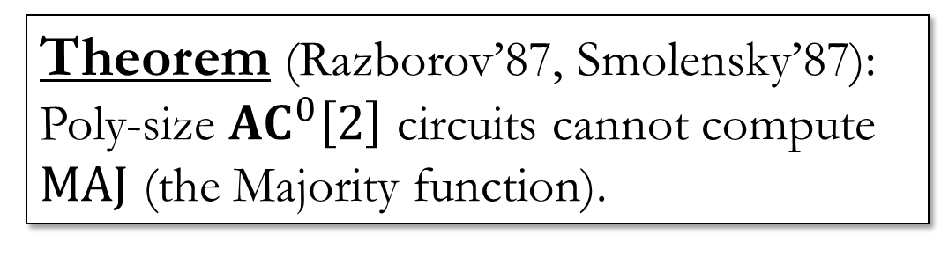
Examples
Theorem (Razborov’87, Smolensky’87):
Poly-size ${AC}^{0}\left[2\right]$ circuits cannot compute $MAJ$ (the Majority function).
“$Refuter\left(MAJ∉{AC}^{0}\left[2\right]\right)$”
Input: an ${AC}^{0}\left[2\right]$-circuit $C$ of size $n^{100}$ and depth $100$
Output: an instance $x$ such that $C\left(x\right)≠MAJ\left(x\right)$.
https://en.wikipedia.org/wiki/ACC0#/media/File:Diagram_of_an_ACC0_Circuit.svg

Slide 16
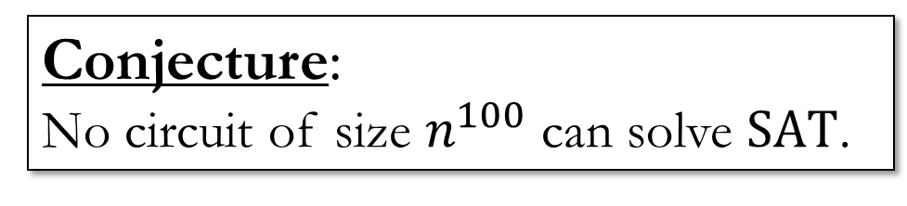
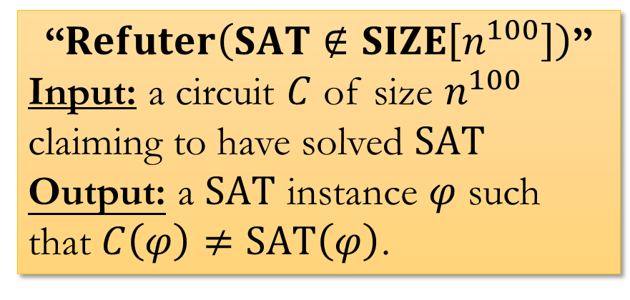

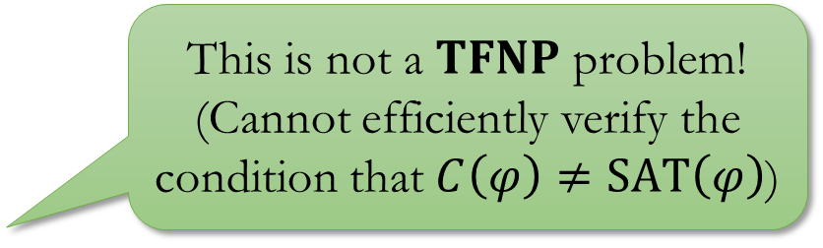
Examples
Conjecture:
No circuit of size $n^{100}$ can solve $SAT$.
“$Refuter\left(searchSAT∉SIZE\left[n^{100}\right]\right)$”
Input: a circuit $C$ of size $n^{100}$ claiming to have solved $searchSAT$
Output: a $SAT$ instance $φ$ and an assignment $a$ such that $φ\left(a\right)=1$ but $C\left(φ\right)$ does not output a satisfying assignment of $φ$.
“$Refuter\left(SAT∉SIZE\left[n^{100}\right]\right)$”
Input: a circuit $C$ of size $n^{100}$ claiming to have solved $SAT$
Output: a $SAT$ instance $φ$ such that $C\left(φ\right)≠SAT\left(φ\right)$.
This is not a $TFNP$ problem!
(Cannot efficiently verify the condition that $C\left(φ\right)≠SAT\left(φ\right)$)

Slide 17



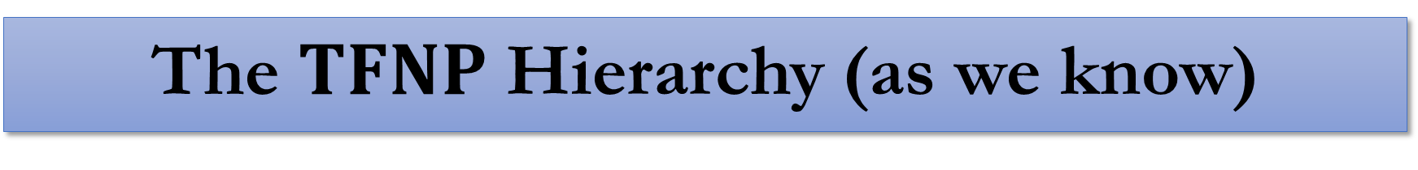





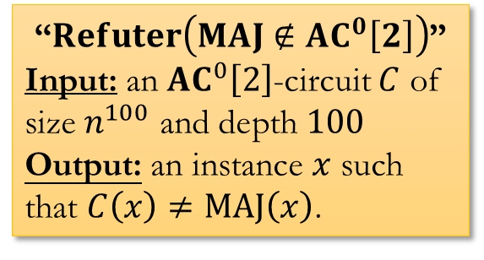



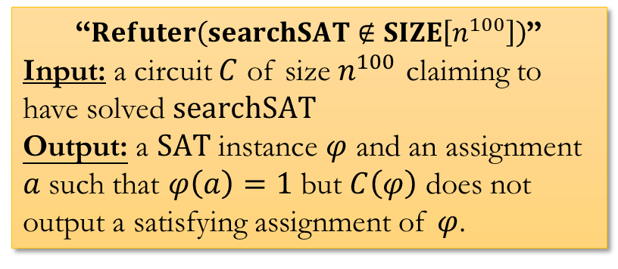
The $TFNP$ Hierarchy (as we know)
“$Refuter\left(searchSAT∉SIZE\left[n^{100}\right]\right)$”
Input: a circuit $C$ of size $n^{100}$ claiming to have solved $searchSAT$
Output: a $SAT$ instance $φ$ and an assignment $a$ such that $φ\left(a\right)=1$ but $C\left(φ\right)$ does not output a satisfying assignment of $φ$.
$$TFNP$$
?
$$…$$
$$…$$
$$…$$
$$PLS$$
$$PPP$$
$$PPA$$
?
“$Refuter\left(MAJ∉{AC}^{0}\left[2\right]\right)$”
Input: an ${AC}^{0}\left[2\right]$-circuit $C$ of size $n^{100}$ and depth $100$
Output: an instance $x$ such that $C\left(x\right)≠MAJ\left(x\right)$.
$$PPADS$$
$$SOPL$$
$$PPAD$$
$$EOPL$$

Slide 18
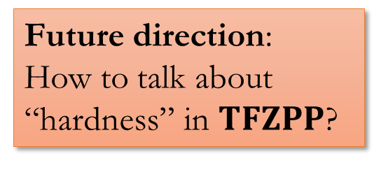


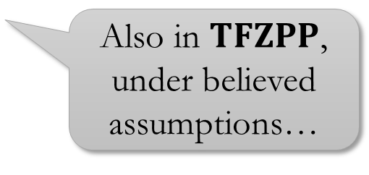
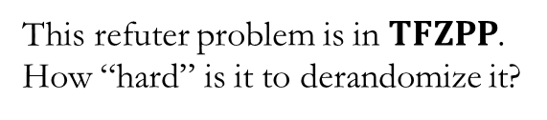
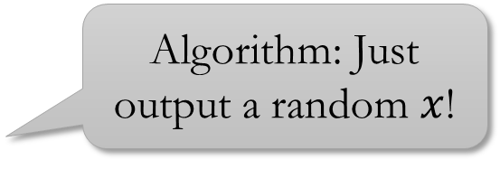
Interlude: $TFZPP$?
$TFZPP$: [FGJLRSY’26]
“$Refuter\left(searchSAT∉SIZE\left[n^{100}\right]\right)$”
Input: a circuit $C$ of size $n^{100}$ claiming to have solved $searchSAT$
Output: a $SAT$ instance $φ$ and an assignment $a$ such that $φ\left(a\right)=1$ but $C\left(φ\right)$ does not output a satisfying assignment of $φ$.
Also in $TFZPP$, under believed assumptions…
Future direction:
How to talk about “hardness” in $TFZPP$?
“$Refuter\left(MAJ∉{AC}^{0}\left[2\right]\right)$”
Input: an ${AC}^{0}\left[2\right]$-circuit $C$ of size $n^{100}$ and depth $100$
Output: an instance $x$ such that $C\left(x\right)≠MAJ\left(x\right)$.
Algorithm: Just output a random $x$!
This refuter problem is in $TFZPP$.
How “hard” is it to derandomize it?

Slide 19
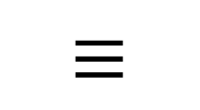
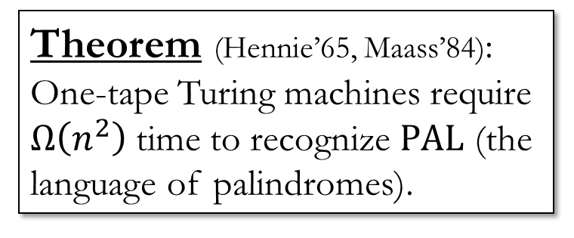

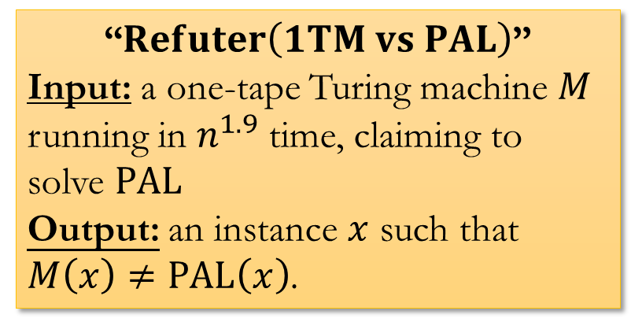
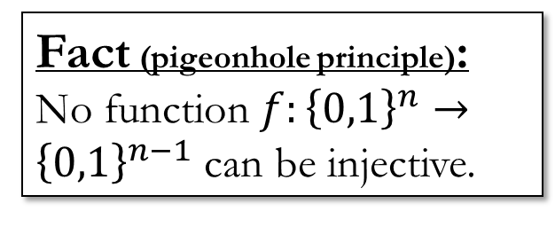
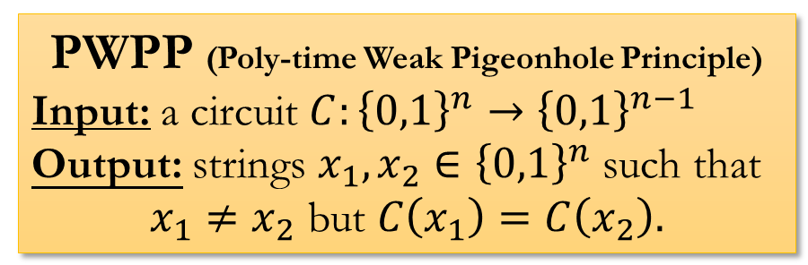
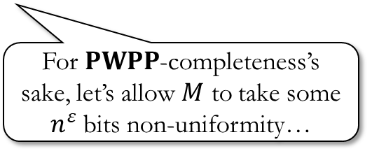
Reverse Maths of One-Tape TM LB [CLO’24]
Theorem (Hennie’65, Maass’84):
One-tape Turing machines require $Ω\left(n^{2}\right)$ time to recognize $PAL$ (the language of palindromes).
Fact (pigeonhole principle): No function $f:{\left\{0,1\right\}}^{n}→{\left\{0,1\right\}}^{n−1}$ can be injective.
$$≡$$
“$Refuter\left(1TM vs PAL\right)$”
Input: a one-tape Turing machine $M$ running in $n^{1.9}$ time, claiming to solve $PAL$
Output: an instance $x$ such that $M\left(x\right)≠PAL\left(x\right)$.
PWPP (Poly-time Weak Pigeonhole Principle)
Input: a circuit $C:{\left\{0,1\right\}}^{n}→{\left\{0,1\right\}}^{n−1}$
Output: strings $x_{1},x_{2}∈{\left\{0,1\right\}}^{n}$ such that
$$x_{1}≠x_{2} \text{but} C\left(x_{1}\right)=C\left(x_{2}\right).$$
$$≡$$
For $PWPP$-completeness’s sake, let’s allow $M$ to take some $n^{ε}$ bits non-uniformity…

Slide 20
How to talk about provability & reverse math?
A short answer & a long answer…

Slide 21
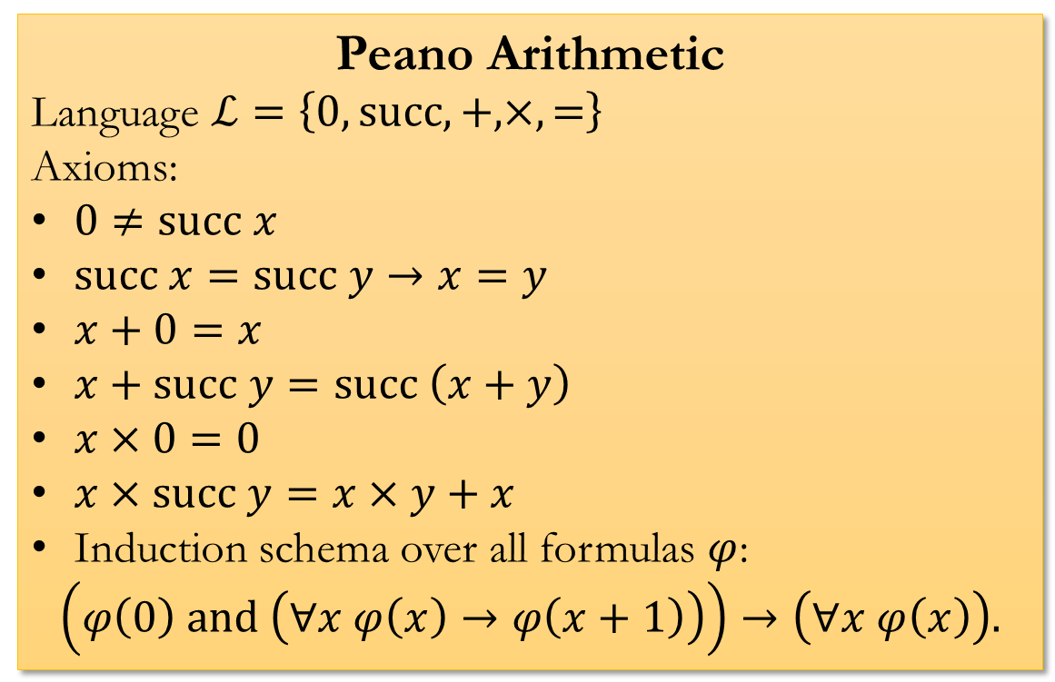
Long answer: Go back to logic ☺
Peano Arithmetic
Language $ℒ=\left\{0,succ,+,×, =\right\}$
Axioms:
$0≠succ x$
$succ x=succ y→x=y$
$x+0=x$
$x+succ y=succ \left(x+y\right)$
$x×0=0$
$x×succ y=x×y+x$
Induction schema over all formulas $φ$:
$$\left(φ\left(0\right) and \left(∀x φ\left(x\right)→φ\left(x+1\right)\right)\right)→\left(∀x φ\left(x\right)\right).$$

Slide 22
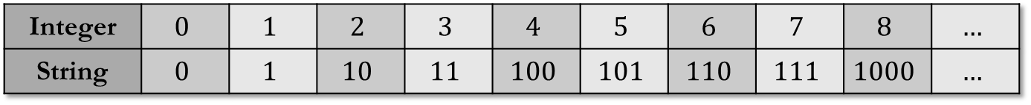
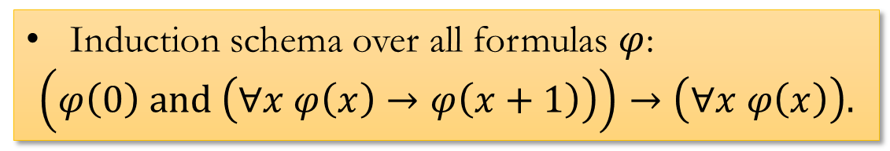





Integer | $$0$$ | $$1$$ | $$2$$ | $$3$$ | $$4$$ | $$5$$ | $$6$$ | $$7$$ | $$8$$ | $$…$$
String | $$0$$ | $$1$$ | $$10$$ | $$11$$ | $$100$$ | $$101$$ | $$110$$ | $$111$$ | $$1000$$ | $$…$$
Minimization schema over all poly-time formulas $φ$:
$$φ\left(a\right)→∃x≤a, \left(φ\left(x\right) and \left(∀y<x, not φ\left(y\right)\right)\right).$$
Idea: What about only using $φ$ that’s polynomial-time?
Caveat: Need a richer language
$$ℒ_{BA}=\{0,succ,+,×,=,\left\lfloor x/2\right\rfloor ,\left|x\right|,x\#y\}$$
Induction schema over all poly-time formulas $φ$:
$$\left(φ\left(0\right) and \left(∀x φ\left(x\right)→φ\left(x+1\right)\right)\right)→\left(∀x φ\left(x\right)\right).$$
Induction schema over all formulas $φ$:
$$\left(φ\left(0\right) and \left(∀x φ\left(x\right)→φ\left(x+1\right)\right)\right)→\left(∀x φ\left(x\right)\right).$$
Induction schema over all poly-time formulas $φ$:
$$φ\left(0\right) and \left(not φ\left(a\right)\right)→∃x, \left(φ\left(x\right) and not φ\left(x+1\right)\right).$$

Slide 23






Minimization schema over all poly-time formulas $φ$:
$$φ\left(a\right)→∃x≤a, \left(φ\left(x\right) and \left(∀y<x, not φ\left(y\right)\right)\right).$$
Induction schema over all $NP$ formulas $φ$:
$$\left(φ\left(0\right) and \left(∀x φ\left(x\right)→φ\left(x+1\right)\right)\right)→\left(∀x φ\left(x\right)\right).$$
Pigeonhole Principle over all poly-time formulas $φ$:
$$\left(∀x<a+1, φ\left(x\right)<a\right)→\left(∃x<y<a+1, φ\left(x\right)=φ\left(y\right)\right)$$
Some formula that returns True if $C$ is an ${AC}^{0}\left[2\right]$ circuit of $n$ inputs and size $n^{100}$, and returns False otherwise
$MAJ∉{AC}^{0}\left[2\right]$:
$$∀n, C,Is_AC_Zero_Two\left(C,n,n^{100}\right)→\left(∃x∈{\left\{0,1\right\}}^{n} EVAL\left(C,x\right)≠MAJ\left(x\right)\right)$$
Caveat: you want “$n∈Log$” in order to talk about $n$-bit strings

Slide 24






Axiom 1 (or theorem 1, lemma 1, …)
$$∀x∃y φ_{1}\left(x,y\right)$$
Axiom 2 (or theorem 2, lemma 2, …)
$$∀x∃y φ_{2}\left(x,y\right)$$
Total Search Problem 1
Input: $x$
Output: $y$ s.t. $φ_{1}\left(x,y\right)$
Total Search Problem 2
Input: $x$
Output: $y$ s.t. $φ_{2}\left(x,y\right)$
Fact (Informal):
If Axiom 1 is implied by Axiom 2, then Total Search Problem 1 $≤$ Total Search Problem 2
Fact (Informal):
If Total Search Problem 1 $≤$ Total Search Problem 2,
Then Axiom 1 is implied by Axiom 2 (over a sufficiently strong base theory, “$T_{PV}$”)

Slide 25

One-Tape Turing Machine Lower Bounds…
Picture generated by Gemini

