Slide 1





Many Proof Complexity Generators
Inside
One Demi-Bits Generator
Xin Li
Johns Hopkins University
Hanlin Ren
IAS $→$ MPI
Yan Zhong
Johns Hopkins University
LFCW02: Logical foundations of complexity theory

Slide 2


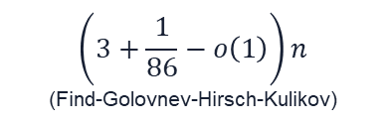




Fig 1: Best Known Circuit Lower Bounds Over Time
Progress:
Introduction
Natural Proofs
Range Avoidance
Generators
Our Results
Fig 1: ???
$$3.5n−o\left(n\right)$$
(Mishra-Santhanam)
$$3.1n−o\left(n\right)$$
(Li-Yang)
$$3n$$
(Blum)
$$\left(3+\frac{1}{86}−o\left(1\right)\right)n$$
(Find-Golovnev-Hirsch-Kulikov)
$$2.75n$$
(Blum)
$$2.5n$$
(Paul)
$$2n$$
(Schnorr)
1974
1981
2016
2022
2026
1975
1983

Slide 3

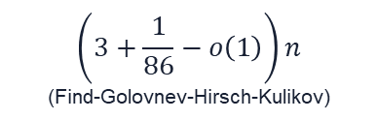





Fig 2: Best Known Circuit Lower Bounds Over Time (More Accurately)
Progress:
Introduction
Natural Proofs
Range Avoidance
Generators
Our Results
Fig 2: ???
$$n^{ω\left(1\right)}$$
$$2n$$
(Schnorr)
$$3n$$
(Blum)
$$2.5n$$
(Paul)
$$2.75n$$
(Blum)
$$\left(3+\frac{1}{86}−o\left(1\right)\right)n$$
(Find-Golovnev-Hirsch-Kulikov)
$$3.5n−o\left(n\right)$$
(Mishra-Santhanam)
$$3.1n−o\left(n\right)$$
(Li-Yang)
1974
1981
2016
2022
2026
1975
1983

Slide 4


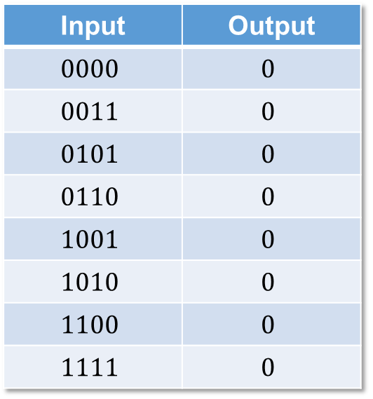
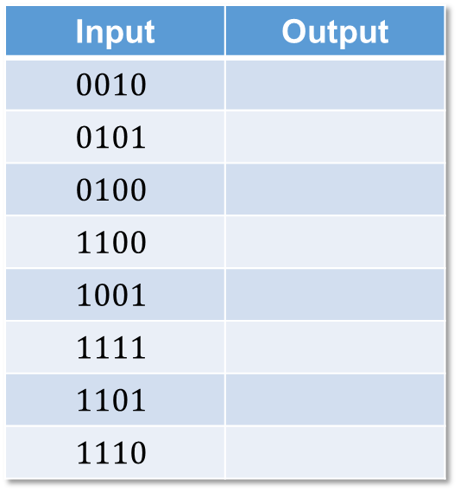
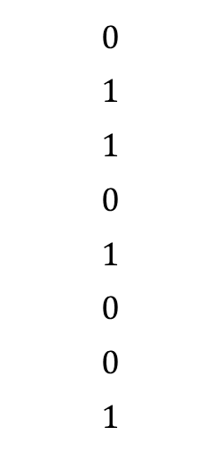
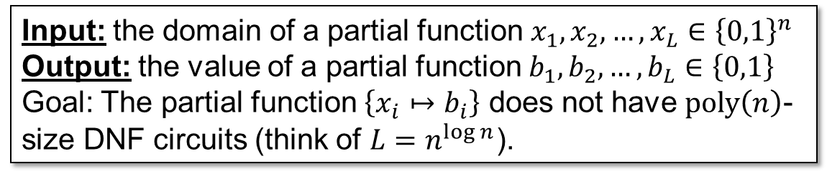
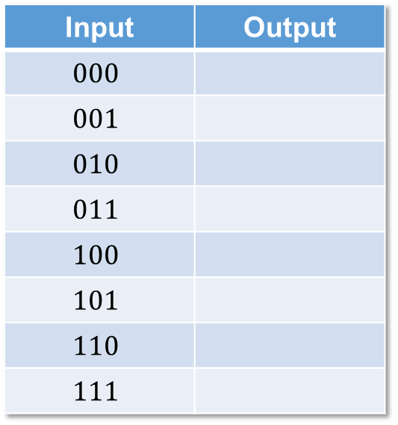
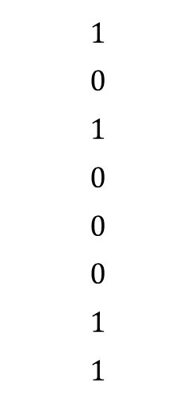
Hard Partial Truth Tables
Progress:
Introduction
Natural Proofs
Range Avoidance
Generators
Our Results
(Arvind-Srinivasan’10)
Input: the domain of a partial function $x_{1},x_{2},…,x_{L}∈{\left\{0,1\right\}}^{n}$
Output: the value of a partial function $b_{1},b_{2},…,b_{L}∈\left\{0,1\right\}$
Goal: The partial function $\left\{x_{i}↦b_{i}\right\}$ does not have $poly\left(n\right)$-size DNF circuits (think of $L=n^{\log{n}}$).
OR
AND
AND
$$…$$
AND
AND
Input | Output
$$000$$
$$001$$
$$010$$
$$011$$
$$100$$
$$101$$
$$110$$
$$111$$
Input | Output
$$0010$$
$$0101$$
$$0100$$
$$1100$$
$$1001$$
$$1111$$
$$1101$$
$$1110$$
Input | Output
$$0000$$ | $$0$$
$$0011$$ | $$0$$
$$0101$$ | $$0$$
$$0110$$ | $$0$$
$$1001$$ | $$0$$
$$1010$$ | $$0$$
$$1100$$ | $$0$$
$$1111$$ | $$0$$
$$0$$
$$1$$
$$1$$
$$0$$
$$1$$
$$0$$
$$0$$
$$1$$
$$1$$
$$0$$
$$1$$
$$0$$
$$0$$
$$0$$
$$1$$
$$1$$
$$?$$
$$?$$
$$?$$
$$?$$
$$?$$
$$?$$
$$?$$
$$?$$

Slide 5
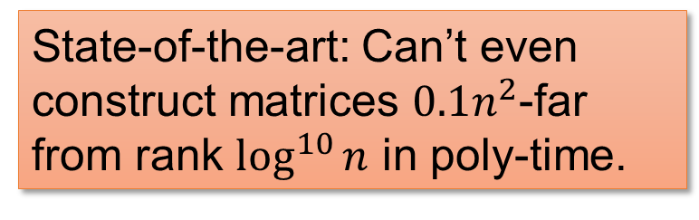
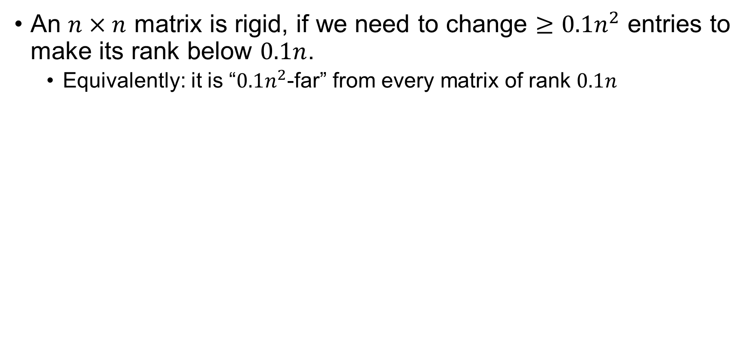
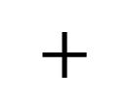



Rigid Matrices
Progress:
Introduction
Natural Proofs
Range Avoidance
Generators
Our Results
(Valiant’77)
An $n×n$ matrix is rigid, if we need to change $≥0.1n^{2}$ entries to make its rank below $0.1n$.
  Equivalently: it is “$0.1n^{2}$-far” from every matrix of rank $0.1n$
Let’s say rank is over $𝔽_{2}$
$$≠$$
$$×$$
$$+$$
State-of-the-art: Can’t even construct matrices $0.1n^{2}$-far from rank $\log^{10}{n}$ in poly-time.
A random matrix is rigid with high probability!

Slide 6
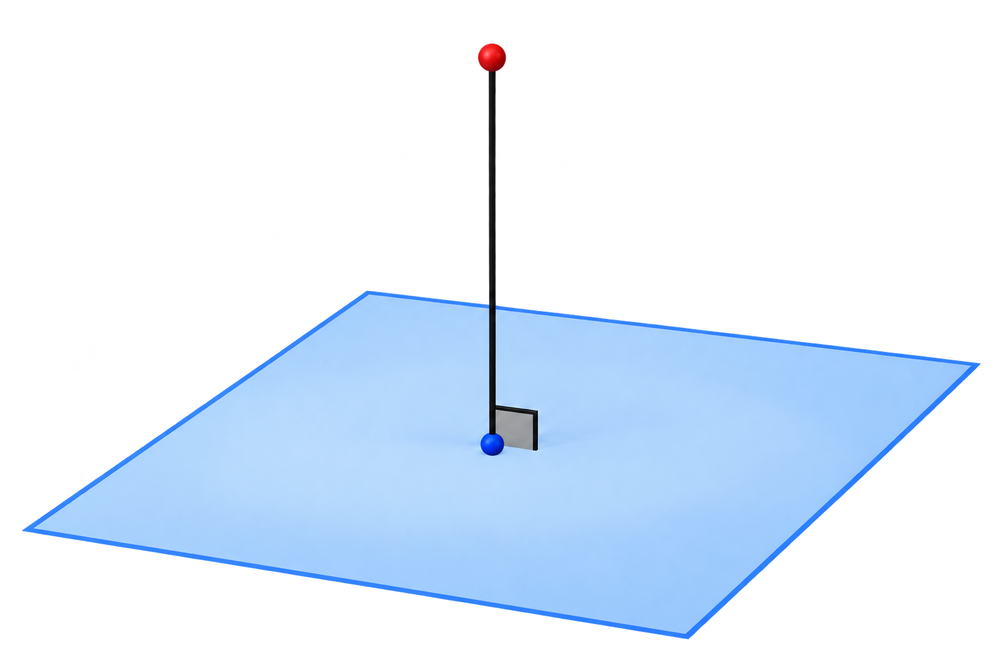
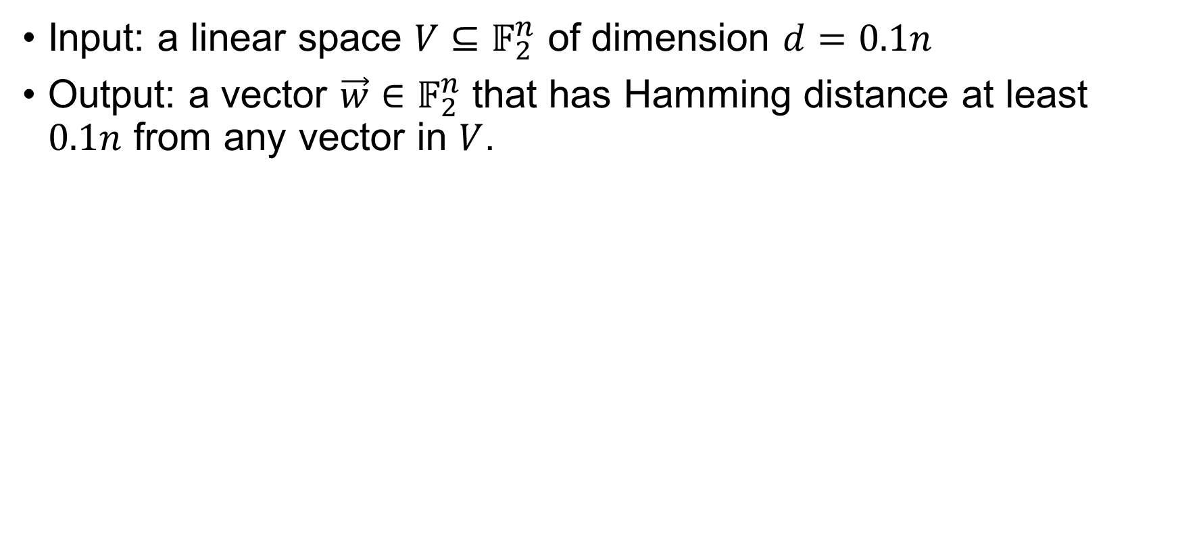
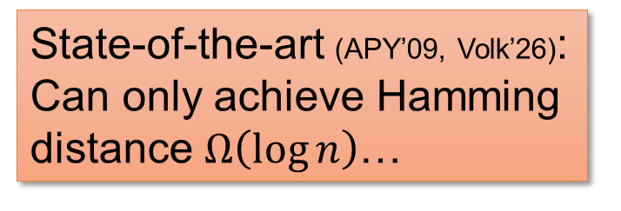
Remote Point Problem
Progress:
Introduction
Natural Proofs
Range Avoidance
Generators
Our Results
(Alon-Panigrahy-Yekhanin’09)
Input: a linear space $V⊆𝔽_{2}^{n}$ of dimension $d=0.1n$
Output: a vector $\vec{w}∈𝔽_{2}^{n}$ that has Hamming distance at least $0.1n$ from any vector in $V$.
APY’09: “In this paper we propose the remote point problem as an intermediate challenge that is less daunting than the challenge of [constructing rigid matrices] …”
State-of-the-art (APY’09, Volk’26): Can only achieve Hamming distance $Ω\left(\log{n}\right)$…
A random vector is a good solution with high probability!
3 / 31

Slide 7
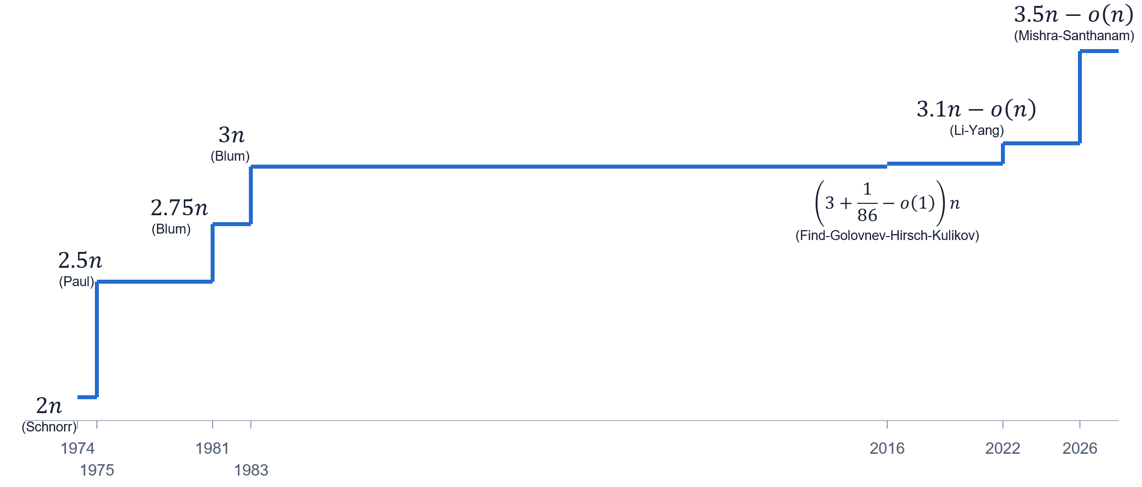
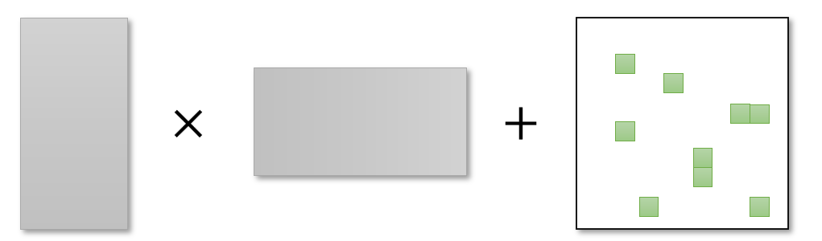
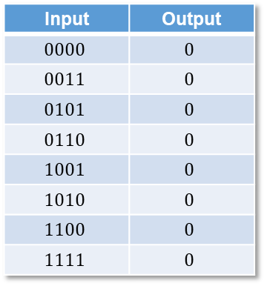
In this talk
Progress:
Introduction
Natural Proofs
Range Avoidance
Generators
Our Results
Input | Output
$$0000$$ | $$0$$
$$0011$$ | $$0$$
$$0101$$ | $$0$$
$$0110$$ | $$0$$
$$1001$$ | $$0$$
$$1010$$ | $$0$$
$$1100$$ | $$0$$
$$1111$$ | $$0$$
Why are these problems so difficult?
(I) Circuit lower bounds
We provide evidence that (II) and (IV) are truly hard and speculate on (I) and (III).
(II) Hard Partial Truth Tables
(III) Rigid matrices
(IV) Remote Point Problem

Slide 8
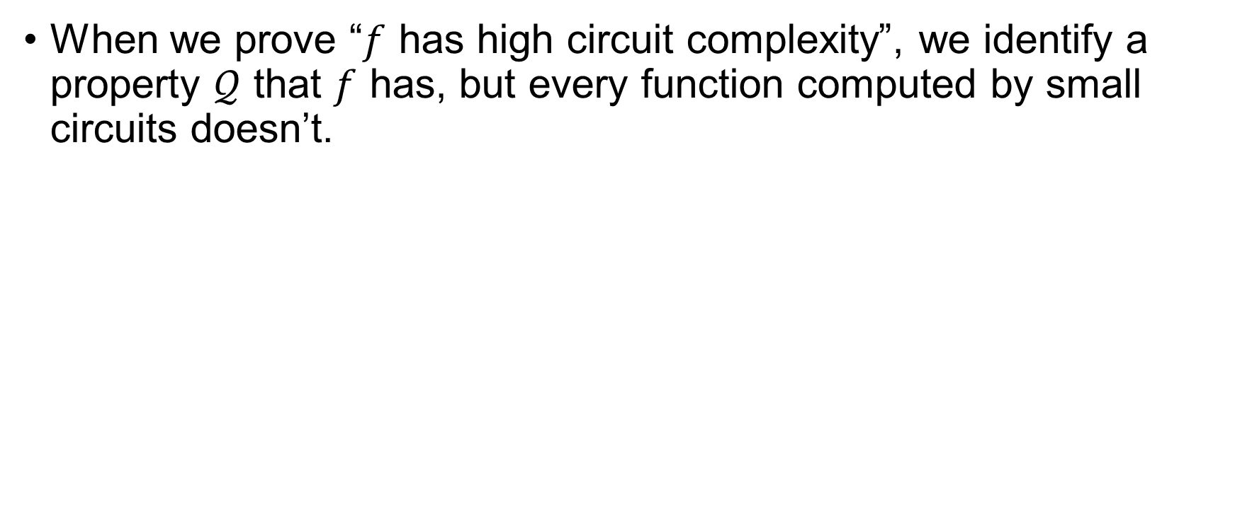
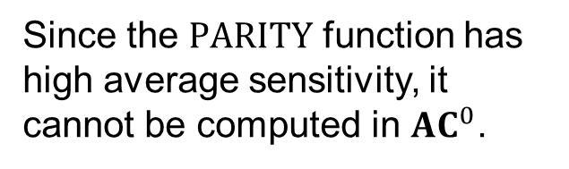
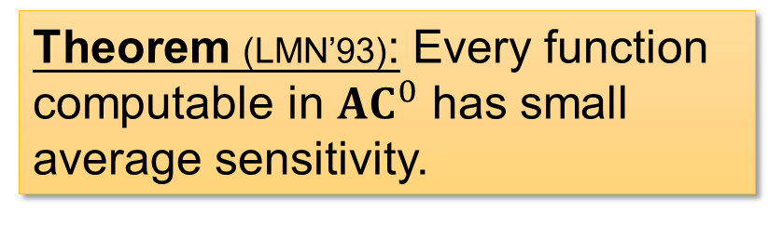
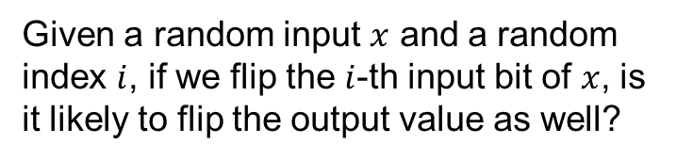
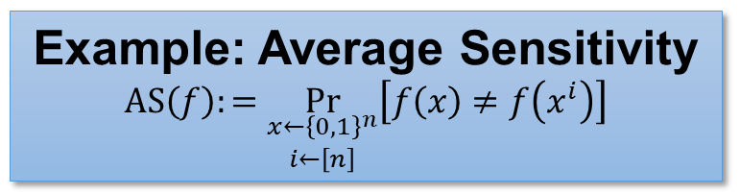
Natural Proofs Barrier
Progress:
Introduction
Natural Proofs
Range Avoidance
Generators
Our Results
Why are circuit lower bounds hard?
When we prove “$f$ has high circuit complexity”, we identify a property $𝒬$ that $f$ has, but every function computed by small circuits doesn’t.
Theorem (LMN’93): Every function computable in ${AC}^{0}$ has small average sensitivity.
Example: Average Sensitivity
$$AS\left(f\right):=\underset{\begin{aligned}x←{\left\{0,1\right\}}^{n} \\ i←\left[n\right]\end{aligned}}{Pr}\left[f\left(x\right)≠f\left(x^{i}\right)\right]$$
Given a random input $x$ and a random index $i$, if we flip the $i$-th input bit of $x$, is it likely to flip the output value as well?
Since the $PARITY$ function has high average sensitivity, it cannot be computed in ${AC}^{0}$.

Slide 9
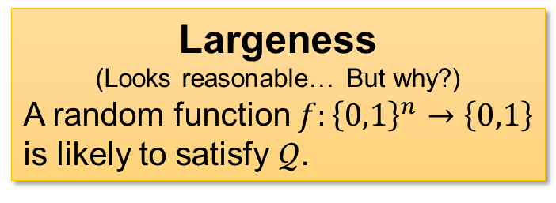
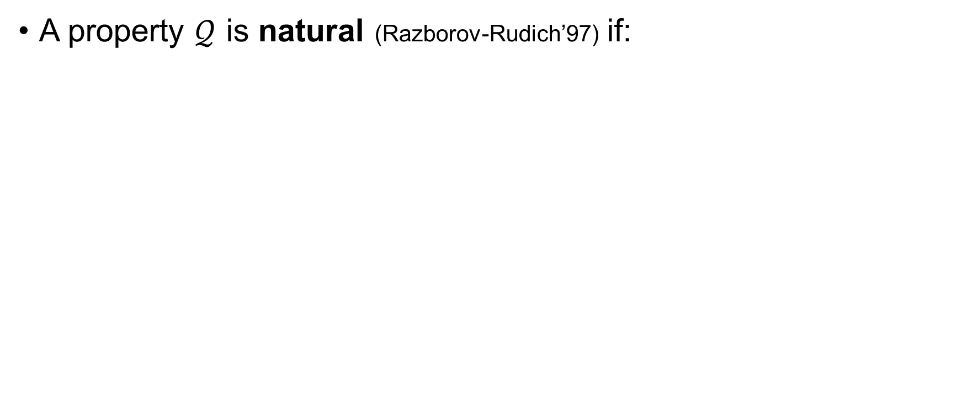
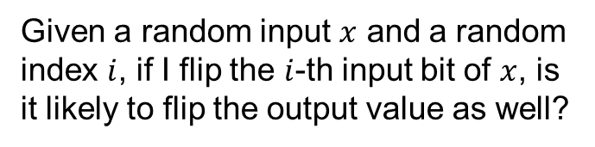
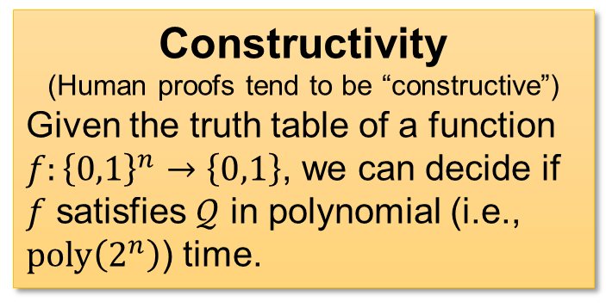
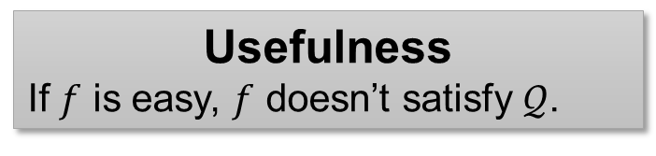
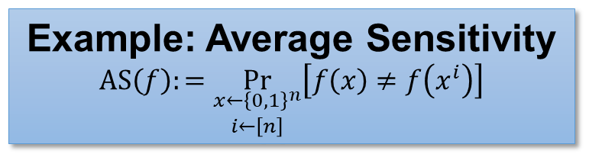
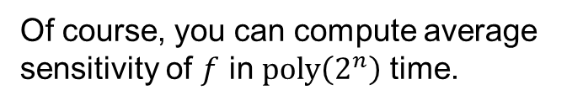
Natural Proofs Barrier
Progress:
Introduction
Natural Proofs
Range Avoidance
Generators
Our Results
A property $𝒬$ is natural (Razborov-Rudich’97) if:
Largeness
(Looks reasonable… But why?)
A random function $f:{\left\{0,1\right\}}^{n}→\left\{0,1\right\}$ is likely to satisfy $𝒬$.
Constructivity
(Human proofs tend to be “constructive”)
Given the truth table of a function $f:{\left\{0,1\right\}}^{n}→\left\{0,1\right\}$, we can decide if $f$ satisfies $𝒬$ in polynomial (i.e., $poly\left(2^{n}\right)$) time.
Usefulness
If $f$ is easy, $f$ doesn’t satisfy $𝒬$.
Of course, you can compute average sensitivity of $f$ in $poly\left(2^{n}\right)$ time.
A random function is likely to have high average sensitivity.
Example: Average Sensitivity
$$AS\left(f\right):=\underset{\begin{aligned}x←{\left\{0,1\right\}}^{n} \\ i←\left[n\right]\end{aligned}}{Pr}\left[f\left(x\right)≠f\left(x^{i}\right)\right]$$
Given a random input $x$ and a random index $i$, if I flip the $i$-th input bit of $x$, is it likely to flip the output value as well?

Slide 10

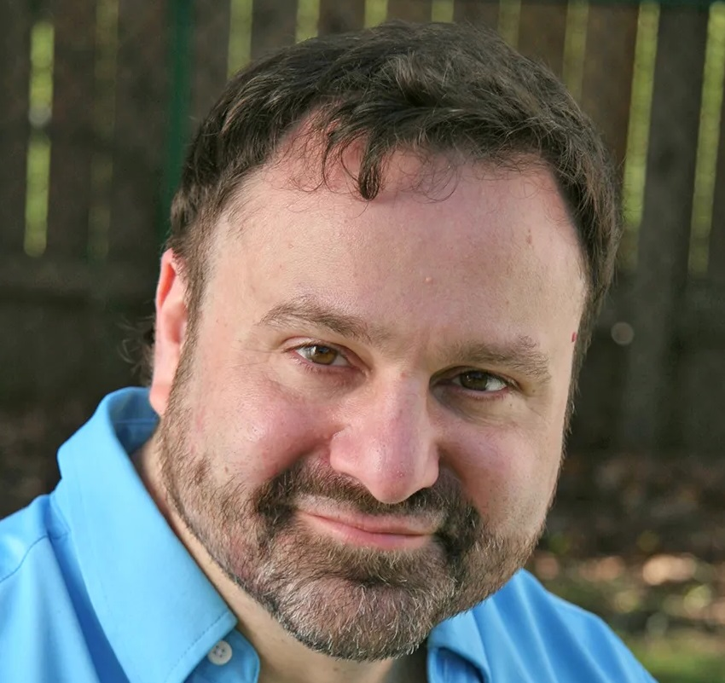
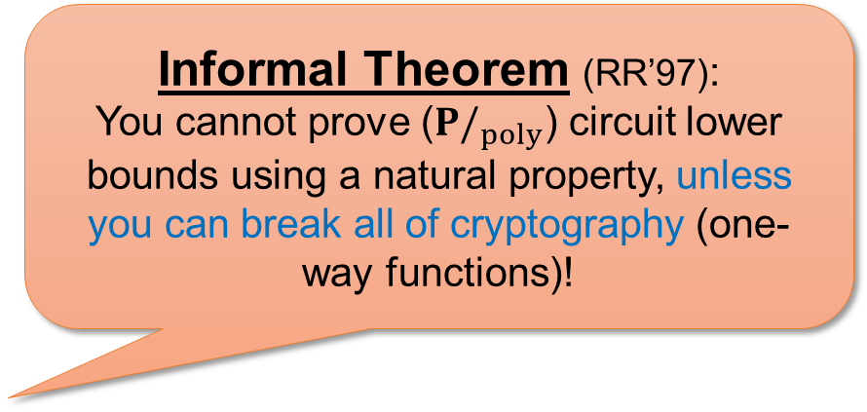
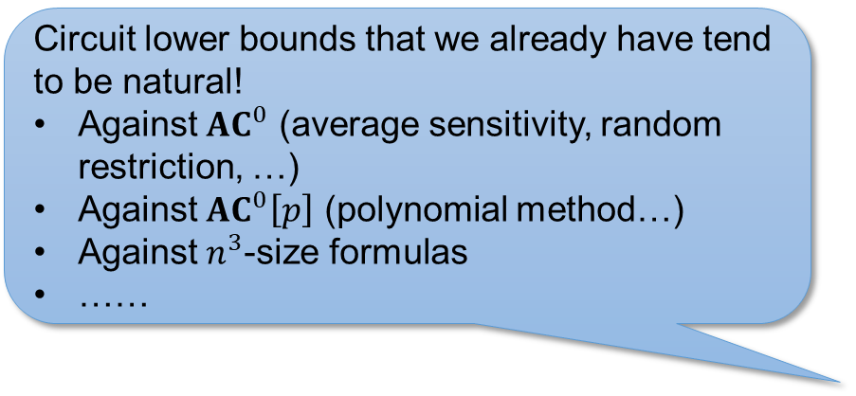
Natural Proofs Barrier
Progress:
Introduction
Natural Proofs
Range Avoidance
Generators
Our Results
Circuit lower bounds that we already have tend to be natural!
Against ${AC}^{0}$ (average sensitivity, random restriction, …)
Against ${AC}^{0}\left[p\right]$ (polynomial method…)
Against $n^{3}$-size formulas
……
Informal Theorem (RR’97):
You cannot prove ($P/_{poly}$) circuit lower bounds using a natural property, unless you can break all of cryptography (one-way functions)!
Alexander Razborov
Steven Rudich

Slide 11

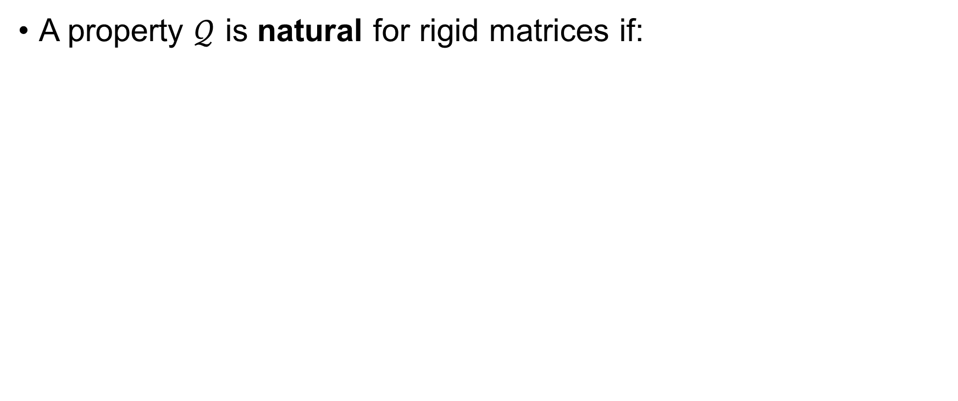


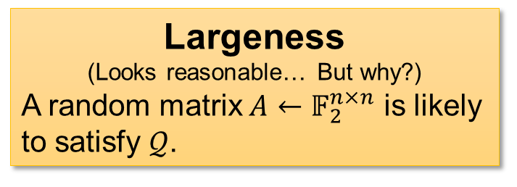
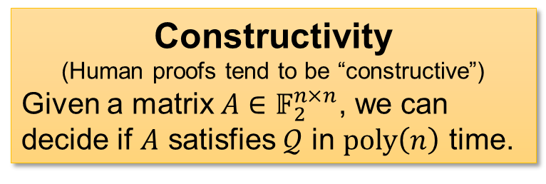
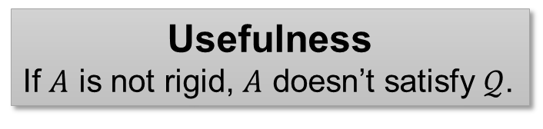
Natural Proofs Barrier for Rigid Matrices
Progress:
Introduction
Natural Proofs
Range Avoidance
Generators
Our Results
A property $𝒬$ is natural for rigid matrices if:
Constructivity
(Human proofs tend to be “constructive”)
Given a matrix $A∈𝔽_{2}^{n×n}$, we can decide if $A$ satisfies $𝒬$ in $poly\left(n\right)$ time.
Largeness
(Looks reasonable… But why?)
A random matrix $A←𝔽_{2}^{n×n}$ is likely to satisfy $𝒬$.
Usefulness
If $A$ is not rigid, $A$ doesn’t satisfy $𝒬$.
The LPN (Learning Parity with Noise) Assumption implies:
(by a hybrid argument)
… which means there is no natural proof for rigid matrices. ☹
$$×$$
$$+$$
$$≈_{c}$$

Slide 12
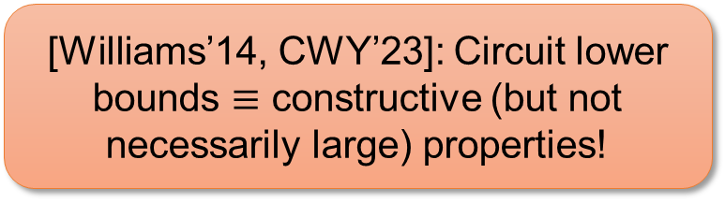
Do Proofs Tend To Be Large?
Progress:
Introduction
Natural Proofs
Range Avoidance
Generators
Our Results
Largeness
(Looks reasonable… But why?)
A random function $f:{\left\{0,1\right\}}^{n}→\left\{0,1\right\}$ is likely to satisfy $𝒬$.
Constructivity
(Human proofs tend to be “constructive”)
Given the truth table of a function $f:{\left\{0,1\right\}}^{n}→\left\{0,1\right\}$, we can decide if $f$ satisfies $𝒬$ in polynomial (i.e., $poly\left(2^{n}\right)$) time.
Usefulness
If $f$ is easy, $f$ doesn’t satisfy $𝒬$.
[Williams’14, CWY’23]: Circuit lower bounds $≡$ constructive (but not necessarily large) properties!
Many proposals for overcoming the natural proof barrier are non-large ☺
(buzzwords: KRW conjecture; hardness magnification; …)

Slide 13
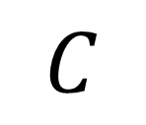
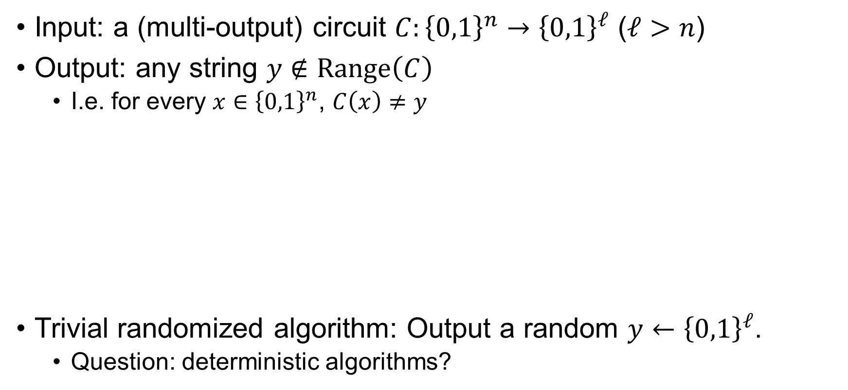



Range Avoidance Problem
Progress:
Introduction
Natural Proofs
Range Avoidance
Generators
Our Results
(Kleinberg-Korten-Mitropolsky-Papadimitriou’21)
Input: a (multi-output) circuit $C:{\left\{0,1\right\}}^{n}→{\left\{0,1\right\}}^{ℓ}$ ($ℓ>n$)
Output: any string $y∉Range\left(C\right)$
  I.e. for every $x∈{\left\{0,1\right\}}^{n}$, $C\left(x\right)≠y$
Trivial randomized algorithm: Output a random $y←{\left\{0,1\right\}}^{ℓ}$.
  Question: deterministic algorithms?
A “non-output” of $C$.
$$y∈{\left\{0,1\right\}}^{ℓ}$$
$$C$$
$$x∈{\left\{0,1\right\}}^{n}$$

Slide 14
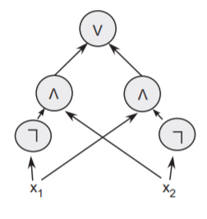



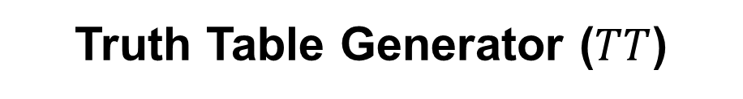

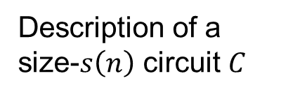
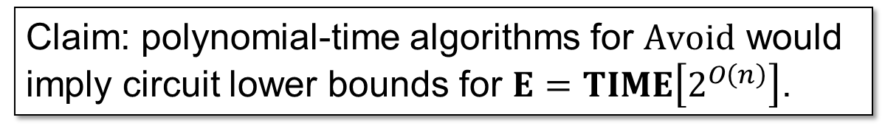
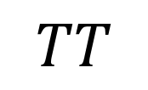
$Avoid$ Captures “Explicit Construction” Problems
Progress:
Introduction
Natural Proofs
Range Avoidance
Generators
Our Results
(Korten’21)
Claim: polynomial-time algorithms for $Avoid$ would imply circuit lower bounds for $E=TIME\left[2^{O\left(n\right)}\right]$.
$$01100111000011…………001010001$$
$2^{n}$ bits
Truth table of $C$
$$TT$$
$≈s\left(n\right)$ bits
Description of a size-$s\left(n\right)$ circuit $C$
Truth Table Generator ($TT$)

Slide 15




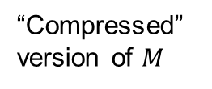

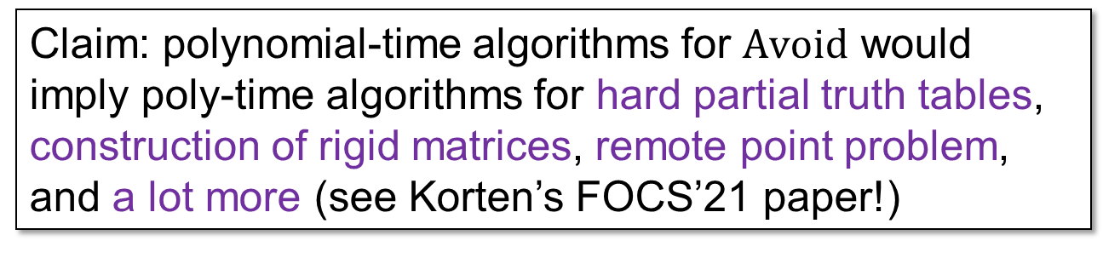

$Avoid$ Captures “Explicit Construction” Problems
Progress:
Introduction
Natural Proofs
Range Avoidance
Generators
Our Results
(Korten’21)
Claim: polynomial-time algorithms for $Avoid$ would imply poly-time algorithms for hard partial truth tables, construction of rigid matrices, remote point problem, and a lot more (see Korten’s FOCS’21 paper!)
$$C\left(x_{1}\right)C\left(x_{2}\right)…C\left(x_{L}\right)$$
A non-rigid matrix $M$
$$A\vec{v}+\vec{e}$$
$$101100011…………001011$$
Rigid matrices
Hard Partial Truth Tables
Remote Point Problem
“Compressed” version of $M$
Size-$s$ circuit $C$
$\vec{v}$ and noise $\vec{e}$

Slide 16


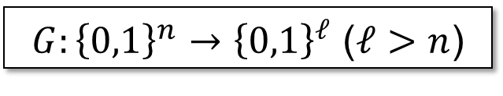
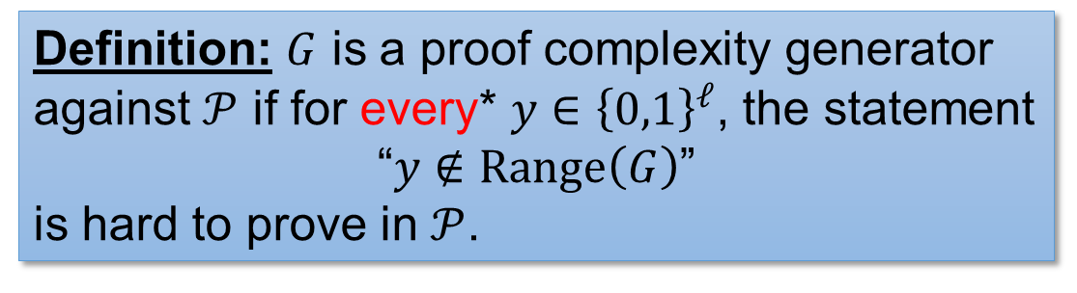
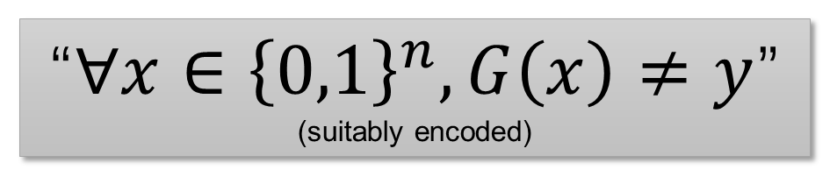
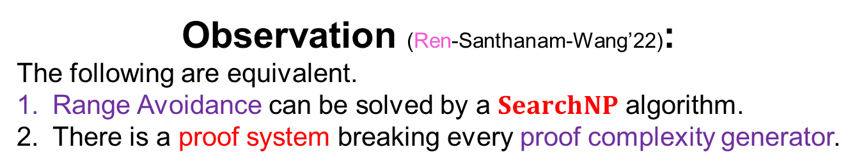
Proof Complexity Generators
Progress:
Introduction
Natural Proofs
Range Avoidance
Generators
Our Results
$G:{\left\{0,1\right\}}^{n}→{\left\{0,1\right\}}^{ℓ}$ ($ℓ>n$)
Definition: $G$ is a proof complexity generator against $𝒫$ if for every* $y∈{\left\{0,1\right\}}^{ℓ}$, the statement
“$y∉Range\left(G\right)$”
is hard to prove in $𝒫$.
$$y∈{\left\{0,1\right\}}^{ℓ}$$
$$G$$
$$x∈{\left\{0,1\right\}}^{n}$$
“$∀x∈{\left\{0,1\right\}}^{n}, G\left(x\right)≠y$”
(suitably encoded)
Range Avoidance
Observation (Ren-Santhanam-Wang’22):
The following are equivalent.
Range Avoidance can be solved by a $SearchNP$ algorithm.
There is a proof system breaking every proof complexity generator.
Proof complexity generators
*If $y$ is actually in $Range\left(G\right)$, then the statement is impossible to prove, hence also hard to prove.

Slide 17












Is $TT$ a Proof Complexity Generator?
Progress:
Introduction
Natural Proofs
Range Avoidance
Generators
Our Results
Truth Table Generator ($TT$)
I find it very difficult to prove circuit lower bounds…
Even if we get to choose our favourite hard function (!)
Truth table of $C$
$$0110010011…………001010$$
$2^{n}$ bits
Okay, maybe that’s because the truth table generator is a very hard proof complexity generator… .
(against whatever proof system capturing our math practice)
$$TT$$
$\tilde{O}\left(s\left(n\right)\right)$ bits
Description of a size-$s\left(n\right)$ circuit $C$
Yes, $TT$ is a proof complexity generator against:
Resolution (Raz’02)
$Res\left(k\right)$ and ${PCR}_{GF\left(3\right)}$ (Razborov’15)
${PCR}_{GF\left(2\right)}$ and SA (GGRT’26)
…
Complexity theorists

Slide 18






Is $Avoid$ in (Non)Deterministic
Poly-Time?
Progress:
Introduction
Natural Proofs
Range Avoidance
Generators
Our Results
No! (ILW’23)
If you assume cryptography (subexp $i𝒪$) and $NP≠coNP$, then $Avoid$ is not in deterministic poly-time.
Rahul Ilango
Jiatu Li
Ryan Williams
Hardness of finding Hard Partial Truth Tables and Remote Point Problems?
Further work (CL’24, Ilango’25, RWZ’26):
Under suitable assumptions (see next slide), $Avoid$ doesn’t have nondeterministic poly-time algorithms.
Implies proof complexity generators for arbitrary proof systems.
Hardness of $Avoid$ for restricted circuits as well…

Slide 19






The assumption: no $NP$-natural proofs
Progress:
Introduction
Natural Proofs
Range Avoidance
Generators
Our Results
Constructivity
(Human proofs tend to be “constructive”)
Given the truth table of a function $f:{\left\{0,1\right\}}^{n}→\left\{0,1\right\}$, we can decide if $f$ satisfies $𝒬$ in polynomial (i.e., $poly\left(2^{n}\right)$) time.
$NP$-Constructivity
(Human proofs tend to be “constructive”)
Given the truth table of a function $f:{\left\{0,1\right\}}^{n}→\left\{0,1\right\}$, we can “prove” that $f$ satisfies $𝒬$ in nondeterministic $poly\left(2^{n}\right)$ time.
Largeness
(Looks reasonable… But why?)
A random function $f:{\left\{0,1\right\}}^{n}→\left\{0,1\right\}$ is likely to satisfy $𝒬$.
Since proof systems are nondeterministic algorithms, let’s use $NP$-constructivity!
Rudich’s conjecture
Circuit lower bounds cannot be proved via an $NP$-natural property.
Steven Rudich
(RANDOM’97)

Slide 20






Demi-Bits Generator
Progress:
Introduction
Natural Proofs
Range Avoidance
Generators
Our Results
Definition: $G$ is a demi-bits generator against $𝒫$ if for a large fraction (say, $1/3$) of $y∈{\left\{0,1\right\}}^{ℓ}$, the statement
“$y∉Range\left(G\right)$”
is hard to prove in $𝒫$.
$G:{\left\{0,1\right\}}^{n}→{\left\{0,1\right\}}^{ℓ}$ ($ℓ>n$)
$$y∈{\left\{0,1\right\}}^{ℓ}$$
$$G$$
“$∀x∈{\left\{0,1\right\}}^{n}, G\left(x\right)≠y$”
(suitably encoded)
$$x∈{\left\{0,1\right\}}^{n}$$
$${\left\{0,1\right\}}^{ℓ}$$
$$Range\left(G\right)$$
What $𝒫$ can figure out to be outside $Range\left(G\right)$

Slide 21











Rudich’s Conjecture
Progress:
Introduction
Natural Proofs
Range Avoidance
Generators
Our Results
Rudich’s conjecture (Rudich’97)
Circuit lower bounds cannot be proved via an $NP$-natural property.
$NP$-Constructivity
(Human proofs tend to be “constructive”)
Given the truth table of a function $f:{\left\{0,1\right\}}^{n}→\left\{0,1\right\}$, we can “prove” that $f$ satisfies $𝒬$ in nondeterministic $poly\left(2^{n}\right)$ time.
Truth Table Generator ($TT$)
Truth table of $C$
Largeness
(Looks reasonable… But why?)
A random function $f:{\left\{0,1\right\}}^{n}→\left\{0,1\right\}$ is likely to satisfy $𝒬$.
$$0110010011…………001010$$
$2^{n}$ bits
$$TT$$
$\tilde{O}\left(s\left(n\right)\right)$ bits
Description of a size-$s\left(n\right)$ circuit $C$
Rudich’s conjecture = “$TT$ is a demi-bits generator against every proof system”!

Slide 22








Comparison
Progress:
Introduction
Natural Proofs
Range Avoidance
Generators
Our Results
$${\left\{0,1\right\}}^{ℓ}$$
Demi-Bits Generator
The statement “$y∉Range\left(G\right)$” is hard to prove for a $1/3$ fraction of $y∈{\left\{0,1\right\}}^{ℓ}$
$Range\left(G\right)$ looks like this
$Range\left(G\right)$ looks like this
$$Range\left(G\right)$$
Proof Complexity Generator
The statement “$y∉Range\left(G\right)$” is hard to prove for every $y∈{\left\{0,1\right\}}^{ℓ}$
Clearly, proof complexity generators are qualitatively stronger objects than demi-bits generators.
However, previous results on the hardness of $Avoid$ (CL’24, Ilango’25, RWZ’26) shows that one can build proof complexity generators from demi-bits generators!

Slide 23




Our Result
Progress:
Introduction
Natural Proofs
Range Avoidance
Generators
Our Results
Let $G:{\left\{0,1\right\}}^{n}→{\left\{0,1\right\}}^{ℓ}$ with $ℓ>10n$, and $𝒫$ be a “well-behaved” proof system.
Theorem
If $G$ is a demi-bits generator against $𝒫$, then for a random subset $I⊆\left[ℓ\right]$,
$$G_{I}:{\left\{0,1\right\}}^{n}→{\left\{0,1\right\}}^{I}$$
is a proof complexity generator against $𝒫$ with noticeable probability.
$$G$$
Since $ℓ>10n$, $\left|I\right|>n$ with high probability.
There are many proof complexity generators hidden inside every demi-bits generator!

Slide 24




Shattering
Progress:
Introduction
Natural Proofs
Range Avoidance
Generators
Our Results
A set of strings $S⊆{\left\{0,1\right\}}^{n}$ shatters a subset of indices $I⊆\left[n\right]$, if every pattern $y∈{\left\{0,1\right\}}^{I}$ appears somewhere in $S$.
  For every $y∈{\left\{0,1\right\}}^{I}$, there exists $z∈S$ such that $z{\left.​\right|}_{I}=y$.
01001100
00100101
11010110
00111110
10011101
10000101
01010110
11000100
01011101
00110111
01000111
10001010
Pajor’s Lemma
(Strengthening of the Sauer-Shelah Lemma)
Any subset $S⊆{\left\{0,1\right\}}^{n}$ shatters at least $\left|S\right|$ many subsets of indices.
Shatters $38$ subsets including $∅,\left\{0\right\},\left\{1\right\},…,\left\{7\right\},\left\{0,1\right\},\left\{0,3\right\},\left\{0,4\right\},\left\{0,6\right\},…,\left\{1,3,7\right\}$
A set of $12$ strings that shatters $I=\left\{1,3,4\right\}$ ($0$-indexed)

Slide 25




Proof of the Main Result
Progress:
Introduction
Natural Proofs
Range Avoidance
Generators
Our Results
Let $H=\{y∈{\left\{0,1\right\}}^{ℓ}:𝒫$ cannot prove “$y∉Range\left(G\right)$” efficiently$\}$.
  Strings that $𝒫$ finds it “hard”
$G$ is a demi-bits generator $⟹\left|H\right|$ is large.
Claim: If $I⊆\left[ℓ\right]$ is shattered by $H$, and $\left|I\right|>n$, then $G_{I}$ is
a proof complexity generator for $𝒫$.
  Suppose $𝒫$ can prove $y∉Range\left(G_{I}\right)$ for some $y∈{\left\{0,1\right\}}^{I}$.
  Since $H$ shatters $I$, there exists $z∈H$ such that $z{\left.​\right|}_{I}=y$.
  Thus, $𝒫$ can prove “$z∉Range\left(G\right)$” as well, contradicting the
  definition of $H$!
01001100
00100101
11010110
00111110
10011101
10000101
01010110
11000100
01011101
00110111
01000111
10001010
There are at least $\left|H\right|$ such sets $I$, most of which has size $>n$.
If I can prove “110 $∉Range(G_{I})$”, then I can prove “01010110 $∉Range\left(G\right)$”.
$$H$$

Slide 26



AI Declaration
Progress:
Introduction
Natural Proofs
Range Avoidance
Generators
Our Results
Feb 28, 2026, Johns Hopkins University
Xin & I arrived at a definition of “zero-error disperser family” (see our paper for details), and we showed that composing a demi-bits generator with a function in this family gives you a proof complexity generator.
Can you compute such family in ${NC}^{0}$?
We tried our luck and asked…
Fig 3: Gemini (Feb 28, 2026)
https://github.com/shuaizenge/ai-girls

Slide 27



AI Declaration
Progress:
Introduction
Natural Proofs
Range Avoidance
Generators
Our Results
Apr 2, 2026, just after we finished our paper.
I asked Gemini to directly obtain proof complexity generators in ${NC}^{0}$ from demi-bits generators in ${NC}^{0}$:
Fig 4: Gemini (Apr 2, 2026)
(generated by Astra)

Slide 28

Corollaries
Progress:
Introduction
Natural Proofs
Range Avoidance
Generators
Our Results
Input | Output
$$0000$$ | $$0$$
$$0011$$ | $$0$$
$$0101$$ | $$0$$
$$0110$$ | $$0$$
$$1001$$ | $$0$$
$$1010$$ | $$0$$
$$1100$$ | $$0$$
$$1111$$ | $$0$$
If “learning” circuits is hard for nondeterministic algorithms, then (II) is hard as well.
Using a reduction in (Daniely & Shalev-Shwartz ’16): If random $k$-SAT is hard for $NP/_{poly}$ algorithms, then HPTT for DNF is hard.
This justifies our lack of progress for HPTT, even for circuit classes as simple as DNF!
(II) Hard Partial Truth Tables
If LPN (Learning Parity with Noise) is hard for nondeterministic algorithms, then (IV) is hard as well.
APY09’s intuition that this is a “less daunting” problem than rigid matrices may be wrong.
(IV) Remote Point Problem

Slide 29







Do Proofs Tend To Be Large?
Progress:
Introduction
Natural Proofs
Range Avoidance
Generators
Our Results
Suppose:
“$TT$ is a demi-bits generator” $⟺$ “$TT$ is a proof complexity generator”
(which is a false claim)
Then largeness is inherent!
A property that’s $NP$-constructive $=$
breaking $TT$ as a proof complexity generator
A property that’s $NP$-constructive and large $=$ breaking $TT$ as a demi-bits generator
To prove stronger lower bounds, we have to use specific properties of $TT$ that distinguishes it from other generators.
Our result means…
If $TT$ is a demi-bits generator, then something that looks similar to $TT$ (namely $TT_{S}$ for a random $S⊆{\left\{0,1\right\}}^{n}$) are proof complexity generators!
Actually, this “specific property” needs to distinguish $TT$ from most generators of the form ${TT}_{S}$ ($S⊆{\left\{0,1\right\}}^{n}$)!
Oliver Korten

Slide 30






Summary
Progress:
Introduction
Natural Proofs
Range Avoidance
Generators
Our Results
Demi-Bits Generator
The statement “$y∉Range\left(G\right)$” is hard to prove for a $1/3$ fraction of $y∈{\left\{0,1\right\}}^{ℓ}$
Theorem
If $G$ is a demi-bits generator against $𝒫$, then for a random subset $I⊆\left[ℓ\right]$,
$$G_{I}:{\left\{0,1\right\}}^{n}→{\left\{0,1\right\}}^{I}$$
is a proof complexity generator against $𝒫$ with noticeable probability.
Proof Complexity Generator
The statement “$y∉Range\left(G\right)$” is hard to prove for every $y∈{\left\{0,1\right\}}^{ℓ}$
In fact, this is true as long as $\left|I\right|>n$ and {hard strings of $G$} shatters $I$!
$$y∈{\left\{0,1\right\}}^{ℓ}$$
Conclusion
To prove a circuit lower bound, we have to use special properties of $TT$ that distinguishes it from not only arbitrary generators, but also $TT_{S}$ for most $S⊆{\left\{0,1\right\}}^{n}$!
$$G$$
$$x∈{\left\{0,1\right\}}^{n}$$

