Slide 1

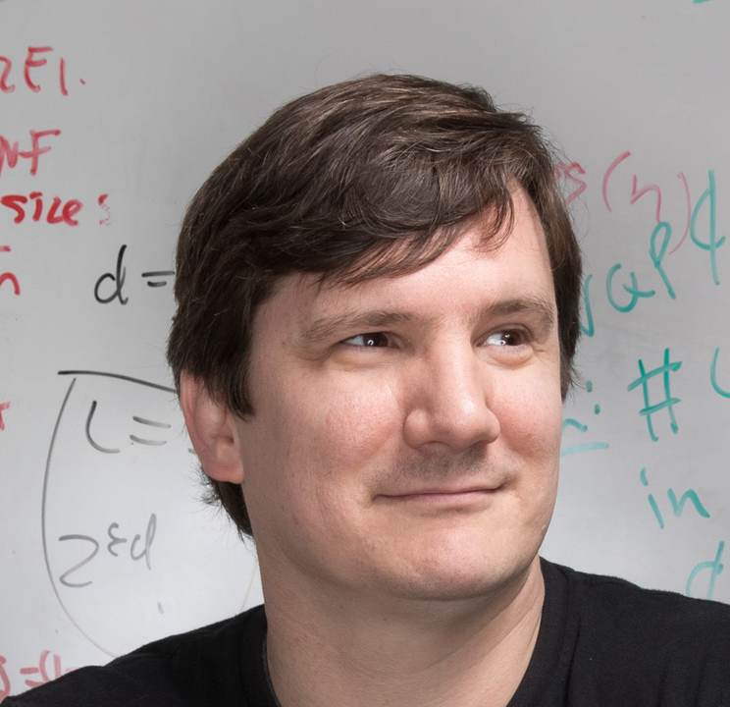

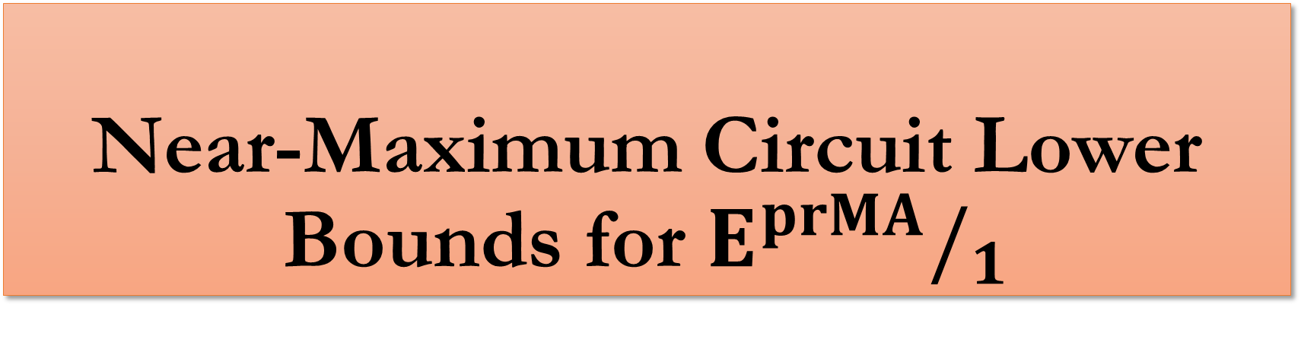
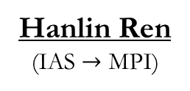
Near-Maximum Circuit Lower Bounds for $E^{prMA}/_{1}$
Hanlin Ren
(IAS $→$ MPI)
Ryan Williams
(MIT)
Sep 10, 2026
Logical foundations of complexity theory
LFCW01: Frontiers in complexity lower bounds

Slide 2

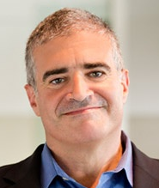

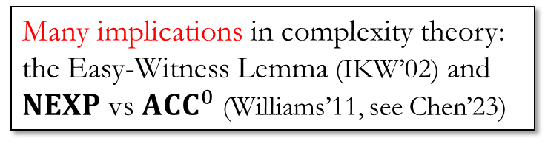
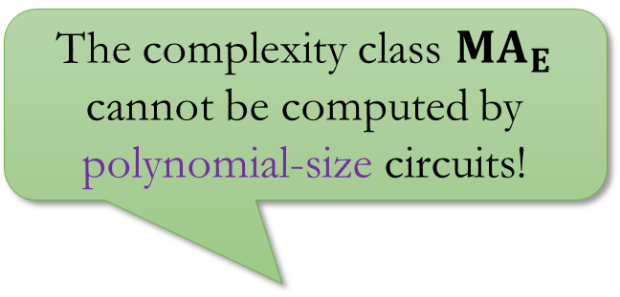
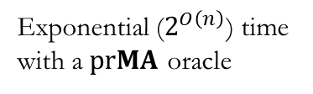
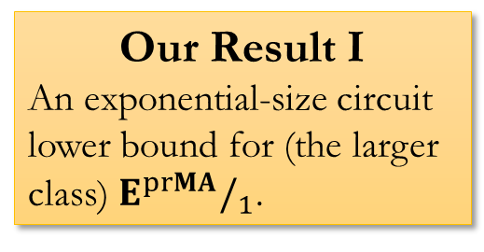
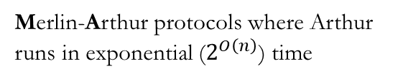
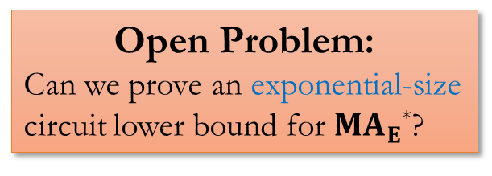
The Result
Progress:
The complexity class ${MA}_{E}$ cannot be computed by polynomial-size circuits!
Open Problem:
Can we prove an exponential-size circuit lower bound for ${MA}_{E}$*?
Merlin-Arthur protocols where Arthur runs in exponential ($2^{O\left(n\right)}$) time
Our Result I
An exponential-size circuit lower bound for (the larger class) $E^{prMA}/_{1}$.
The smallest complexity class for which super-poly circuit lower bounds are known.
Buhrman-Fortnow-Thierauf
(CCC’98)
Many implications in complexity theory:
the Easy-Witness Lemma (IKW’02) and $NEXP$ vs ${ACC}^{0}$ (Williams’11, see Chen’23)
Exponential ($2^{O\left(n\right)}$) time with a $prMA$ oracle
*: exponential lower bounds for the “promise” version of ${MA}_{E}$ are open as well!

Slide 3


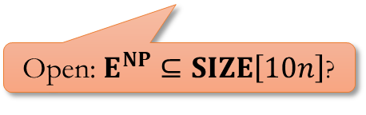



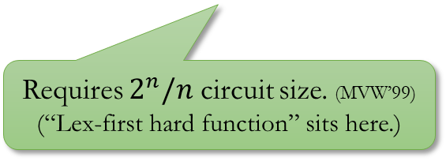


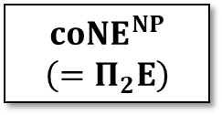


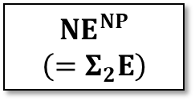


Circuit Lower Bounds
Progress:
Proven by “win-win analysis”; stops at super-poly and doesn’t give you exponential lower bounds (will see it soon!)
Requires super-poly size circuits (Kannan, KW, BCGKT, CCHO, Cai, BFT)
$$MA_{E}$$
$${NE}^{NP}$$
$$\left(=Σ_{2}E\right)$$
$$NE$$
$$S_{2}E$$
$${ZPE}^{NP}$$
$$E^{{NP}^{NP}}$$
$$E$$
$$E^{NP}$$
$$E^{{NP}^{NP}}$$
$$coNE$$
$${coNE}^{NP}$$
$$\left(=Π_{2}E\right)$$
$$AM_{E}$$
Open: $E^{NP}⊆SIZE\left[10n\right]$?
Requires $2^{n}/n$ circuit size. (MVW’99)
(“Lex-first hard function” sits here.)

Slide 4
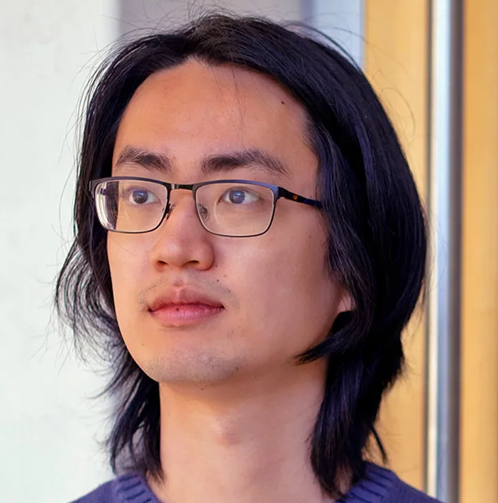







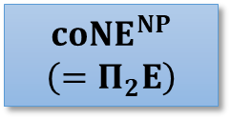

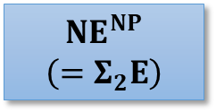



Exponential size lower bounds
Progress:
Hanlin Ren
Ryan Williams
Lijie Chen
Shuichi Hirahara
Hanlin Ren
Zeyong Li
Near-max lower bounds for $E^{prMA}/_{1}$ (2026)
$$E^{prMA}$$
Near-max lower bounds for $S_{2}E$ (2023)
☹
$$MA_{E}$$
$${NE}^{NP}$$
$$\left(=Σ_{2}E\right)$$
$${NE}^{NP}$$
$$\left(=Σ_{2}E\right)$$
$$NE$$
$$S_{2}E$$
$$S_{2}E$$
$${ZPE}^{NP}$$
$${ZPE}^{NP}$$
$$E^{{NP}^{NP}}$$
$$E$$
$$E^{NP}$$
$$E^{{NP}^{NP}}$$
$$coNE$$
$${coNE}^{NP}$$
$$\left(=Π_{2}E\right)$$
$${coNE}^{NP}$$
$$\left(=Π_{2}E\right)$$
$$AM_{E}$$
$$AM_{E}$$
Requires $2^{n}/n$ circuit size. (MVW’99)
(“Lex-first hard function” sits here.)
Lijie Chen
Jiatu Li
Jingxun Liang
Near-max lower bounds for $AM_{EXP}/_{2^{n^{ε}}}$ (2025)

Slide 5




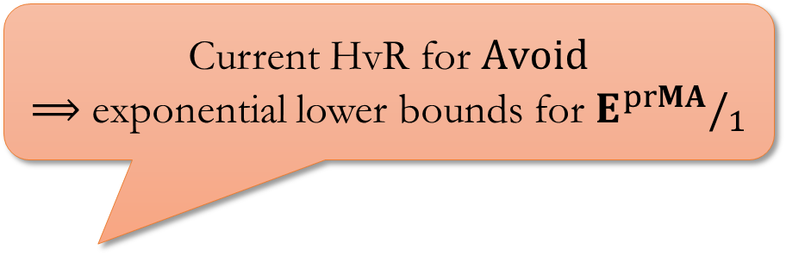
Progress:
Current HvR for $Avoid$
$⟹$ exponential lower bounds for $E^{prMA}/_{1}$
Good Hardness-vs-Randomness Tradeoffs for $Avoid$
Better circuit lower bounds from better HvR?
https://www.amazon.co.uk/dp/B06W571TQF

Slide 6




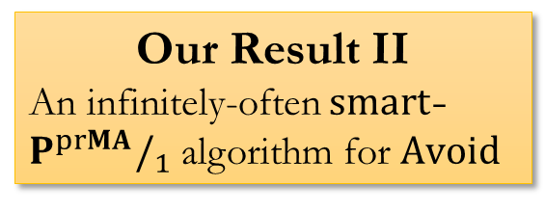

Range Avoidance Problem
Progress:
Input: a (multi-output) circuit $C:{\left\{0,1\right\}}^{n}→{\left\{0,1\right\}}^{ℓ}$ ($ℓ>n$)
Output: any string $y∉Range\left(C\right)$
  I.e., for every $x∈{\left\{0,1\right\}}^{n}$, $C\left(x\right)≠y$
A “non-output” of $C$.
$$y∈{\left\{0,1\right\}}^{ℓ}$$
$$C$$
Our Result II
An infinitely-often $smart$-$P^{prMA}/_{1}$ algorithm for $Avoid$
$$x∈{\left\{0,1\right\}}^{n}$$

Slide 7
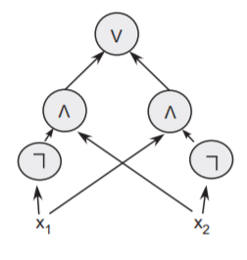




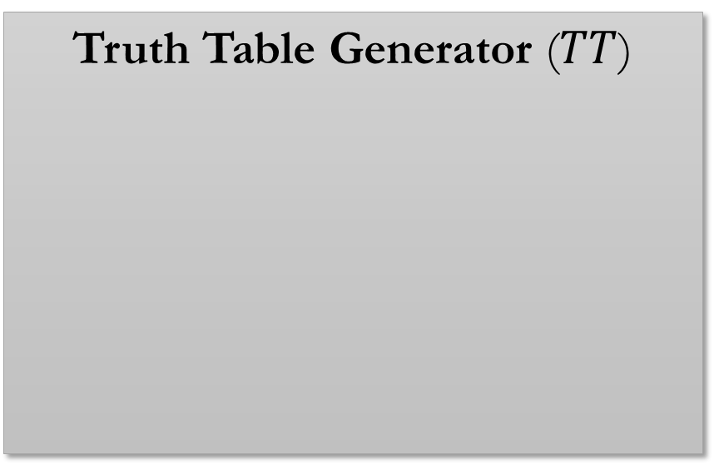




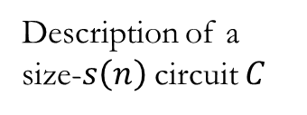

Algorithms for $Avoid$
$⟹$ Circuit Lower Bounds
Progress:
Say that we want to prove a lower bound of size $s\left(n\right)$.
Truth Table Generator ($TT$)
Algorithms for range avoidance
$⟹$ circuit lower bounds!
E.g. solving range avoidance in deterministic poly-time
$⟹$ proving $E⊈SIZE\left[s\left(n\right)\right]$
Truth table of $C$
$$0110010011…………001010$$
$2^{n}$ bits
$$TT$$
$\tilde{O}\left(s\left(n\right)\right)$ bits
Proof: $L_{hard}\left(x\right)=x$-th output bit of $Avoid\left(TT\right)$
Description of a size-$s\left(n\right)$ circuit $C$

Slide 8

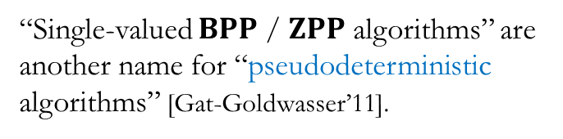
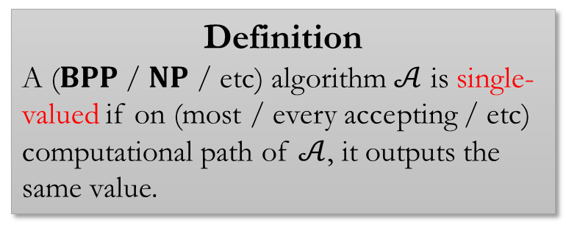
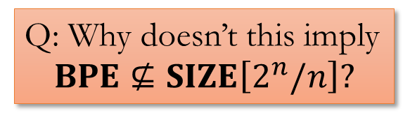

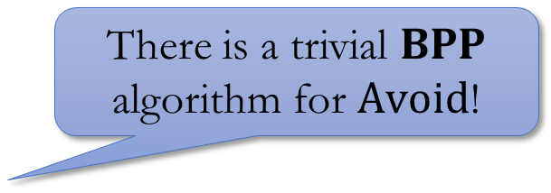
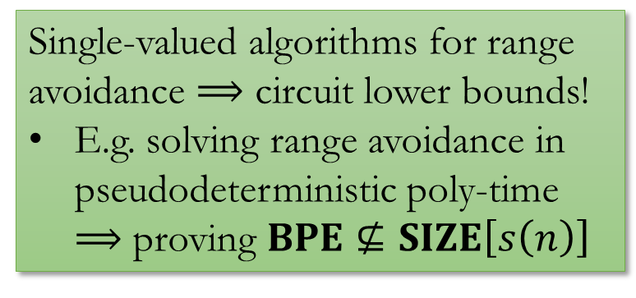
Single-Valued Algorithms
Progress:
There is a trivial $BPP$ algorithm for $Avoid$!
Definition
A ($BPP$ / $NP$ / etc) algorithm $𝒜$ is single-valued if on (most / every accepting / etc) computational path of $𝒜$, it outputs the same value.
Just output a random length-$ℓ$ string.
$$y∈{\left\{0,1\right\}}^{ℓ}$$
$$C$$
“Single-valued $BPP$ / $ZPP$ algorithms” are another name for “pseudodeterministic algorithms” [Gat-Goldwasser’11].
Q: Why doesn’t this imply
$$BPE⊈SIZE\left[2^{n}/n\right]?$$
$$x∈{\left\{0,1\right\}}^{n}$$
Single-valued algorithms for range avoidance $⟹$ circuit lower bounds!
E.g. solving range avoidance in pseudodeterministic poly-time
$⟹$ proving $BPE⊈SIZE\left[s\left(n\right)\right]$
A: Because the algorithm is not single-valued!
It does not define a hard truth table.

Slide 9

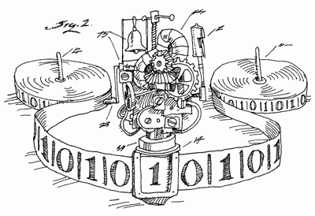
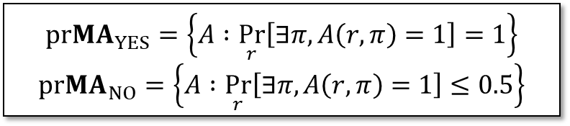

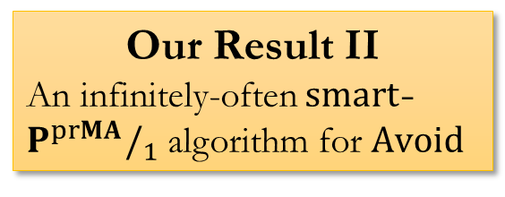
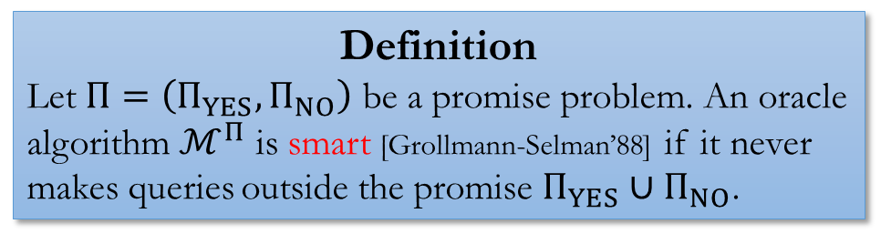
Smart Algorithms
Progress:
Promise Problem
YES instances
$$pr{MA}_{YES}=\left\{A :\underset{r}{Pr}\left[∃π,A\left(r,π\right)=1\right]=1\right\}$$
$$pr{MA}_{NO}=\left\{A :\underset{r}{Pr}\left[∃π,A\left(r,π\right)=1\right]≤0.5\right\}$$
NO instances
Our Result II
An infinitely-often $smart$-$P^{prMA}/_{1}$ algorithm for $Avoid$
Definition
Let $Π=\left(Π_{YES},Π_{NO}\right)$ be a promise problem. An oracle algorithm $ℳ^{Π}$ is smart [Grollmann-Selman’88] if it never makes queries outside the promise $Π_{YES}∪Π_{NO}$.
Smart $⟹$ Single-valued!

Slide 10


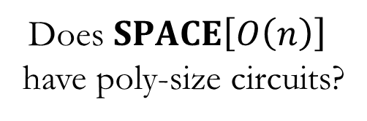


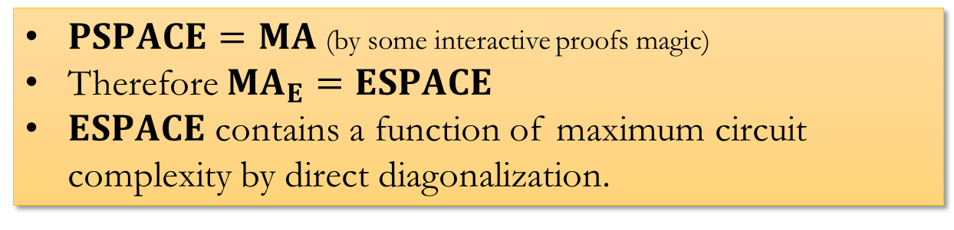
The BFT98 Proof
Progress:
$${MA}_{E}⊈P/_{poly}$$
$PSPACE=MA$ (by some interactive proofs magic)
Therefore ${MA}_{E}=ESPACE$
$ESPACE$ contains a function of maximum circuit complexity by direct diagonalization.
YES
“$ESPACE$” = space $2^{O\left(n\right)}$
Does $SPACE\left[O\left(n\right)\right]$ have poly-size circuits?
NO
Since ${MA}_{E}$ contains $SPACE\left[O\left(n\right)\right]$, ${MA}_{E}$ doesn’t have poly-size circuits as well.

Slide 11

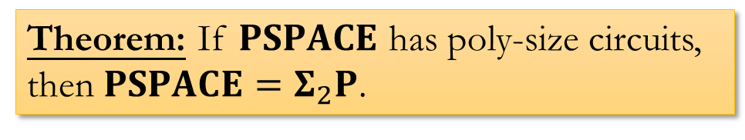
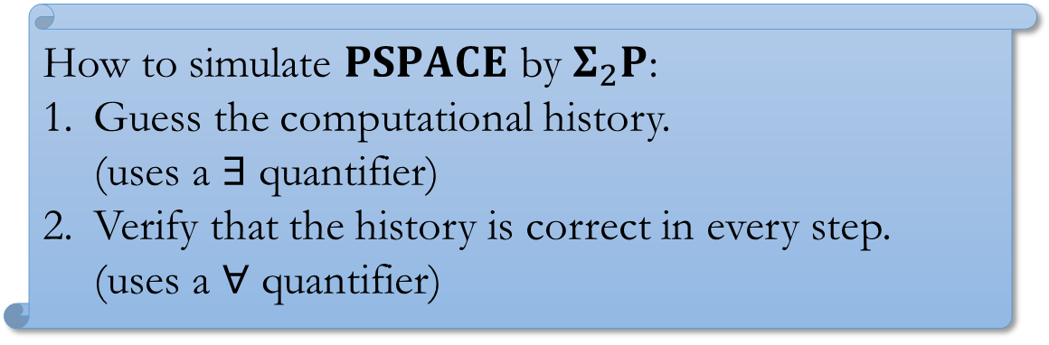
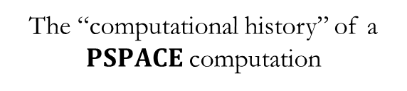

Guess-and-check
Progress:
a.k.a. “Karp-Lipton theorems”
Time
Theorem: If $PSPACE$ has poly-size circuits, then $PSPACE=Σ_{2}P$.
How to simulate $PSPACE$ by $Σ_{2}P$:
Guess the computational history.
(uses a $∃$ quantifier)
Verify that the history is correct in every step.
(uses a $∀$ quantifier)
$$2^{n}$$
Space
$$poly\left(n\right)$$
The “computational history” of a $PSPACE$ computation

Slide 12
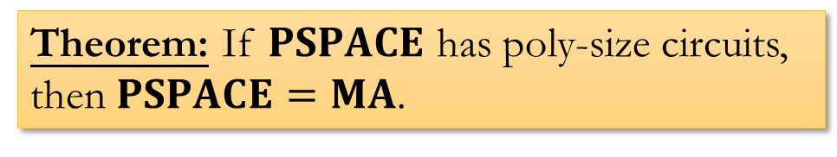
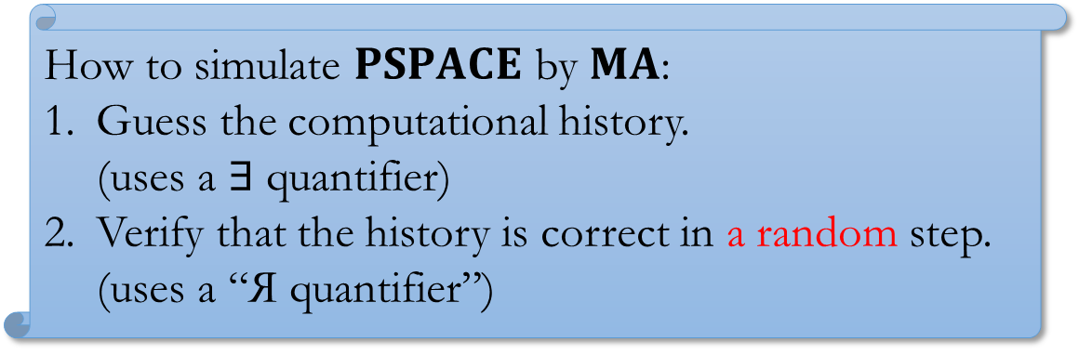
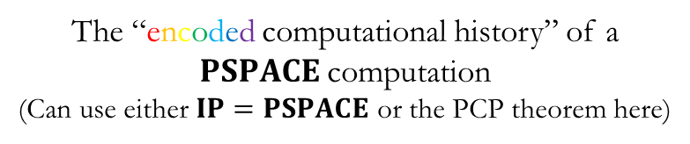
Interactive Proofs Magic
Progress:
Time
Theorem: If $PSPACE$ has poly-size circuits, then $PSPACE=MA$.
How to simulate $PSPACE$ by $MA$:
Guess the computational history.
(uses a $∃$ quantifier)
Verify that the history is correct in a random step.
(uses a “Я quantifier”)
$$2^{n}$$
Space
$$poly\left(n\right)$$
The “encoded computational history” of a $PSPACE$ computation
(Can use either $IP=PSPACE$ or the PCP theorem here)

Slide 13
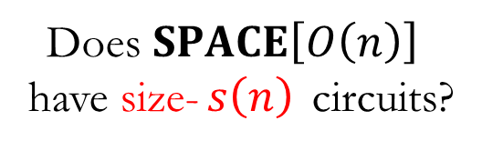
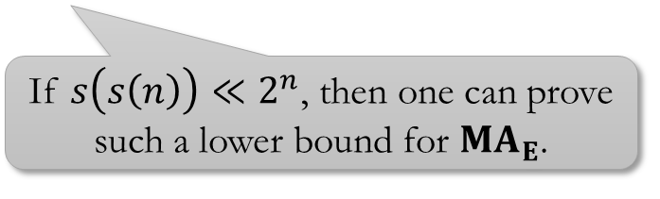
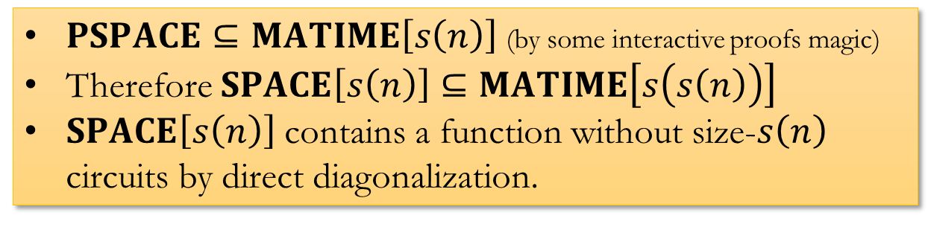
Why Only Super-Polynomial?
Progress:
$PSPACE⊆MATIME\left[s\left(n\right)\right]$ (by some interactive proofs magic)
Therefore $SPACE\left[s\left(n\right)\right]⊆MATIME\left[s\left(s\left(n\right)\right)\right]$
$SPACE\left[s\left(n\right)\right]$ contains a function without size-$s\left(n\right)$ circuits by direct diagonalization.
YES
Does $SPACE\left[O\left(n\right)\right]$ have size-$s\left(n\right)$ circuits?
If $s\left(s\left(n\right)\right)≪2^{n}$, then one can prove such a lower bound for ${MA}_{E}$.
NO
Since ${MA}_{E}$ contains $SPACE\left[O\left(n\right)\right]$, ${MA}_{E}$ doesn’t have poly-size circuits as well.
Some poly factors omitted for ease of notation. For example, “$TIME\left[f\left(n\right)\right]$” actually means “$TIME\left[poly\left(f\left(n\right)\right)\right]$”.

Slide 14




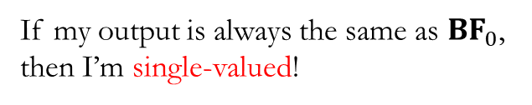


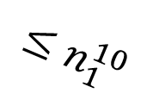
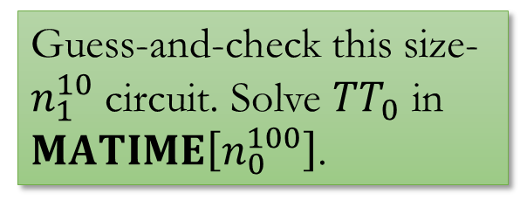












BFT98 as an $Avoid$ Algorithm
Progress:
Now, our goal is to solve $Avoid$ in single-valued $FMA$
$Avoid$ instances
(set $n_{1}=n_{0}^{10}$)
Goal: solve $TT_{i}$ in $2^{n_{i}}$ time.
${hist}_{0}$ is a solution of $TT_{1}$, computable in $2^{n_{1}}$ time (deterministically)
$$…$$
$$>n_{1}^{10}$$
$$2^{n_{1}}$$
What’s the circuit complexity of ${hist}_{0}$?
$$TT_{1}$$
Guess-and-check this size-$n_{1}^{10}$ circuit. Solve $TT_{0}$ in $MATIME\left[n_{0}^{100}\right]$.
$$≤n_{1}^{10}$$
$$n_{1}^{10}$$
$$…$$
$$2^{n_{0}}$$
${BF}_{0}$: Solve $Avoid$ (naively) in deterministic time $2^{n_{0}^{10}}$
If my output is always the same as ${BF}_{0}$, then I’m single-valued!
$$TT_{0}$$
$$n_{0}^{10}$$
The “computational history” of ${BF}_{0}$ is a string of length $≈2^{n_{0}^{10}}$.
$$…$$
$$hi{st}_{0}$$

Slide 15
















Can you solve small-stretch $Avoid$?
Progress:
Towards $2^{Ω\left(n\right)}$ circuit lower bounds…
$Avoid$ instances
(set $N_{1}=N_{0}^{10}$)
Goal: solve $TT_{i}$ in $poly\left(N_{i}\right)$ time.
$\left|{hist}_{0}\right|≈2^{N_{0}}$, way larger than $N_{1}$.
What should we do?
$$…$$
$$>N_{1}^{10}$$
$$2N_{1}$$
What’s the circuit complexity of ${hist}_{0}$?
$$C_{1}$$
Guess-and-check this size-$N_{1}^{10}$ circuit. Solve $C_{0}$ in $MATIME\left[N_{0}^{100}\right]$.
$$≤N_{1}^{10}$$
$$N_{1}$$
$$…$$
$$2N_{0}$$
${BF}_{0}$: Solve $Avoid$ (naively) in deterministic time $2^{N_{0}}$
If my output is always the same as ${BF}_{0}$, then I’m single-valued!
$$C_{0}$$
$$…$$
$$N_{0}$$
The “computational history” of ${BF}_{0}$ is a string of length $≈2^{N_{0}}$.
$$hi{st}_{0}$$

Slide 16









We want Hardness-vs-Randomness for $Avoid$!
Progress:
Length $2^{N_{0}}$, circuit complexity $>N_{1}^{10}$
Hardness-vs-Randomness for $Avoid$
(a too-good-to-be-true version)
Given: length-$T$ truth table with circuit complexity $>poly\left(s\right)$
Solve: $Avoid$ for size-$s$ instances in deterministic $poly\left(T\right)$ time
$$hi{st}_{0}$$
$$2N_{1}$$
$$C_{1}$$
Next:
The too-good-to-be-true HvR implies exponential lower bounds for ${MA}_{E}$
What’s the actual available HvR? How can we use it?
$$N_{1}$$
Goal: solve $Avoid$ on $C_{1}$ in $2^{O\left(N_{0}\right)}$ time

Slide 17









Good HvR $⟹$ Good lower bounds!
Progress:
The “iterative win-win” method of CLORS’23
Hardness-vs-Randomness for $Avoid$
(a too-good-to-be-true version)
Given: length-$T$ truth table with circuit complexity $>poly\left(s\right)$
Solve: $Avoid$ for size-$s$ instances in deterministic $poly\left(T\right)$ time
$Avoid$ instances
(set $N_{1}=N_{0}^{10}$)
Goal: solve $C_{i}$ in $poly\left(N_{i}\right)$ time.
$$…$$
$$2N_{1}$$
Plugging $hi{st}_{0}$ into HvR and solve $C_{1}$ in $2^{O\left(N_{0}\right)}≤2^{N_{1}^{0.1}}$ time.
$$>N_{1}^{10}$$
$$C_{1}$$
What’s the circuit complexity of ${hist}_{0}$?
$$N_{1}$$
$$…$$
$$≤N_{1}^{10}$$
Guess-and-check this size-$N_{1}^{10}$ circuit. Solve $C_{0}$ in $MATIME\left[N_{0}^{100}\right]$.
$$2N_{0}$$
${BF}_{0}$: Solve $Avoid$ (naively) in deterministic time $2^{N_{0}}$
$$C_{0}$$
$$…$$
$$N_{0}$$
The “computational history” of ${BF}_{0}$ is a string of length $≈2^{N_{0}}$.
$$hi{st}_{0}$$

Slide 18





















Good HvR $⟹$ Good lower bounds!
Progress:
The “iterative win-win” method of CLORS’23
Hardness-vs-Randomness for $Avoid$
(a too-good-to-be-true version)
Given: length-$T$ truth table with circuit complexity $>poly\left(s\right)$
Solve: $Avoid$ for size-$s$ instances in deterministic $poly\left(T\right)$ time
$Avoid$ instances
(set $N_{2}=N_{1}^{10}$)
Goal: solve $C_{i}$ in $poly\left(N_{i}\right)$ time.
$$2N_{2}$$
Plugging $hi{st}_{1}$ into HvR and solve $C_{2}$ in $2^{O\left(N_{0}\right)}≤2^{N_{2}^{0.01}}$ time.
$$C_{2}$$
$$>N_{2}^{10}$$
What’s the circuit complexity of ${hist}_{1}$?
$$…$$
$$N_{2}$$
$$2N_{1}$$
$$≤N_{2}^{10}$$
Guess-and-check this size-$N_{2}^{10}$ circuit. Solve $C_{1}$ in $MATIME\left[N_{1}^{100}\right]$.
$$C_{1}$$
$$…$$
$$N_{1}$$
$$2N_{0}$$
${BF}_{1}$: Plugging $hist_{0}$ into HvR and solve $C_{1}$ in deterministic time (still) $≈2^{N_{0}}$
$$C_{0}$$
$$hi{st}_{1}$$
$$…$$
$$N_{0}$$
The “computational history” of ${BF}_{1}$ is a string of length (still) $≈2^{N_{0}}$

Slide 19

























Good HvR $⟹$ Good lower bounds!
Progress:
The “iterative win-win” method of CLORS’23
Hardness-vs-Randomness for $Avoid$
(a too-good-to-be-true version)
Given: length-$T$ truth table with circuit complexity $>poly\left(s\right)$
Solve: $Avoid$ for size-$s$ instances in deterministic $poly\left(T\right)$ time
$Avoid$ instances
$$C_{i}$$
${BF}_{0}$: naïve algorithm solving $C_{0}$
${BF}_{1}$: (not-so-)naïve algorithm solving $C_{1}$
${BF}_{2}$: (even-less-)naïve algorithm solving $C_{2}$
${BF}_{3}$…
$$…$$
NO
NO
NO
$$2N_{2}$$
Is $hist\left({BF}_{0}\right)$ in size $N_{1}^{10}$?
Is $hist\left({BF}_{1}\right)$ in size $N_{2}^{10}$?
Is $hist\left({BF}_{2}\right)$ in size $N_{3}^{10}$?
$$C_{2}$$
$$…$$
$$N_{2}$$
$$2N_{1}$$
YES
YES
YES
$$C_{1}$$
$$…$$
$$N_{1}$$
$$2N_{0}$$
Use $C_{1}$ to solve $C_{0}$ in $svMATIME\left[N_{1}^{10}\right]$
Use $C_{2}$ to solve $C_{1}$ in $svMATIME\left[N_{2}^{10}\right]$
Use $C_{3}$ to solve $C_{2}$ in $svMATIME\left[N_{3}^{10}\right]$
$$C_{0}$$
$$…$$
$$N_{0}$$

Slide 20






Analysis
Progress:
$N_{i}$ = size of the $i$-th $Avoid$ instance
$T_{i}$ = time complexity of ${BF}_{i}$
$T_{i}={\left(T_{i−1}\right)}^{α}$
  Depending on the HvR overhead
Just set $N_{i}={\left(N_{i−1}\right)}^{2α}$ ☺
${BF}_{i}$: Since (we assumed) $hist\left({BF}_{i−1}\right)$ has large circuit complexity, we obtain a derandomized algorithm for $Avoid$.
$$T_{i}$$
$$N_{i}$$
Corollary
Assuming the “too-good-to-be-true” hardness vs randomness for $Avoid$, we can prove an exponential lower bound for ${MA}_{E}/_{1}$.
$$i$$

Slide 21















Back to the real world…
Progress:
What’s an HvR for $Avoid$ that we actually have?
$f∈{\left\{0,1\right\}}^{T}$: a length-$T$ truth table
$$i$$
$x_{4}←C\left(x_{3}\right).left$ and read $y_{i}$ from $x_{4}$
$$T=2^{4}N$$
$$x_{3}←C\left(x_{2}\right).right$$
$$2^{3}N$$
$$x_{2}←C\left(x_{1}\right).left$$
$$2^{2}N$$
$$2^{1}N$$
$$x_{1}←C\left( \right).right$$
$$y∈{\left\{0,1\right\}}^{2N}$$
$$N$$
$$C$$
Claim: If we didn’t solve $Avoid$, then $f$ has a circuit of size $poly\left(N,\log{T}\right)$.
$$x∈{\left\{0,1\right\}}^{N}$$

Slide 22







Back to the real world…
Progress:
What’s an HvR for $Avoid$ that we actually have?
Given $y∈{\left\{0,1\right\}}^{2N}$, need an $NP$ oracle to find a preimage in $C^{−1}\left(y\right)$.
Length $T$, circuit complexity $>s$
$$f$$
Hardness-vs-Randomness for $Avoid$
(a realistic version)
Given: length-$T$ truth table with circuit complexity $>poly\left(s\right)$
Solve: $Avoid$ for size-$s$ instances in deterministic $poly\left(T\right)$ time, but with an $NP$ oracle
$$2N$$
$$C$$
$$N$$
This is the Jeřábek-Korten reduction [Jeřábek’04, Korten’21].

Slide 23








Need a new guess-and-check…
Progress:
Use the Jeřábek-Korten HvR to solve $C_{2}$ in $2^{O\left(N_{0}\right)}$ time.
$$>N_{1}^{10}$$
What’s the circuit complexity of ${hist}_{1}$?
$$≤N_{1}^{10}$$
Guess-and-check this size-$N_{1}^{10}$ circuit???
$hist_{1}$ is now the history of some $P^{NP}$ computation!
You cannot “verify every step of a $P^{NP}$ computation”, unless you (Arthur) also have an $NP$ oracle…
You can still guess-and-check the “encoded history” of a $P^{NP}$ computation in $S_{2}P$ (see [Hirahara’15]).
This leads to a near-max lower bound for $S_{2}E$ [CHR’24].

Slide 24





The Crucial Observation
Progress:
This procedure is $P^{NP}$… But only with $poly\left(n,\log\left|f\right|\right)$ many rounds of adaptive $NP$ oracle calls!
$$f$$
$$P^{NP}\left[\begin{matrix}\#rounds=r\left(n\right) \\ length=ℓ\left(n\right)\end{matrix}\right]$$
The machine makes $r\left(n\right)$ adaptive rounds of $NP$ queries.
Each $NP$ query has witness length $≤ℓ\left(n\right)$.
Technical ingredient I
How to define “encoded computational history” of a $P^{NP}\left[\begin{matrix}\#rounds=r\left(n\right) \\ length=ℓ\left(n\right)\end{matrix}\right]$ computation?
Technical ingredient II
If the “encoded computational history” of a $P^{NP}\left[\begin{matrix}\#rounds=r\left(n\right) \\ length=ℓ\left(n\right)\end{matrix}\right]$ computation has small circuits, how to guess-and-check this circuit in $P^{prMA}$?

Slide 25







Encoded History of $P^{NP}$ Computation
Progress:
$NP$-complete: Find a satisfying assignment of $C$.
“History” of an $NP$ computation $M$: any satisfying assignment of $φ_{M}$.
$$C$$
$P^{NP}$-complete: Find the lexicographically smallest satisfying assignment of $C$.
“History” of a $P^{NP}$ computation $M$:
lex-smallest satisfying assignment of $φ_{M}$.
$P^{NP}\left[\begin{matrix}\#round=r \\ \#length=ℓ\end{matrix}\right]$-complete: Find a satisfying assignment of $C$ that has the lexicographically smallest length-$\tilde{O}\left(r\right)$ prefix.
“Encoded” history: just apply a (suitable) PCP to $C$!
“History” of a $P^{NP}\left[\begin{matrix}\#round=r \\ \#length=ℓ\end{matrix}\right]$ computation $M$:
any satisfying assignment of $φ_{M}$ with the smallest length-$\tilde{O}\left(r\right)$ prefix.

Slide 26





Guess-and-check
Progress:
“History” of a $P^{NP}\left[\begin{matrix}\#round=r \\ \#length=ℓ\end{matrix}\right]$ computation $M$:
any satisfying assignment of $φ_{M}$ with the smallest length-$\tilde{O}\left(r\right)$ prefix.
$$C$$
Goal: If the history has size-$s$ circuits, compute it in $TIME{\left[poly\left(r,s\right)\right]}^{prMA}$.
$$T$$
(think of $T=\exp\left(n\right)$, but $r,s=poly\left(n\right)$)
$pfx←ε$
For $i←1…\tilde{O}\left(r\right)$
Test if there’s a satisfying assignment with “$pfx 0$” as a prefix
If yes, $pfx←pfx 0$; otherwise, $pfx←pfx 1$
This is a $prMA$ query:
Is there a size-$s$ circuit whose truth table passes a random PCP test and has a particular length-$\tilde{O}\left(r\right)$ prefix?

Slide 27

















An Exponential Lower Bound for $E^{prMA}/_{1}$
Progress:
$Avoid$ instances
(set $N_{i+1}=N_{i}^{10}$)
Can achieve: $r_{i+1},s_{i+1}≤poly\left(N_{i+1}\right)$, $t_{i+1}≤poly\left(t_{i}\right)$
Goal: solve $C_{i}$ in $poly\left(N_{i}\right)$ time.
$$…$$
Plugging $hi{st}_{0}$ into HvR and solve $C_{i+1}$ in $TIME{\left[t_{i+1}\right]}^{NP}\left[\begin{matrix}\#rounds=r_{i+1} \\ length=ℓ_{i+1}\end{matrix}\right]$.
$$2N_{i+1}$$
$$>N_{i+1}^{10}$$
What’s the circuit complexity of ${hist}_{i}$?
$$C_{i+1}$$
$$N_{i+1}$$
$$≤N_{i+1}^{10}$$
Guess-and-check this size-$N_{i+1}^{10}$ circuit. Solve $C_{i}$ in smart $TIME{\left[poly\left(N_{i}\right)\right]}^{prMA}$.
$$…$$
$$2N_{i}$$
${BF}_{i}$: Solve $Avoid$ for $C_{i}$ in ${TIME\left[t_{i}\right]}^{NP}\left[\begin{matrix}\#rounds=r_{i} \\ length=ℓ_{i}\end{matrix}\right]$
$$C_{i}$$
$$…$$
$$N_{i}$$
Here $t_{i}$ may be exponential in $N_{i}$, but $r_{i},ℓ_{i}≤poly\left(N_{i}\right)$
$$hi{st}_{i}$$

Slide 28








Prospective: Better HvR for $Avoid$?
Progress:
Hardness-vs-Randomness for $Avoid$
Given: length-$T$ truth table with circuit complexity $>poly\left(s\right)$
Solve: $Avoid$ for size-$s$ instances in deterministic $poly\left(T\right)$ time
Complexity: $P^{NP}\left[\begin{matrix}\#rounds=poly\left(n,\log{T}\right) \\ length=O\left(n\right)\end{matrix}\right]$.
This is so annoying! Maybe we only need $1$ round of $NP$ oracle to solve $Avoid$ (in “$P_{tt}^{NP}$”)?
Theorem (Klivans-van Melkebeek; Miltersen-Vinodchandran; …)
If $E_{tt}^{NP}$ requires exponential size single-valued nondeterministic (SVN) circuits, then $Avoid∈{FP}_{tt}^{NP}$.
However, we don’t know how to guess-and-check SVN circuits in $MA$.
You can do it in $AM$! Leads to near-max lower bounds for ${AM}_{EXP}/_{2^{n^{ε}}}$ (CLL25)
Q2: Can we use better HvR for $Avoid$ to obtain better near-max lower bounds?
Q1: Can we find better HvR for $Avoid$?

Slide 29







Prospective: Better HvR for $searchSAT$?
Progress:
Hardness-vs-Randomness for $Avoid$
Given: length-$T$ truth table with circuit complexity $>poly\left(s\right)$
Solve: $Avoid$ for size-$s$ instances in deterministic $poly\left(T\right)$ time
Complexity: $P^{NP}\left[\begin{matrix}\#rounds=poly\left(n,\log{T}\right) \\ length=O\left(n\right)\end{matrix}\right]$.
$$f$$
If $searchSAT∈{FP}_{tt}^{NP}$, we can get rid of this $n$ factor in the current Jeřábek-Korten reduction .
Theorem (Klivans-van Melkebeek; Miltersen-Vinodchandran; …)
If $E_{tt}^{NP}$ requires exponential size single-valued nondeterministic (SVN) circuits, then $searchSAT∈{FP}_{tt}^{NP}$.
Hint: the isolation lemma.
Q2: Can we use better HvR for $searchSAT$ to obtain better near-max lower bounds?
Q3: What does “better” mean?
Putting $Avoid$ or $searchSAT$ into ${FP}_{tt}^{NP}$ under minimal assumptions?
Q1: Can we find better HvR for $searchSAT$?
Corollary: $searchSAT∈{FP}_{tt}^{NP}⟹{MA}_{E}/_{2^{εn}}⊈SIZE\left[2^{n}/2n\right]$.

Slide 30






Summary
Progress:
Hardness-vs-Randomness for $Avoid$
Given: length-$T$ truth table with circuit complexity $>poly\left(s\right)$
Solve: $Avoid$ for size-$s$ instances in deterministic $poly\left(T\right)$ time
Complexity: $P^{NP}\left[\begin{matrix}\#rounds=poly\left(n,\log{T}\right) \\ length=O\left(n\right)\end{matrix}\right]$.
Good Hardness-vs-Randomness Tradeoffs for $Avoid$
The “encoded computational history” of a $P^{NP}\left[\begin{matrix}\#rounds=r\left(n\right) \\ length=ℓ\left(n\right)\end{matrix}\right]$ computation
An infinitely-often $smart$-$P^{prMA}/_{1}$ algorithm for $Avoid$
Guess-and-check the “encoded history” of a $P^{NP}\left[\begin{matrix}\#rounds=r\left(n\right) \\ length=ℓ\left(n\right)\end{matrix}\right]$ computation in $P^{prMA}$
An exponential-size circuit lower bound for $E^{prMA}/_{1}$.
Thank you!
Questions are welcome!

