Slide 1
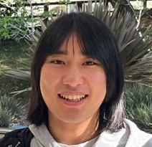
$NP$-Hardness of Approximating Meta-Complexity: A Cryptographic Approach
Yizhi Huang
(Tsinghua)
Rahul Ilango
(MIT)
Hanlin Ren
(Oxford)
Minimal Complexity Assumptions for Cryptography
Meta-Complexity @ Simons
0 / 16

Slide 2
In this talk, you will see
(For complexity theorists)
(For cryptographers)
Minimum Oracle Circuit Size Problem ($MOCSP$)
$NP$-hardness of meta-complexity
Cryptography
Meta-complexity
Witness encryption
(the one proposed in GGSW)
approximating
with optimal inapprox gap
How we used crypto constructions to prove something interesting in complexity theory
… Unconditionally!
PCPs
YOU can make progress in meta-complexity!
1 / 16

Slide 3
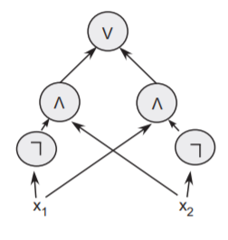
Minimum Circuit Size Problem
$MCSP$ (Minimum Circuit Size Problem)
Given a truth table, compute its circuit complexity
What’s the complexity of $MCSP$?
Input length $=N=2^{n}$
$$x$$ | $$0^{n}$$ | $$…$$ | $$1^{n}$$
$$f$$ | $$f\left(0^{n}\right)$$ | $$…$$ | $$f\left(1^{n}\right)$$
$$Circuit_Complexity\left(f\right)$$
The (meta-)complexity of circuit complexity!
$MCSP$ is intractable under standard crypto assumptions.
$MCSP$ is in $NP$.
Is $MCSP$ $NP$-complete?
[RR97, KC00]
Cryptography
Meta-complexity
2 / 16

Slide 4
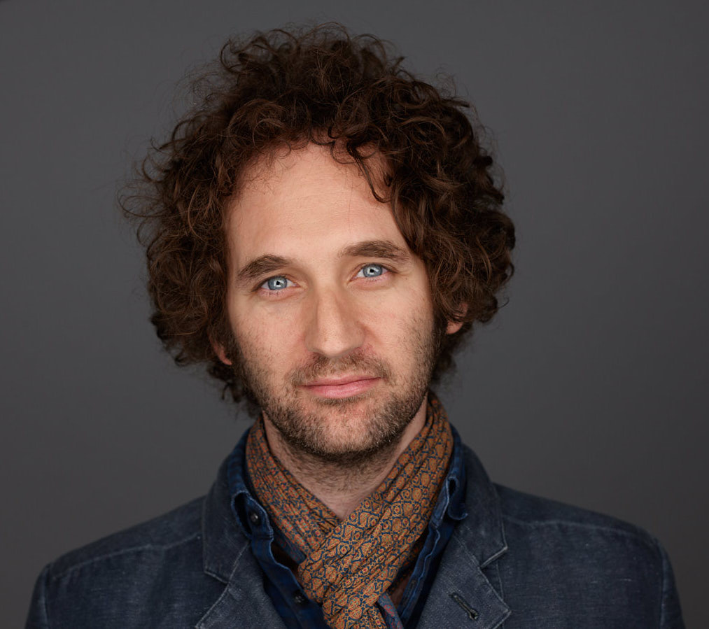
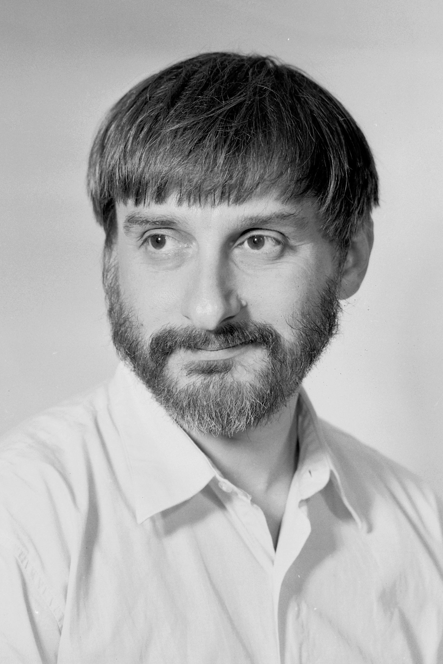
$NP$-completeness of $MCSP$: Why care about it?
[Murray-Williams 17]: If $MCSP$ is $NP$-hard under deterministic mapping reductions, then $EXP≠ZPP$.
Is it $NP$-hard? This problem will be “hard to solve”, but Yes or No?
Curiosity
[LP20, LP22]: Average-case complexity of “cousins” of $MCSP$ characterizes one-way functions!
Excluding Heuristica
$MCSP$ is a natural problem whose complexity remain unidentified
… for 50 yrs!
OWF from $NP⊈BPP$?
[Hirahara18]: If $GapMCSP$ is $NP$-hard, then the worst- and average-case complexity of $NP$ are equivalent.
3 / 16

Slide 5
Minimum Oracle Circuit Size Problem
“Approaching $MCSP$ from above” [Ilango’20]
Given a function $f$ and an oracle $O$, compute the $O$-oracle circuit complexity of $f$
A “testing ground” for $MCSP$?
$NP$-hardness of $MOCSP$ under deterministic reductions $⟹EXP≠ZPP$ (still!)
[Ilango’20]: $NP$-hard under randomized reductions!
$$($$
$$,$$
$$)$$
$$x$$ | $$0^{n}$$ | $$…$$ | $$1^{n}$$
$$f$$ | $$f\left(0^{n}\right)$$ | $$…$$ | $$f\left(1^{n}\right)$$
$$x$$ | $$0^{m}$$ | $$…$$ | $$1^{m}$$
$$O$$ | $$O\left(0^{m}\right)$$ | $$…$$ | $$O\left(1^{m}\right)$$
4 / 16

Slide 6
Hardness of Approximation…?
Yes instances: complexity $≤s$
No instances: complexity $≥2^{\left(1−ε\right)n}s$
$$\left(s vs 2^{\left(1−ε\right)n}s\right)$$
Theorem (Hirahara’18): If ${Gap}_{ε}MCSP$ is $NP$-hard for every $ε>0$, then Heuristica doesn’t exist.
$$(s vs 0.1n⋅s)$$
Theorem (Ilango’20): $GapMOCSP$ is $NP$-hard!
Comment: reduction from set cover, so $Θ\left(\log{N}\right)$-approx is optimal
$$\left(s vs 2^{\left(1−ε\right)n}s\right)$$
This work: ${Gap}_{ε}MOCSP$ is $NP$-hard for every $ε>0$!
Yes instances: exactly computed by size $s$
No instances: hard on average against size $2^{\left(1−ε\right)n}s$
5 / 16

Slide 7
Why Cryptography Helps
Intuition I: “Structured” Hardness
If we “merely” assume circuit lower bounds, seems unclear how to use it and prove $MCSP$ is $NP$-hard.
What if we assume cryptographic hardness?
Intuition II: Arguments
Argument systems = $NP$-hardness of “meta-complexity”
More on the next slide ☺
SNARG
DDH
$$iO$$
LWE
6 / 16

Slide 8
Warm-Up: Arguments = $NP$-Hardness of Meta-Complexity
Arguments: proof systems sound against computationally bounded provers
An argument system for $L$
$L$: some language in $NP$
$x∈L$: $∃$ a size-$s$ prover (with a witness of $x$) that convinces the verifier
$x∉L$: any size-$s^{10}$ prover cannot convince the verifier (except with negl probability)
$L$ reduces to “meta-complexity”
“meta-complexity” problem: what’s the complexity of convincing the verifier?
$x∈L$: complexity $≤s$
$x∉L$: complexity $>s^{10}$
Remark 1: hardness of approximation!
(Arbitrarily large inapprox, by adjusting the security parameter)
Remark 2: the No instances are average-case hard! Any size-$s^{10}$ prover has only negl prob of convincing the verifier
7 / 16

Slide 9
Witness Encryption
Encryption using a (public) SAT instance!
$Encrypt\left(φ,msg;rand\right)→ct$
$Decrypt\left(φ,α,ct\right)→msg$
Intuition: encrypt a message, but anyone knowing the solution to a Sudoku puzzle / a proof of Riemann Hypothesis can decrypt!
Assumption: $Encrypt$ is randomized, but $Decrypt$ is not
Correctness: If $φ\left(α\right)=1$, then $Decrypt$ outputs the correct $msg$.
Security: If $φ$ is unsatisfiable, then
$$Encrypt\left(φ,0\right)≈_{c}Encrypt\left(φ,1\right).$$
8 / 16

Slide 10
Oracle Witness Encryption
Everybody has access to a (specifically designed) oracle $𝒪$
${Encrypt}^{𝒪}\left(φ,msg;rand\right)→ct$
${Decrypt}^{𝒪}\left(φ,α,ct\right)→msg$
Caveat: the oracle fan-in is only $O\left(λ\right)$ where $λ \sim \log\left|φ\right|$ is the security parameter
Oracle length$=2^{O\left(λ\right)}=poly\left(\left|φ\right|\right)$
Need exponential security ($2^{Ω\left(λ\right)}$)!
Correctness: If $φ\left(α\right)=1$, then ${Decrypt}^{𝒪}$ outputs the correct $msg$.
Security: If $φ$ is unsatisfiable, then
$${Encrypt}^{𝒪}\left(φ,0\right)≈_{c}{Encrypt}^{𝒪}\left(φ,1\right).$$
Hope 1: if we design $𝒪$ carefully, then oracle witness encryption unconditionally exists…?
Hope 2: if oracle witness encryption exists, then $MOCSP$ is $NP$-hard (with large approx gap)?
9 / 16

Slide 11
Oracle WE $⟹NP$-hardness of $MOCSP$
Given an instance $φ$, want to produce an instance $\left(f,O\right)$
$φ$ is satisfiable if and only if $f$ has small $O$-oracle circuit complexity!
$$O$$
$$f$$
(random truth table)
$O_{1}$: the oracle under which witness encryption exists
If $φ$ is satisfiable, then by correctness of witness encryption, $f$ has a small $O$-oracle circuit:
$O_{2}\left(i,j\right)=j$-th bit of ${Encrypt}^{O_{1}}\left(φ,f_{i}\right)$
$f\left(i\right):$
Hardcode a witness $α$ of $φ$
Query $O_{2}$ to obtain $ct={Encrypt}^{O_{1}}\left(φ,f\left(i\right)\right)$
Run ${Decrypt}^{O_{1}}(φ,α,ct)$ and obtain $f\left(i\right)$
If $φ$ is unsatisfiable, then any small $O$-oracle circuit for $f$ violates the security of witness encryption! (Need a non-trivial proof)
10 / 16

Slide 12
How to construct oracle WE?
Look at candidate witness encryptions in literature one by one, and find oracles that make them secure
GGSW works!
GGSW uses multilinear maps, so our oracle implements the generic multilinear map model.
Security proof highly non-trivial.
11 / 16

Slide 13
GGSW Witness Encryption
Starting point: $Exact_Cover$
Input: universe $\left[n\right]$ and “pieces” $X_{1},X_{2},…,X_{m}⊆\left[n\right]$
Decide: Are there pieces $X_{i_{1}},X_{i_{2}},…,X_{i_{k}}$ that exactly covers $\left[n\right]$?
(Their disjoint union is exactly $\left[n\right]$)
Implementation
$r_{1},…,r_{n},r_{n+1},r_{n+2}←$random numbers
Wlog assume $msg∈\left\{n+1,n+2\right\}$
Announce $r_{n+1}$, $r_{n+2}$, $r\left(\left[n\right]∪\left\{msg\right\}\right)$, and each $r\left(X_{i}\right)$ to the public
Decryption:
Find $r\left(\left[n\right]\right)=r\left(X_{i_{1}}\right)+…+r\left(X_{i_{k}}\right)$
Compare $r\left(\left[n\right]∪\left\{n+1\right\}\right)$ and $r\left(\left[n\right]∪\left\{n+2\right\}\right)$ with $r\left(\left[n\right]∪\left\{msg\right\}\right)$
Idea
Assign a random number $r_{i}$ to element $i∈\left[n\right]$
$r\left(S\right)≔\sum_{i∈S}{r_{i}}$
Announce $r\left(\left[n\right]\right)$ and each $r\left(X_{i}\right)$ to the public
Decryption reduces to finding $i_{1},i_{2},…,i_{k}$ such that $r\left(\left[n\right]\right)=r\left(X_{i_{1}}\right)+r\left(X_{i_{2}}\right)+…+r\left(X_{i_{k}}\right)$
Unconditional security?
Use oracle to obfuscate the $+$ operation!
12 / 16

Slide 14
Multilinear Map
Groups $𝔾_{1},𝔾_{2},…,𝔾_{n+1}$, each $𝔾_{i}$ is the cyclic group of order $p$
Each group $𝔾_{i}$ is paired with a random bijection $σ_{i}:𝔾_{i}→[p]$
For a set $S$, use the $\left|S\right|$-th group to obfuscate $r\left(S\right)=\sum_{i∈S}{r_{i}}$
Multilinear map:
$$e_{i,j}:\left[p\right]×\left[p\right]→\left[p\right], e_{i,j}\left(σ_{i}\left(a\right),σ_{j}\left(b\right)\right)=σ_{i+j}\left(a+b\right)$$
Intuition: $σ_{i}\left(j\right)$ is the label of $j$. Given $σ_{i}\left(j\right)$, it’s hard to infer $j$ back
”Obfuscation of $r\left(S\right)$”$=σ_{\left|S\right|}\left(r\left(S\right)\right)$
$$\left(i,j,σ_{i}\left(a\right),σ_{j}\left(b\right)\right)$$
$$σ_{i+j}\left(a+b\right)$$
Note: this enables us to compute $σ_{i_{1}+i_{2}+…+i_{k}}\left(a_{1}+a_{2}+…+a_{k}\right)$ from $\left\{σ_{i_{j}}\left(a_{j}\right)\right\}$!
13 / 16

Slide 15
GGSW, revisited
Secure Implementation
$r_{1},…,r_{n},r_{n+1},r_{n+2}←𝔾_{1}$
Wlog assume $msg∈\left\{n+1,n+2\right\}$
Announce $σ_{1}\left(r_{n+1}\right)$, $σ_{1}\left(r_{n+2}\right)$, $σ_{n+1}\left(r\left(\left[n\right]∪\left\{msg\right\}\right)\right)$, and each $σ_{\left|X_{i}\right|}\left(r\left(X_{i}\right)\right)$ to the public
”Obfuscation of $r\left(S\right)$”$=σ_{\left|S\right|}\left(r\left(S\right)\right)$
Implementation
$r_{1},…,r_{n},r_{n+1},r_{n+2}←$random numbers
Wlog assume $msg∈\left\{n+1,n+2\right\}$
Announce $r_{n+1}$, $r_{n+2}$, $r\left(\left[n\right]∪\left\{msg\right\}\right)$, and each $r\left(X_{i}\right)$ to the public
Intuition: if $∄$exact cover, then $σ_{n}\left(r\left(\left[n\right]\right)\right)$ and $σ_{\left|X_{i}\right|}\left(r\left(X_{i}\right)\right)$ are “independent”!
$$e_{i,j}:\left[p\right]×\left[p\right]→\left[p\right], e_{i,j}\left(σ_{i}\left(a\right),σ_{j}\left(b\right)\right)=σ_{i+j}\left(a+b\right)$$
$$\left(i,j,σ_{i}\left(a\right),σ_{j}\left(b\right)\right)$$
$$σ_{i+j}\left(a+b\right)$$
Note: this enables us to compute $σ_{i_{1}+i_{2}+…+i_{k}}\left(a_{1}+a_{2}+…+a_{k}\right)$ from $\left\{σ_{i_{j}}\left(a_{j}\right)\right\}$!
14 / 16

Slide 16
Wrap Up
Oracle Witness Encryption
${Encrypt}^{𝒪}\left(φ,msg;rand\right)→ct$
${Decrypt}^{𝒪}\left(φ,α,ct\right)→msg$
Reducing $Exact_Cover$ to $MOCSP$:
$Exact_Cover$ instance: universe $\left[n\right]$ and “pieces” $X_{1},X_{2},…,X_{m}⊆\left[n\right]$
$f←$random truth table
$O_{1}←$ generic multilinear map model
$O_{2}←$stores the ciphertexts
Obfuscations of $r_{n+1}$, $r_{n+2}$, $r\left(\left[n\right]∪\left\{f\left(i\right)\right\}\right)$, and each $r\left(X_{i}\right)$
$O←O_{1}∪O_{2}$
Oracle WE $⟹NP$-Hardness of $MOCSP$
$O_{1}$: the oracle under which witness encryption exists
$$\left(i,j,σ_{i}\left(a\right),σ_{j}\left(b\right)\right)$$
$$σ_{i+j}\left(a+b\right)$$
$O_{2}\left(i,j\right)=j$-th bit of ${Encrypt}^{O_{1}}\left(φ,f_{i}\right)$
15 / 16

Slide 17
Summary
For complexity theorists: new techniques for $NP$-hardness of meta-complexity!
For cryptographers: YOU can make progress on central problems in meta-complexity!
GGSW
Oracle witness encryption
(with unconditional security!)
(unconditional) $NP$-hardness of $GapMOCSP$
“generic multilinear map”
Large inapprox gap
Average-case hardness in the No case
Thank you!
Questions are welcome!
16 / 16

Slide 18
Discussion 1: PCP Theorems from Meta-Complexity?
Previous results
Starts from inapprox results (using PCP theorem)
Weak hardness of approx ($s$ vs $0.1s\log{N}$)
$$GapMOCSP$$
Yes instances: $f$ admits size-$s$ $O$-oracle circuits
No instances: $f$ is $0.9$-avg hard against size-$2s$ $O$-oracle circuits
Our results
Strong hardness of approx ($N^{0.0001}$ vs $N^{0.9999}$)
Direct reduction from $Exact_Cover$
Randomly choose $x$ and verify $C^{O}\left(x\right)=f\left(x\right)$…
PCP Proof: size-$s$ oracle circuit $C$
PCP verifier
PCP Theorem from Meta-Complexity?
Wait, computing $C^{O}\left(x\right)$ takes too much time ☹
17 / 18

Slide 19
Discussion 2: $MCSP$?
Question: Is $MCSP$ $NP$-complete under “reasonable” crypto assumptions?
What are “reasonable” assumptions?
SNARG
Arguments? What type of arguments do we need?
$$iO$$
Combinations of fancy cryptos?
18 / 18

