Slide 1
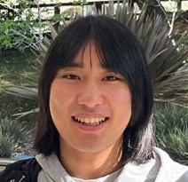
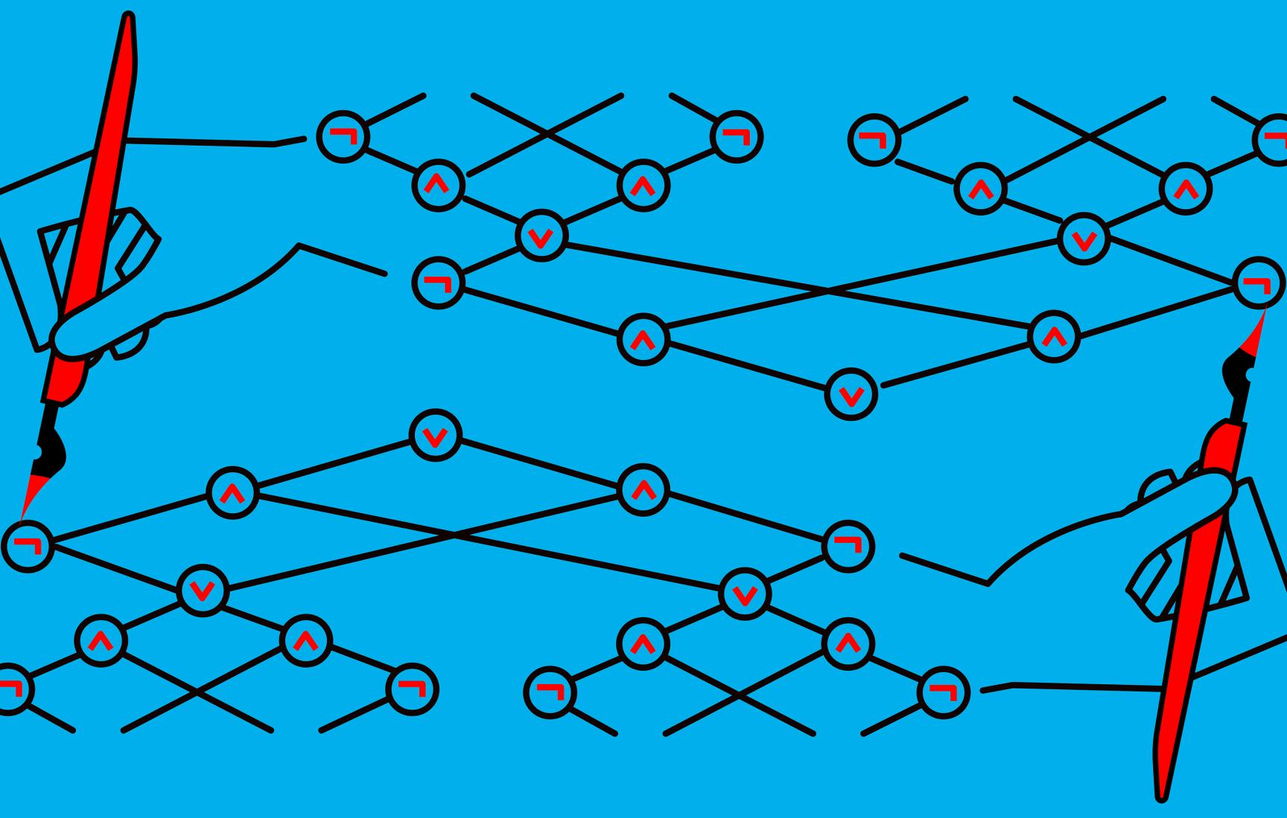
$NP$-Hardness of Approximating Meta-Complexity: A Cryptographic Approach
Yizhi Huang
(Tsinghua)
Rahul Ilango
(MIT)
Hanlin Ren
(Oxford)
May 30, 2023
0 / 20

Slide 2
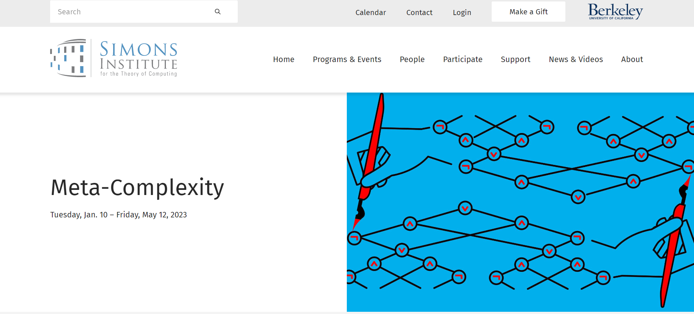
Part 1: Meta-Complexity
What is meta-complexity?
Why do people find it interesting?
https://simons.berkeley.edu/programs/Meta-Complexity2023

Slide 3
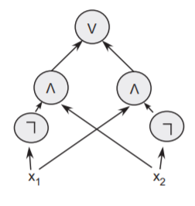
Circuit Complexity
Circuits: DAGs with $AND$, $OR$, $NOT$ gates
An approach towards $P≠NP$ (proposed in 1980s)
$SAT$ requires super-poly circuit size $⟹P≠NP$!
Progress nearly nonexistent…
Best known lower bounds (for general circuits) are $3.1n$ or $5n$
Open: any $NP$ problem that doesn’t have $10n$-size circuits?
A circuit computing $x_{1}⊕x_{2}$ from [Arora-Barak]
1 / 20

Slide 4
Minimum Circuit Size Problem
$MCSP$: Given the truth table of a function $f:{\left\{0,1\right\}}^{n}→\left\{0,1\right\}$, what’s the smallest circuit computing it?
$MCSP=\left\{\left(f, s\right):Circuit_Complexity\left(f\right)≤s\right\}$
( ,$s$)
$$s$$
$$⟹$$
$$x$$ | $$0^{n}$$ | $$…$$ | $$1^{n}$$
$$f$$ | $$f\left(0^{n}\right)$$ | $$…$$ | $$f\left(1^{n}\right)$$
Is there a size-$s$ circuit computing $f$?
Input length $=N=2^{n}$
The (meta-)complexity of circuit complexity!
2 / 20

Slide 5
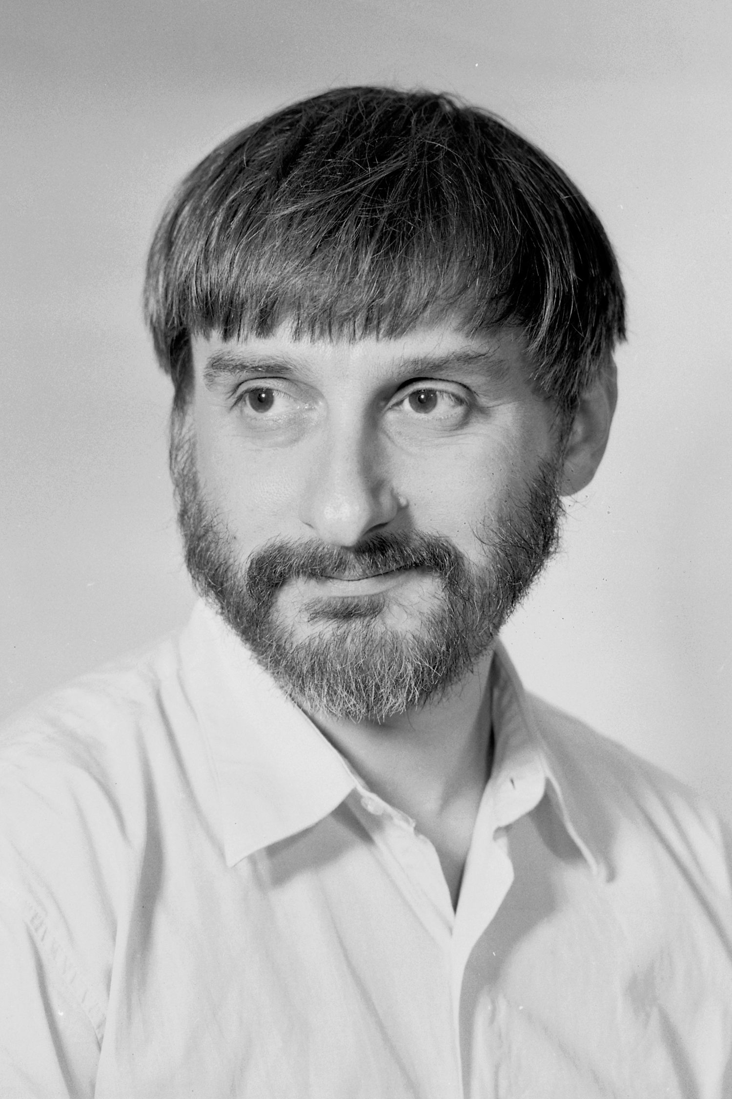
The Complexity of $MCSP$
$MCSP$ is in $NP$.
$$MCSP$$
( ,$s$)
Guess-and-check a circuit, in $poly\left(2^{n}\right)=poly\left(N\right)$ time
$$s$$
$$⟹$$
$$x$$ | $$0^{n}$$ | $$…$$ | $$1^{n}$$
$$f$$ | $$f\left(0^{n}\right)$$ | $$…$$ | $$f\left(1^{n}\right)$$
Is there a size-$s$ circuit computing $f$?
$MCSP$ is intractable under standard crypto assumptions.
You can use $MCSP$ oracles to invert any one-way functions. Thus, if OWFs exist, then $MCSP$ is intractable [RR97, KC00].
Theme: connections between cryptography and meta-complexity
Is $MCSP$ $NP$-complete?
Cryptography
Meta-complexity
3 / 20

Slide 6
Time-Bounded Kolmogorov Complexity and Its Meta-Complexity
$K\left(x\right)$: length of the shortest program computing $x$ (on empty input)
$K\left(01010101…01\right)=O\left(\log{n}\right)$
Counting argument: $K\left(random string\right)≈n$
Not computable ☹
$K^{t}\left(x\right)$: length of the shortest program computing $x$ in $t$ steps
$t=poly\left(\left|x\right|\right)⟹$ computing $K^{t}$ is in $NP$!
print("01" * (n/2))
Henceforth $K^{poly}$
$K^{poly}$ is also intractable under standard crypto assumptions.
Also big open question:
Is $K^{poly}$ $NP$-complete?
4 / 20

Slide 7
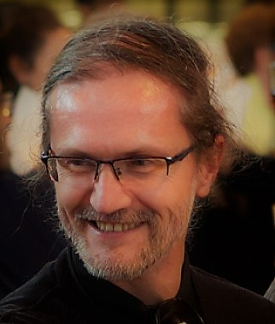
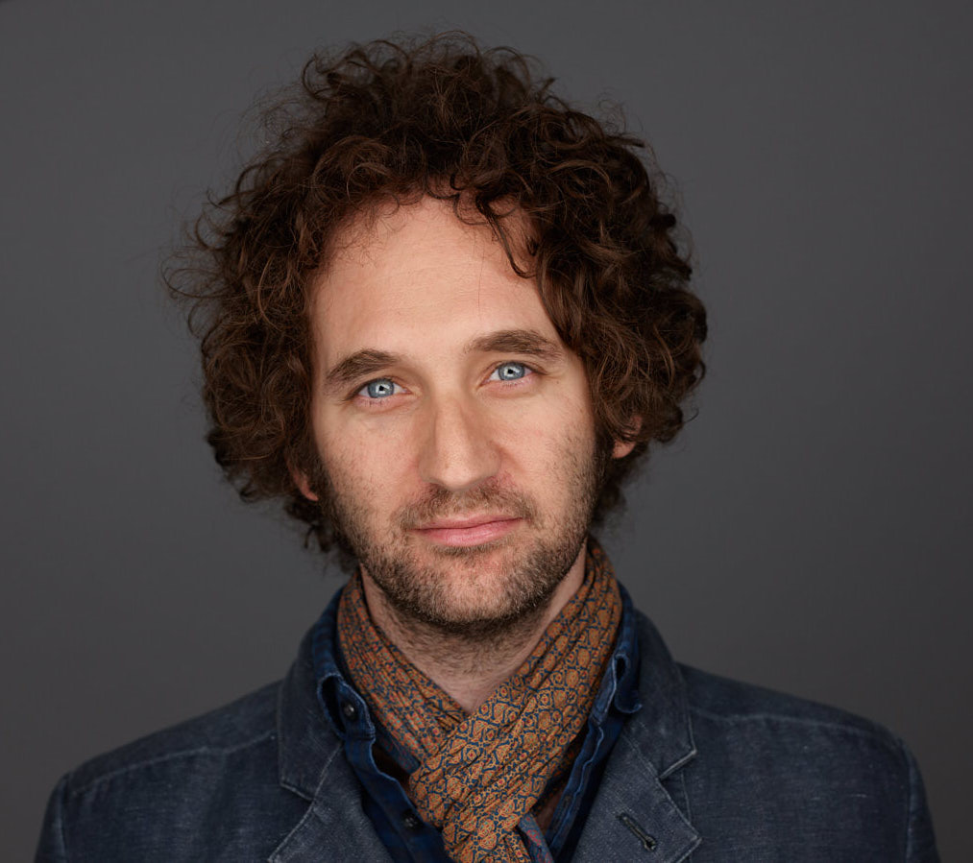
Why Care About Meta-Complexity?
[CIKK16]: If $MCSP$ is easy, then there exists a learning algorithm for general circuits
Learning Theory
[Hirahara 18]: $GapMCSP$ and $GapK^{poly}$ admit non-black-box worst-case to average-case reductions
Meta-complexity
Cryptography
[Liu-Pass 20]: average-case hardness of $K^{poly}$ characterizes the feasibility of cryptography
Average-case Complexity
5 / 20

Slide 8
Why Care About Meta-Complexity?
Corollary: If $GapMCSP$ is $NP$-hard, then the worst-case and average-case complexity of $NP$ are equivalent.
If $NP$ is hard on the worst case ($P≠NP$), is $NP$ also hard on average ($P≠NP$ “on typical instances”)?
Long-standing open problem in average-case complexity!
[Hirahara 18]: $GapMCSP$ and $GapK^{poly}$ admit non-black-box worst-case to average-case reductions
Meta-complexity
“exclude Heuristica”
[Bogdanov-Trevisan 06]: black-box barrier for worst-case to average-case reductions in $NP$
Average-case Complexity
Hirahara’s result overcomes this barrier!
6 / 20

Slide 9
Part 1.5: $NP$-Hardness of Meta-Complexity
Can we reduce $SAT$ to $MCSP$?

Slide 10
So, Is $MCSP$ NP-Complete?
Short answer: We don’t know.
Long answer:
NO instances of $MCSP$ are circuit lower bounds
Thus, reducing $SAT$ to $MCSP$ seems to require proving breakthrough lower bounds!
[KC00, MW17, …]: If $MCSP$ is $NP$-complete under deterministic mapping reductions, then $EXP≠ZPP$.
Caveat: $EXP≠ZPP$ is something we believe but seems hard to prove.
These results say that “$NP$-hardness of $MCSP$” would be hard to resolve but does not give evidence for or against it!
7 / 20

Slide 11
Variants of $MCSP$ are $NP$-complete!
MW17: If $MCSP$ is $NP$-complete under deterministic reductions, then $EXP≠ZPP$.
Deterministic reductions are too weak, let’s use randomized reductions!
Rahul Ilango
The minimum oracle circuit size problem ($MOCSP$)
Straightforward from MW17: If $MOCSP$ is $NP$-complete under deterministic reductions, then $EXP≠ZPP$.
[Ilango’20]: $MOCSP$ is indeed $NP$-complete under randomized reductions!
Variants of $MCSP$ are $NP$-complete…
$MOCSP$ [Ilango’20]
Conditional $K^{poly}$ [Liu-Pass’22]
Multi-output $MCSP$ [Ilango-Loff-Oliveira’20]
Learning [Ilango-Loff-Oliveira’20, Hirahara’22b]
${MCSP}^{∗}$ [Hirahara’22b]
All under randomized reductions!
8 / 20

Slide 12
Minimum Oracle Circuit Size Problem
“Approaching $MCSP$ from above” [Ilango’20]
Given a function $f$ and an oracle $O$, compute the $O$-oracle circuit complexity of $f$
$$($$
$$,$$
$$)$$
$$x$$ | $$0^{n}$$ | $$…$$ | $$1^{n}$$
$$f$$ | $$f\left(0^{n}\right)$$ | $$…$$ | $$f\left(1^{n}\right)$$
$$x$$ | $$0^{m}$$ | $$…$$ | $$1^{m}$$
$$O$$ | $$O\left(0^{m}\right)$$ | $$…$$ | $$O\left(1^{m}\right)$$
Is there a size-$s$ $O$-oracle circuit computing $f$?
Theorem (Ilango’20): $MOCSP$ is $NP$-complete!
9 / 20

Slide 13
Conditional $K^{poly}$ Complexity
$K^{t}\left(x | y\right)$: length of the shortest program computing $x$ in $t$ steps, given $y$
Using similar ideas as [Ilango’20], [Liu-Pass’22] showed that computing $K^{t}\left(x | y\right)$is $NP$-complete
$MOCSP$ is like “conditional circuit complexity”
Sublinear regime: $t≪\left|y\right|$
$NP$-complete [Liu-Pass’22, Hirahara’22a]
The lower bound argument in the reduction: “In the NO case, the program has to miss some information in $y$ (because it cannot read all of $y$)”
Superlinear regime: $t≫\left|y\right|$
$NP$-completeness is unknown ☹
[Hirahara’22a]: $NP$-completeness (in a certain param setting) excludes Heuristica! (Equivalence between worst-case and average-case complexity of $NP$)
Generalizes the non-black-box reduction in [Hirahara’18]…
10 / 20

Slide 14
Hardness of Approximation…?
Yes instances: complexity $≤s$
No instances: complexity $≥2^{\left(1−ε\right)n}s$
$$\left(s vs 2^{\left(1−ε\right)n}s\right)$$
Theorem (Hirahara’18): If ${Gap}_{ε}MCSP$ is $NP$-hard for every $ε>0$, then Heuristica doesn’t exist.
$$(s vs 0.1n⋅s)$$
Reduction from set cover, so $Θ\left(\log{N}\right)$-approx is optimal
Theorem (Ilango’20): $GapMOCSP$ is $NP$-hard!
$$\left(s vs n^{ε}⋅s\right)$$
Theorem (Hirahara’22b): ${GapMCSP}^{∗}$ is $NP$-hard!
$$\left(s vs N^{1/O\left(\log{\log{N}}\right)}⋅s\right)$$
Theorem (Hirahara’22a): ${GapK}^{t}\left(x | y\right)$ is $NP$-hard!
Reduction from “Min Monotone Sat Assignment”, only $N^{1/O\left(\log{\log{N}}\right)}$ inapprox is known
When $N=2^{n}$, this is $\left(s vs 2^{n/O\left(\log{n}\right)}⋅s\right)$
11 / 20

Slide 15
Our Results
Strong (yet plausible) crypto
Result 1
Under plausible crypto assumptions, $GapK^{t}\left(x | y\right)$ is $NP$-hard to approximate in the super-linear regime
$NP$-hardness of “the problem in [Hirahara’22a], whose $NP$-hardness excludes Heuristica”
$$(N^{0.0001} vs N−100)$$
[Hirahara’22a]’s program of excluding Heuristica is viable!
Average-case hardness of $NP$
Yes case: computable in size $s$,
No case: average-case hard against size $2^{0.9999n}⋅s$
Result 2
Unconditionally, $GapMOCSP$ is $NP$-hard with near-optimal hardness-of-approximation
$$(s vs 2^{0.9999n}⋅s)$$
Previous results
$$\left(s vs n^{ε}⋅s\right)$$
$$(s vs 0.1n⋅s)$$
$$\left(s vs 2^{n/O\left(\log{n}\right)}⋅s\right)$$
12 / 20

Slide 16
Part 2: Proof Ideas
How to use cryptography to prove $NP$-hardness of meta-complexity?
… unconditionally?

Slide 17
Why Cryptography Helps
Intuition I: “Structured” Hardness
If we “merely” assume circuit lower bounds, seems unclear how to use it and prove $MCSP$ is $NP$-hard.
What if we assume cryptographic hardness?
Intuition II: Arguments
Argument systems = $NP$-hardness of “meta-complexity”
More on the next slide ☺
SNARG
DDH
$$iO$$
LWE
13 / 20

Slide 18
Warm-Up: Arguments = $NP$-Hardness of Meta-Complexity
Arguments: proof systems sound against computationally bounded provers
An argument system for $L$
$L$: some language in $NP$
$x∈L$: $∃$ a size-$s$ prover (with a witness of $x$) that convinces the verifier
$x∉L$: any size-$s^{10}$ prover cannot convince the verifier (except with negl probability)
$L$ reduces to “meta-complexity”
“meta-complexity” problem: what’s the complexity of convincing the verifier?
$x∈L$: complexity $≤s$
$x∉L$: complexity $>s^{10}$
Remark 1: hardness of approximation!
(Arbitrarily large inapprox, by adjusting the security parameter)
Remark 2: the No instances are average-case hard! Any size-$s^{10}$ prover has only negl prob of convincing the verifier
14 / 20

Slide 19
Witness Encryption
Encryption using a (public) SAT instance!
$Encrypt\left(φ,msg;rand\right)→ct$
$Decrypt\left(φ,α,ct\right)→msg$
Intuition: encrypt a message, but anyone knowing the solution to a Sudoku puzzle / a proof of Riemann Hypothesis can decrypt!
Assumption: $Encrypt$ is randomized, but $Decrypt$ is not
Correctness: If $φ\left(α\right)=1$, then $Decrypt$ outputs the correct $msg$.
Security: If $φ$ is unsatisfiable, then
$$Encrypt\left(φ,0\right)≈_{c}Encrypt\left(φ,1\right).$$
15 / 20

Slide 20
$NP$-Hardness of $GapK^{t}\left(x | y\right)$ (super-linear regime)
Given: $φ$, want to reduce it to $\left(x,y\right)$
$x=$random message (of length $n^{100}$)
$y=\left(φ,Encrypt\left(φ,x;rand\right)\right)=\left(φ,ct\right)$
If $φ$ is satisfiable:
Let $α∈{\left\{0,1\right\}}^{n}$ be a witness, then $Decrypt\left(φ,α,ct\right)=x$.
$$K^{poly}\left(x | y\right)≤\left|α\right|+O\left(1\right).$$
If $φ$ is unsatisfiable:
Suppose $K^{2^{poly}}\left(x | y\right)<n−100$, then we can enumerate possible $x$ and break the security of witness encryption!
16 / 20

Slide 21
Oracle Witness Encryption
Everybody has access to a (specifically designed) oracle $𝒪$
${Encrypt}^{𝒪}\left(φ,msg;rand\right)→ct$
${Decrypt}^{𝒪}\left(φ,α,ct\right)→msg$
Caveat: the oracle fan-in is only $O\left(λ\right)$ where $λ \sim \log\left|φ\right|$ is the security parameter
Oracle length$=2^{O\left(λ\right)}=poly\left(\left|φ\right|\right)$
Need exponential security ($2^{Ω\left(λ\right)}$)!
Correctness: If $φ\left(α\right)=1$, then ${Decrypt}^{𝒪}$ outputs the correct $msg$.
Security: If $φ$ is unsatisfiable, then
$${Encrypt}^{𝒪}\left(φ,0\right)≈_{c}{Encrypt}^{𝒪}\left(φ,1\right).$$
17 / 20

Slide 22
Oracle WE $⟹NP$-hardness of $MOCSP$
Given an instance $φ$, want to produce an instance $\left(f,O\right)$
$φ$ is satisfiable if and only if $f$ has small $O$-oracle circuit complexity!
$$O$$
$$f$$
(random truth table)
$O_{1}$: the oracle under which witness encryption exists
If $φ$ is satisfiable, then by correctness of witness encryption, $f$ has a small $O$-oracle circuit:
$O_{2}\left(i,j\right)=j$-th bit of ${Encrypt}^{O_{1}}\left(φ,f_{i}\right)$
$f\left(i\right):$
Hardcode a witness $α$ of $φ$
Query $O_{2}$ to obtain $ct={Encrypt}^{O_{1}}\left(φ,f\left(i\right)\right)$
Run ${Decrypt}^{O_{1}}(φ,α,ct)$ and obtain $f\left(i\right)$
If $φ$ is unsatisfiable, then any small $O$-oracle circuit for $f$ violates the security of witness encryption! (Need a non-trivial proof)
18 / 20

Slide 23
How to construct oracle WE?
Look at the paper that introduced WE…
GGSW uses multilinear maps, so our oracle implements the generic multilinear map model.
Security proof highly non-trivial.
Yizhi Huang
19 / 20

Slide 24
Summary
Learning Theory
$NP$-hardness of approximating meta-complexity:
$GapK^{t}\left(x | y\right)$: super-linear regime, under crypto
$GapMOCSP$: unconditionally!
Meta-complexity
$$(N^{0.0001} vs N−100)$$
$$(s vs 2^{0.9999n}⋅s)$$
Average-case Complexity
Cryptography
A cryptographic approach
Witness encryption
Unconditional oracle witness encryption
Thank you!
Questions are welcome!
20 / 20

Slide 25
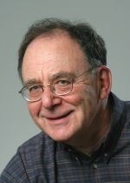
GGSW Witness Encryption
Starting point: $Exact_Cover$
Input: universe $\left[n\right]$ and “pieces” $X_{1},X_{2},…,X_{m}⊆\left[n\right]$
Decide: Are there pieces $X_{i_{1}},X_{i_{2}},…,X_{i_{k}}$ that exactly covers $\left[n\right]$?
(Their disjoint union is exactly $\left[n\right]$)
Implementation
$r_{1},…,r_{n},r_{n+1},r_{n+2}←$random numbers
Wlog assume $msg∈\left\{n+1,n+2\right\}$
Announce $r_{n+1}$, $r_{n+2}$, $r\left(\left[n\right]∪\left\{msg\right\}\right)$, and each $r\left(X_{i}\right)$ to the public
Decryption:
Find $r\left(\left[n\right]\right)=r\left(X_{i_{1}}\right)+…+r\left(X_{i_{k}}\right)$
Compare $r\left(\left[n\right]∪\left\{n+1\right\}\right)$ and $r\left(\left[n\right]∪\left\{n+2\right\}\right)$ with $r\left(\left[n\right]∪\left\{msg\right\}\right)$
Idea
Assign a random number $r_{i}$ to element $i∈\left[n\right]$
$r\left(S\right)≔\sum_{i∈S}{r_{i}}$
Announce $r\left(\left[n\right]\right)$ and each $r\left(X_{i}\right)$ to the public
Decryption reduces to finding $i_{1},i_{2},…,i_{k}$ such that $r\left(\left[n\right]\right)=r\left(X_{i_{1}}\right)+r\left(X_{i_{2}}\right)+…+r\left(X_{i_{k}}\right)$
Unconditional security?
Use oracle to obfuscate the $+$ operation!
21 / 26

Slide 26
Multilinear Map
Groups $𝔾_{1},𝔾_{2},…,𝔾_{n+1}$, each $𝔾_{i}$ is the cyclic group of order $p$
Each group $𝔾_{i}$ is paired with a random bijection $σ_{i}:𝔾_{i}→[p]$
For a set $S$, use the $\left|S\right|$-th group to obfuscate $r\left(S\right)=\sum_{i∈S}{r_{i}}$
Multilinear map:
$$e_{i,j}:\left[p\right]×\left[p\right]→\left[p\right], e_{i,j}\left(σ_{i}\left(a\right),σ_{j}\left(b\right)\right)=σ_{i+j}\left(a+b\right)$$
Intuition: $σ_{i}\left(j\right)$ is the label of $j$. Given $σ_{i}\left(j\right)$, it’s hard to infer $j$ back
”Obfuscation of $r\left(S\right)$”$=σ_{\left|S\right|}\left(r\left(S\right)\right)$
$$\left(i,j,σ_{i}\left(a\right),σ_{j}\left(b\right)\right)$$
$$σ_{i+j}\left(a+b\right)$$
Note: this enables us to compute $σ_{i_{1}+i_{2}+…+i_{k}}\left(a_{1}+a_{2}+…+a_{k}\right)$ from $\left\{σ_{i_{j}}\left(a_{j}\right)\right\}$!
22 / 26

Slide 27
GGSW, revisited
Secure Implementation
$r_{1},…,r_{n},r_{n+1},r_{n+2}←𝔾_{1}$
Wlog assume $msg∈\left\{n+1,n+2\right\}$
Announce $σ_{1}\left(r_{n+1}\right)$, $σ_{1}\left(r_{n+2}\right)$, $σ_{n+1}\left(r\left(\left[n\right]∪\left\{msg\right\}\right)\right)$, and each $σ_{\left|X_{i}\right|}\left(r\left(X_{i}\right)\right)$ to the public
”Obfuscation of $r\left(S\right)$”$=σ_{\left|S\right|}\left(r\left(S\right)\right)$
Implementation
$r_{1},…,r_{n},r_{n+1},r_{n+2}←$random numbers
Wlog assume $msg∈\left\{n+1,n+2\right\}$
Announce $r_{n+1}$, $r_{n+2}$, $r\left(\left[n\right]∪\left\{msg\right\}\right)$, and each $r\left(X_{i}\right)$ to the public
Intuition: if $∄$exact cover, then $σ_{n}\left(r\left(\left[n\right]\right)\right)$ and $σ_{\left|X_{i}\right|}\left(r\left(X_{i}\right)\right)$ are “independent”!
$$e_{i,j}:\left[p\right]×\left[p\right]→\left[p\right], e_{i,j}\left(σ_{i}\left(a\right),σ_{j}\left(b\right)\right)=σ_{i+j}\left(a+b\right)$$
$$\left(i,j,σ_{i}\left(a\right),σ_{j}\left(b\right)\right)$$
$$σ_{i+j}\left(a+b\right)$$
Note: this enables us to compute $σ_{i_{1}+i_{2}+…+i_{k}}\left(a_{1}+a_{2}+…+a_{k}\right)$ from $\left\{σ_{i_{j}}\left(a_{j}\right)\right\}$!
23 / 26

Slide 28
Wrap Up
Oracle Witness Encryption
${Encrypt}^{𝒪}\left(φ,msg;rand\right)→ct$
${Decrypt}^{𝒪}\left(φ,α,ct\right)→msg$
Reducing $Exact_Cover$ to $MOCSP$:
$Exact_Cover$ instance: universe $\left[n\right]$ and “pieces” $X_{1},X_{2},…,X_{m}⊆\left[n\right]$
$f←$random truth table
$O_{1}←$ generic multilinear map model
$O_{2}←$stores the ciphertexts
Obfuscations of $r_{n+1}$, $r_{n+2}$, $r\left(\left[n\right]∪\left\{f\left(i\right)\right\}\right)$, and each $r\left(X_{i}\right)$
$O←O_{1}∪O_{2}$
Oracle WE $⟹NP$-Hardness of $MOCSP$
$O_{1}$: the oracle under which witness encryption exists
$$\left(i,j,σ_{i}\left(a\right),σ_{j}\left(b\right)\right)$$
$$σ_{i+j}\left(a+b\right)$$
$O_{2}\left(i,j\right)=j$-th bit of ${Encrypt}^{O_{1}}\left(φ,f_{i}\right)$
24 / 26

Slide 29
Discussion 1: PCP Theorems from Meta-Complexity?
Previous results
Starts from inapprox results (using PCP theorem)
Weak hardness of approx ($s$ vs $0.1s\log{N}$)
$$GapMOCSP$$
Yes instances: $f$ admits size-$s$ $O$-oracle circuits
No instances: $f$ is $0.9$-avg hard against size-$2s$ $O$-oracle circuits
Our results
Strong hardness of approx ($N^{0.0001}$ vs $N^{0.9999}$)
Direct reduction from $Exact_Cover$
Randomly choose $x$ and verify $C^{O}\left(x\right)=f\left(x\right)$…
PCP Proof: size-$s$ oracle circuit $C$
PCP verifier
PCP Theorem from Meta-Complexity?
Wait, computing $C^{O}\left(x\right)$ takes too much time ☹
25 / 26

Slide 30
Discussion 2: $MCSP$?
Question: Is $MCSP$ $NP$-complete under “reasonable” crypto assumptions?
What are “reasonable” assumptions?
SNARG
Arguments? What type of arguments do we need?
$$iO$$
Combinations of fancy cryptos?
26 / 26

