Slide 1
On the Range Avoidance Problem for Circuits
Hanlin Ren
Oxford
Rahul Santhanam
Oxford
Zhikun Wang
Xi’an Jiaotong
November 2, 2022
$$C$$
0 / 11

Slide 2
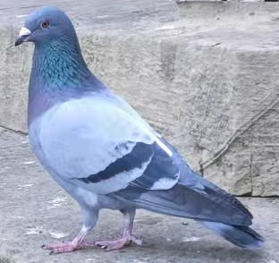
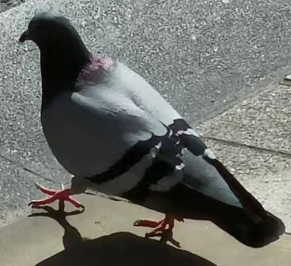
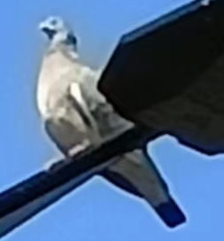
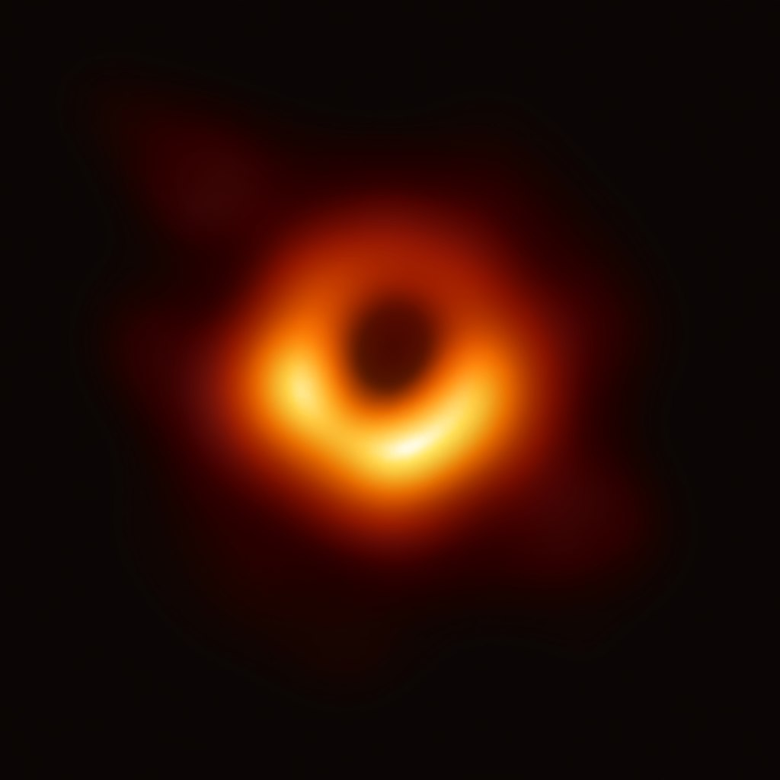
Motivation: The Empty Pigeonhole Principle
If you throw $N$ pigeons into $M$ holes, and $N<M$, then there is an empty pigeonhole.
Weak version: if you throw $N$ pigeons into $M$ holes, and $2N<M$, then there is an empty pigeonhole.
(These are REAL pigeons in Oxford)
empty
empty
empty
empty
1 / 11

Slide 3
Range Avoidance Problem
Input: a (multi-output) circuit $C:{\left\{0,1\right\}}^{n}→{\left\{0,1\right\}}^{ℓ}$ ($ℓ>n$)
Output: any string $y∉Range\left(C\right)$
I.e. for every $x∈{\left\{0,1\right\}}^{n}$, $C\left(x\right)≠y$
Trivial randomised algorithm: Output a random $y←{\left\{0,1\right\}}^{ℓ}$.
Question: deterministic algorithms?
A “non-output” of $C$.
$$y∈{\left\{0,1\right\}}^{ℓ}$$
$C\left(index of pigeon\right)=index of hole$, find an empty hole!
$$C$$
A problem that captures the complexity of weak empty pigeonhole principle!
$$x∈{\left\{0,1\right\}}^{n}$$
2 / 11

Slide 4
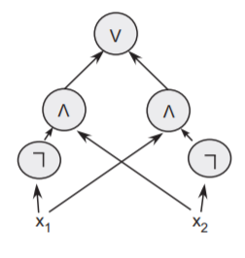
Example: Circuit Lower Bounds
Embarrassing open Q: $E^{NP}⊆SIZE\left[10n\right]$?
Problem $HARD$: On input $1^{N}$, output a truth table of length $N$ without $N^{1/2}$-size circuits
Equivalent to proving lower bounds against $SIZE\left[2^{n/2}\right]$
Problem $HARD$: On input $1^{2^{n}}$, output a truth table of length $2^{n}$ without $2^{n/2}$-size circuits
Truth table of $C$
$$01100010011………………001010$$
The probabilistic proof that hard truth table exists…
$2^{n}$ bits
$$TT$$
… is a reduction from $HARD$ to $Avoid$!
$2^{n/2}poly\left(n\right)$ bits
Description of a size-$2^{n/2}$ circuit $C$
$TT$ stands for “truth table generator”.
3 / 11

Slide 5
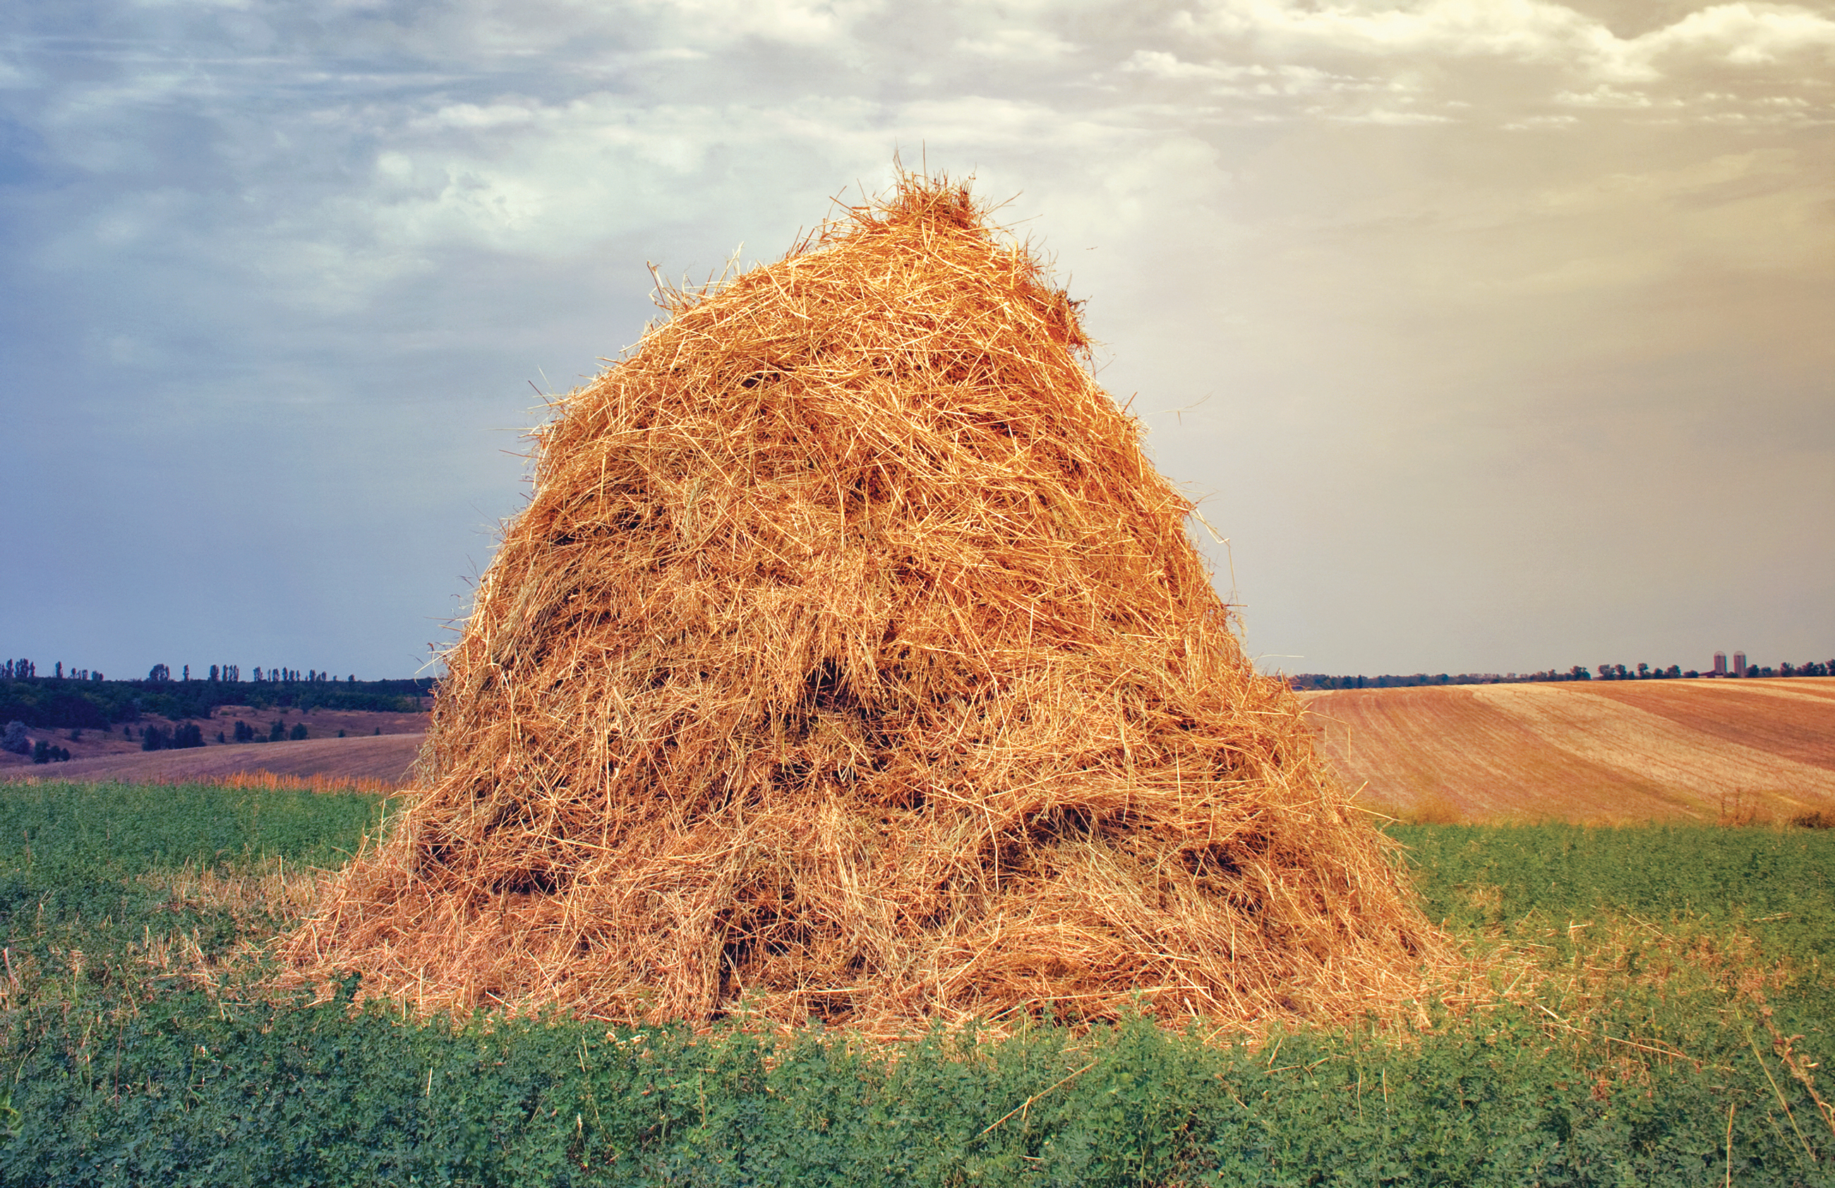
Explicit Constructions
Weak empty PHP (“the probabilistic method”) proves that a random object satisfies some property $𝒫$, but we don’t know how to explicitly find any object satisfying $𝒫$
[Korten’21]: Range avoidance captures explicit constructions!
Constructing an object satisfying $𝒫$ reduces to range avoidance
Also: a structural complexity theory for explicit constructions
Rigid matrices, hard truth tables, Ramsey graphs, extractors, pseudorandom generators, hard data structure problems…
Quote from [Arora-Barak], picture by Vladyslav Danilin via Quanta Magazine
4 / 11

Slide 6
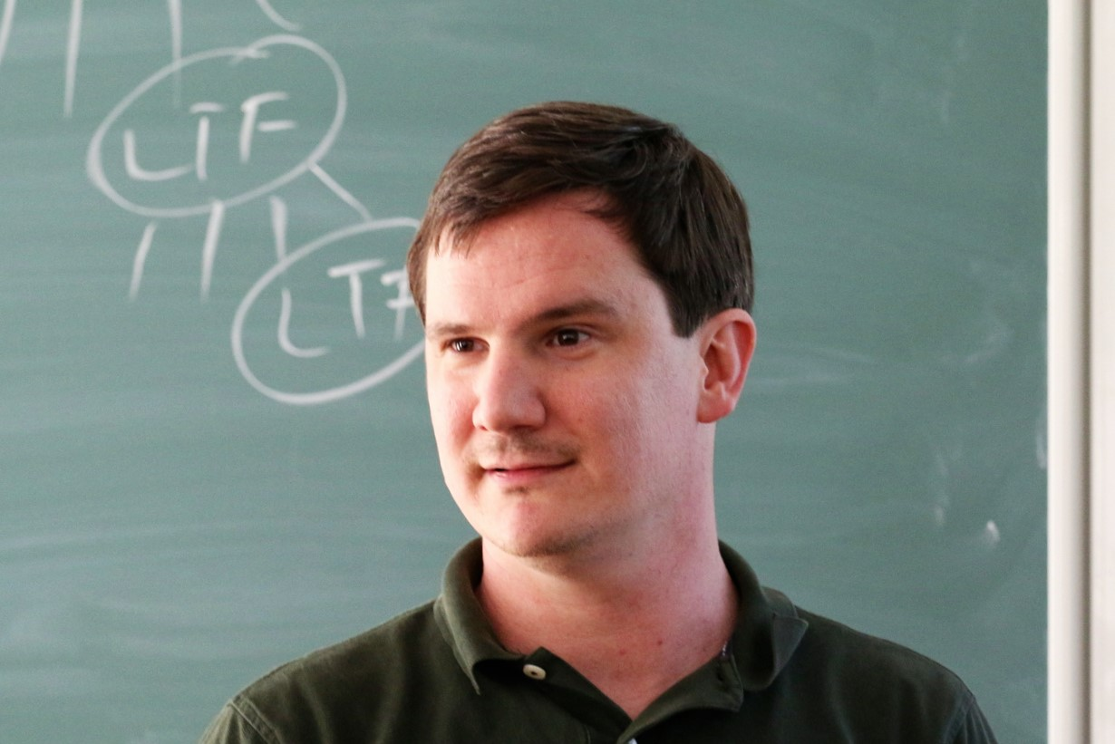
Circuit Lower Bounds via “Algorithmic Method”
${ACC}^{0}$: a frontier circuit class that we don’t know how to prove lower bounds otherwise
[Williams’11]: $NEXP⊈{ACC}^{0}$.
Two steps in the proof:
CAPP for ${ACC}^{0}$ admits a non-trivial algorithm
Such algorithms imply circuit lower bounds!
The connection between algorithm and lower bounds is very general, applicable to other classes besides ${ACC}^{0}$
Nontrivial: Running in $2^{n}/n^{ω\left(1\right)}$ time
$𝕮$-CAPP (Circuit Acceptance Probability Problem):
Given a $ℭ$ circuit $C$, estimate
$$\underset{x}{Pr}\left[C\left(x\right)=1\right].$$
5 / 11

Slide 7
Our Results: Algorithmic Method for Range Avoidance
Non-trivial Hamming Weight Estimation data structures imply ${FP}^{NP}$ algorithms for range avoidance
output
Hamming Weight Estimation
Preprocessing: Given a circuit $C:{\left\{0,1\right\}}^{n}→{\left\{0,1\right\}}^{ℓ}$, compute a data structure $DS$ in $P^{NP}$
Query: Given $x∈{\left\{0,1\right\}}^{n}$, estimate the Hamming weight of $C\left(x\right)$ in deterministic $ℓ/\log^{ω\left(1\right)}{ℓ}$ time, with oracle access to $DS$
$$C$$
input
Remark: CAPP = Hamming Weight Est. for $TT$ (the truth table generator)!
This result generalises Williams’s Algorithmic Method!
6 / 11

Slide 8
Comparison with the Algorithmic Method
The Algorithmic Method
Our results
(running in $ℓ/\log^{ω\left(1\right)}ℓ$ time, with $P^{NP}$ preprocessing)
(running in $2^{n}/n^{ω\left(1\right)}$ time)
Non-trivial algorithms
Hamming weight estimation of $ℭ$
… for
CAPP of $ℭ$
… implies
Circuit lower bounds against $ℭ$
${FP}^{NP}$ algorithms for
$ℭ$-Avoid
(Assuming $ℭ$ is “typical”)
7 / 11

Slide 9
Characterisation of Circuit Lower Bounds for $E^{NP}$
Immediate corollary of the previous result: non-trivial CAPP algorithms, even with $E^{NP}$ preprocessing, imply lower bounds
CAPP with $E^{NP}$ preprocessing
Preprocessing: given $1^{n}$, run in $poly\left(2^{n}\right)$ time with an $NP$ oracle, produce a data structure $DS$ of length $poly(2^{n})$
Query: given a circuit $C$ and oracle access to $DS$, estimate the accept probability of $C$ in non-trivial time
Example: $E^{NP}$-computable PRGs
$G:{\left\{0,1\right\}}^{0.9n}→{\left\{0,1\right\}}^{n}$ computable in $E^{NP}$
Preprocessing: compute $G\left(s\right)$ for every $s∈{\left\{0,1\right\}}^{0.9n}$
Query: given $C$, output
$$\underset{s}{Pr}\left[C\left(G\left(s\right)\right)=1\right].$$
Our second result: Actually, CAPP with $E^{NP}$ preprocessing characterises $E^{NP}$ lower bounds!
8 / 11

Slide 10
Characterisation of Circuit Lower Bounds for $E^{NP}$
Non-trivial ($2^{n}/n^{ω\left(1\right)}$) CAPP algorithm with $E^{NP}$ preprocessing
Our result
$$E^{NP}⊈P_{/poly}$$
Standard hardness-randomness connections
Unconditional speedup for “CAPP with $E^{NP}$-preprocessing!”
Subexponential-time ($2^{n^{ε}}$) CAPP algorithm with $E^{NP}$ preprocessing
9 / 11

Slide 11
Other Results
A reduction from ${NC}^{1}$-$Avoid$ to ${NC}^{0}$-$Avoid$
Using the randomised encoding tricks of Applebaum-Ishai-Kushilevitz
Characterising “$Avoid∈FP$” and “$Avoid∈FNP$”
In particular, “$Avoid∈FNP$” is connected to proof complexity generators
See the paper!
https://eccc.weizmann.ac.il/report/2022/048
10 / 11

Slide 12
Ongoing Work
(Chen-Huang-Li-R) ${FP}^{NP}$ algorithms for ${ACC}^{0}$-Avoid!
With parameters matching the current lower bounds [CLW’20]
Techniques: Non-trivial algorithms for $ℭ$-Satisfying-Pairs imply ${FP}^{NP}$ algorithm for $ℭ$!
$$x_{1}$$
$$x_{2}$$
$$x_{3}$$
$$x_{4}$$
$$1$$
$$0$$
$$1$$
$$0$$
Satisfying-Pairs
Input: $N$ $ℭ$ circuits $C_{1},C_{2},…, C_{N}:{\left\{0,1\right\}}^{n}→\left\{0,1\right\}$ and $M$ inputs $x_{1},x_{2},…,x_{M}∈{\left\{0,1\right\}}^{n}$
Estimate: the number of $\left(i,j\right)$ such that $C_{i}\left(x_{j}\right)=1$.
$$C_{1}$$
$$0$$
$$1$$
$$0$$
$$0$$
$$C_{2}$$
$$1$$
$$1$$
$$1$$
$$0$$
$$C_{3}$$
Thank you!
$$1$$
$$0$$
$$0$$
$$1$$
We solved ${ACC}^{0}$-Satisfying-Pairs using Midbit polynomials (GKT’92).
$$C_{4}$$
Questions are welcome! ☺
11 / 11

