Slide 1
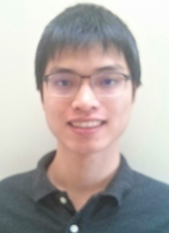
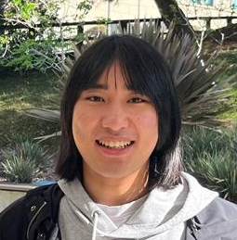
Bounded Relativization
Shuichi Hirahara
National Institute of Informatics
Zhenjian Lu
University of Oxford
Hanlin Ren
University of Oxford
0 / 17

Slide 2
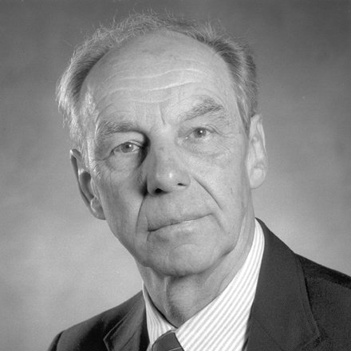
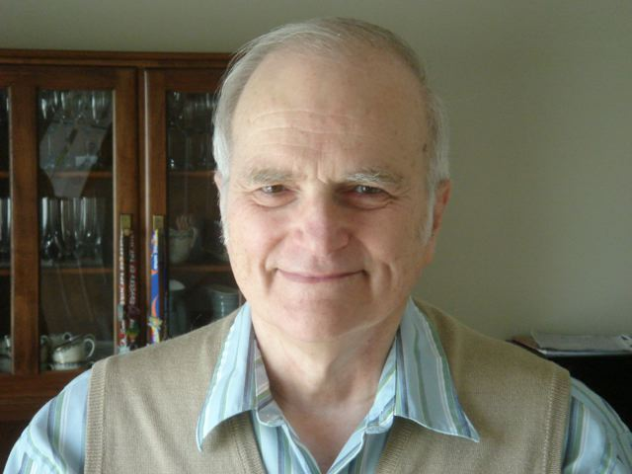
In the beginning…
God said, “Let there be time.”
J. Hartmanis and R. E. Stearns. On the computational complexity of algorithms.
Time Hierarchy Thm
If $T=o\left(\sqrt{U}\right)$, then $TIME\left[U\right]⊈TIME\left[T\right]$.
1 / 17

Slide 3
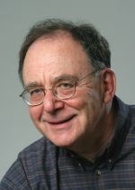
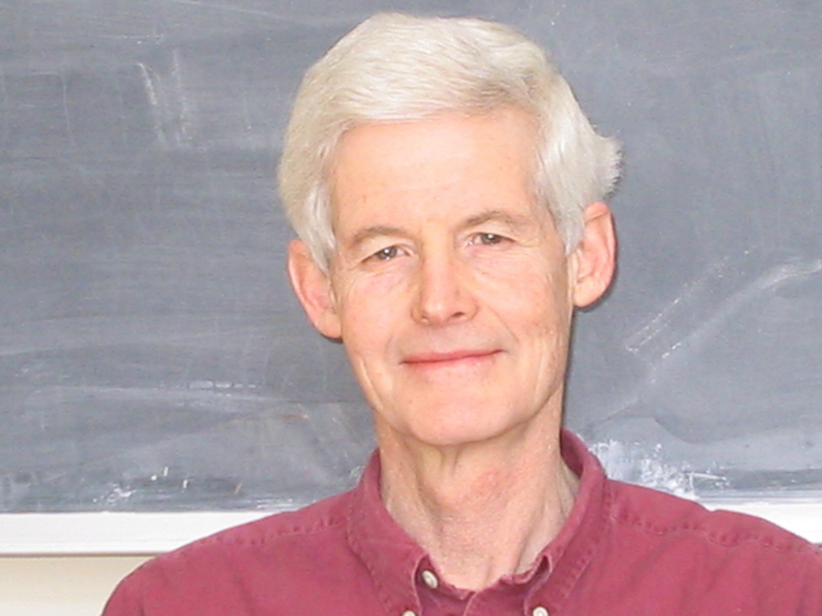
In the beginning…
And God said, “Let there be $NP$.”
$$SAT$$
Poly-time languages
Stephen A. Cook. The Complexity of Theorem-Proving Procedures.
Does $P=NP$?
Richard M. Karp. Reducibility among Combinatorial Problems.
2 / 17

Slide 4
How not to solve $P$ vs $NP$
The relativization barrier (Baker-Gill-Solovay)
Complexity classes with oracles
$P^{A}$: poly-time with $A$ oracle
${NP}^{A}$: nondeterministic poly-time with $A$ oracle
Relativizing techniques cannot resolve $P$ vs $NP$
$∃A$, $P^{A}={NP}^{A}$
$∃B,P^{B}≠{NP}^{B}$
Conclusion: any proof of $P≠NP$ (or $P=NP$) had better not separate $P^{A}$ from ${NP}^{A}$ (or collapse ${NP}^{B}$ to $P^{B}$)!
Previous* separations are “relativizing”
Simulation / diagonalization techniques
Time hierarchy theorem, $P^{O}≠{EXP}^{O}$ for every oracle $O$
*Before Baker-Gill-Solovay (1975)
3 / 17

Slide 5
Not only $P$ vs $NP$…
Relativization also pinpoints the exact place that we’re stuck!
${ZPEXP}^{NP}⊈BPP$ (easy)
${ZPP}^{NP}⊈SIZE\left[n^{2}\right]$ (known)
$NTIME\left[n^{\log{n}}\right]⊈NP$ (known)
Almost-everywhere $NTIME$ hierarchy?
${EXP}^{NP}=BPP$?
$P^{NP}⊆SIZE[n^{2}]$?
Buhrman-Torenvliet: ${EXP}^{{NP}^{O}}={BPP}^{O}$ for some $O$
Wilson: $P^{{NP}^{O}}⊆SIZE{\left[n^{2}\right]}^{O}$ for some $O$
Buhrman-Fortnow-Santhanam: ${NEXP}^{O}⊆io.{NP}^{O}$ for some $O$
4 / 17

Slide 6
Debates Around Oracles
Oracles are great!
They tell you limits of a broad family of techniques, saving your time from trying something that’s doomed to fail
They pinpoint the exact place that we’ll be stuck
Oracles are not good ☹
Anything that’s not obviously false (?) is true under some oracles
Do they provide any insight about non-relativizing classes at all???
5 / 17

Slide 7
$$IP=PSPACE$$
Fortnow-Sipser: ${coNP}^{O}⊈{IP}^{O}$ for some $O$
Lund-Fortnow-Karloff-Nisan, Shamir: $IP=PSPACE$!!!
The first “truly compelling” examples of theorems that doesn’t relativize
—— Eric Allender’90
The proof is non-relativizing!
It uses the following non-relativizing fact:
“Arithmetization”: every computation extends to a low-degree polynomial.
6 / 17

Slide 8
Non-relativizing techniques are everywhere…
Algorithmic method for proving lower bounds
$NP$-hardness of ${MCSP}^{∗}$
Anyway, oracle results are not relevant nowadays.
…?
PCP theorem
$$MIP=NEXP$$
$$IP=PSPACE$$
Uniform derandomization
Karp-Lipton theorems for $MA$
Pseudodeterministic constructions
Circuit lower bounds for ${BPP}^{MCSP}$
Circuit lower bounds for $MA$
7 / 17

Slide 9
Algebrization
The algebrization barrier (Aaronson-Wigderson):
Oracles $O$ and their algebraic extensions $\tilde{O}$
${PSPACE}^{O}⊆{IP}^{\tilde{O}}$ for every $O$
But, $∃A, {NP}^{\tilde{A}}⊆P^{A}$ and $∃B,{NP}^{B}⊈P^{\tilde{B}}$
One needs non-algebrizing techniques to resolve $P$ vs $NP$…
$IP=PSPACE$ is non-relativizing!
It uses the following non-relativizing fact:
“Arithmetization”: every computation extends to a low-degree polynomial.
8 / 17

Slide 10
Debates Around Algebrization
Algebrization is great!
Captures “relativization + interactive proofs” reasonably well
Explains the difficulty of resolving major open problems such as $NEXP$ vs $P/_{poly}$
Algebrization is subtle ☹
Conceptually difficult to reason about, for slightly complicated statements…
Many different versions of algebrization, each with its own pros and cons
Does ${MIP}^{∗}=RE$ algebrize?
9 / 17

Slide 11
This work
One step back: are oracle results truly useless?
Not really, if you also consider the complexity of the oracle itself!
Observation: For every oracle $O∈PSPACE$, ${IP}^{O}={PSPACE}^{O}$.
Proof
Since $IP⊆PSPACE$ is relativizing, we have ${IP}^{O}⊆{PSPACE}^{O}$.
On the other hand, since $O∈PSPACE$, we have ${PSPACE}^{O}=PSPACE=IP⊆{IP}^{O}$.
10 / 17

Slide 12
Bounded Relativization
For a complexity class $𝕮$, a statement is $𝕮$-relativizing if it is true relative to every $O∈𝕮$
$IP=PSPACE$ is $PSPACE$-relativizing
${MIP}^{∗}=RE$ is $R$- (i.e., computable-)relativizing
This captures a bunch of results proven by “relativizing techniques + interactive proofs”!
Proof in IW01: Suppose XXX. We show YYY. Hence ZZZ. Since $IP=PSPACE$, it follows that VVV and UUU holds. Hence the theorem is true.
$$EXP≠BPP$$
(uniform lb)
Impagliazzo-Wigderson’01
$$BPP⊆io.heurSUBEXP$$
(avg-case derand)
11 / 17

Slide 13
Bounded Relativization
For a complexity class $𝕮$, a statement is $𝕮$-relativizing if it is true relative to every $O∈𝕮$
$IP=PSPACE$ is $PSPACE$-relativizing
${MIP}^{∗}=RE$ is $R$- (i.e., computable-)relativizing
This captures a bunch of results proven by “relativizing techniques + interactive proofs”!
Proof in IW01: Suppose ${\text{XXX}}^{O}$. We show ${\text{YYY}}^{O}$. Hence ${\text{ZZZ}}^{O}$. Since ${IP}^{O}={PSPACE}^{O}$, it follows that ${\text{VVV}}^{O}$and ${\text{UUU}}^{O}$holds. Hence the theorem is $PSPACE$-relativizing.
$${EXP}^{O}≠{BPP}^{O}$$
(uniform lb)
IW01 is $PSPACE$-relativizing
(by simply replacing $IP=PSPACE$ with ${IP}^{O}={PSPACE}^{O}$ everywhere)
$${BPP}^{O}⊆io.heur{SUBEXP}^{O}$$
(avg-case derand)
11 / 17

Slide 14
Bounded Relativization
Suppose there is an oracle $O$ under which a statement $𝒮$ is false.
If $O∈PSPACE$:
$PSPACE$-relativizing techniques cannot prove $𝒮$!
If $O∈EXPH$:
If one uses $PSPACE$-relativizing techniques to prove $𝒮$, then one also separates $PSPACE$ from $EXPH$
This is no easier than separating $L$ from $NP$…
Suppose “our current techniques” are $PSPACE$-relativizing and cannot separate $PSPACE$ from $EXPH$. Then “our current techniques” cannot prove $𝒮$…
This is classical, Baker-Gill-Solovay style relativization!
In many cases (in fact all three cases $→$), we only get oracles in $EXPH\left(=EXP^{PH}\right)$!
Buhrman-Torenvliet: ${EXP}^{{NP}^{O}}={BPP}^{O}$ for some $O$
Wilson: $P^{{NP}^{O}}⊆SIZE{\left[n^{2}\right]}^{O}$ for some $O$
Buhrman-Fortnow-Santhanam: ${NEXP}^{O}⊆io.{NP}^{O}$ for some $O$
12 / 17

Slide 15
Relativization barrier for worst-case uniform derandomization
Can we improve IW01 to worst-case derandomization:
$EXP≠BPP \underset{⇒}{?}BPP⊆io. SUBEXP$
Result
There is an oracle $O∈EXPH$ such that
$${RP}^{O}⊈io. {DTIME}^{O}\left[2^{n}\right] \left(\text{no} \text{worst}\text{-}\text{case} \text{derand}\right) \text{but} \\ {UP}^{O}⊈{BPTIME}^{O}\left[2^{n}\right] \text{(}\text{strong} \text{uniform} \text{lower} \text{bounds}\text{).}$$
New techniques are needed.
If one uses $PSPACE$-relativizing techniques to “improve IW01”, then one also separates $PSPACE$ from $EXPH$!!!
13 / 17

Slide 16
I’m enough of barrier results.
Okay, let’s prove some actual lower bounds by bounded relativization!

Slide 17
A Near-Maximum Circuit Lower Bound
Theorem: ${BPE}^{MCSP}/_{2^{0.01n}} ⊈SIZE\left[2^{n}/n\right]$.
That is, there is a language $L$ computable in probabilistic $2^{O\left(n\right)}$ time with $MCSP$ oracle and $2^{0.01n}$ bits of advice, but has near-maximum ($2^{n}/n$) circuit complexity.
What is previously known:
${ZPE}^{MCSP}⊈P/_{poly}$ (IKV18)
This is only a super-poly lower bound, not a near-maximum one!
$E/_{2^{n}} ⊈SIZE\left[2^{n}/n\right]$
Trivial, but needs $2^{n}$ bits of advice… (We only need $2^{0.01n}$)
$E^{Σ_{2}P}⊈SIZE\left[2^{n}/n\right]$ (Kannan82, MVW99)
Sounds “one level higher” than ${BPE}^{MCSP}$ (?)
$MCSP$: minimum circuit size problem
Input: the length-$2^{n}$ truth table of a Boolean function $f:{\left\{0,1\right\}}^{n}→\left\{0,1\right\}$
Output: the circuit complexity of $f$
14 / 17

Slide 18
The LOS PRG
Lu-Oliveira-Santhanam (STOC’21) (henceforth LOS):
Theorem: There is, unconditionally, a PRG
$$G:{\left\{0,1\right\}}^{n^{0.001}}→{\left\{0,1\right\}}^{n},$$
computable in pseudodeterministic $poly\left(n\right)$ time with $1$ bit of advice, that fools every uniform probabilistic $n^{10}$-time machine.
Pseudorandom generators
For every $n^{10}$-time machine $M$, there are infinitely many $n$ such that
$$\left|\underset{x}{Pr}\left[M\left(x\right)=1\right]−\underset{seed}{Pr}\left[M\left(G\left(seed\right)\right)=1\right]\right|<0.1$$
Pseudodeterministic algorithms
Randomized algorithms that output a fixed string with high probability
Although $G$ needs randomness to compute, each $G\left(x\right)$ is a fixed, well-defined string!
15 / 17

Slide 19
LOS is $PSPACE$-Relativizing
And $MCSP∈PSPACE$:
Theorem: There is, unconditionally, a PRG
$$G:{\left\{0,1\right\}}^{n^{0.001}}→{\left\{0,1\right\}}^{n},$$
computable in pseudodeterministic $poly\left(n\right)$ time with $1$ bit of advice, that fools every uniform probabilistic $n^{10}$-time machine.
Theorem: There is, unconditionally, a PRG
$$G:{\left\{0,1\right\}}^{n^{0.001}}→{\left\{0,1\right\}}^{n},$$
computable in pseudodeterministic $poly\left(n\right)$ time with $MCSP$ oracle and $1$ bit of advice, that fools every uniform probabilistic $n^{10}$-time machine with $MCSP$ oracle.
Let $M$ be the machine that gets a truth table $f$ as input, and outputs whether $\left(f,2^{n}/n\right)∈MCSP$.
$$\left|\underset{x}{Pr}\left[M\left(x\right)=1\right]−\underset{seed}{Pr}\left[M\left(G\left(seed\right)\right)=1\right]\right|<0.1$$
Our hard function
Advice: $z∈{\left\{0,1\right\}}^{2^{0.001n}}$ such that $G\left(z\right)∈{\left\{0,1\right\}}^{2^{n}}$ requires $2^{n}/n$ circuit complexity
On input $i$, output the $i$-th bit of $G\left(z\right)$.
16 / 17

Slide 20
Summary
$IP=PSPACE$ is true relative to every oracle $O∈PSPACE$, hence is “$PSPACE$-relativizing”.
On the other hand, if some statement $𝒮$ is false relative to some oracle in $EXPH$, then proving $𝒮$ using $PSPACE$-relativizing techniques would require proving breakthroughs ($L≠NP$)!
Many interesting theorems are $PSPACE$-relativizing
Negative results: Barrier oracles in $EXPH$!
Improving IW01 to worst-case derand
More in the paper…
Many interesting oracles are in $EXPH$
Takeaway message: Oracle results are still meaningful, if you consider the complexity of the oracles!
Positive results: near-max circuit lower bounds for ${BPE}^{MCSP}/_{2^{0.01n}}$!
By $PSPACE$-relativizing the LOS PRG
Thank you!
Questions are welcome!
17 / 17

